Slide 1
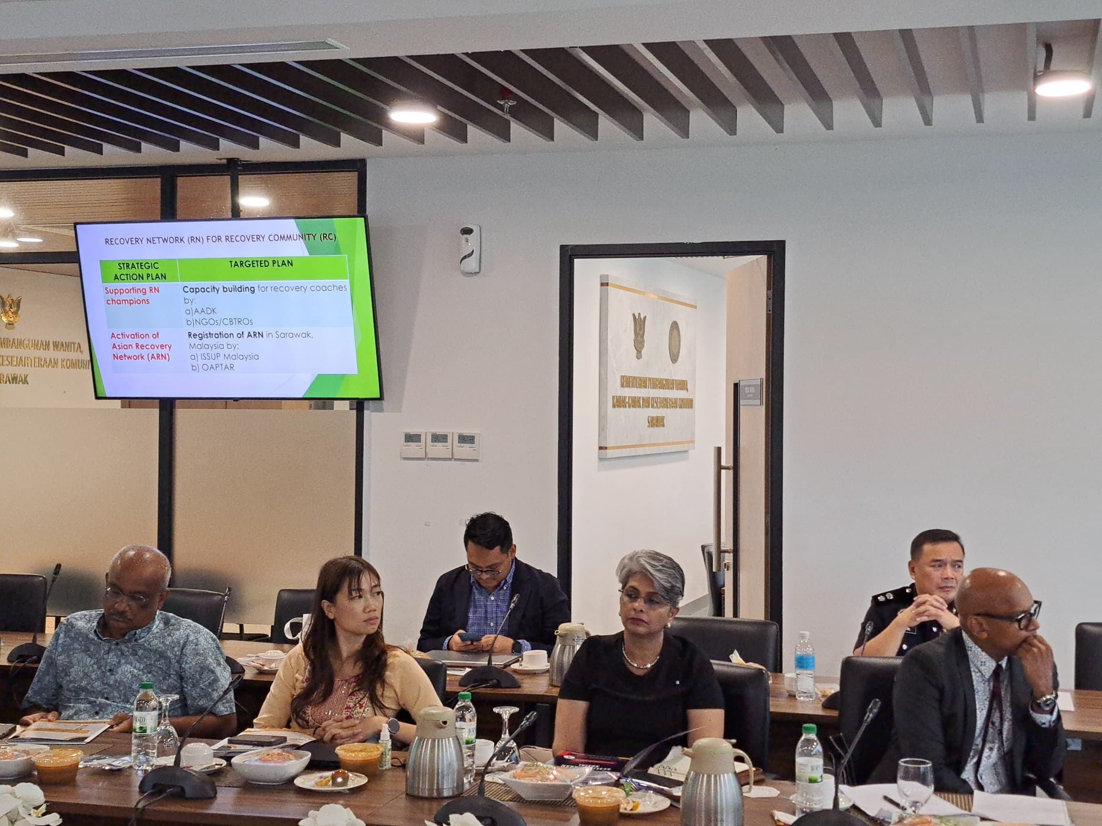
Mapping out stakeholder readiness to pilot decriminalization initiatives

Slide 2
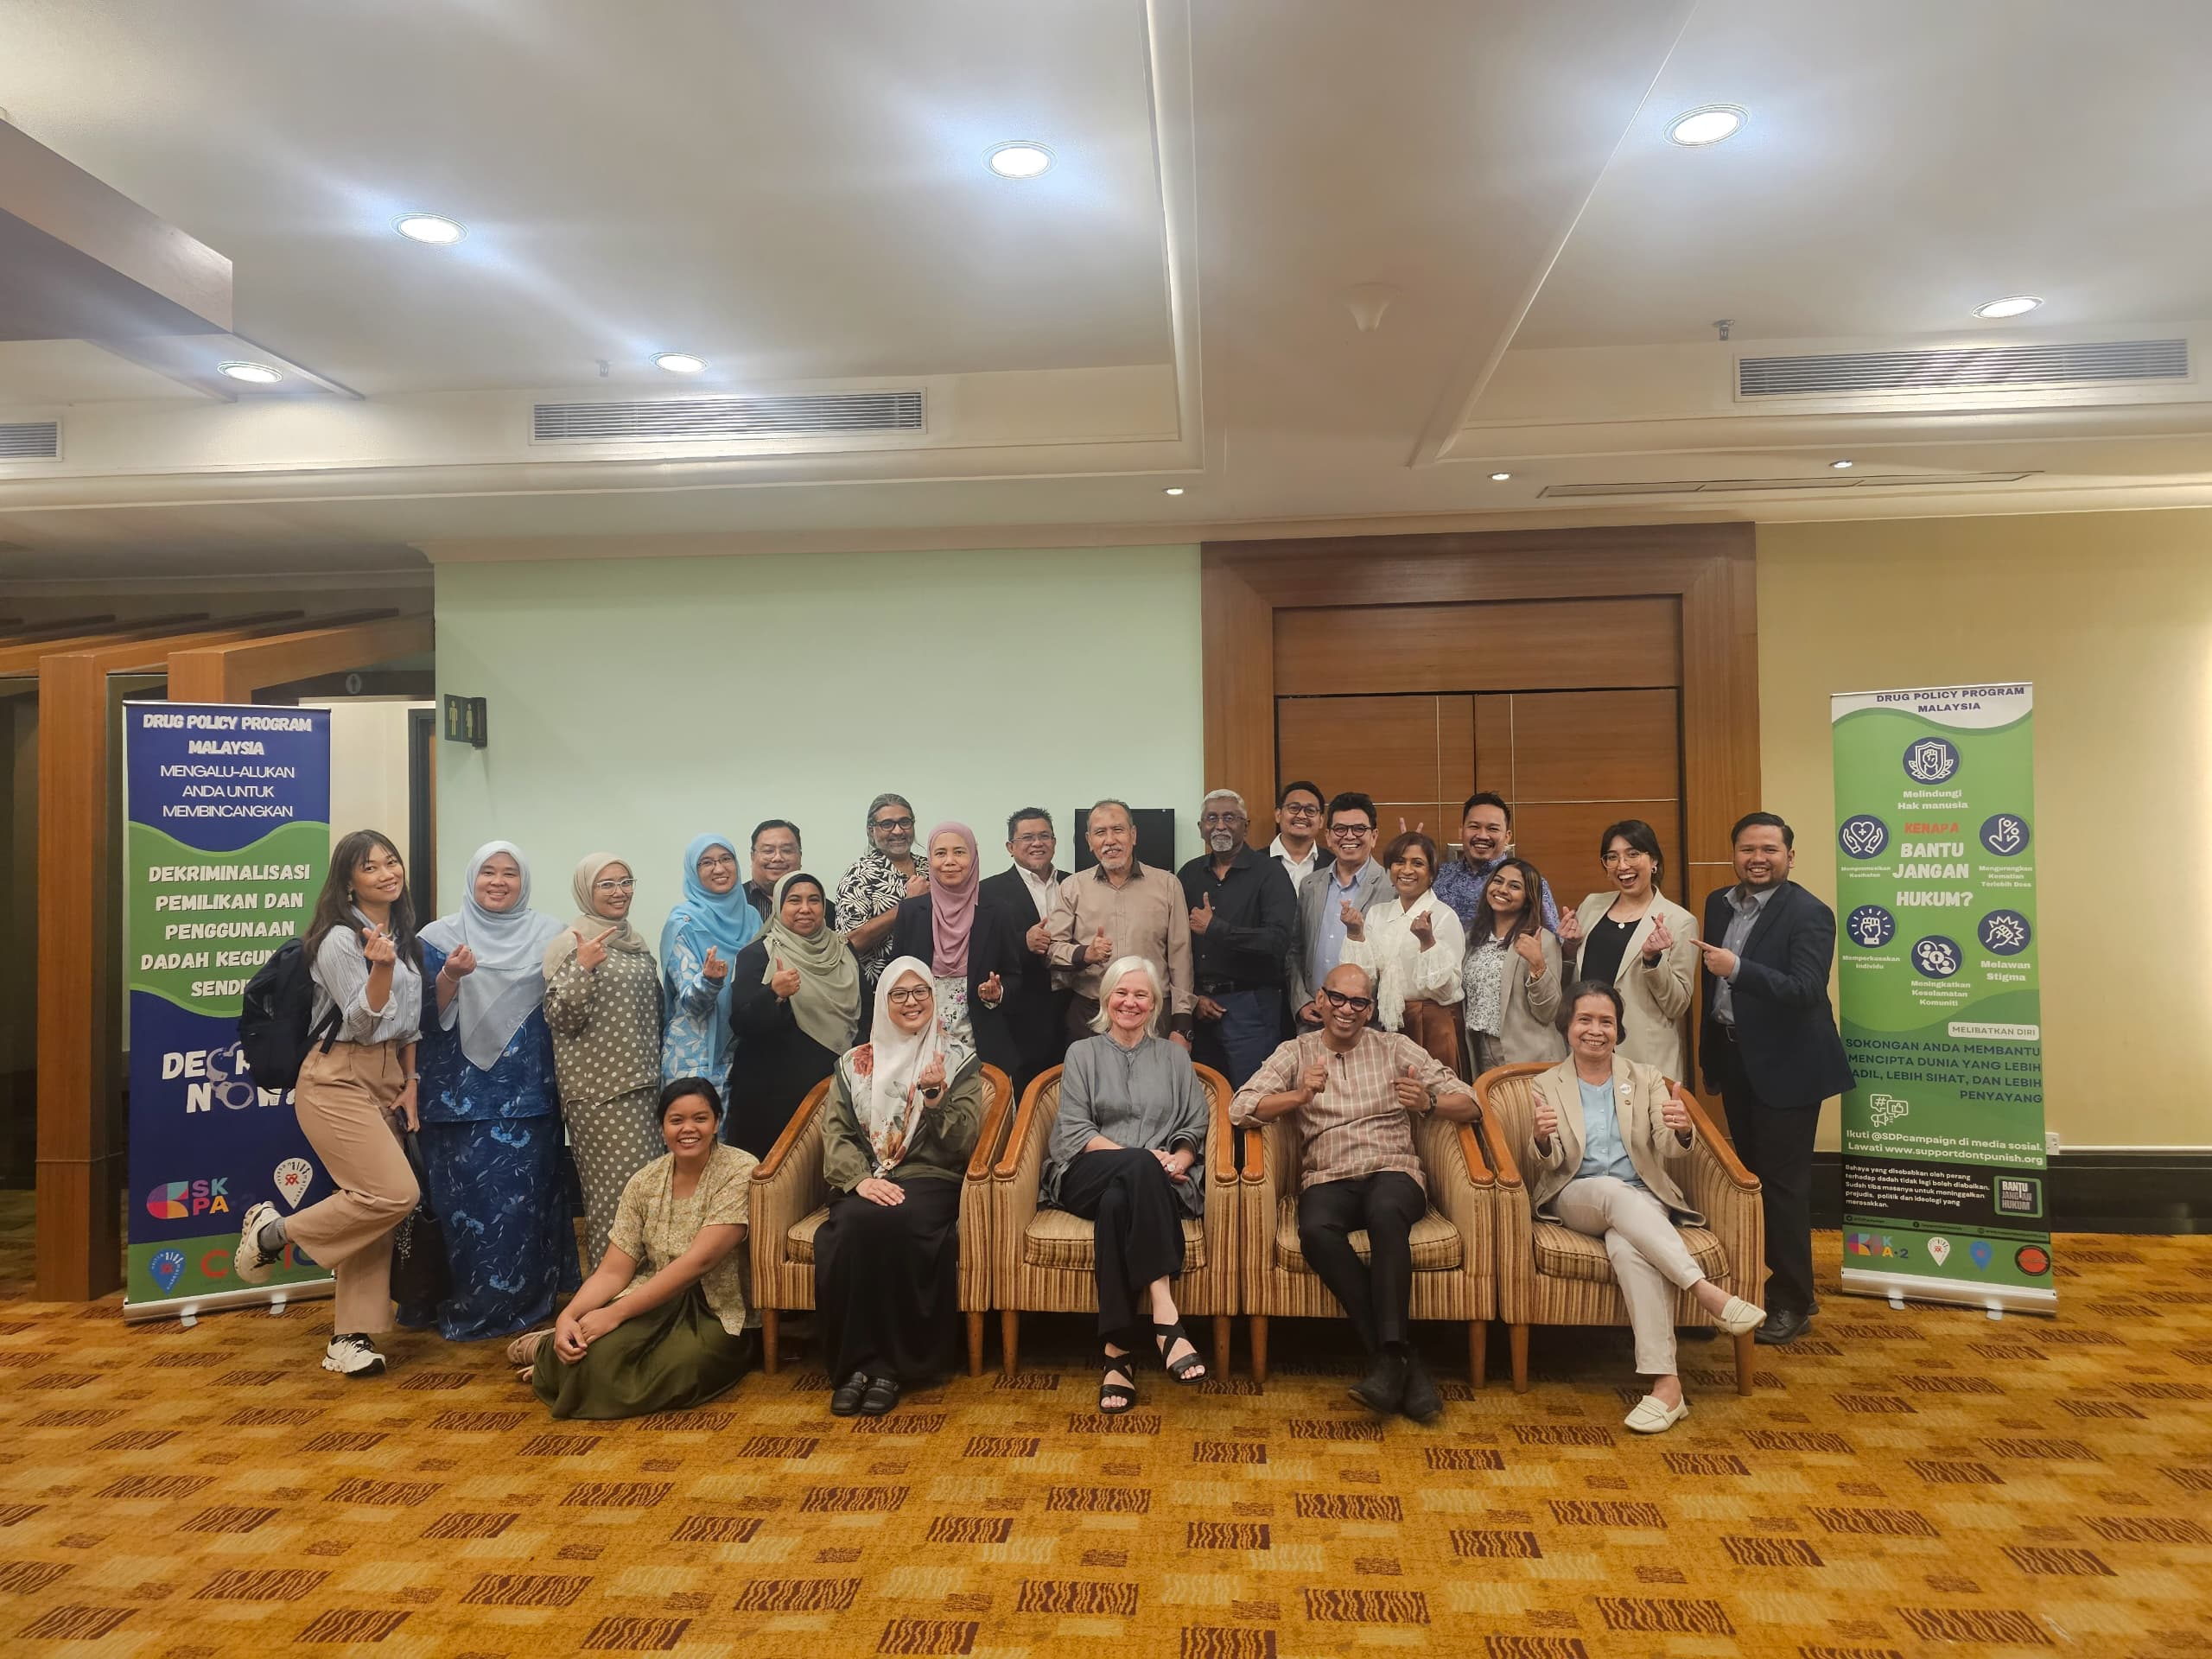
Expert Round Table Meeting in preparation to pilot decriminalization

