Slide 1
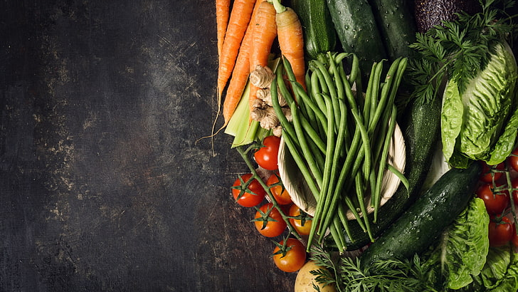
The Role of Nutrition in Addiction Recovery
Khary Rigg, Ph.D.
Department of Mental Health Law & Policy
University of South Florida
Kelly Miller, NTM
Nutritional Therapist
The Addiction Nutritionist, llc

Slide 2
Today’s Agenda
Nutritional consequences of SUDs
Nutritional strategies to reduce cravings
Blood Sugar: A relapse prevention tool
Free Handout
Q & A

Slide 3

SUDs are a Global Health Issue
35 million people suffer from a SUD
30% increase since 2009
Worldwide focus on improving outcomes for people in SUD treatment

Slide 4

Poor SUD Treatment Outcomes
Relapse
Low quality of life
Poor sense of wellbeing
Early dropout

Slide 5

Factors that Undermine SUD Treatment
Depression
Anxiety
Insomnia
Anger
Drug cravings
Lethargy
Low motivation

Slide 6

Nutrition Often Overlooked
Nutrition therapy uses food to prevent/reverse the course of chronic conditions, but rarely is it applied to SUD
SUDs can cause metabolic changes, constipation, weight loss/gain, lead to lifestyle of unhealthy eating
SUD professionals are often unaware of how diet can improve treatment and enhance recovery

Slide 7

Nutritional Consequences of SUDs
Alter brain chemistry
Through repeated drug misuse permanent changes in the brain can occur
Some of these brain alterations can cause unhealthy eating patterns and impair metabolic absorption of nutrients.

Slide 8

Nutritional Consequences of SUDs
Malnutrition
Eating becomes deprioritized
Loss of appetite
Homelessness
Criminal justice involvement

Slide 9

Nutritional Consequences of SUDs
Unhealthy eating
Preference for sweets
Fasting to boost/prolong high
Skipping meals
Consuming few fruits/vegetables

Slide 10

Nutritional Consequences of SUDs
Food insecurity
Inability to obtain adequate healthy food on a day-to-day- basis
People w/SUDs tend to live in “food deserts”
limited access to affordable, nutritious food
oversaturated with fast food restaurants

Slide 11
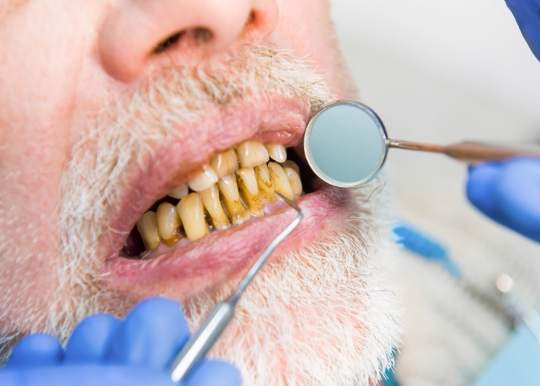
Nutritional Consequences of SUDs
Poor oral health
Xerostomic (reduces saliva)
Tooth decay
Gum infection
Missing teeth
Dry mouth

Slide 12
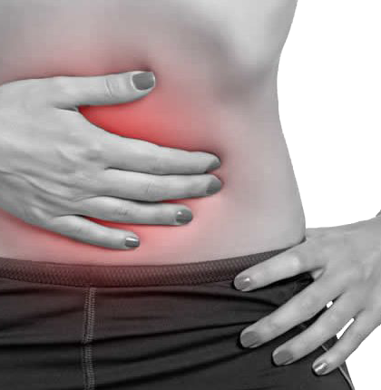
Nutritional Consequences of SUDs
Constipation
Drugs like opioids delay the intestinal transit of food and slow gastric emptying
Some people avoid eating certain foods or stop eating altogether

Slide 13

Nutritional Consequences of SUDs
Route of administration
Inhaling or injecting drugs can have a more direct effect on the CNS
Neuronal function can be impaired, leading to the inability to move food nutrients into the brain and keep toxins out

Slide 14

Nutritional Consequences of SUDs
HIV/HCV
Co-occurring infectious diseases can impact nutritional status
HCV can go undiagnosed, damaging the liver, causing loss of appetite, nausea, constipation, etc.
HIV can lead to malnutrition due to:
Decreased dietary intake
Excessive diarrhea, nausea, abdominal pain
ARV meds leading to lean body mass breakdown

Slide 15
Nutritional Aspects of Detox
Considerations
Suggestions
Atypical eating habits
Loss of nutrients/fluids
Dehydration
Irregular heartbeat
Eat a balanced diet
Replace lost fluids
Replenish lost nutrients
Monitor blood glucose levels

Slide 16
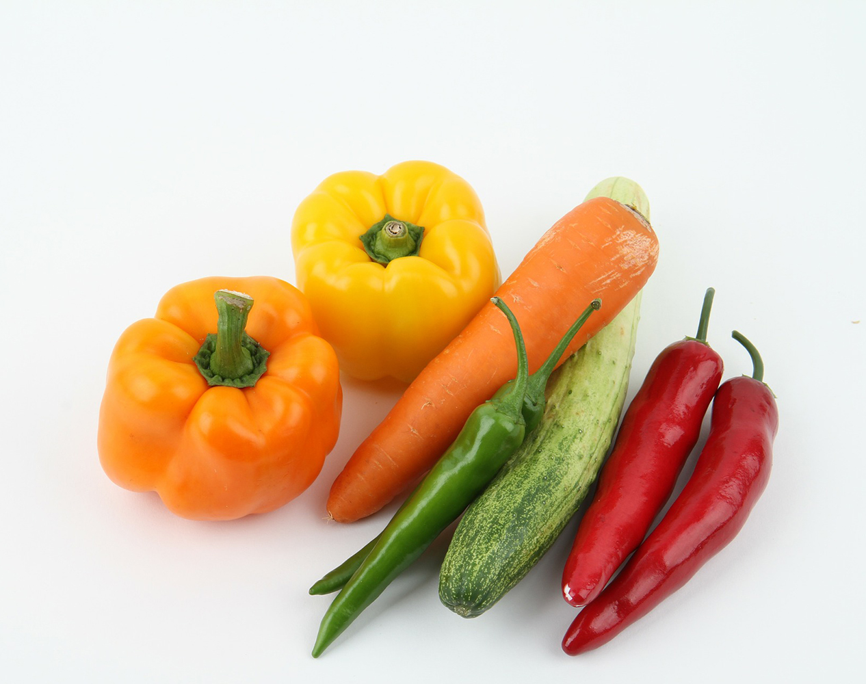
How can Nutrition Therapy be used to improve outcomes?
Improve Mood
Reduce Cravings
Prevent Relapse

Slide 17

Post Acute Withdrawal Syndrome (PAWS)
Cluster of mood and biology related symptoms that typically last 1-2 years, post acute detox.
Although post-acute withdrawal rarely involves physical symptoms, it can be just as intense as acute withdrawal and still puts a person at risk of relapse, as they may return to drug use in an attempt to stop the discomfort.

Slide 18
Symptoms of PAWS
Hostility or Aggression
Anxiety, Panic, or Fear
Irritability & Mood Swings
Depression
Exhaustion or Fatigue
Insomnia
Brain Fog
Low Libido
Anhedonia or Joylessness
Poor Memory
Sensitivity to Stress

Slide 19
The Nature of Cravings
Psychological
Biochemical

Slide 20
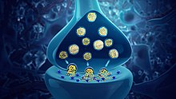
The Mood Regulating Neurotransmitters
Serotonin-The “Happy Hormone”, 95% produced in the gut, other 5% in brain stem
Dopamine-The “Pleasure Reward Hormone”
GABA-anti-anxiety
Endorphins-pain relief
New batch every day

Slide 21
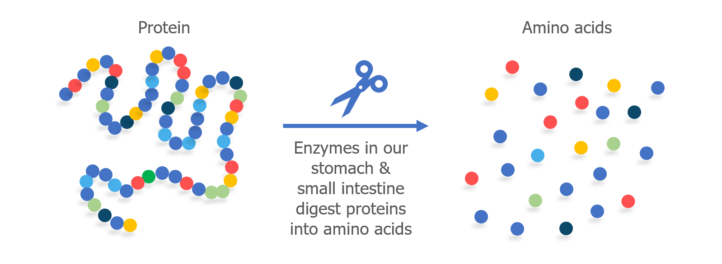
Amino Acids
The building blocks of protein and neurotransmitters

Slide 22
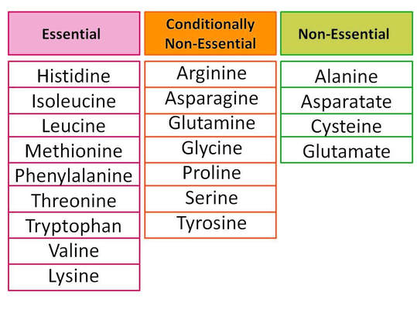
Amino Acids
Tryptophan > Serotonin
Phenylalanine > Dopamine

Slide 23

Amino Acids
Amino Acids
Neurotransmitters
Homeostasis

Slide 24

Homeostasis
Mood regulating neurotransmitters are out of balance in early recovery
>Imbalance
>Cravings
>Seeking
>Relapse

Slide 25
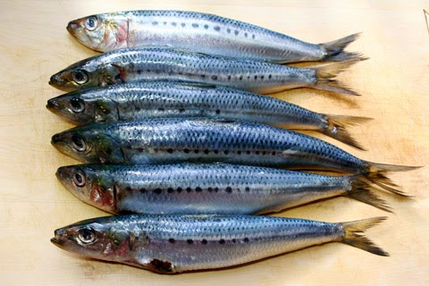
Omega 3 EFAs
May increase dopamine by 40%
Enhances binding to the receptor
Block enzymes that degrade dopamine in the synapse
Sources
Fatty fish/supplements
Sublette ME, Galfalvy HC, Hibbeln JR, et al. Polyunsaturated fatty acid associations with dopaminergic indices in major depressive disorder. The international journal of neuropsychopharmacology. https://www.ncbi.nlm.nih.gov/pmc/articles/PMC3956108/#:~:text=Dietary%20supplementation%20with%20omega%2D3,et%20al.%2C%201998). Published December 3, 2013. Accessed February 27, 2021. (11)

Slide 26
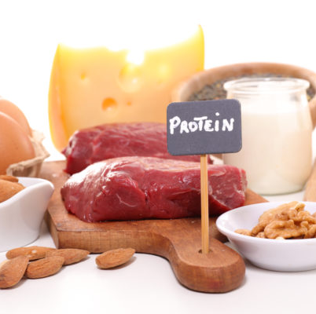
Homeostasis
Protein/Amino Acids
Healthy Fats
Avocado, EVOO, nuts and seeds
Omega 3
Reduce Inflammation
Sugar
Processed foods
Repair Gut Health/Digestion
Fermented foods
Probiotics

Slide 27
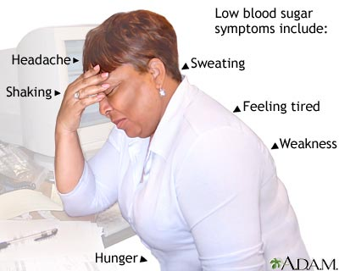
Blood Sugar Management
Key relapse prevention tool
Mood stabilization
Reduced cravings
Enhanced decision making

Slide 28
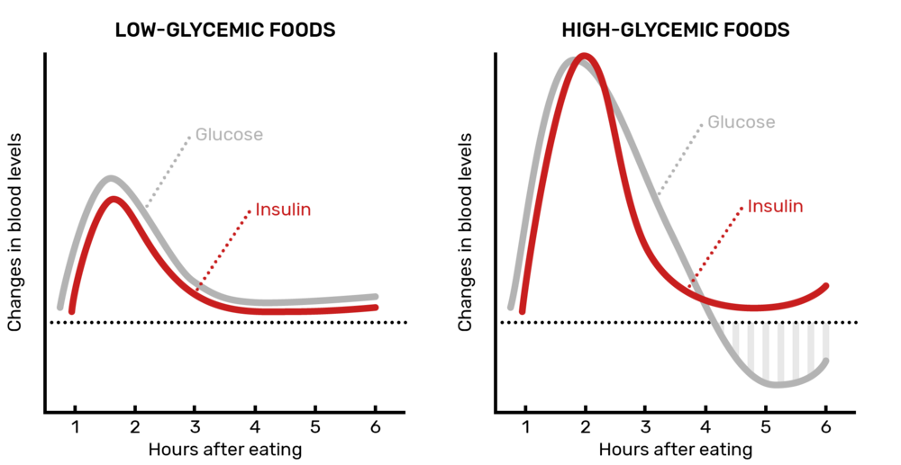
Blood Sugar Roller Coaster

Slide 29
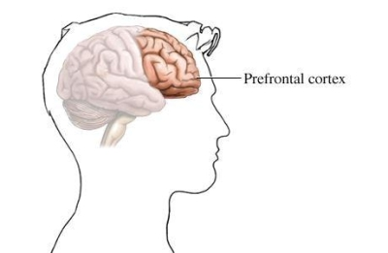
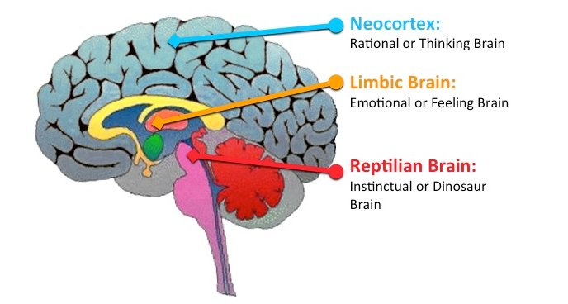
Key Brain Functions

Slide 30
Key Brain Functions

Slide 31

Lack of Reliable Resources
Internet search
Blogs
Social media
Fad diets
Keto, IF, Vegan…

Slide 32

Nutrition Therapy
Nutritional strategies to:
Repair nutrient deficiencies
Balance hunger hormones
Address neurotransmitter imbalances/PAWS
Reduce inflammation
Optimize digestion
Blood sugar management

Slide 33

PAWS PROTOCOL
A dietary intervention designed to meet the unique needs of individuals in recovery
Improve mood, reduce cravings and prevent relapse
Step #1- Protein, Protein, Protein
60-90 grams per day
3 meals/2 snacks
Cronometer
Free and Easy Food Logging App

Slide 34
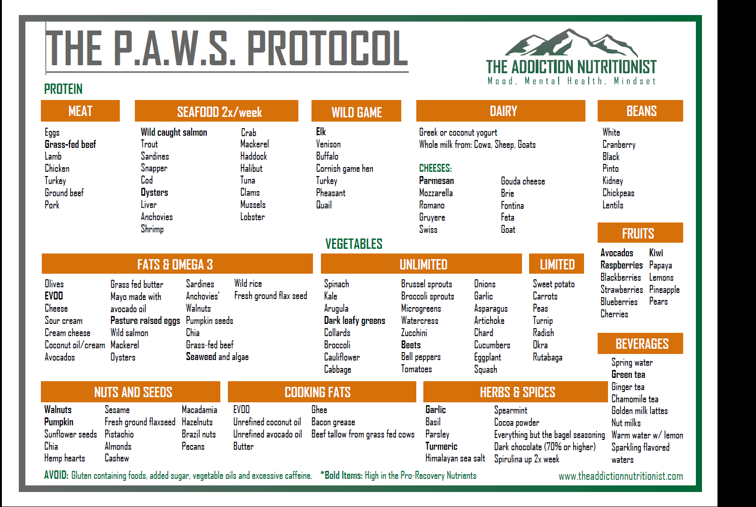
PAWS Info-graphic www.theaddictionnutritionist.com
Free Handout

Slide 35


Thank you!
Khary Rigg, Ph.D.
rigg@usf.edu
@krigg01
Kelly Miller, NTM
kelly@theaddictionnutritionist.com
@theaddictionnutritionist

