Slide 1

Risk & Protective Factors of Substance USE : Youth Focused Prevention
Prof. Dr Uzma Ali
Director Institute of Clinical Psychology, University of Karachi (ICP-UOK)
Managing Director Dr Farrukh Z Ahmad Trust of Clinical Psychology
Member ISSUP Pakistan Chapter, Advanced Member ISSUP Global
Certified Trainer of Hypnotherapy (NGH,USA)
Consultant Clinical Psychologist and Certified Practitioner of NLP (Society For NLP, USA)
Advisor. Youth Forum Pakistan (For drug Use Prevention)

Slide 2
Topic of areas &Learning Outcomes
Risk and Protective factors of SUD,
Programs for Prevention of SUD for Youth
Educational & Skills Focused Strategies
Parenting & Copying Strategies
Audiences will learn about the factors/strategies that are playing a major role in the development and prevention of substance use

Slide 3
Introduction
Substance use and abuse continue to be important Global public health problems that contribute greatly to morbidity and mortality rates throughout the world.
The prevalence of alcohol, tobacco, and other drug use increases rapidly from early to late adolescence, peaks during the transition to young adulthood, and declines though the remainder of adulthood.
The initiation of substance use early in life contributes to higher levels of use and abuse later in life.
Early onset is also associated with a host of later negative health, social, and behavioral outcomes including physical and mental health problems, violent and aggressive behavior, and adjustment problems in the workplace and family .
(Newcomb & Health,2005)

Slide 4
Understanding of Substance (drugs) misuse
According to “Modified Social Stress Model” People starts using substance, or drugs due to variety of reasons (UNODC –CP, 2002)
Understanding what the person Motivation & Needs are… Helps to explain why that person is Misusing Drugs.

Slide 5
Risk & Protective Factors
There are a number of factors in once life that can cause one t start using drug or a substance called RISK Factors (Personnel & Environmental)
At the same time ,there are some other factors that prevent one from doing so, these are called Protective Factors (Personnel & Environmental)

Slide 6
Risk Factors
Personnel
Environmental
Gender of a person (Male/female ratio)
Young age { (identity crises)/Needs /Motivation Boredom/ Freedom }
Mental Health issues
Undeveloped or underdeveloped personnel skills
Role of Parental training
Drug use in a family
Lack of Family support
NO housing/street living
Peers in drug /Su
Lack of opportunity for education
Lack of employment
Health servces/ healthy life style not available in the community
Availability of drug/ laws and regulation to control drug use is not enforced
Substance use in culture/ community is common

Slide 7
Protective Factors
Personal Factors
Environmental Factors
Well developed Personnel Skills & internal resources to deal with difficult situations e.g
An ability to analyses situations e.g
To take quick & right decisions e.g
To communicate with others e.g
To manage stress & Relax e.g
To do negotiations e.g
Enter into Compromises e.g
Good Personnel connections with people e.g
Have adequate External resources, e.g family supports, education, sports,health etc
Have network to use internal resources
Cultural Norms discourage Substance abuse
Laws that regulate SU are stringent and well enforced
Access to licit or illicit drug is difficult or limited

Slide 8
Basic Preventive Principals
Substance use/ use Prevention Programs should be
Community Based
Broadly focused
Youth Focused /Family
Prevention is better than cure , focused at different level in community

Slide 9
Some Basic Elements for Prevention of SU
Promotion of Health
Focus on people & encouragement of social interaction
Local involvement of young people & Respect for cultural values
Encouragement of positive alternative
Gaining Knowledge from Research and Experience
Long tem perspective
Specific population

Slide 10
Education & Skills Based Training
To develop Youth Focused Prevention Program
Following Steps are Important
-get to gather a youth Planning Team, this team will help to design the activities (need assessment & program Planning.
The goal of these activities are:
Define the youth culture in your community
Identify the young people who would be most beneficial for the program
Define the type of activities that would be interesting to youth
Develop a strategy for reaching a youth
Understand what young people in your Community are doing & what they would like to do in order to prevent drug use in their community

Slide 11
Skills based Training
Choose youth leaders / bases of different strengths e.g
Size of youth team should be 10-15
Find team members through contact/other youth organizations
Working together
Find a place to work
The future of the planning team
( you as counselor/psychologist/social workers/ organizer) serves as an advisory committees of the team
Training of the Team through Role Play , drawing, plays dramas, psychological/motivational strategies

Slide 12
Copying Skills
Problem Focused Copying
Emotional Focused Copying
Cognitive
Behavioral
Cognitive
Behavioral

Slide 13
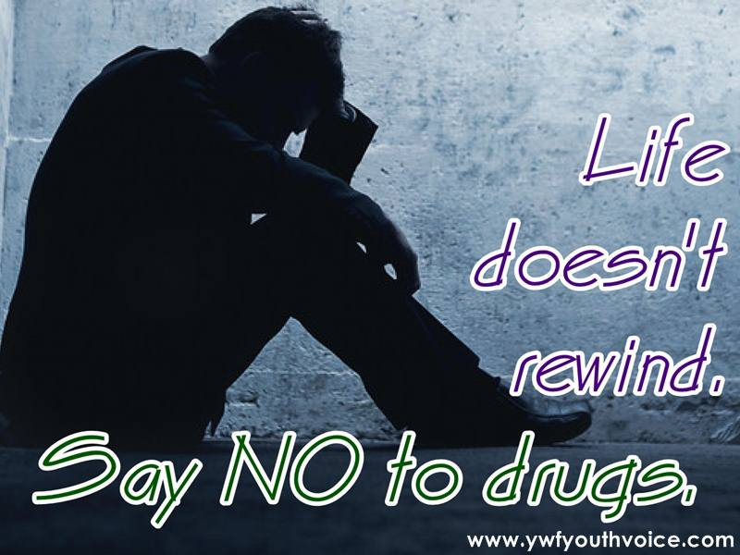
Communication Skills
According to CBT model of Communication persons may use to
learn to Change Negative Words
Problems into situation
Always into Never
Should into Could have
Bad into unwise
Fault into differences
Mistakes into valuable lessons
Must into Prefer
Please would you please

Slide 14
Assertiveness training
Assertiveness training is a form of Cognitive behavior therapy designed to help people (children, adolescents, young people )stand up for themselves—to empower themselves, in more contemporary terms.
Assertiveness is a response that seeks to maintain an appropriate balance between passivity and aggression.
For Youth Focused Drug use Prevention it is apart of Program, so that youth would better able to communicate his /her emotion , feeling , needs and to resist and learn to say NO to drug.
Involve Youth Leaders during trainings

Slide 15
Assertive Communication: Remember 3 Cs
Confidence – you believe in your ability to handle a situation.
Clear – the message you have is clear and easy to understand.
Controlled – you deliver information in a calm and controlled manner.

Slide 16
Techniques of AT
Cognitive Restructuring
Relaxation training
Role Playing
Role Reversal

Slide 17
Thank you ISSUP Global
ISSUP Pakistan
PARTICIPANTS
Uzma_kamranali@yahoo.com

