Slide 1
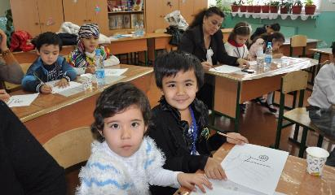
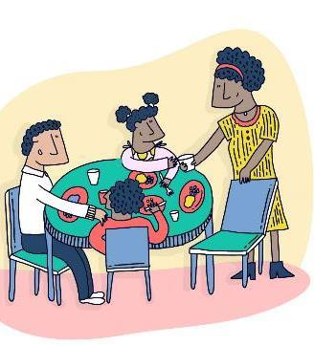
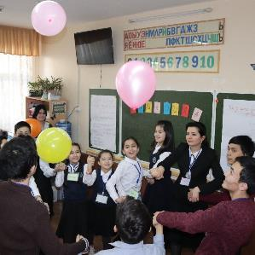

Family skills for Prevention of Substance Use, Mental Health and Violence and for Development, including under COVID-19
Wadih Maalouf, Global Programme Coordinator, UNODC
Drug Prevention and Health Branch / Prevention, Treatment and Rehabilitation Section
Division of Operations
Email: wadih.maalouf@un.org Twitter: @wmaaloufun @unodc_ptrs

Slide 2







First edition – SECOND EDITION!!!
2013
2018
Notes:
Another thing that I need to draw your attention to is the fact that, in this presentation, I will use as a basis the NEW Standards.
As you might know, UNODC has published the first edition of the International Standards on Drug Use Prevention in 2013. Last year, UNODC started to work on an updated version of the Standards, and this time, we were very happy that WHO decided to come on board to publish a JOINT second and updated edition.

Slide 3

Prevention is a science No need to improvise
Prevention is BEYOND Awareness raising / fear arousal
Initiation at young age is NOT the result of A FREE & INDEPENDENT CHOICE “JUST SAY NO” ISN’T ENOUGH
Prevention helps personal growth: INTELLECTUAL LANGUAGE COGNITIVE-EMOTIONAL AND SOCIAL COMPETENCY SKILLS AT EACH DEVELOPMENTAL AGE
Point of focus of EB Prevention is developing individual NOT the drug

Slide 4
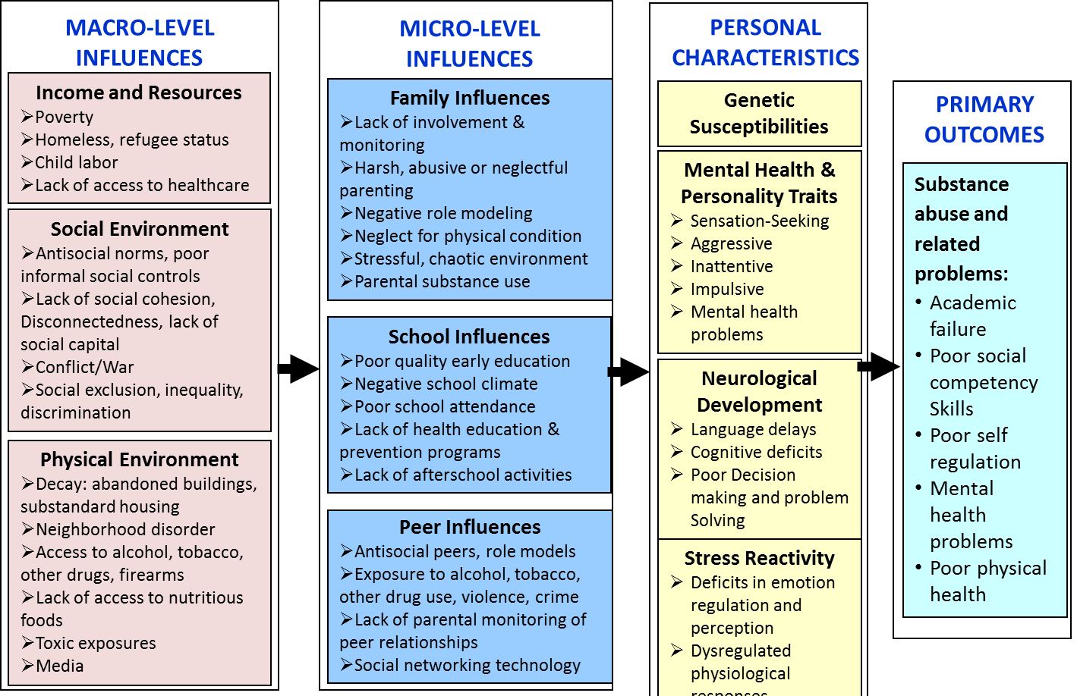
VULNERABILITY FRAMEWORK Environmental and Personal Influences

Slide 5
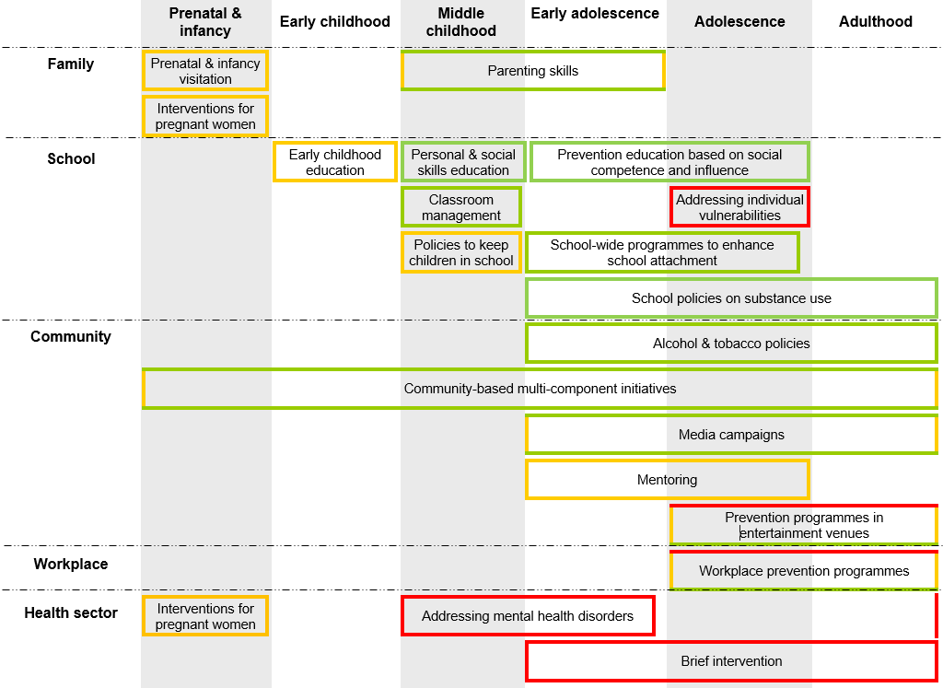
Notes:
And here they are! I know that this might be a bit difficult to read, but I would like you to get a sense of the fact that there are MANY strategies that are at your disposal.
Also, this table shows how there are strategies in many different settings: family, school, community, workplace and the health sector.
Finally, this table show that there are strategies that are available targeting ALL ages in the life of an individual: from before a baby is born, into his or her childhood, adolescence and adulthood.

Slide 6
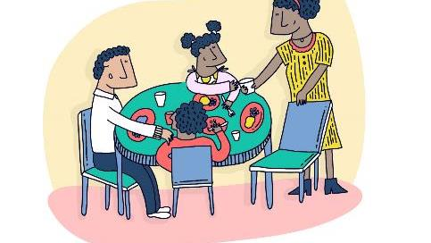
Family is key!

Slide 7





Healthy parenting is essential to early child development
Parenting supports a child’s adjustment beyond their own individual resilience (Betancourt & Khan, 2008)
Harsh, inconsistent parenting predicts later poor outcomes: drug use, low school attainment, delinquency, poor mental health
Parents need support in all contexts

Slide 8
Effective Family Skills Programmes: what are they?
Programmes that aim to strengthen family protective factors such as communication, trust, problem-solving skills and conflict resolution that are relevant to their culture
Often include opportunities for parents and children to spend positive time together, as ways to strengthen the bonding and attachment between the two
Focus on relationships and behaviour change and PRACTICE

Slide 9
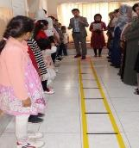
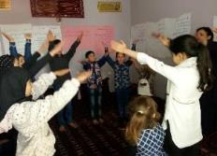
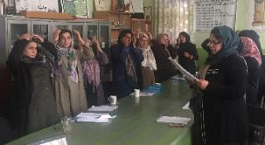
Recommendations
Organised in fun, easy and appealing way for all to participate (e.g. out-of-office hours, meals, child care, transportation, small prize for completing the sessions, etc.)
Delivered by trained individuals, in many cases without any other formal qualification
Typically include a series of sessions
Typically include activities for the parents, the children and the whole family

Slide 10
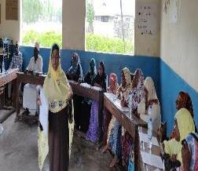
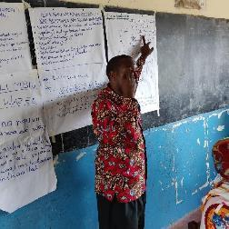
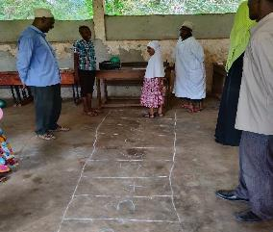
What does NOT work
Undermine parents’ authority
Use only lecturing as a means of delivery
Only provide information to parents about drugs so that they can talk about it with their children
Focus exclusively on the child
Delivered by poorly trained staff

Slide 11
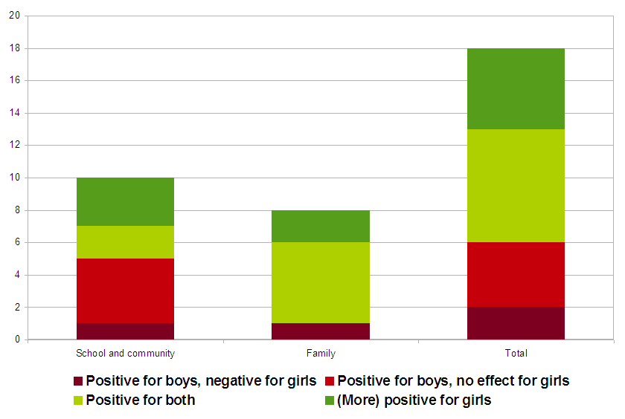
GENDER SENSITIVITY Family based prevention more consistently benefits girls as well as boys
Notes:
There are 115 evidence-based programmes for substance abuse prevention in the NREPP, the National Registry of Evidence-based Programs and Practices of the Substance Abuse and Mental Health Services Administration and there are 282 programmes on prevention in the Exchange on Drug Demand Reduction Action (EDDRA) of the European Monitoring Centre for Drugs and Drug Addiction (EMCDDA), the impact of 41 of which has been evaluated. We wrote to them all and looked in the literature. We have the results disaggregated by sex for only 16 of them. Clearly we need more research. However, the little that we have provides for some interesting indications.

Slide 12
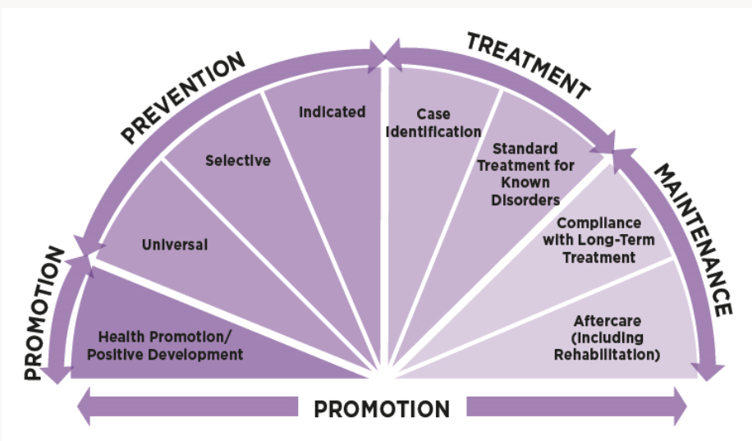
Adapted from Institute of Medicine (1994, Fig. 2.1, p. 23)

Slide 13

Common obstacles at start
OUR FAMILIES DO NOT LIKE TO DISCUSS DRUG ISSUES ???
OUR FAMILIES ARE DIFFERENT THAN FAMILIES WHERE EVIDENCE IS GENERATED??

Slide 14
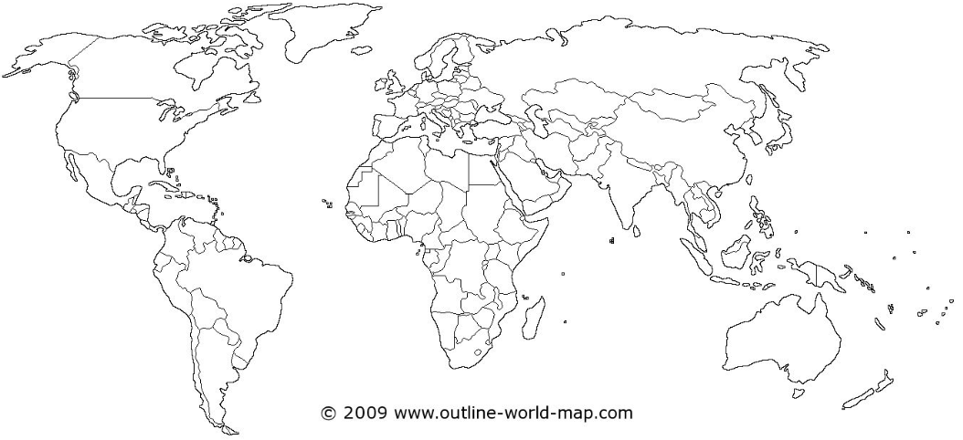
34 countries currently piloting family skills globally with UNODC
Albania
Bosnia & Herzegovina
Montenegro
North Macedonia
Serbia
Slovenia
Kazakhstan
Afghanistan
Bangladesh
Indonesia
Iran
Kyrgyzstan
Lebanon
Jordan
Maldives
Pakistan
Philippines
Cambodia
State of Palestine
Tajikistan
Turkmenistan
Uzbekistan
Brazil
Costa Rica
Dominican Republic
El Salvador
Guatemala
Honduras
Mexico
Nicaragua
Panama
Côte d’Ivoire
Senegal
Tanzania
Brazil

Slide 15
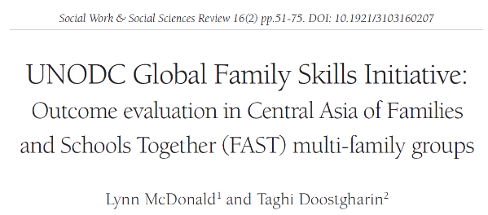
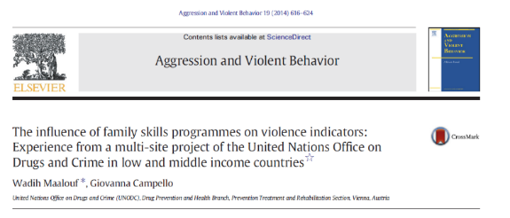
Support generation of evidence from the recipient countries

Slide 16
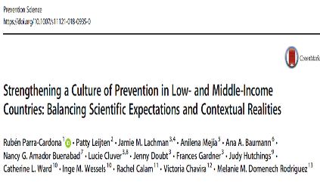
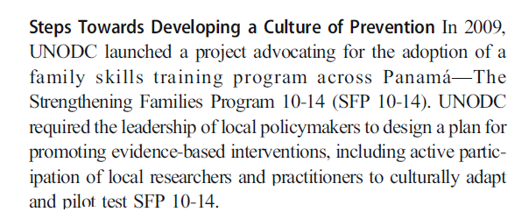


Slide 17
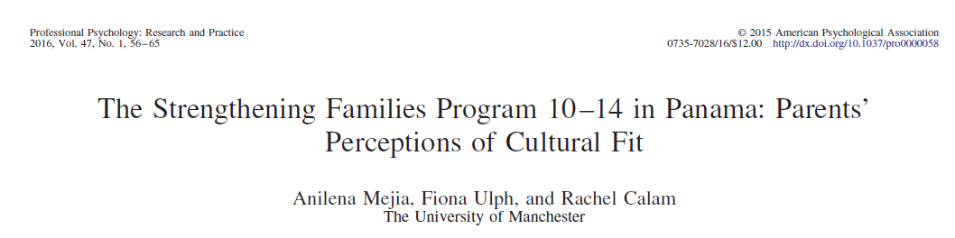
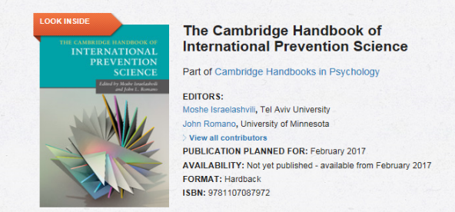
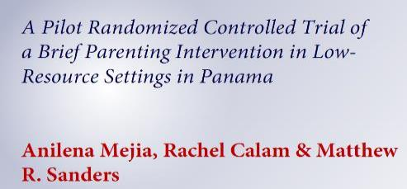


Slide 18
Common obstacles during scale up
Infrastructure (electricity, A/V materials, experienced facilitators, …)
Cost of material (production, etc…)
Royalty / Copyrights
& more

Slide 19
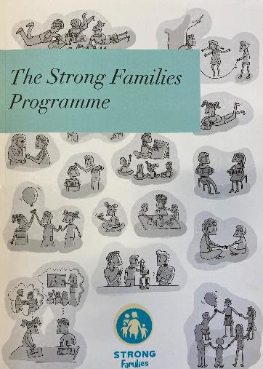


Slide 20




The Strong Families Programme
Family Skills programme for families in Humanitarian & challenged settings
Aims to improve parenting skills, child well-being and family mental health
For caregivers with children aged 8-15
Light touch-only 3 sessions
https://www.unodc.org/documents/drug-prevention-and-treatment/Strong_families_Brochure.pdf

Slide 21
Family Sessions Families practice positive communication Families practice stress relief techniques together Families learn about family values and are encouraged to share appreciation for each other
Caregiver sessions
Explore parents challenges
Develop ways to better deal with stress
The value of using both love and limits
Listening to children
How to encourage good behaviour and discourage misbehaviour
Child sessions
How to deal with stress
Explore rules and responsibilities
Think about future goals in addition to the important roles their caregivers play in their lives

Slide 22
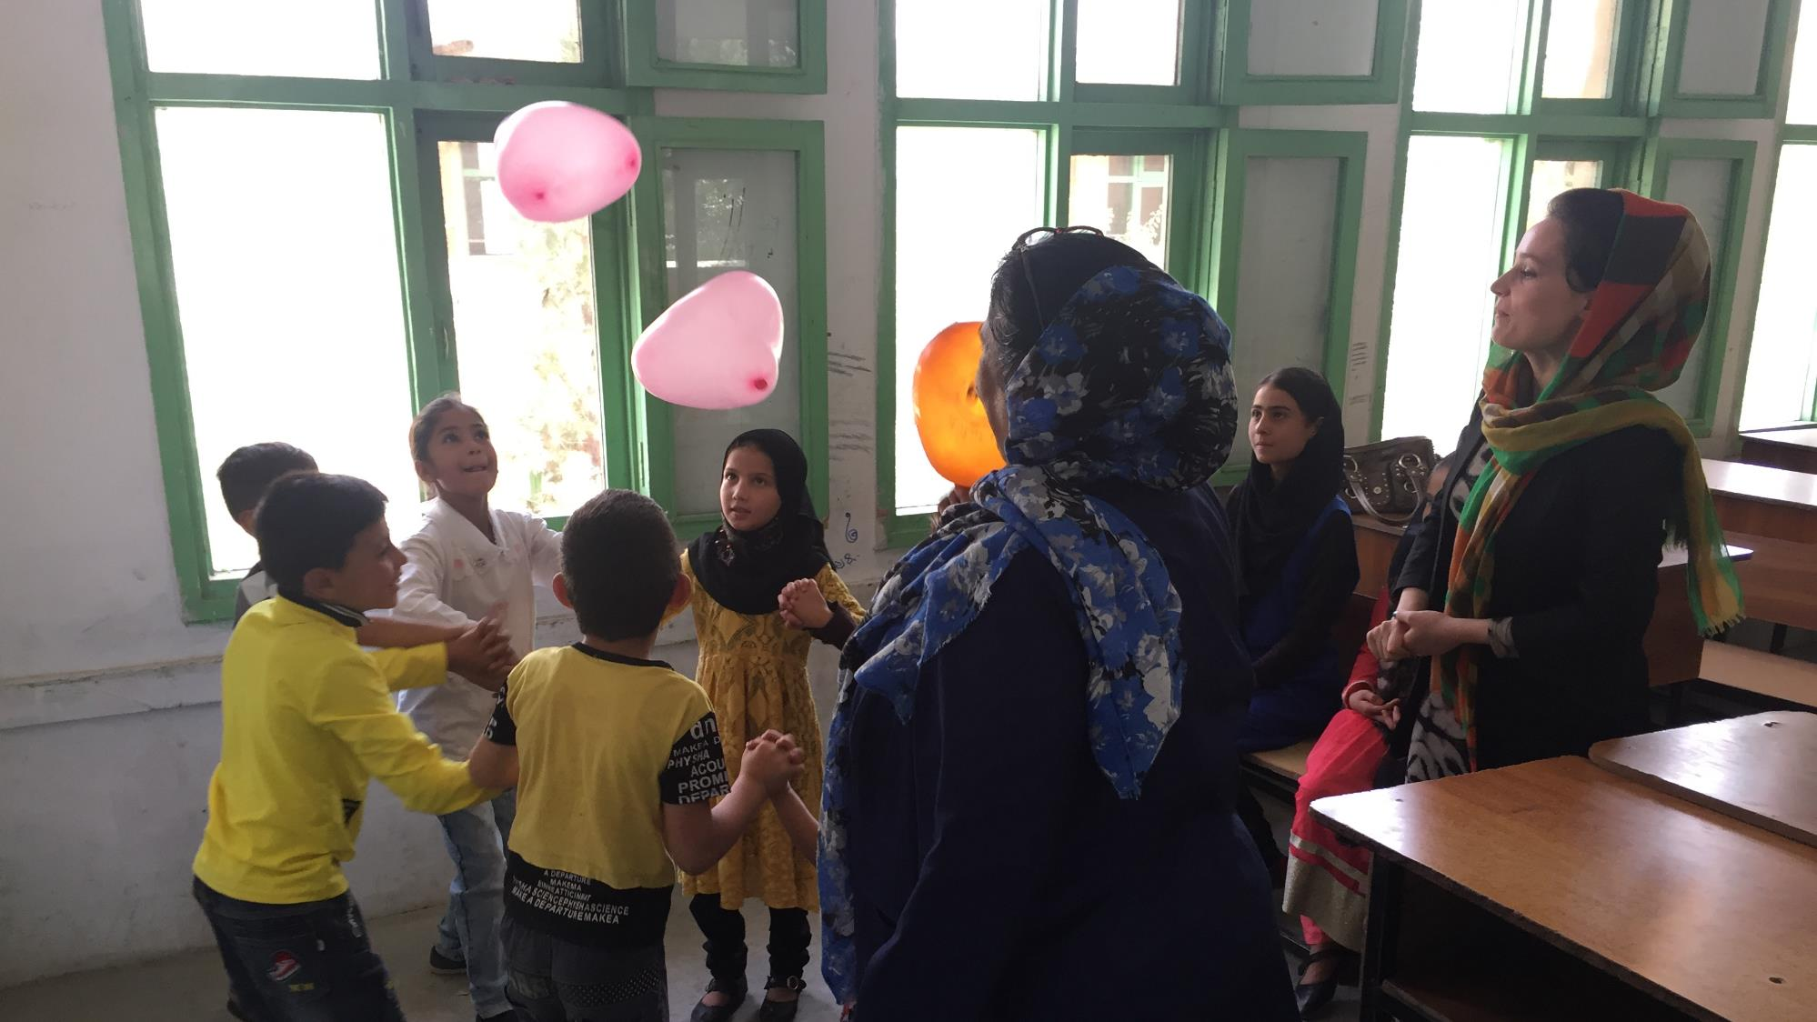

Slide 23
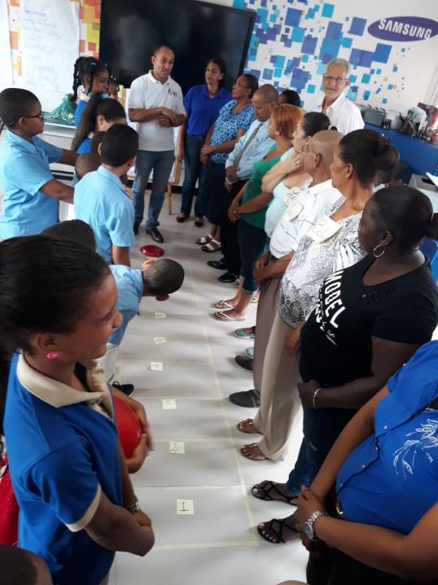

Slide 24
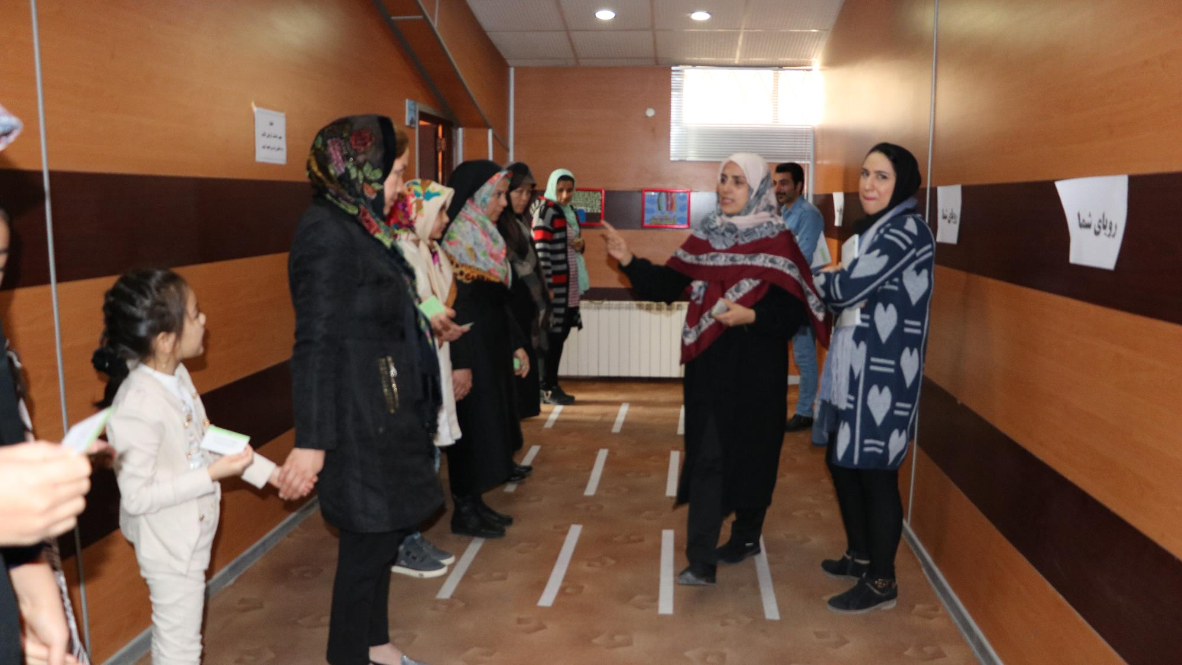

Slide 25
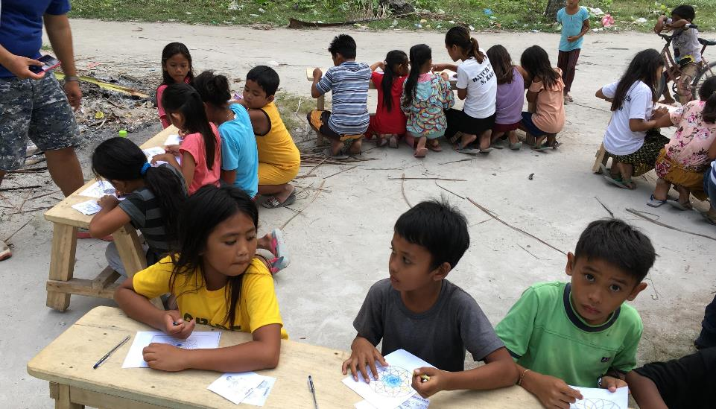
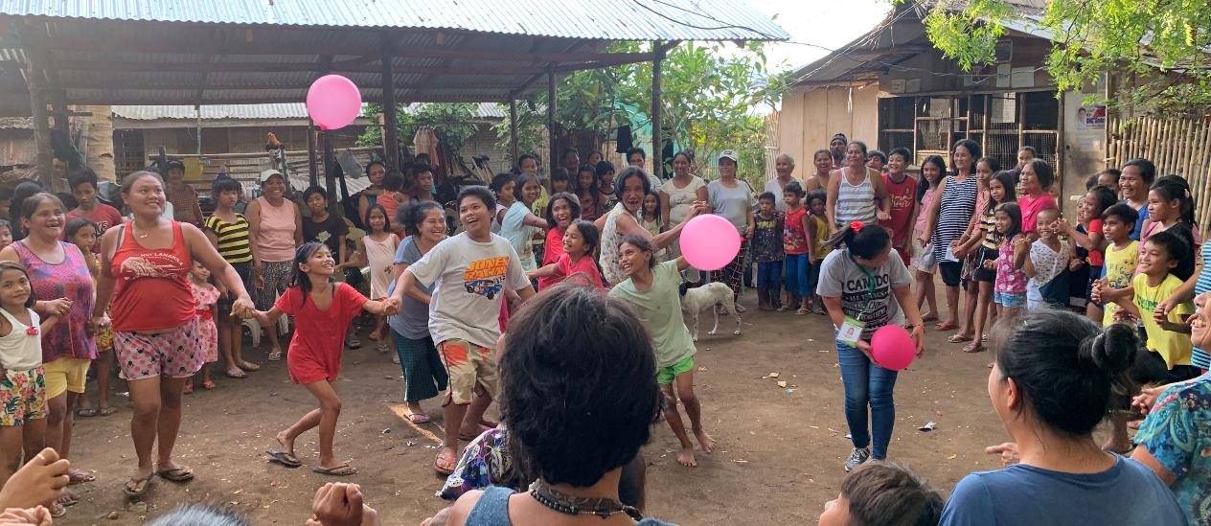
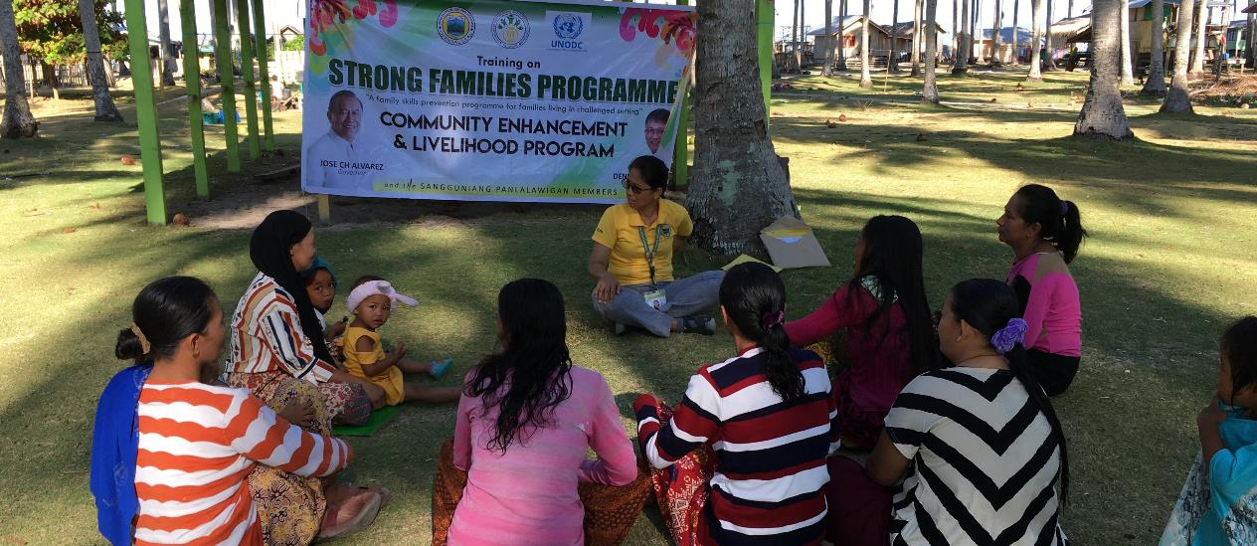
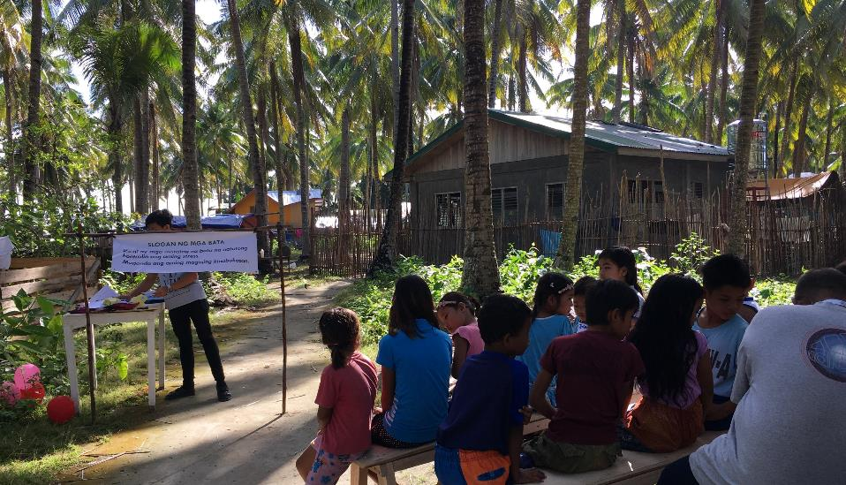

Slide 26
Caregivers completed 3 measures 1-Family Background Questionnaire 2-Strengths and Difficulties Questionnaire 3-Parenting and Family Adjustment Scale Two weeks pre-intervention (Time 1) One-two weeks post intervention (Time 2) Five-six weeks post intervention (Time 3)
Study 1
Afghan families living in 3 cities in Afghanistan (n=72)
Gender of children: Female (n=33), males (n=38)
Study 2
Afghan families residing in 3 reception centres in Serbia (n=25)
Gender of children: Female (n=9), males (n=16)

Slide 27
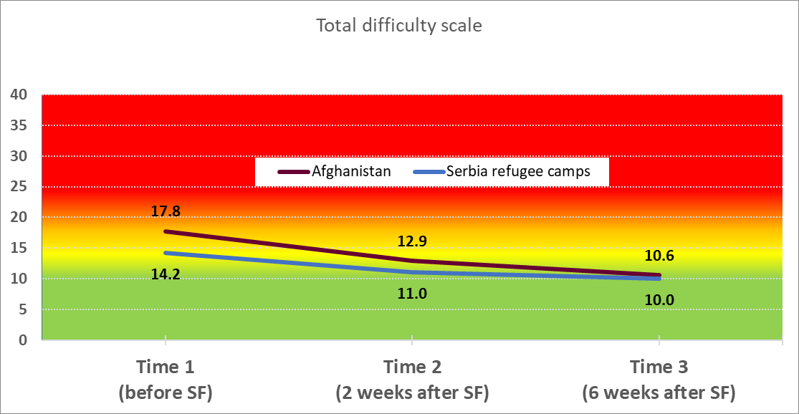
Change in Total Strengths and Difficulties scores for children in Afghanistan and in refugee reception centers in Serbia
SDQ SCORES
VERY HIGH 20-40pts
HIGH 17-19pts
SLIGHTY RAISED 14-16pts
CLOSE TO AVG. 0-13pts

Slide 28
Change in Total Strengths and Difficulties scores for children in the very high or high category in Afghanistan (n=41) and in refugee reception centers in Serbia (n=9)
SDQ SCORES
VERY HIGH 20-40pts
HIGH 17-19pts
SLIGHTY RAISED 14-16pts
CLOSE TO AVG. 0-13pts

Slide 29
Difference in overall SDQ score over time in all boys and girls in Afghanistan
SDQ SCORES
VERY HIGH 20-40pts
HIGH 17-19pts
SLIGHTY RAISED 14-16pts
CLOSE TO AVG. 0-13pts
Significant differences: Boys: p_{t1-t2} <0.001; p_{t2-t3} = 0.009; p_{t1-t3} <0.001
Girls: p_{t1-t2} = 0.009; p_{t1-t3} <0.001
No difference between boys and girls

Slide 30

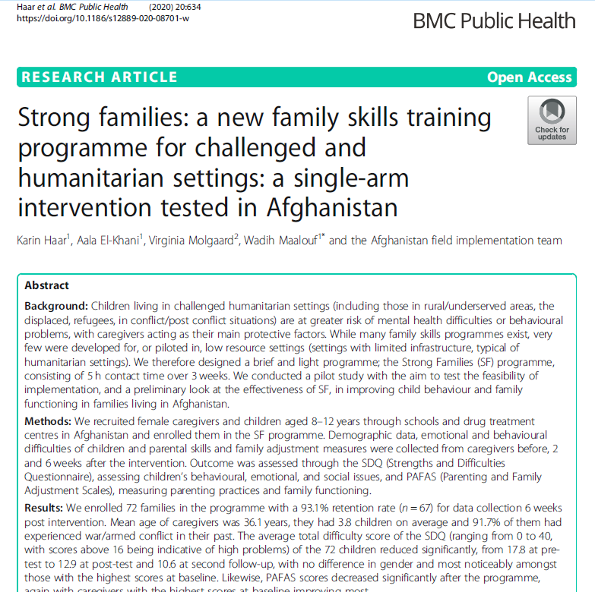


Slide 31
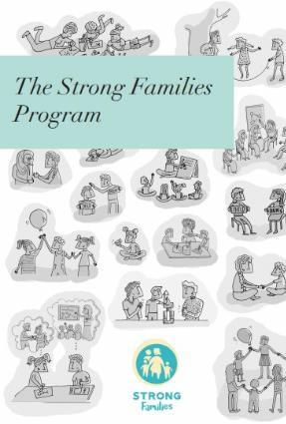
Already available in (or very shortly):
Arabic
English
Dari
Farsi
French
Russian
Serbian
Spanish
Swahili
Uzbek
Bangla (plans with UNHCR Cox Bazar)
Khmer
Tagalog

Slide 32

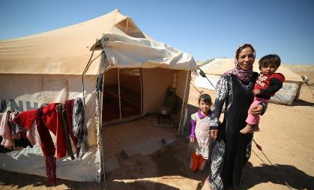
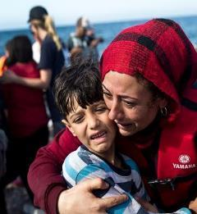
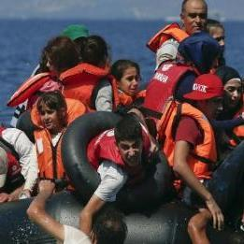
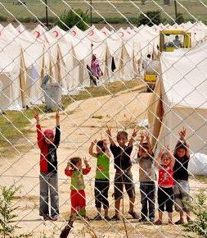
Over 1.5 billion people in the world are experiencing conflict and humanitarian challenges One in every 113 people in the world is a refugee

Slide 33
Families are the front line of defence
Primary caregiver- ‘protective shield’ or further complicate war stress
Family interaction predictive of children’s adjustment in conflict settings yet there’s a significant lack of Family Skills programmes in such contexts

Slide 34


A FAMILY MULTI-LEVEL PARENTING AND CAREGIVER SUPPORT DELIVERY MODEL FOR FAMILIES LIVING THROUGH CONFLICT AND DISPLACEMENT
TRT+ Parenting Programme
5 child sessions (aged 8+ years) (15 children per group) + 5 parent sessions (15 per group); one child and one parent session per week
Strong Families Programme
3 sessions (families of children of all ages) (15 parents per group); one session per week
Parent Seminar + Booklet
1 or multiple parent sessions (20-30 parents) + booklet or handouts to take home
Leaflets providing basic parenting information
Notes:
Mental health needs are enormous with rising levels of psychological distress
Reducing emotional suffering and promoting mental health is a major global health challenge
TRT+ Parenting Programme
5 child sessions (aged 8+ years) (15 children per group) + 5 parent sessions (15 per group); one child and one parent session per week
Parent Programme
5 parent sessions (families of children of all ages) (15 parents per group); one session per week
Parent Seminar + Booklet
1 or multiple parent sessions (20-30 parents) + booklet or handouts to take home
Leaflets giving basic information

Slide 35
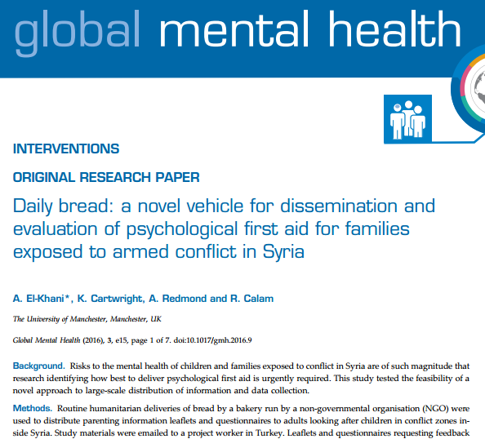
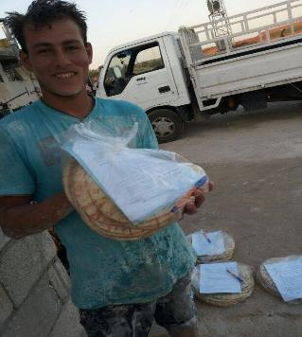
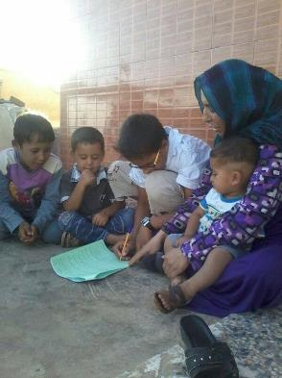
The Bread Wrapper Study

Slide 36
Perceived overall usefulness of parenting leaflet

Slide 37
A FAMILY MULTI-LEVEL PARENTING AND CAREGIVER SUPPORT DELIVERY MODEL FOR FAMILIES LIVING THROUGH CONFLICT AND DISPLACEMENT
TRT+ Parenting Programme
5 child sessions (aged 8+ years) (15 children per group) + 5 parent sessions (15 per group); one child and one parent session per week
Strong Families Programme
3 sessions (families of children of all ages) (15 parents per group); one session per week
Parent Seminar + Booklet
1 or multiple parent sessions (20-30 parents) + booklet or handouts to take home
Leaflets providing basic parenting information
Notes:
Mental health needs are enormous with rising levels of psychological distress
Reducing emotional suffering and promoting mental health is a major global health challenge
TRT+ Parenting Programme
5 child sessions (aged 8+ years) (15 children per group) + 5 parent sessions (15 per group); one child and one parent session per week
Parent Programme
5 parent sessions (families of children of all ages) (15 parents per group); one session per week
Parent Seminar + Booklet
1 or multiple parent sessions (20-30 parents) + booklet or handouts to take home
Leaflets giving basic information

Slide 38
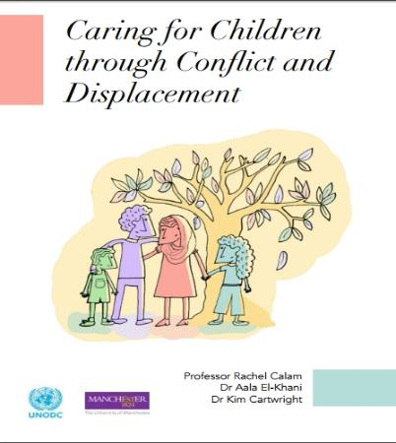
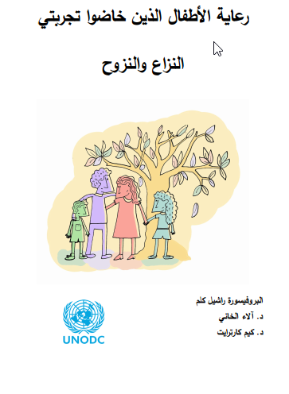
Booklet and Seminar: ‘Caring for Children through Conflict and Displacement’
No extensive training-for low resource settings
119 caregivers in Nablus
Open access
El-Khani, Maalouf, et al., 2019. Caregiving for Children through Conflict and Displacement; A pilot study testing the feasibility of delivering and evaluating a light touch parenting intervention for caregivers in the West Bank. Journal of International Psychology.

Slide 39
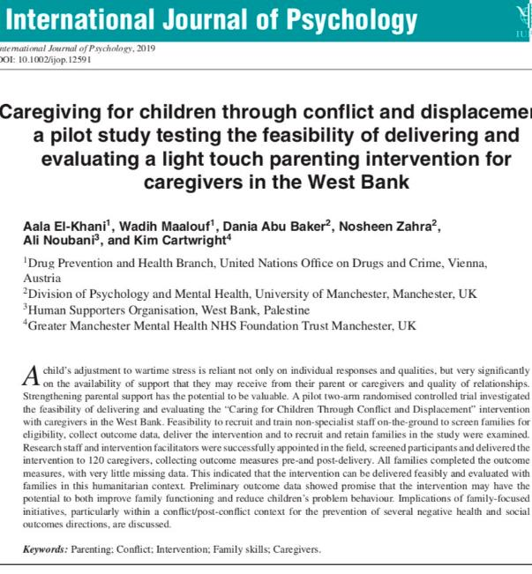
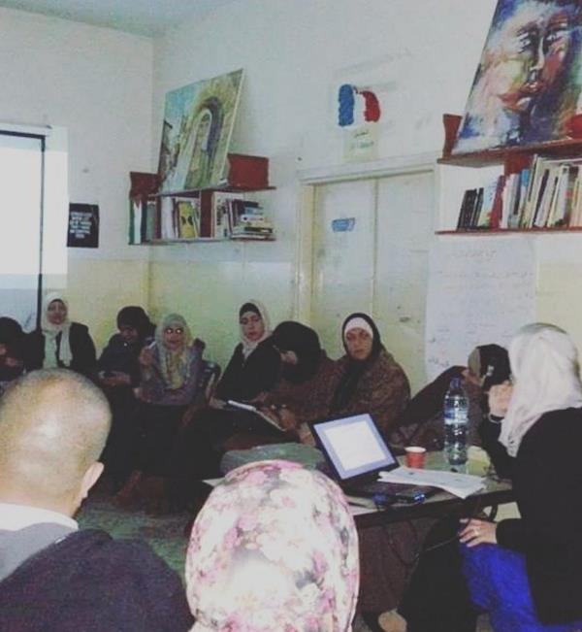

Slide 40
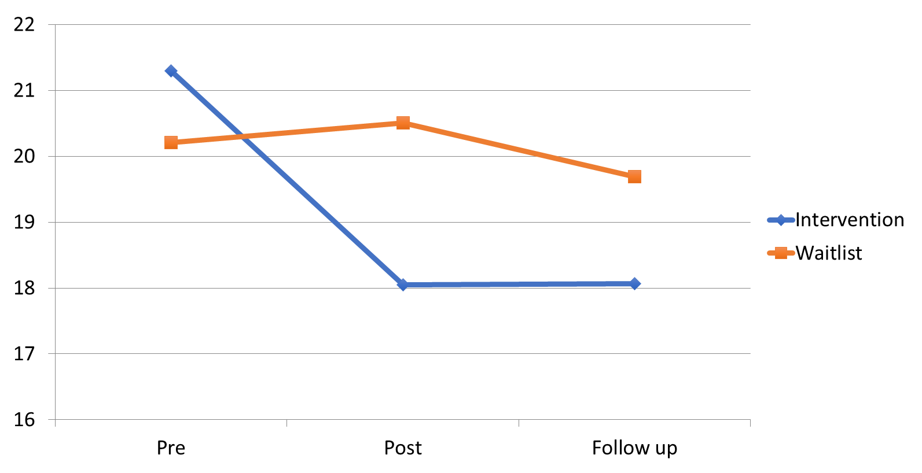
Strengths and Difficulties Questionnaire (SDQ) Child Total Difficulties

Slide 41
A FAMILY MULTI-LEVEL PARENTING AND CAREGIVER SUPPORT DELIVERY MODEL FOR FAMILIES LIVING THROUGH CONFLICT AND DISPLACEMENT
TRT+ Parenting Programme
5 child sessions (aged 8+ years) (15 children per group) + 5 parent sessions (15 per group); one child and one parent session per week
Strong Families Programme
3 sessions (families of children of all ages) (15 parents per group); one session per week
Parent Seminar + Booklet
1 or multiple parent sessions (20-30 parents) + booklet or handouts to take home
Leaflets providing basic parenting information
Notes:
Mental health needs are enormous with rising levels of psychological distress
Reducing emotional suffering and promoting mental health is a major global health challenge
TRT+ Parenting Programme
5 child sessions (aged 8+ years) (15 children per group) + 5 parent sessions (15 per group); one child and one parent session per week
Parent Programme
5 parent sessions (families of children of all ages) (15 parents per group); one session per week
Parent Seminar + Booklet
1 or multiple parent sessions (20-30 parents) + booklet or handouts to take home
Leaflets giving basic information

Slide 42
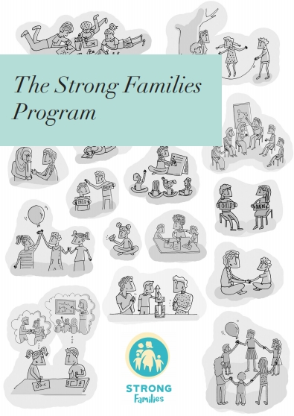

The Strong Families Programme
Family Skills programme for families in Humanitarian & challenged settings
Aims to improve parenting skills, child well-being and family mental health
For caregivers with children aged 8-15
Light touch-only 3 sessions

Slide 43
A FAMILY MULTI-LEVEL PARENTING AND CAREGIVER SUPPORT DELIVERY MODEL FOR FAMILIES LIVING THROUGH CONFLICT AND DISPLACEMENT
TRT+ Parenting Programme
5 child sessions (aged 8+ years) (15 children per group) + 5 parent sessions (15 per group); one child and one parent session per week
Strong Families Programme
3 sessions (families of children of all ages) (15 parents per group); one session per week
Parent Seminar + Booklet
1 or multiple parent sessions (20-30 parents) + booklet or handouts to take home
Leaflets providing basic parenting information
Notes:
Mental health needs are enormous with rising levels of psychological distress
Reducing emotional suffering and promoting mental health is a major global health challenge
TRT+ Parenting Programme
5 child sessions (aged 8+ years) (15 children per group) + 5 parent sessions (15 per group); one child and one parent session per week
Parent Programme
5 parent sessions (families of children of all ages) (15 parents per group); one session per week
Parent Seminar + Booklet
1 or multiple parent sessions (20-30 parents) + booklet or handouts to take home
Leaflets giving basic information

Slide 44


Teaching Recovery Techniques plus Parenting (TRT+)
Original program:
Teaching Recovery Techniques (TRT)
5 child trauma recovery sessions and 2 parent support sessions
Enhanced program:
Teaching Recovery Techniques plus Parenting (TRT+)
3 additional sessions for parents on parenting children experiencing post-traumatic stress

Slide 45
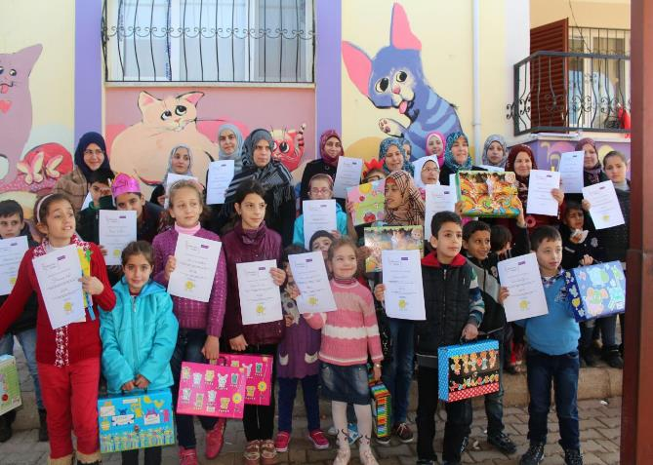
Testing TRT+ Parenting Program Turkey
Significant improvements
in children’s wellbeing,
behaviour and parental
efficacy
High engagement and
completion rate
El-Khani, A., Cartwright, K., Ang, C., Henshaw, E., Tanveer, M., & Calam, R. (2018). Testing the feasibility of delivering and evaluating a child mental health recovery program enhanced with additional parenting sessions for families displaced by the Syrian conflict: A pilot study. Peace and Conflict: Journal of Peace Psychology, 24(2), 188.

Slide 46
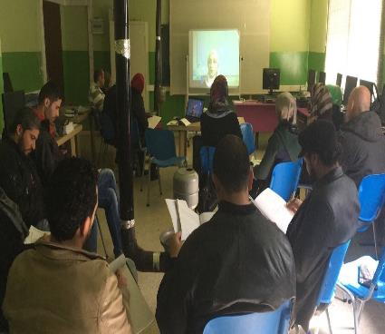
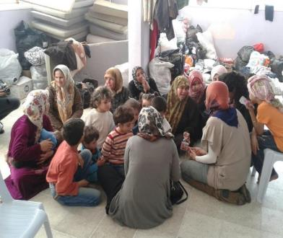


TRT + Parenting Program- Lebanon
Developed remote Skype training
119 families
RCT comparing TRT, TRT+ Parenting, Waitlist

Slide 47
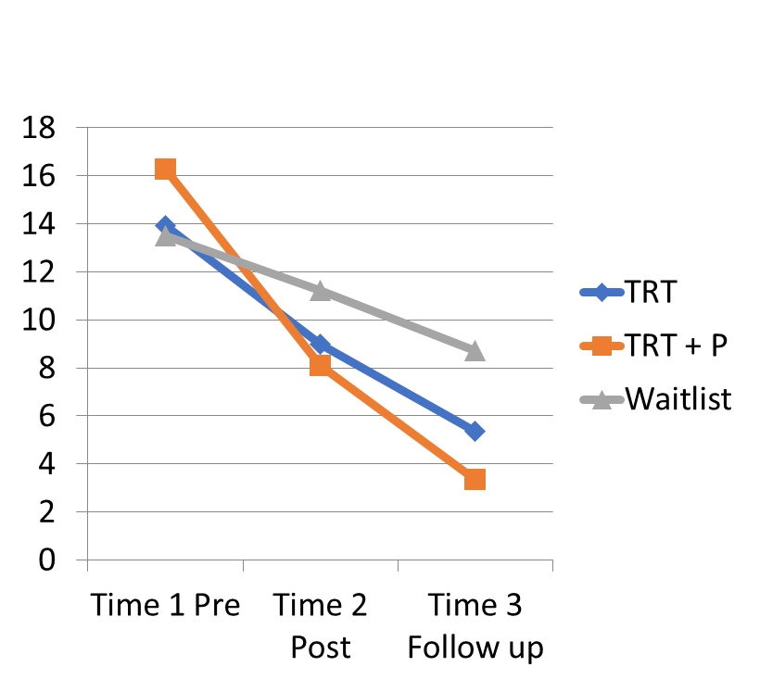
Child: CRIES
Intrusion **
CRIES measures three aspects of stress post trauma: Intrusion, Avoidance and Arousal.
All three showed significant effects, with significant effects of time
Greatest reductions were in the TRT + Parenting group

Slide 48


SCARED Screen for Child Anxiety Related Disorders
Child self report*
Parent report:*

Slide 49
Rewarding results on:
SCALES:
Strength and Difficulty Questionnaires - SDQ
Screen for Childhood Anxiety Related Disorders – SCARED
Impact of Event Scale (IES/CRIES)
Depression Self Rating Scales
Stay tuned publications in progress…

Slide 50
A FAMILY MULTI-LEVEL PARENTING AND CAREGIVER SUPPORT DELIVERY MODEL FOR FAMILIES LIVING THROUGH CONFLICT AND DISPLACEMENT
TRT+ Parenting Programme
5 child sessions (aged 8+ years) (15 children per group) + 5 parent sessions (15 per group); one child and one parent session per week
Strong Families Programme
3 sessions (families of children of all ages) (15 parents per group); one session per week
Parent Seminar + Booklet
1 or multiple parent sessions (20-30 parents) + booklet or handouts to take home
Leaflets providing basic parenting information
Notes:
Mental health needs are enormous with rising levels of psychological distress
Reducing emotional suffering and promoting mental health is a major global health challenge
TRT+ Parenting Programme
5 child sessions (aged 8+ years) (15 children per group) + 5 parent sessions (15 per group); one child and one parent session per week
Parent Programme
5 parent sessions (families of children of all ages) (15 parents per group); one session per week
Parent Seminar + Booklet
1 or multiple parent sessions (20-30 parents) + booklet or handouts to take home
Leaflets giving basic information

Slide 51

https://www.unodc.org/documents/listenfirst/covid19/Family-UNited-leaflet-20200218.pdf

Slide 52


Slide 53


Slide 54


Slide 55



Listen First New material
https://www.unodc.org/unodc/en/listen-first/parenting-resources.html

Slide 56

And seemingly multiple setting interventions could carry multiplicative preventive effect

Slide 57
Example: Meth Initiation Results at 4½ Years Past Baseline (when life skills based prevention (LST) only, and when in combination with parenting skills (SFP)
Source: Spoth, R., Clair, S., Shin, C., & Redmond , C. (2006). Long-term effects of universal preventive interventions on methamphetamine use among adolescents. Archives of Pediatrics and Adolescent Medicine, 160, 876-882.
Notes:
Something we will return on the last day: evidence comes from single interventions – no real data on the combinations, or from system level
However, as you can see, what we have looks very promising indeed!

Slide 58

Example of family- plus school-based prevention Crowley et al., 2014

Slide 59

https://www.unodc.org/documents/drug-prevention-and-treatment/UNODC_Treatnet_Family_brochure_190320.pdf

Slide 60
Family Skills
Violence
Physical & Mental Health
Education
Abstinence from risky sexual behavior
Occupational health
Engagement in community
Moderates poverty
Substance use
Generational effect
10 return for every 1

Slide 61




Common denominator for many strategies

Slide 62




Slide 63



Parenting under COVID19 resources www.unodc.org/listenfirst

Slide 64


Slide 65

One-on-one time
Keeping positive
Structure up
Bad behaviour
Keep calm and manage stress
Talking about COVID-19
Protecting children online
Family budgeting in times of financial stress
Family harmony at home
Learning through play
When we get angry
Parenting in crowded homes and communities

Slide 66

https://www.youtube.com/watch?v=j1ShU5pwpaQ&ab_channel=COVID-19Parenting

Slide 67

https://www.unodc.org/documents/drug-prevention-and-treatment/Practical-Guidance-RCCE-Refugees-IDPs-Migrants.pdf

Slide 68

Evolving needs
Beirut recent incident prioritized a new tool on parenting under crisis that might be useful for different scenarios (security threats, natural disasters and more)

Slide 69


SDGs as an Interlinked Web
Notes:
https://www.unbonn.org/SDG_ExplainerVideo

Slide 70
Acknowledgment
Prof. Virginia Molgaard
Dr. Leland Molgaard
Prof. Rachel Calam
Dr. Aala El-Khani
Dr. Karin Haar
Dr. Ziad el Khatib
Ms. Celina Herrera
UNODC PTRS colleagues
UNODC Field Office colleagues
UN & non UN partners:
WHO, UNICEF, UNHCR, Partnership to End Violence against Children and many more…
Donors: Japan, US INL, Sweden, Spain, Saudi Arabia, France.

Slide 71
Family skills for Prevention of Substance Use, Mental Health and Violence and for Development, including under COVID-19
Wadih Maalouf, Global Programme Coordinator, UNODC
Drug Prevention and Health Branch / Prevention, Treatment and Rehabilitation Section
Division of Operations
Email: wadih.maalouf@un.org Twitter: @wmaaloufun @unodc_ptrs

