Slide 1

Environmental factors in prevention of alcohol use by young people in Sub-Saharan Africa
Neo K. Morojele, PhD
University of Johannesburg
South African Medical Research Council
University of Cape Town
University of the Witwatersrand

Slide 2


Overview
The nature and extent of alcohol use
Why prevention of alcohol use and misuse among adolescents and young adults matters
Environmental/community risk and protective factors
Implications for prevention of alcohol use by young people
Final comment

Slide 3
Prevalence of alcohol use

Slide 4
Percentage (%) of adolescents (15-19) and young adults (20-24 years) who engage in heavy episodic drinking: 2000-2015 (WHO Afro Region)
Source: WHO (2018). Global Status Report on Alcohol and Health

Slide 5

Why prevention matters
Numerous short-term and long-term consequences:
Health: Non-communicable and infectious diseases
Social/behavioural: Sexual risk behaviour; interpersonal violence; self-harm; injuries
Academic: School drop-out/failure
Alcohol Use Disorders (AUDs)
Other mental health problems

Slide 6
Risk and protective factors for alcohol use by adolescents
Societal Factors Culture Demographic and economic shifts Social inequality/socioeconomic disadvantage | Community Factors Societal norms favouring use (e.g. mass media) Access to alcohol Community disorganistion Subjective adult norms favouring alcohol use
School and Academic Environment Permissive drinking norms Availability of alcohol in school proximity Low academic aspirations and suboptimal performance in school Individual Factors Engagement in rebellious and anti-social behaviours Low religious involvement Short term goals in life Depressive symptoms Poor sense of well-being | Familial Environment Parental/caregiver consumption of alcohol (modelling) Insufficient time spent with adolescent Little monitoring Lack of nurturing in the home environment Peers/Friends Peers’ alcohol use Peer engagement in anti-social behaviours

Slide 7

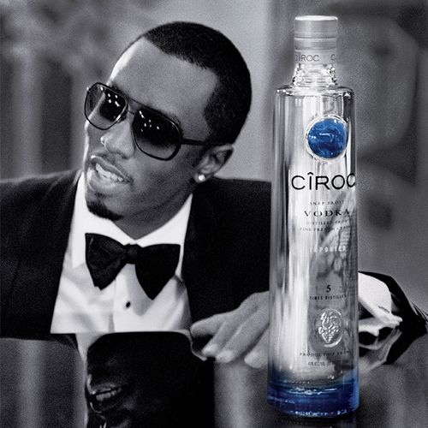
Societal norms: Advertising and marketing of alcoholic beverages
Exposure to marketing associated cross-sectionally with alcohol consumption among young people in sub-Saharan Africa (Letsela et al., 2018; Morojele et al., 2018; Swahn et al. 2015)
Systematic review of longitudinal studies shows significant associations between exposure to alcohol marketing and (a) alcohol use initiation and (b) heavy use among young people (Jernigan et al., 2017)

Slide 8
Percentage of adolescent and adult drinkers reporting exposure to different modes of advertising and marketing of alcohol brands and products
(Source: Morojele et al., 2018)

Slide 9

Access to alcohol
Alcohol is easily accessible to adolescents (Parry et al., 2018)
High density of drinking venues (Letsela et al., 2018)
Drinking venues, taverns, shebeens often in close proximity of schools (e.g. Letsela et al., 2018)
High access is associated with alcohol consumption (Morojele et al., 2018)

Slide 10

Community risk factors
Exposure to community drunkenness (Parry et al., 2004)
Exposure to violence/crime (Francis et al., 2019)
Lacking a sense of belonging to one’s community/low neighbourhood cohesion (Morojele et al., 2018)

Slide 11
Implications for Prevention
Effective alcohol policy interventions
Need to Target community risk factors and enhance protective factors
Restricting or completely banning alcohol advertising
Restricting the availability of alcohol
Increasing prices through taxation
Increasing the legal age for purchasing and consuming alcohol
Marketing and advertising
Access to alcohol
Community disorganization/ disadvantage

Slide 12
Final Comment
Advertising and marketing, easy access to alcohol and community disadvantage are key community risk factors for alcohol use among young people
Effective interventions are needed to address community risk factors
There is a need for further research
To identify challenges associated with the implementation of effective policy interventions
To identify and evaluate the effectiveness of additional context-specific interventions for addressing alcohol use in sub-Saharan Africa

