Slide 1
Virtual Conference on
Drug Demand Reduction in Africa: Prevention, Treatment and Epidemiology
20 October 2020
`

Slide 2

Presentation Outline
Introduction
What is epidemiology?
Prevalence of drug use in Africa
Alcohol use indicators
The Pan-African Epidemiology Network on Drug Use (PAENDU)
Challenges and opportunities
Conclusion

Slide 3
Introduction
There is continuing lack of relevant and current data on drugs in Africa
Academic research growing in some countries
Aided by publication of the African Journal of Drug and Alcohol Studies
Epidemiologic data networks are being developed across the continent
West Africa (WENDU)
African Union (PAENDU)
National efforts (South Africa, Nigeria, etc.)
Effective prevention, treatment and policy need to rely on available data, research evidence

Slide 4
What is Epidemiology?
“Study of the distribution and determinants of health-related states in a population”
Application of the findings to control health problems
Epidemiological research is used to:
describe the health status of populations
explore the social determinants of health and disease
evaluate the effectiveness of health services

Slide 5
Methods of data collection
General population surveys
School surveys
Survey of special/vulnerable populations
Data from the health care sector (emergency, specialist treatment centres, PHC, etc.)
Data from law enforcement organizations
Qualitative research techniques
Experimental research/RCTs
Analyses of available (secondary) data

Slide 6
Types of data
Availability (arrests, seizures, price and purity, etc.)
Use/consumption (who? what? how?)
Determinants of use (e.g., why?
Consequences/Effects of use
Health care sector (e.g., overdose deaths)
Social welfare
Demand for treatment
Traffic/Law enforcement (arrests, fines, imprisonment)

Slide 7
Annual prevalence (%) of drug use in Africa 2018 (data from the WDR 2020; Best estimates)
Region | Cannabis | Opioids | Opiates | Cocaine | ATS | Ecstasy | IDU
Africa | 6.32 | 1.04 | 0.49 | 0.27 | 0.41 | 0.26 | 0.13
East | - | - | - | - | - | - | 0.15
North | 5.08 | 1.06 | 1.06 | 0.27 | - | - | 0.12
Southern | - | - | - | - | - | - | 0.14
West and Central | 9.27 | - | 0.18 | 0.15 | 0.36 | - | 9.12
Global | 3.86 | 1.16 | 0.61 | 0.38 | 0.55 | 0.41 | 0.23
Non-medical use of drugs has become a public health concern in
West, Central and North Africa. Data from treatment centres in
countries like Benin, Mali, Egypt and Nigeria show that Tramadol is
associated with drug use disorders.

Slide 8
National Survey of Drug Use in Nigeria 2017
Consisted of:
National Household Survey on Drug Use and Health (40,000 households; interviewed 15-64 year olds)
National Survey on Problem Drug Use (more than 9,000 persons with substance use disorders)
Key Informant Survey (3,000 key informants)
Covered all 36 states of the Federation + Federal Capital Territory
Monitoring mechanisms through Technical and Steering Committees
Technical support from United Nations Office on Drugs and Crime
Funded by European Union (10th EDF)

Slide 9
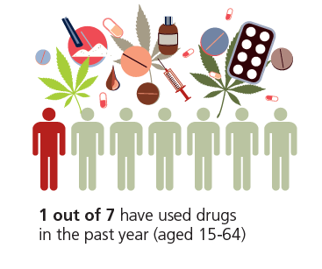
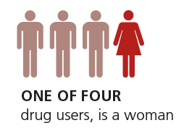
Annual prevalence of drug use in Nigeria
14.4% of population 15-64 or 14,300,000 persons
One of four drug users is a woman
Estimated 10.8 million men and 3.4 million women reported past year drug use

Slide 10
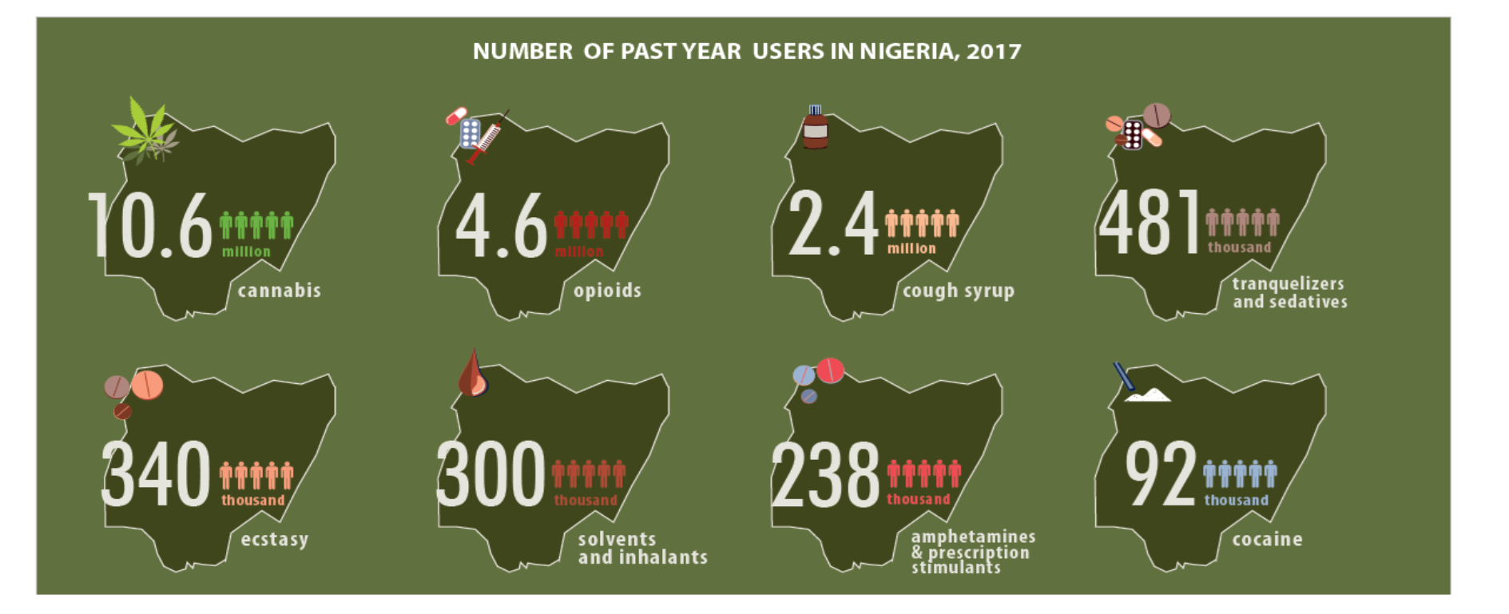
Number of past year drug users in Nigeria 2017

Slide 11
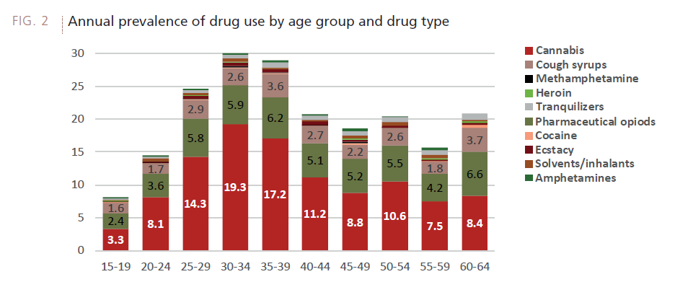
Drug use and age

Slide 12
Alcohol Use Indicators: Africa and the World
Indicators | Africa | World
Lifetime Abstainers | 57.5% | 44.5%
Adult per capita consumption (all) | 6.3 litres 13.6 gms/day | 6.4 litres 13.9 gms/day
Adult per capita consumption (drinkers only) | 18.4 litres 40 gms/day | 15.1 litres 32.8 gms/day
Heavy episodic drinking | 50.2% | 39.5%
Alcohol attributable deaths (per 100,000) | 70.6 | 38.8
Source: WHO Global status report on alcohol and health 2018

Slide 13
Pan-African Epidemiology Network on Drug Use (PAENDU)
In 2014 ministers in charge of drug control identified lack of baseline data and information on drug use as a major hindrances to programme development.
In 2016 a surveillance system for the collection and dissemination of comparable data on drug use and related problems in African countries was launched.
More than 30 countries are participating in the network.

Slide 14
Tunisia
Morocco
Algeria
Libya
Sahrawi Republic
Egypt
Mauritania
Senegal
Niger
Sudan
Eritrea
Djibouti
The Gambia
Mali
Burkina
Faso
Chad
Guinea-Bissau
Guinea
Côte
d'Ivoire
Benin
Nigeria
Ethiopia
Sierra Leone
Ghana
Togo
Central African
Republic
Liberia
South Sudan
Cameroon
Somalia
São Tomé
and Príncipe
EG
Uganda
Kenya
Gabon
Congo Republic
DR Congo
R
B
Tanzania
Lot 1 Countries
Comoros
Lot 2 Countries
Angola
Mayotte (France)
Zambia
Malawi
Lot 3 Countries
Mozambique
Already pre-existing networks
Namibia
Zimbabwe
Madagascar
Lot 4 Countries
Botswana
Lot 5 Countries
S
L
South Africa
Pan-African Epidemiology Network on Drug Use (PAENDU)

Slide 15
Progress to date
National drug surveillance networks established in 30 out of a total of 55 AU Member States (as at 09 October 2020)
Inaugural Pan African Epidemiology Network on Drug Use Report launched in 2019 for 2016 and 2017
2020 report to be released soon
Improvement in availability and quality of data in the continent
Fulfilment of international reporting obligations

Slide 16
Summary of findings
In 2017 the number of facilities ranged from one in Guinea, 39 in Kenya to 83 in South Africa.
Treatment episodes ranged from 188 in Guinea to more than 19,000 in South Africa
In every country the primary substance of abuse among people seeking treatment was either cannabis or alcohol. Where one was the primary substance the other tended to be the secondary substance
Young adults between the ages of 15 and 34 years accounted for the majority of people seeking treatment in various countries with the average age between 25 and 29 years.
The typical treatment seeker had completed secondary school, unemployed, lived in urban areas
The average age for entry into treatment for alcohol problems was higher than for cannabis dependence.
Most countries report seizures of cannabis, followed by cocaine/crack.
Relatively few countries report seizures of heroin and amphetamine-type stimulants (in this case methcathinone and methamphetamine).

Slide 17
Major Constraints
Unavailability of data (weak tradition of record keeping, ad hoc data collection, data not integrated in National Health Information Systems)
Lack of funding for research, especially population surveys
Issues of reliability and validity of data from existing sources of information
Lack of qualified personnel (for data collection, analysis and reporting)
Lack of standardized definitions and data collection tools across treatment institutions in the same country
Evaluation of treatment outcomes is often weak as outcome indicators are often lacking

Slide 18
Major Constraints (contd)
Civil society organizations not willing to share data with Government agencies
Data collection limited to facilities in urban areas
Lack of basic equipment for data collection including poor IT and connectivity.
Drug Epidemiology Focal points are often changed.
Sustainability of data collection systems remains problematic.

Slide 19
Opportunities
Epidemiology information has been used to spark national debate on drugs
Facilitates more consistent record keeping
Countries have the opportunity to use the PAENDU framework/template for replicability and scaling up at national level
Countries can leverage existing political commitment at continental level
Offers continuous staff training and employment of qualified manpower for prevention, treatment, etc.
Policy makers and key stake holders are more exposed to the nature and extent of drug problems

Slide 20
Conclusions
Substance use epidemiology is a young but growing field in Africa.
Available data from a limited number of studies show that drug use and drug use disorders are increasing and associated with public health problems.
There is urgent need for regular data from population surveys and other methods to inform prevention, treatment and policy.

Slide 21
Thank you!
Email: obotis@gmail.com
Phone: +234 703 940 8945

