Slide 1
The Rapidly Changing Composition of the World’s Drug Supply and Its Effect on High Risk for COVID-19
ISSUP Webinar
Thom Browne Jr.
CEO
Colombo Plan Secretariat
June 26, 2020

Slide 2
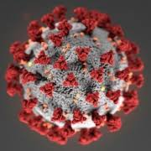
High-Risk for Coronavirus
Although COVID-19 is usually mild and most people recover quickly, certain groups of people are at higher risk of severe illness & complications from CV-19 (elderly, compromised immune systems, HBP, diabetes, heart problems, kidney & liver disease, chronic respiratory/lung disease).
People with addictions have numerous co-occurring health problems that make them more susceptible to Covid-19. *
(respiratory, pulmonary, and cardiovascular diseases, in
addition to suppression of the immune system & chronic
obstructive pulmonary disease, all high-risk factors for
acquisition of COVID-19 infection).
Compromised/diminished lung capacity from COVID-19 places users of opioids, methamphetamine, and other psychostimulants like cocaine at risk for mortality and severe complications from the virus. **
____________________
*Marsden J, et al. Mitigating and learning from the impact of COVID-19 infection on addictive
disorders. Addiction. Editorial. doi:10.1111/add.15080
**Volkow N. Collision of the COVID-19 and Addiction Epidemics. Annals of Internal Medicine.
Ideas and Opinions. 2 April 2020. https://doi.org/10.7326/M20-1212

Slide 3
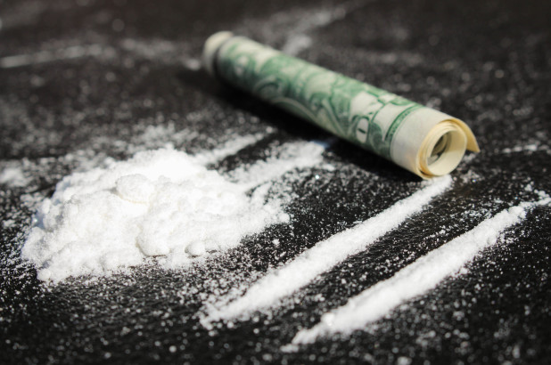
Cocaine is Toxic
Toxic effects of cocaine are well documented, most of which are due to adverse effects on the cardiovascular system*
Cocaine greatly influences the cardiovascular system and is a well-known trigger of acute coronary syndromes**
Cocaine causes transient increases in blood pressure, respiratory rate, and heart rate***
___________________
*Havakuk O, Rezkalla SH, Kloner RA (2017) The cardiovascular effects of cocaine. J Am Coll Cardiol 70(1):101–113
**Kloner RA & Rezkalla SH. Cocaine and the Heart. New Engl J Med 2003;348(6):487-8.
***Katarzyna M, et al, Acute coronary syndrome after levamisole-adulterated cocaine abuse. Journal of Forensic & Legal Medicine, 21 (2014) 48-52.

Slide 4
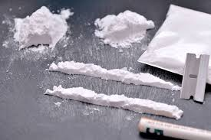
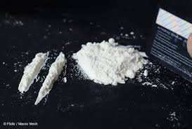
Cocaine is Toxic
Its abuse most often results in cardiopulmonary symptoms*
Toxic effects of cocaine include arterial vasoconstriction**
Vasoconstriction occurs through contraction of the muscular walls of blood vessels and results in increased blood pressure, a high-risk factor for Covid-19
___________________
*Restrepo CS, Carrillo JA, Martinez S, Ojeda P, Rivera AL, & Hatta A. Pulmonary Complications from Cocaine and Cocaine-based Substances: Imaging Manifestations. RadioGraphics. Vol. 27, No. 4. Jul 1, 2007.
**Katarzyna M, et al, Acute coronary syndrome after levamisole-adulterated cocaine abuse. Journal of Forensic & Legal Medicine, 21 (2014) 48-52.

Slide 5
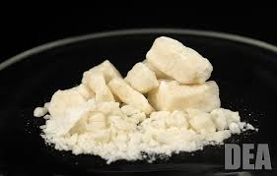
Crack Cocaine
Smoking cocaine irritates and inflames the lungs
Prolonged crack use may result in lung damage and causes a number of pulmonary conditions, including severe respiratory problems,* a high-risk factor for COVID-19
Smoking crack can cause various forms of pneumonia, pulmonary hypertension and pulmonary edema**
Crack users are prone to more severe COVID-19 infections due to the greater inflammation and damage of long tissue resulting from smoking cocaine***
___________________
*Haim DY, Lippmann ML, Goldberg SK, & Walkenstein MD. The pulmonary complications of crack cocaine. Chest 1995;107;233-240
**Katarzyna M, et al, Acute coronary syndrome after levamisole-adulterated cocaine abuse. Journal of Forensic & Legal Medicine, 21 (2014) 48-52.
***Marsden J, et al. Mitigating and learning from the impact of COVID-19 infection on addictive disorders. Addiction. Editorial. doi:10.1111/add.15080

Slide 6
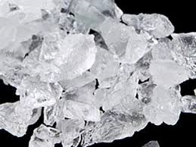
Methamphetamine
Methamphetamine users may be vulnerable to COVID-19 due to the drug’s effect on the respiratory and pulmonary systems*
Meth causes pulmonary damage, pulmonary hypertension, and chronic disease of the heart muscle,** high-risk factors for COVID-19
Methamphetamine constricts blood vessels, one of the causes for pulmonary damage and pulmonary hypertension in people who use it.*
___________________
* Nora Volkow Blog. COVID-19: Potential Implications for Individuals with Substance Use Disorders, NIDA, March 24, 2020.
** Zhao SX, Kwong C, Swaminathan A, et al. Clinical characteristics and outcome of methamphetamine-associated pulmonary arterial hypertension and dilated cardiomyopathy. JACC Heart Fail. 2018;6: 209-218. [PMID: 29496022] doi:10.1016/j.jchf.2017.10.006

Slide 7
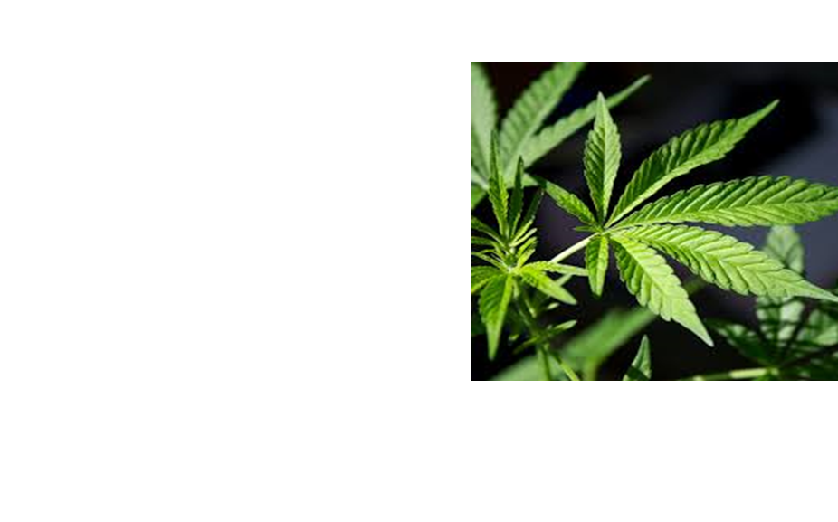
Marijuana/Vaping
Both marijuana smoke* and e-cigarette vapor** are associated with inflammation of the airways similar to that observed in patients with COPD and with the development of bronchitis and asthma, all of which are shown to increase risk of severe complications and mortality from COVID-19
_______________________
*Tashkin DP, Baldwin GC, Sarafian T, Dubinett S, Roth MD. Respiratory and immunologic consequences of marijuana smoking.
J Clin Pharmacol. 2002 Nov;42(S1):71S-81S
**Gotts, J. E., Jordt, S. E., McConnell, R., &Tarran, R. (2019). What are the respiratory effects of e-cigarettes? BMJ, 366(I5275)

Slide 8
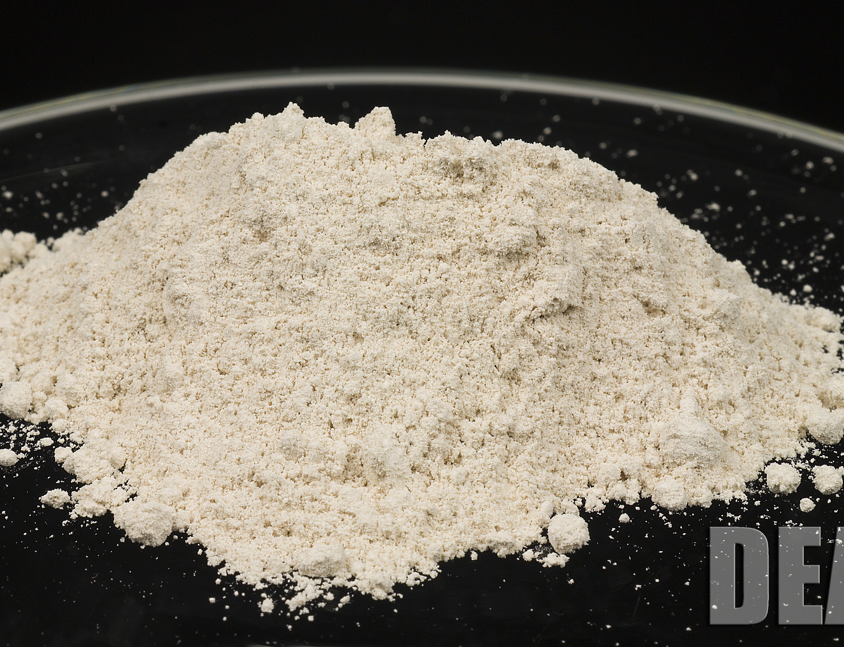
Heroin/Opioids
The most well-known complications of opioid use and misuse include respiratory and central nervous system depression*
Opioids have also been reported to affect the immune system, and place users at increased risk for many different infectious complications* (including CV-19)
Lung diseases such as abscesses, pneumonia, and tuberculosis are usual among heroin abusers**
___________________
* Radke JB, Owen KP, Sutter ME, Ford JB, Albertson TE. The effects of opioids on the lung. Clin Rev Allergy Immunol. 2014 Feb;46(1):54-64.
**Hind CRK. (1990) Pulmonary complications of intravenous drug misuse. 1. Epidemiology and non-infective complications. Thorax, 45, 891-898

Slide 9
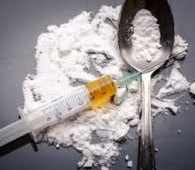
Heroin/Opioids
Because opioids like heroin slow breathing, people with opioid use disorder (OUD) may suffer from diminished lung capacity that could become fatal with the onset of COVID-19*
Slowed breathing due to opioid use can also result in a low concentration of oxygen in the blood (hypoxemia), which can lead to pulmonary and cardiac complications*
___________________
*Nora Volkow Blog. COVID-19: Potential Implications for Individuals with Substance Use Disorders, NIDA, March 24, 2020.

Slide 10
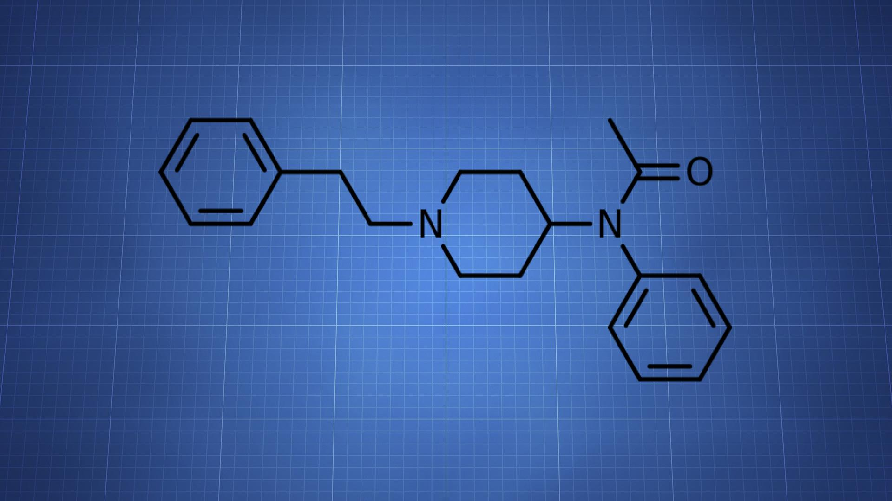
Fentanyl
Fentanyl is a highly potent synthetic opioid
Fentanyl is 80 to 100 times stronger than morphine and 50 times more potent than heroin
Carfentanil is estimated to be 10,000 X more potent than morphine
Fentanyl’s effects include respiratory depression and arrest

Slide 11
Illicit Drugs are Rarely Pure
Diluents
Adulterants
Inert substances added to illicit drugs to bulk out the drug and decrease the amount of active ingredient.
Pharmacologically active ingredients added to illicit drugs to give bulk, complement or enhance the effects, or produce synergistic effects

Slide 12
Chemical Profile of Cocaine Samples in the Southern Cone - 2012
 | Brazil | Chile | Paraguay | Uruguay | Argentina
No. Samples Tested: | 40 | 20 | 20 | 9 | 15
Average Purity (Range) | (29.7% -89.6%) | (15.8% - 92.2%) | (4.6% – 84.6%) | (35.8% - 82.4%) | (17.4% - 18.4%)
Number (%) with Adulterants | 30 (75%) | 8 (40%) | 17 (85%) | 9 (100%) | 15 (100%)
Phenacetin | 26 (65%) | 1 (5%) | 13 (65%) | 2 (22%) | 15 (100%)
Levamisole | 1 (3%) |  | 1 (5%) | 2 (22%)
Other | 3 (7%) | 7 (35%) | 3 (15%) | 5 (55%)
Aminopyrine + Phenacetin | 16 (40%) | - | 8 (40%) | 1 (11%)

Slide 13
2016 Drug Adulterant Testing Results
Argentina
Ecuador
Paco (cocaine paste base)
-- Phenacetin and Metamizole
-- Phenacetin and Aminopyrine
“H” (new street drug)
-- Heroin cut with diltiazem,
phenacetin, and cocaine
Cocaine HCl
-- cut with levamisole and lidocaine

Slide 14
Chemical Profile of Drug Samples in South Africa – May 2017
(50 samples each)
Adulterants | Cocaine | Heroin
Phenacetin | 94% | 32%
Acetaminophen | -- | 18%
Levamisole | 16% | --

Slide 15
Uncommon Toxic Adulterants Detected in Africa & Asia: 2016 - 2017
Adulterant | Classification | Country Detected | Health Consequences | Street Drug
Diethyl Methylphosphonate | Nerve Agent (precursor Sarin & Somon gas) Flame Retardant | South Africa (Pretoria) [June 2016] | *Respiratory failure *Convulsions *Paralysis | Pink tablets sold as gym morphine
Maneb | Fungicide Neurotoxin | South Africa (Johannesburg) [June 2016] | *Parkinson’s symptoms *Tremors *Muscle rigidity/Slow gait *Impaired voice/Jaw stiffness | Sold as new street drug called ‘Swipe’ by mixing maneb, corn syrup & talc powder
Nitroethane Chinomethionate | Neurotoxin Fungicide Neurotoxin Carcinogen | South Africa (Johannesburg) [June 2016] | *Genetic damage *Harmful to nervous system, liver, and kidneys ----------------------------------------- *Causes cancer *Damage to bodily organs | Used to cut nyaope or whoonga (a heroin concoction with several adulterants)
Di(ethylene glycon) dibezoate | Neurotoxin Industrial Solvent | South Africa (Cape Town) [June 2016] | *CNS Depression *Neurologic dysfunction *Liver/Kidney damage | Used to cut crack cocaine (also adulterated with phenacetin)
2,2diethoxyacetophenone Methyl benzoyl formate | Carcinogens | Thailand (Bangkok) [April 2017] | *Causes Cancer *Organ toxicity – single exposure *Skin corrosion/irritation *Respiratory tract irritation | Used to cut cocaine HCl

Slide 16
UN World Drug Report 2009: Afghanistan & Heroin Cutting Agents
Paracetamol: analgesic/fever reducer. Causes liver damage at higher doses. When combined with heroin, it has a double depressant effect. Mixture can significantly slow down – and sometimes completely stop – critical body functions, including respiration and heart rate.
Phenolphthalein: used as a laxative for more than a century, but removed from the market because of concerns over its carcinogenicity - its potential to cause or increase the risk of cancer by altering cellular metabolism.
Chloroquine: a well-known antimalarial drug. Can cause hypotension.
Caffeine: with heroin, can cause abnormal heart rhythm & respiratory distress.

Slide 17
Health Consequences of Illicitly Manufactured Heroin Impurities
Acetylcodeine – potentiates the convulsant effects of heroin suggesting a mechanism for some of the heroin-related deaths reported in human addicts
6-Monoacetylmorphine (6-MAM) - found in significant amounts of black tar heroin or heroin exposed to moisture. Thirty (30) percent more active than heroin. Can cause CNS depression.
Papaverine - comprises 0.5 to 2.5% of opium. Toxic at high doses. Taken with other drugs that make one drowsy, it can worsen the effect. Relaxes muscles & lowers blood pressure. Can cause CNS depression.
Noscapine - comprises 4 to 8% of opium. A non-controlled opium alkaloid that is byproduct of heroin production and is usually discarded as processing waste. Some heroin manufacturers process the waste to make noscapine enriched powder, which has reportedly been used as a cutting agent for heroin and identified as a substance adulterated with fentanyl and sold as ‘heroin.’ Toxic at high doses. Side effects include increased heart rate.
Morphine - unreacted morphine is present in poorly processed heroin, which may bring about adverse reactions in users, especially when the drug is injected intravenously. Can cause neurodegeneration (loss of nerve structure and function). Can cause respiratory distress and death when taken in high doses or combined with other substances, including alcohol
Codeine - unreacted codeine is present in some poorly processed heroin, which may bring about adverse reactions in users, especially when the drug is injected intravenously. Can cause CNS depression. Can cause respiratory distress and death when taken in high doses or combined with other substances, including alcohol.

Slide 18
Middle East: Health Consequences of Counterfeit Captagon*
Ephedrine – stimulant to treat low BP. Can cause hypertension, tachycardia, cardiac arrhythmias, fluid in lungs, vasoconstriction.
Metronidazole – an antibiotic. Can cause decrease in white blood cells, CNS toxicity, nerve damage.
Theophylline – a bronchodilator. Can cause tachycardia, cardiac arrhythmias, convulsions.
Chlorphenamine – an antihistamine. Can cause drowsiness.
Trimethoprim – an antibiotic. Can cause low levels of platelets that help blood to clot.
Chloroquine – an antimalarial. Can cause hypotension.
Quinine – an antimalarial. Can cause cardiovascular toxicity, including abnormal heart rhythms and reduction of red blood cells.
Caffeine – a psychostimulant. Can cause cardiotoxicity, changes in heart rate, and cardiac injury.
Procaine – a local anesthetic. Can cause cardiac arrhythmias.
Amphetamine – Can cause hypertension and tachycardia.
Methamphetamine – Can cause hypertension and tachycardia.
______________
* Alabdalla MA. Chemical characterization of counterfeit captagon tablets seized in Jordan. Forensic Sci Int 2005;152:185-8.

Slide 19
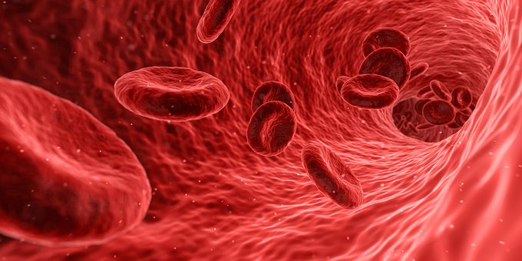
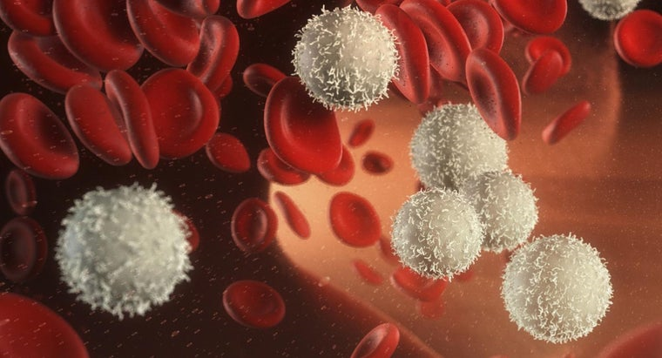
Adulterant Effects on Health
Phenacetin Depletes Red Blood Cells, Damages Kidneys, and Bladder Cancer
Levamisole & Aminopyrine Deplete White Blood Cells

Slide 20
Health Consequences of Adulterants
Adulterant | Classification | Country Detected | Health Consequences | Street Drug
Phenacetin | Analgesic | United States, Ecuador, Argentina, Peru, South Africa, Brazil | *Hemolytic anemia ( reduction red blood cells ) *Kidney Failure *Bladder/Kidney Cancer *Analgesic Nephropathy *Hematological disorders | Heroin, “H,” Coca Paste, Paco, Cocaine HCl, Crack
Levamisole | Medication used for expelling worms | United States, Ecuador, Argentina, Brazil, South Africa, Sri Lanka, Honduras | *Fever *Agranulocytosis ( reduction white blood cells ) | Cocaine HCl, Heroin, Methamphetamine
Lidocaine | Local Anesthetic | United States, Ecuador, Brazil, South Africa | *CNS Problems *Respiratory Depression *Bradycardia *Hypotension *Tremors *Convulsions *Cardiac Arrhythmia | Cocaine HCl, Heroin
Benzocaine | Local Anesthetic | United States, South Africa, Brazil | *Blood disorder (Methemoglobinemia: inability to release oxygen effectively to body tissues) | Crack, Heroin
Aminopyrine | Analgesic Anti-inflammatory | United States, Argentina, Brazil, Ecuador | *Agranulocytosis ( reduction white blood cells ) | Crack, Paco, Heroin, “H”

Slide 21
Adulterant | Classification | Country Detected | Health Consequences | Street Drug
Diltiazem | Calcium channel blocker Antihypertensive drug | United States, Ecuador | *Heroin laced with Diltiazem could cause users to overdose *Bradycardia *Hypotension *Potentiates cocaine toxicity & toxic cardiac effects | Heroin, “H”
Metamizole/Dipyrone | Pain killer Fever reliever Spasm reliever | United States, Argentina | *Agranulocytosis ( reduction white blood cells ) *Aplastic anemia | Heroin, Paco
Acetaminophen | Analgesic | United States, South Africa, Afghanistan, | *With heroin, dramatically depresses heart rate/breathing *Acute liver (hepatic) failure *Coma *Cocaine increases hepatoxicity (liver damage) | Heroin, Cocaine HCl
Diphenhydramine | Antihistamine | United States | *With heroin, dramatically depresses heart rate/breathing *Tachycardia *Torsade de Pointes *Encephalitis *Seizures | Heroin, Cocaine HCl, Methamphetamine
Caffeine | Psychoactive Stimulant | United States, Argentina, Brazil, Peru, Ecuador, Uruguay, South Africa, Thailand | *Neurodegenerative disease *Respiratory distress *Arrhythmia, cardiotoxicity *Potentiate toxic effects of cocaine at high doses | Heroin, Cocaine HCl, Paco, “H,” Methamphetamine, Coca Paste

Slide 22
Adulterant | Classification | Country Detected | Health Consequences | Street Drug
Xylazine | Veterinary Anesthetic Muscle relaxant Analgesic Sedative | United States, Puerto Rico, Dominican Republic | *Respiratory depression *CNS depression *Bradycardia *Hypotension | Heroin
Tramadol | Opioid pain medication | United States, Mexico, Africa | *Respiratory distress and death when taken in high doses or when combined with other substances *Serotonin syndrome *Seizures *Convulsion at high doses | Heroin
Carisoprodol | Muscle Relaxant | United States, Mexico | *Potentiating effect on narcotics *CNS & respiratory depression *Dangerous when combined with other sedatives or alcohol | Heroin
Quetiapine | Antipsychotic for major depressive disorder, bipolar disorder, and schizophrenia | United States | *Torsade de Pointes *Respiratory failure *Tachycardia *Neutropenia *Hypotension *Sudden cardiac arrest | Heroin

Slide 23
Adulterant | Classification | Country Detected | Health Consequences | Street Drug
Alprazolam | Benzodiazepine | United States | *CNS depression *Hypotension *with opioids & alcohol, may cause profound sedation, respiratory depression, coma, and death | Heroin
Quinine | Antimalarial Medication | United States | *Kidney damage *Arrhythmias *Brown-Sequard syndrome *Cardiovascular toxicity *Torsade de Pointes *CNS overstimulation *Thrombosis *Hypotension *Acute renal failure | Heroin, Cocaine HCl
Procaine | Local Anesthetic | United States | *CNS problems *Convulsions *Poisoning at high doses *Cardiac arrhythmia *Methemoglobinemia | Heroin, Cocaine HCl
Lidocaine | Local Anesthetic | United States | *Cardiac arrhythmia *Methemoglobinemia | Heroin, Cocaine HCl

Slide 24
Adulterant | Classification | Country Detected | Health Consequences | Street Drug
Diethyl Phthalate | Phthalate ester used in plastics, fragrances, cosmetics, aerosol sprays, etc. | Ecuador | *Nervous system damage *Reproductive organ damage *When burned, produces toxic gas | “H”
Noxiptiline | Tricyclic Antidepressant | Ecuador | *Tachycardia *Hypotension *Seizures *Tremors *Dizziness *Drowsiness | “H”
Tolycaine | Local Anesthetic | Ecuador | *??? | “H”
Benzocaine | Local Anesthetic | United States | *Cardiac arrhythmia *Methemoglobinemia | Heroin, Cocaine HCl

Slide 25
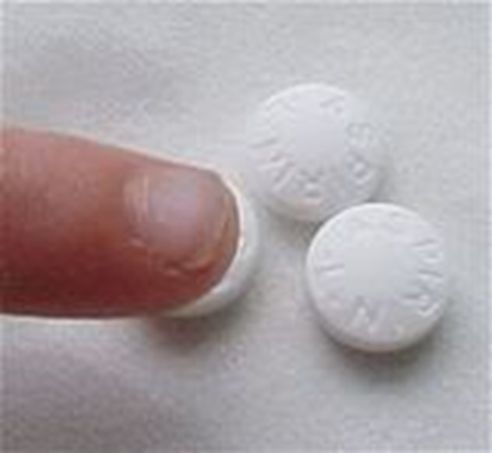
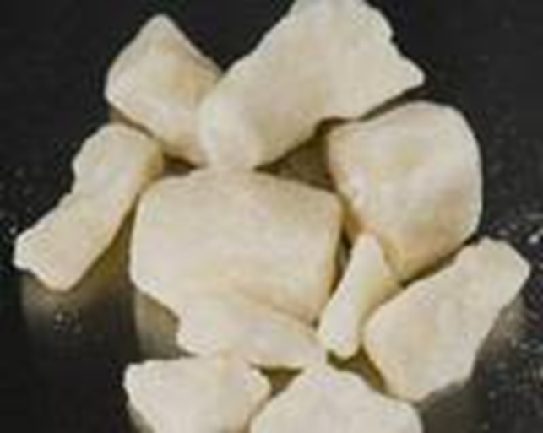
Severe Health Problems Accelerated with
Adulterated Drugs versus Adulterated Aspirin
Health Problems from Aspirin Containing Phenacetin Took Years to Appear. Aspirin was Taken as needed for Pain in the 1960s
Crack Used 15 X day X 7 days/week X 6 months
Today Health Problems Appear within Months

Slide 26
Adulterant Testing in the United States
A 2016 CDC study found that fentanyl was detected in over half (56%) of the 5,152 opioid overdose deaths in ten states between July – December 2016.*
However, in 2017 there were an estimated 72,306 drug overdose deaths according to CDC, of which 29,406 (41%) were due to synthetic opioids such as fentanyl.**
Thus, fentanyl is undoubtedly contributing to overdose rates, but it is far from their only cause.
_____________________________________
*O’Donnell JK, Halpin J, Mattson CL, Goldberger BA, Gladden RM. Deaths Involving Fentanyl, Fentanyl Analogs, and U-47700 — 10 States, July–December 2016. MMWR Morb Mortal Wkly Rep 2017;66:1197–1202. DOI: http://dx.doi.org/10.15585/mmwr.mm6643e1
**NIDA, Overdose Death Rates, revised August 2018

Slide 27
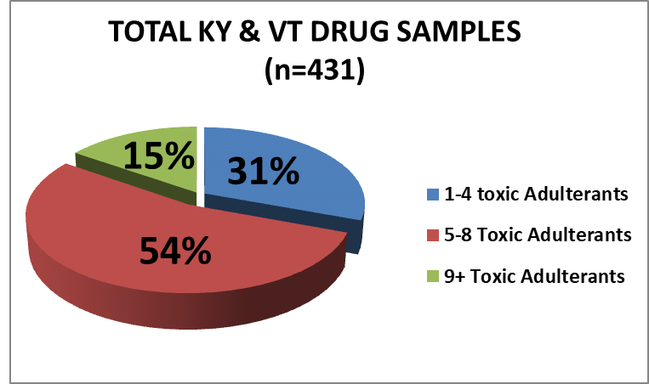
*No sample had 0 Toxic Adulterants

Slide 28
United States Street-level Drug Samples (2016 - 2017)
VT #156 | VT #160 | KY #26 | KY #105
Heroin | Heroin | Heroin | Heroin
Cocaine | Cocaine | Cocaine | Cocaine
Tramadol | Fentanyl | Tramadol | Fentanyl
Ketamine | Levamisole | Fentanyl | 4-ANPP
Fentanyl | Acetaminophen | 4-ANPP | Acetaminophen
Aminopyrine | Quinine | Aminopyrine | Diphenhydramine
Diltiazem | Lidocaine | Diphenhydramine | Levamisole
Quinine | Procaine | Quinine | Phenacetin
Quetiapine | Caffeine | Lidocaine | Quinine
Caffeine | Acetylcodeine | Dipyrone | Caffeine
Acetylcodeine | 6-MAM | Caffeine | Acetylcodeine
6-MAM | Papaverine | Acetylcodeine | 6-MAM
Noscapine | Noscapine | 6-MAM | Papaverine
Papaverine |  | Papaverine | Noscapine
Morphine |  | Noscapine
Legend:
Black = controlled drugs
Purple = fentanyls
Red = adulterants
Green = impurities from heroin manufacturing process

Slide 29
Argentina & Brazil Street-level Drug Samples
ARGENTINA | BRAZIL | BRAZIL | BRAZIL
Cocaine | Cocaine HCl | Cocaine Base | Cocaine Base
Phenacetin | Caffeine | Aminopyrine | Phenacetin
Metamizole/Dipyrona | Lidocaine | Phenacetin | Aminopyrine
Benadryl | Levamisole | Benzocaine | Lidocaine
Aminopyrine | Benzocaine | Caffeine | Benzocaine
 |  |  | Levamisole
 |  |  | Caffeine
Legend:
Black = controlled drugs
Purple = fentanyls
Red = adulterants
Green = impurities from heroin manufacturing process

Slide 30
Ecuador Street-level Drug Samples
ECUADOR | ECUADOR | ECUADOR | ECUADOR
Heroin | Heroin | Heroin | Heroin
Levamisole | Cocaine | Cocaine | Diltiazem
Diltiazem | Diltiazem | Diltiazem | Noxiptilina
Caffeine | Phenacetin | Caffeine | Caffeine
 | Caffeine | Diethyl Phthalate | 6-MAM
 | Diethyl Phthalate | Pyridine 3,4-difenil | Acetylcodeine
 | Bumetrizole | 6-MAM | Papaverine
 | 6-MAM | Acetylcodeine
 | Acetylcodeine | Papaverine
 | Papaverine
Legend:
Black = controlled drugs
Purple = fentanyls
Red = adulterants
Green = impurities from heroin manufacturing process

Slide 31
South Africa Street-level Drug Samples
S AFRICA | S AFRICA | S AFRICA | S AFRICA | S AFRICA
Heroin | Cocaine | Cocaine | Cocaine
Phenacetin | Methamphetamine | Levamisole | Heroin
Acetaminophen | Phenacetin | Phenacetin | Phenacetin
Caffeine
Legend:
Black = controlled drugs
Purple = fentanyls
Red = adulterants
Green = impurities from heroin manufacturing process

Slide 32
Multiple Drugs/Adulterants/Impurities (12)

Slide 33
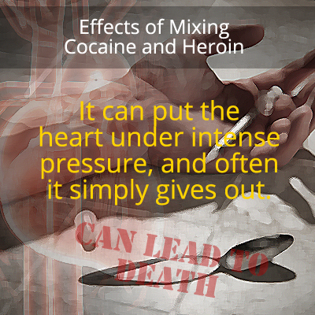

Speedballs are Dangerous

Slide 34
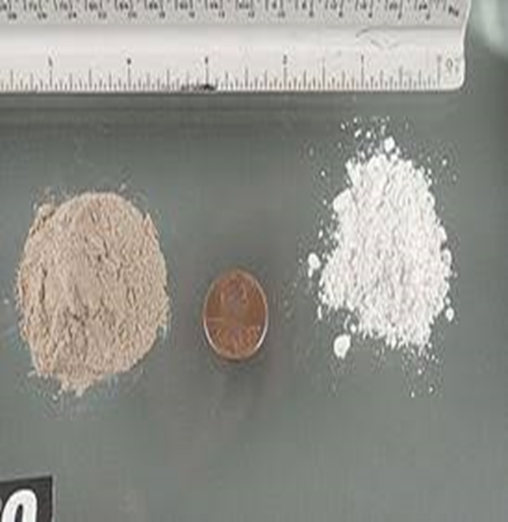
Super Speedball Effect
[Quintuple Depressant / Double Stimulant]

Slide 35
What effects do adulterants have on Naloxone, an opioid antagonist designed to rapidly reverse opioid overdose?
Naloxone only partially reverses the toxic effects of Tramadol overdose and may increase the risk of seizures.*
Naloxone will not reverse overdose resulting from non-opioid drugs, like benzodiazepines (e.g., alprazolam).**
The effects of multiple toxic adulterants, controlled drugs, and impurities from the heroin manufacturing process in individual drug samples on Naloxone are unknown, as are the synergistic and poisonous effects of these drug combinations on the user.
____________________________
*Rossi, S, ed. (2013). Australian Medicines Handbook (2013 ed.). Adelaide: The Australian Medicines Handbook Unit Trust. ISBN 978-0-9805790-9-3.
**Bureau of Justice Assistance. Law Enforcement Naloxone Toolkit. BJA National Training and Technical Assistance Center.

Slide 36
What effect does metamizole/dipyrone have on Naloxone, an opioid antagonist designed to rapidly reverse opioid overdose?
One study found that naloxone was unable to reverse the effect of metamizole/dipyrone alone or in combination with morphine.*
Another study found that a dose of naloxone that is completely effective to block morphine is only partially effective in blocking the supra-additive effects of morphine plus dipyrone.**
To almost abolish the potentiated effect produced by this combination, it is necessary to administer higher naloxone doses.**
____________________________
*Taylor J, et al. (1998). Metamizole potentiates morphine effects on visceral pain and evoked c-Fos immunoreactivity in spinal cord. Eur. J. Pharmacol. 351, 39-47.
**Hernandez-Delgadillo G & Cruz S. (2006). Endogenous opioids are involved in morphine and dipyrone analgesic potentiation in the tail flick test in rats. Eur. J. of Pharmacol. 546, 54-59.

Slide 37
What effect does Levamisole have on Naloxone, an opioid antagonist designed to rapidly reverse opioid overdose?
A Colombo Plan-funded study by the research institute Cinvestav (UNAM – Mexico) reported “Levamisole significantly potentiates the lethal effects of heroin.”
Potentiation for lethality can be prevented by “a dose of Naloxone higher than that needed to antagonize heroin’s effect.”
Alternatively, potentiation can be prevented by administration of two antagonists: Naloxone (NAL) and Mecamylamine (MEC)

Slide 38
The worldwide adulterants include, but are not limited to, banned pharmaceuticals, veterinary products, analgesic pain relievers, sedatives, antihistamines, opioid pain medications, muscle relaxants, antiarrhythmics, and impurities from the heroin manufacturing process.
These compounds have been associated with severe health effects, including decreased production of red and white blood cells due to bone marrow damage, multifocal inflammatory leukoencephalopathy, hemolytic uremic syndrome, renal failure, multiple malignancies, and life-threatening cardiac arrhythmias.*
Variation in the substances used to adulterate street drugs and their concentrations contributes to the unpredictability of the drug’s effects, and the potential for unknown, unexpected, and potentially life-threatening effects.**
____________________________________________________
*Mark Gold. Deadly Adulterants: New Dangers of Illicit Drugs. The Sober World Magazine – July 2017.
*Phillips et al. Cardiac complications of unwitting co-injection of quinine/quinidine with heroin in an intravenous drug user. J Gen Intern Med 27(12): 1722-5.
**Cole et al. Adulterants in illicit drugs: a review of empirical evidence. Drug Testing Analysis 2011, 3, 89 – 96.

Slide 39
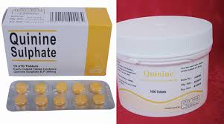
Quinine
Quinine is a medication used to treat malaria and is used to cut heroin
Quinine has been related to cardiovascular toxicity including abnormal heart rhythms and hemolysis (reduction of red blood cells)*
Quinine can cause prolongation of the QT interval, which can lead to a life-threatening cardiac arrhythmia called Torsades des Pointes (TdP)**
__________________
* Grewal RS. The role of quinine in haemolysis. Br J Pharmacol Chemother. 1958 Jun;13(2):175-77.
* Bodenhamer JE & Smilkstein MJ. Delayed cardiotoxicity following quinine overdose: A case report. J Emerg Med. May-Jun 1993;11(3):279-85.
** Phillips et al. Cardiac complications of unwitting co-injection of quinine/quinidine with heroin in an intravenous drug user. J Gen Intern Med 27(12): 1722-5.

Slide 40
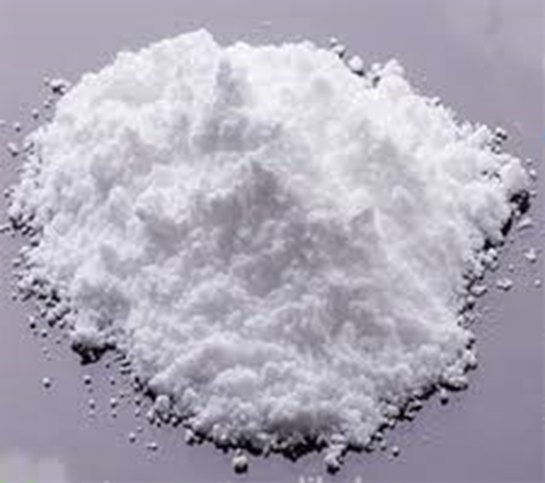
Levamisole is Toxic
Withdrawn from the Canadian (2003) and USA (1999) markets due to toxicity
Results in a decrease of white blood cells that can lower immunity and increase opportunist infections (e.g., CV-19)
Associated with inflammation of blood vessels that can cause severe skin necrosis
Known to provoke hypersensitivity reactions
Chronic exposure to levamisole-contaminated cocaine is associated with broad cognitive and neuroanatomical impairments
Levamisole is also linked to neurotoxic effects with regular use

Slide 41
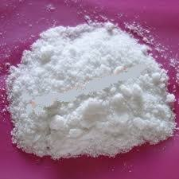
Phenacetin
Phenacetin induces hemolytic anemia, a disorder in which red blood cells are destroyed prematurely, affecting oxygen transfer*
Respiratory depression & cardiac arrest may ensue from lack of oxygen
The chronic use of phenacetin is associated with nephrotoxicity and analgesic nephropathy (kidney damage)**
__________________
*Millar J, et al, Phenacetin-induced hemolytic anemia. Can Med Assoc J (1972) Apr 8; 106(7): 770–775
** C. Cole, Liverpool John Moores University, Centre for Public Health, CUT: A Guide to Adulterants, Bulking Agents and Other Contaminants Found in Illicit Drugs, Centre for Public Health, Faculty of Health and Applied Social Sciences, Liverpool John Moores University, Liverpool, 2010

Slide 42
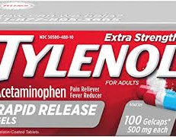
Acetaminophen
Acetaminophen is an over-the-counter pain relief medication responsible at high chronic doses for liver damage
When mixed with heroin, it can dramatically depress heart rate and breathing
When cut into cocaine, it can increase hepatoxicity (liver damage)

Slide 43
Acetaminophen Risks
Cases of severe liver damage have occurred in patients who:
took more than the prescribed dose in a 24-hour period (i.e., 3 grams or 3,000 mg);
took more than one acetaminophen-containing product at the same time; or
drank alcohol while taking the product (risk of kidney disease also).
____________________________________________
FDA recommended dose – 325 mg/tablet
Increased liver damage used in conjunction with cocaine

Slide 44

Cocaethylene Risks
Cocaethylene is the byproduct of concurrent consumption of alcohol and cocaine as metabolized by the liver.
In most users, cocaethylene produces euphoria and has a longer duration of action than cocaine.
Some studies suggest that consuming alcohol in combination with cocaine may be more cardiotoxic than cocaine* and "it also carries an 18 to 25-fold increase over cocaine alone in risk of immediate death".**
______________________________________
*Wilson, L.D. et al. (2001). Cocaine, ethanol, and cocaethylene cardiotoxity in an animal model of cocaine and ethanol abuse. Academic Emergency Medicine, 8 (3): 211–22.
**Andrews P (1997). Cocaethylene toxicity. Journal of Addictive Diseases, 16 (3): 75–84.

Slide 45
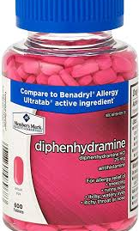
Diphenhydramine
When mixed with heroin, it can dramatically depress heart rate and breathing
Can cause prolongation of the QT interval, which can lead to a life-threatening cardiac arrhythmia called Torsades des Pointes (TdP)*
The combination of cocaine and H1-antihistamines like diphenhydramine can be synergistic in terms of super-additive reinforcing effects with regard to potency**
__________________
*Husain Z, Hussain K, Nair R, Steinman R. Diphenhydramine induced QT prolongation and torsade de pointes: an uncommon effect of a common drug. Cardiol J 2010;17(5):509–11
**Wang Z, Woolverton WL (2007) Self-administration of cocaine-antihistamine combinations: super-additive reinforcing effects. Eur J Pharmacol 557: 159–160.

Slide 46
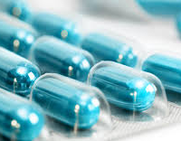
Diltiazem
Diltiazem is a medication belonging to a class of calcium-channel blockers and it is commonly used to treat high blood pressure
Double-depressant effect with heroin
As an adulterant, it can cause severe adverse cardiovascular reactions, including angina, bradycardia, hypotension, and arrhythmia*
Potentiates cocaine toxicity & toxic cardiac effects (possibly due to hypoxemia)*
__________________
*Brunt T. Monitoring illicit psychostimulants and related health issues. Oisterwijk, The Netherlands: BOXPress, 2012.

Slide 47
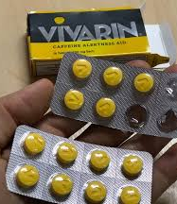
Caffeine
The mixture of caffeine and cocaine enhances cocaine’s psychostimulant effects and produces additive effects between the two drugs*
Potentiates toxic effects of cocaine**
With heroin, can cause abnormal heart rhythm & respiratory distress
Caffeine is also addictive and chronic use can lead to cardiotoxicity, changes in heart rate, and cardiac injury ***
May increase long-term neurotoxicity (adverse effect on CNS) induced by MDMA****
______________
*Duffau BE, Rojas SA, Ayala SA. A decade of analysis of illicit street cocaine in Chile. J. of Pharmacy & Pharmacognosy Research, 2020, 8(2), 146-154.
**Derlet RW, Tseng JC, Albertson TE. Potentiation of cocaine and d-amphetamine toxicity with caffeine. Am J Emerg Med 1992;10(3):211-216
*** Mehta MC, Jain AC, Billie M (2004) Effects of cocaine and caffeine alone and in combination on cardiovascular performance: An experimental hemodynamic and coronary flow reserve study in a canine model. Int J Cardiol 97(2): 225–232.
**** Vanattou-Saifoudine et al, Caffeine provokes adverse interactions with 3,4-methyledioxy-methamphetamine and related psychostimulants: mechanisms and mediators. British J of Pharmacology, 167, 946-959.

Slide 48
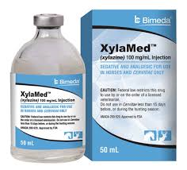
Xylazine
Xylazine is commonly used as an adulterant in heroin; has a synergistic effect with heroin*
It is only approved as an animal tranquilizer and used as a sedative, analgesic and muscle relaxant*
The most common side effects in humans associated with xylazine administration include bradycardia, respiratory depression, hypotension, and other changes in cardiac output**
__________________
*Ruiz-Colón K, Chavez-Arias C, Díaz-Alcalá JE, Martínez MA (July 2014). "Xylazine intoxication in humans and its importance as an emerging adulterant in abused drugs: A comprehensive review of the literature". Forensic Science International. 240: 1–8.
**Reyes JC, Negrón JL, Colón HM, Padilla AM, Millán MY, Matos TD, Robles RR (June 2012).”The emerging of xylazine as a new drug of abuse and its health consequences among drug users in Puerto Rico”. Journal of Urban Health. 89 (3): 519–26.

Slide 49
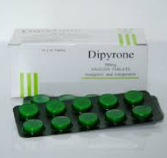
Metamizole/Dipyrone
Metamizole is a pain reliever, fever reducer, and spasm reliever
Side effect of agranulocytosis (a dangerously suppressed immune system that places user at very high risk for serious infections due to a severely lowered white blood cell count)*
Combining dipyrone with opiates like heroin results in analgesic potentiation and produces supra-additive effects**
__________________
* Brack A, Rittner HL, Schäfer M (March 2004). "Nichtopioidanalgetika zur perioperativen Schmerztherapie" [Non-opioid analgesics for perioperative pain therapy. Risks and rational basis for use]. Der Anaesthesist (in German). 53 (3): 263–80.
** Hernandez-Delgadillo G & Cruz S. (2004). Dipyrone potentiates morphine-induced antinociception in dipyrone-treated and morphine-tolerant rats. Eur. J. of Pharmacol. 502, 67-73.

Slide 50
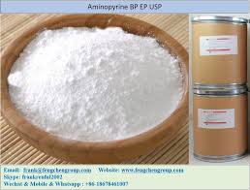
Aminopyrine
Banned analgesic & anti-inflammatory
Dramatic decrease in white blood cells, leading to increased susceptibility to infection, suppressing immune function and the body’s ability to fight off even minor infections*
People who smoke coca paste or crack cocaine contaminated by aminopyrine can experience overwhelming, rapidly-developing, life threatening infections* (e.g., CV-19)
________________
*Gilman AG, et al (eds.). Goodman and Gilman’s The Pharmacological Basis of Therapeutics. 8th ed. New York, NY. Pergamon Press, 1990., p. 655.

Slide 51
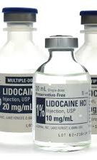
Lidocaine
Lidocaine, a common local anesthetic, is often used as a cocaine adulterant
Cardiovascular problems like myocardial depression, hypotension, bradycardia, and arrhythmias have been reported*
Additional side effects of lidocaine also include respiratory depression and hypertension,** (CV-19 risk factors)
__________________
*T. Brunt, Monitoring Illicit Psychostimulants and Related Health Issues, BOXPress, 2012.
**Pawlik E, Mahler H, Hartung B, Pl€asser G, Daldrup T. Drug-related death: adulterants from cocaine preparations in lung tissue and blood. Forensic Sci Int 2015;249:294–303.

Slide 52
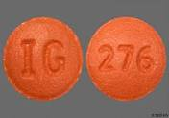
Hydroxyzine
Hydroxyzine is used to treat itching caused by allergies. It may also be used short-term to treat anxiety
Potentiates the side effects of cocaine*
As an adulterant, associated with cardiac arrhythmias**,shortness of breath, hypotension, and tachycardia ***
_____________
*Kudlacek, O et al. (2017) Cocaine adulterants and effects on monamine transporters. The neuroscience of cocaine. Elsevier Inc.
**Knuth, M et al. (2018) Analysis of cocaine adulterants in human brain cases of drug-related health. Forensic Science International, 285, 86-92.
***Phillips et al. Cardiac complications of unwitting co-injection of quinine/quinidine with heroin in an intravenous drug user. J Gen Intern Med 27(12): 1722-5.

Slide 53
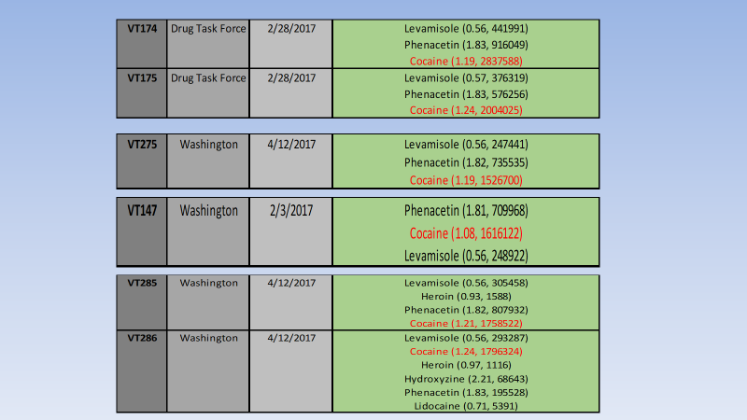
Increased Phenacetin/Levamisole Combos Seen in the U.S.

Slide 54
Cardiovascular Threat of Phenacetin/Levamisole Combinations
Phenacetin
Levamisole
Phenacetin induces hemolytic anemia, a disorder in which red blood cells are destroyed prematurely, affecting oxygen transfer*
_________________
*Millar J, et al, Phenacetin-induced hemolytic anemia. Can Med Assoc J (1972) Apr 8; 106(7): 770–775
Humans metabolize levamisole to aminorex*
Aminorex ingestion responsible for Idiopathic Pulmonary Hypertension (IPH)**
  IPH: arteries in the lungs become blocked or narrowed, making it harder for the heart to pump blood through them
__________________________
*Hofmaier T, et al, Aminorex, a metabolite of the
cocaine adulterant levamisole, exerts amphetamine
like actions at monoamine transporters. Neurochem
Int (2014) Jul; 73(100): 32-41
**Karch SB, et al, Aminorex poisoning in cocaine
abusers. Int J Cardiol (2011);158(3):344-6

Slide 55
Many drug users reside in geographical areas characterized by:
social deprivation
high population densities
poor-quality housing
homelessness
reduced access to healthcare
Putting them at high-risk for CV-19

Slide 56
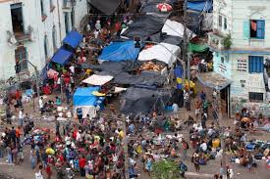
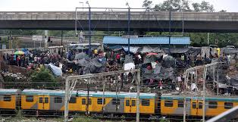
Open Air Drug Markets: Overseas
Sao Paulo: Crackolandia
Durban: Whoonga Park

Slide 57
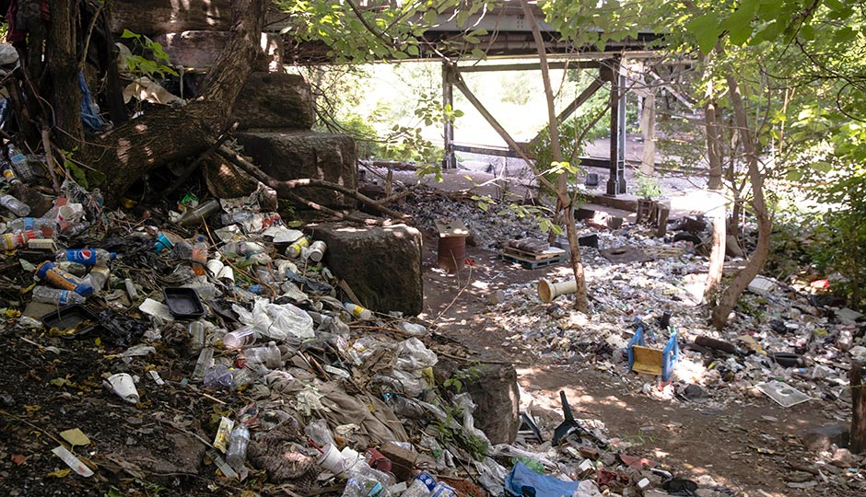
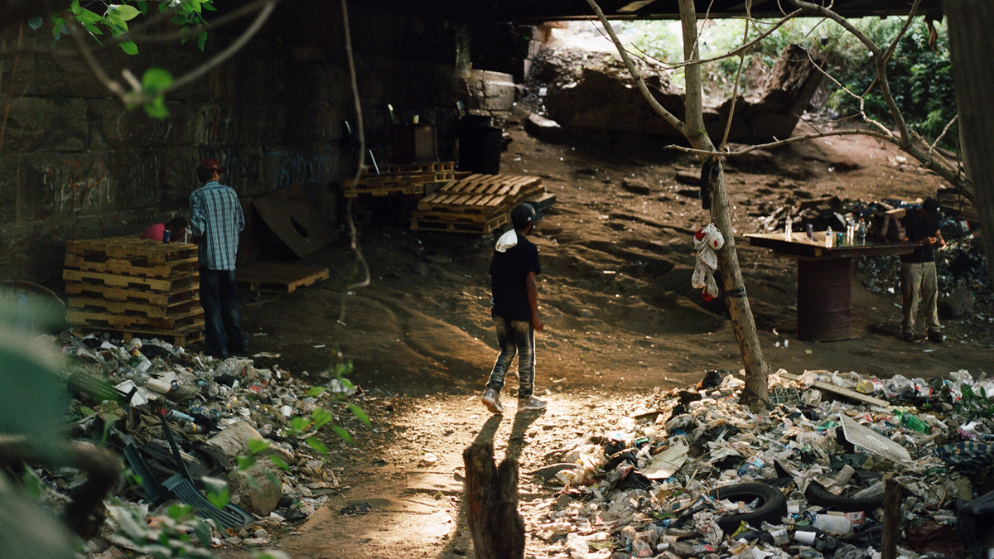
Open Air Drug Markets: United States (Philadelphia)

Slide 58
COVID-19, Drug Supply, and Overdose
The COVID-19 Pandemic is Disrupting the Illegal Drug Trade
Overdose Deaths on the Rise Again Amid COVID-19
Per a UNODC research brief: Many countries across all regions have reported an overall shortage of numerous types of drugs at the retail level, as well as increases in prices, reductions in purity and that drug users have consequently been switching substance.
OD submissions to ONDCP’s Overdose Data Mapping Application Program from Jan – Apr 2020 are up 16.6% vs the same period in 2019
“Overdoses go up, paradoxically, as supply goes down,” according to Daniel Ciccarone, a professor at the UCSF School of Medicine. During shortfalls, people will substitute drugs they’re less familiar with, or change their habits, making dosing less reliable and potentially causing a spike in overdoses.
Traffickers increase adulterants when supply goes down

Slide 59
Public Health Contributions: Flow Diagrams for Diagnosis & Treatment

Slide 60
Exams and Tests
Complete blood count (red & white blood cells)
CT scan of the kidney
Intravenous pyelogram (IVP): X-Ray of the kidney and bladder
Toxicology screen
Urinalysis
Kidney ultrasound
Cardiovascular & liver function tests
Chronic respiratory disease (e.g., COPD)

