Slide 1

ISAM COVID-19
First Webinar
23 March 2020

Slide 2
Few Housekeeping Notes:
Video-recording
The webinar will be entirely video-recorded and shared with the ISAM network members subsequently, so if you wish not to be in the recorded video, you may keep your webcam off during the webinar.
Q&A
We have dedicated time at the end of the webinar to group discussion and Q&A. We kindly advise you to raise your hand if you have any questions or comments. We highly encourage you to actively engage in the discussion and present your ideas on how you can contribute to ISAM.
Mic and Video
Please keep your mic mute during the entire meeting unless you want to make a question or comment. We recommend keeping your camera on during the entire session.
Chat space
Please use the chat option in the webinar platform during the entire session to post your questions and comments.

Slide 3


ISAM 1st Webinar on COVID19 and SUD: 23rd March 2020
Mission: Global excellence in addiction medicine
Vision: A strong and forward looking society in addiction medicine that focuses on providing educational support for its members and affiliate organisations to enhance delivery of high-quality patient centred care all over the world
Values: Our values underpin everything we do at ISAM:
Innovation
Respect
Excellence
Collaboration
Learning
Diversity

Slide 4
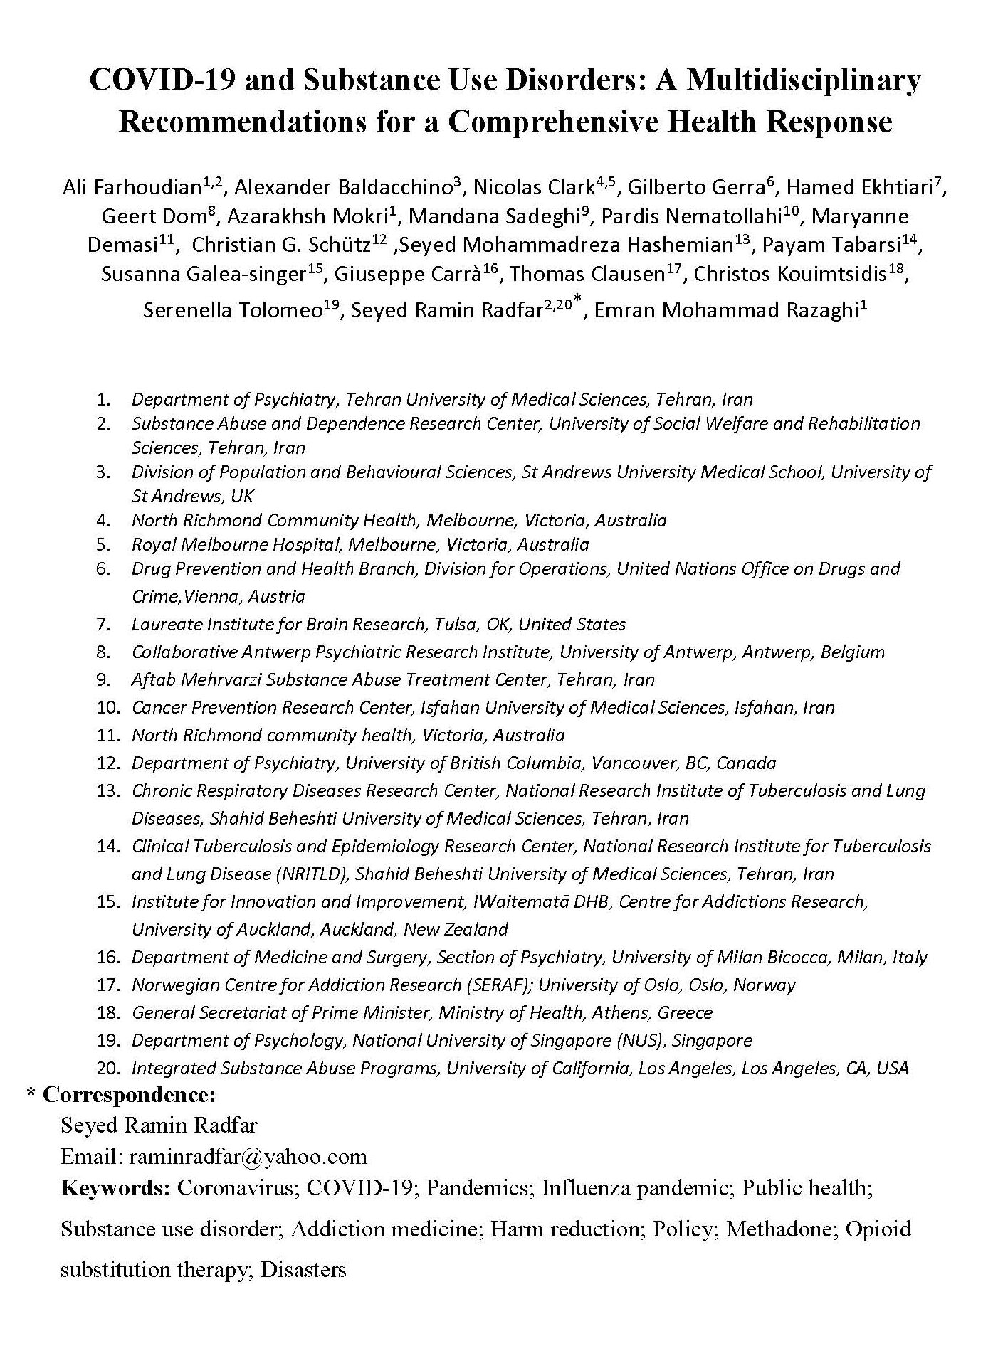
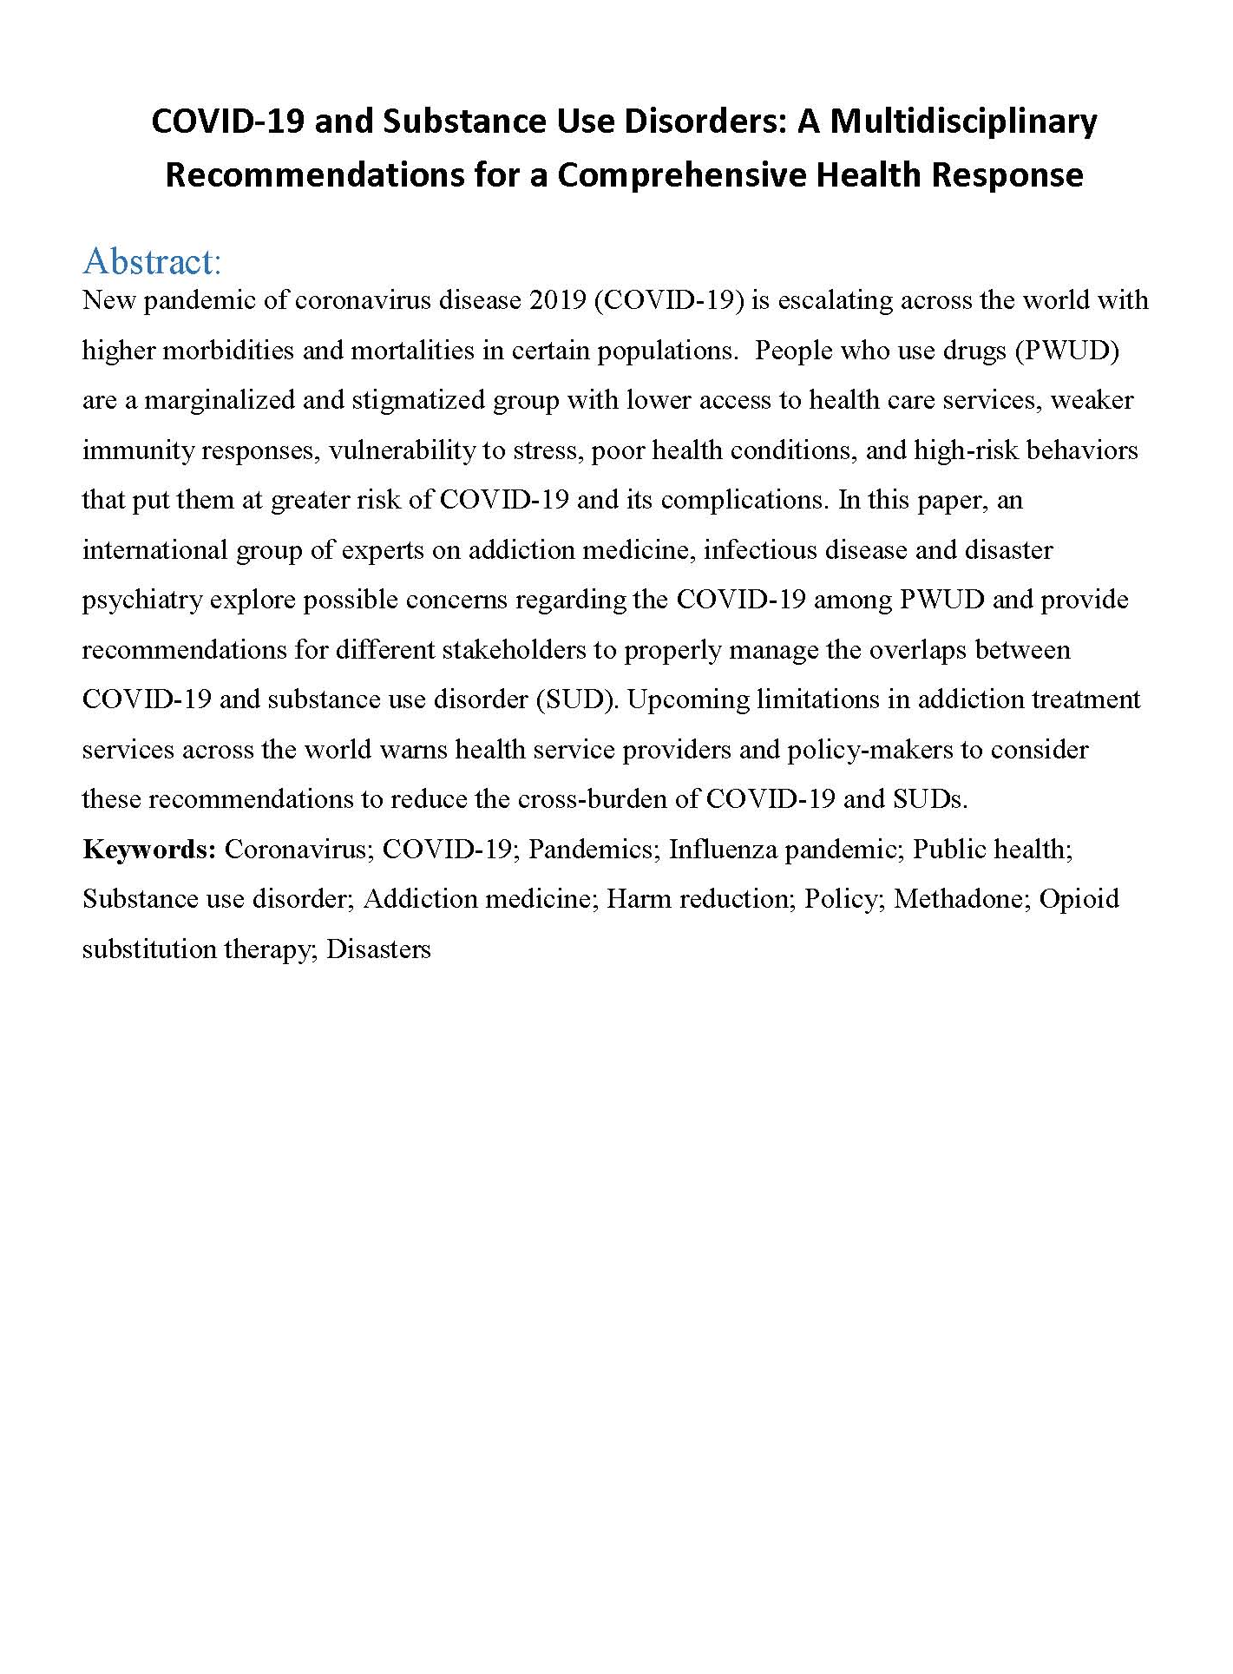

Slide 5
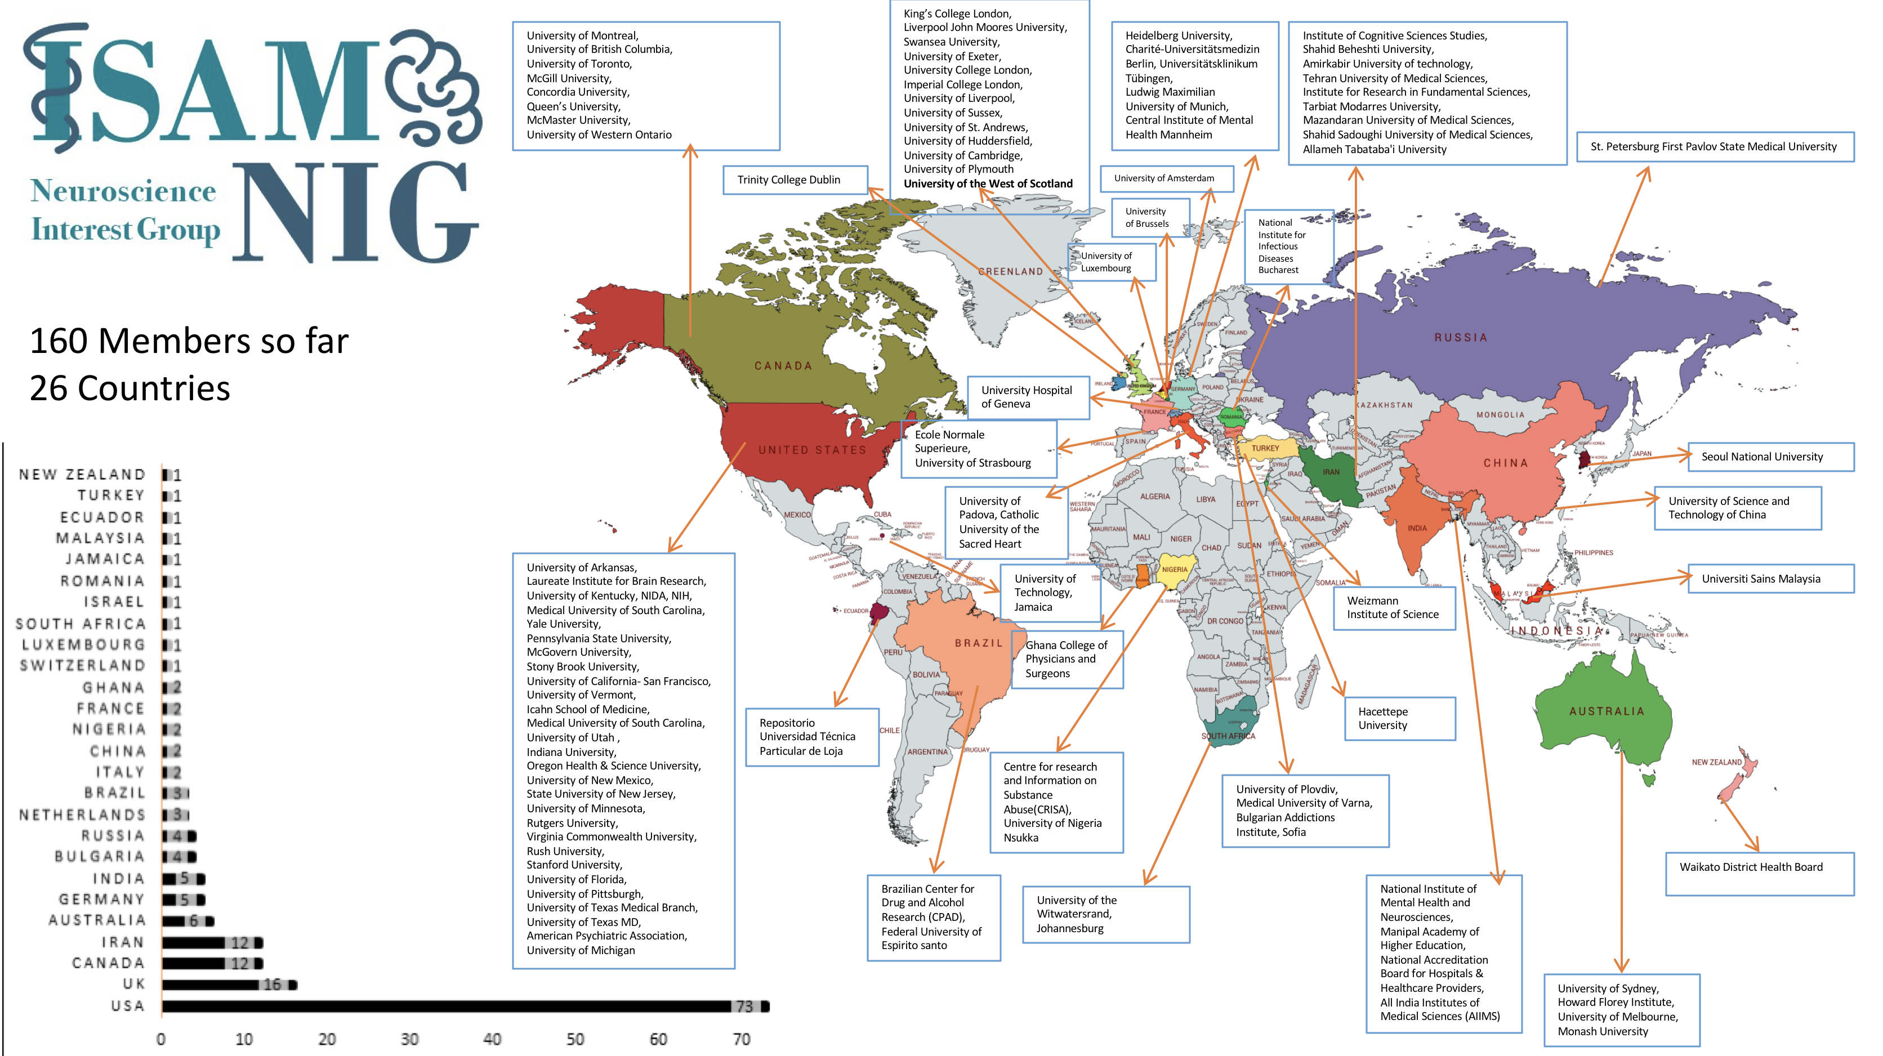
ISAM Policy and Practice Interest Group (ISAM PPIG)
COVID-19 is a global problem that needs international solutions
Three major steps to have a global map of policies/practices
Representatives from different countries/regions/cities
A checklist of potential concerns/policies/practices on SUD and COVID19
Regular updates from representatives with filling the checklist
Short Communications Outputs
ISAM COVID-19 Repository
Please be in touch with
ISAM.NIG@gmail.com

Slide 6
COVID-19: Key Ideas from Disaster Psychiatry
Craig L. Katz, M.D.
Clinical Professor of Psychiatry, Medical Education, System Design and Global Health
Icahn School of Medicine at Mount Sinai
New York, New York, USA
March 23, 2020

Slide 7
Psychological First Aid
Provide for basic needs
Protect from further harm
Reduce agitation & arousal
Support those in most distress
Keep families together and provide social support
Provide information, foster communication & education
Orient to available services
Use effective risk communication techniques
NIMH, 2002
Notes:
7
The key psychological intervention that you and your support staff can perform during the impact phase is “psychological first aid.” The National Institutes of Mental Health counts among the key components of early psychological intervention attention to basic needs and provision of “psychological first aid.”
Basic needs include providing pain relief, medical care, food, shelter, safety, and security. Orientation of survivors to the availability of services/support and encouraging communication of patients with family and friends is also important. Psychological first aid encompasses further steps, including: (1) protect survivors from further harm; (2) reduce agitation/arousal; (3) mobilize support for those people in the most distress; (4) keep families together, where possible, and facilitate reunions with loved ones; (5) provide information and foster communication and education; and (6) use effective risk communication techniques.
Most of these approaches are basic enough to be readily shared among professional and para-professional emergency department staff in the event of a catastrophic event. Mental health professionals are not specifically needed for these efforts, although, when available, they may bring specific skills to bear on these interventions.
We will try to elaborate on the various elements of psychological first aid in the next few slides as well as in a case discussion during our last hour.

Slide 8
Risk Factors for Post-Disaster Psychopathology
Dose of trauma, level of exposure to the event
Prior exposure to trauma such as disaster
Prior psychiatric history
Problems of living prior to the disaster/low socioeconomic status
Lack of perceived or actual social supports after the event
Presence of “secondary stresses”
Female
Middle age
Ethnic minority
(Norris et al., 2002)
(Katz et al, 2002)
Notes:
Knowledge of risk factors of post-disaster psychiatric disorders like Post-Traumatic Stress Disorder (PTSD) and Major Depression will help to identify who among disaster survivors are at highest risk for the development, or worsening, of such disorders, in contrast to those who may suffer from symptoms of acute but time-limited nature. That is, the more such risk factors that a person in the acute phase has, the more likely the psychological issues they are having will persist into the post-acute phase, if not worsen, and become psychiatric illness.
Research suggests that a number of factors increase someone’s risk for developing long-term psychiatric problems after a disaster: “dose” of their exposure to the event, where this includes injury, property loss, and loss of a loved one or friend; existence of prior psychiatric history, especially one including trauma/disaster; being from a low socio-economic class; lack of perceived or actual social support after the event; presence of additional, so-called “secondary stresses” post-disaster (e.g., financial stresses because of a disaster associated economic downturn) ; female gender; middle age (because this age group may be more likely to give rather than receive support); and being from an ethnic minority. You have a handout detailing this list.

Slide 9
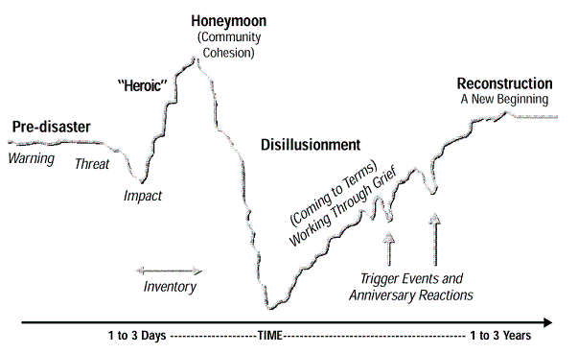
Psychological Stages of Disaster
Notes:
This depicts the customary ebbs and flows of psychological responses to disaster that seem to hold up across disaster types and locations. After the initial shock of the impact, there is a burst of heroism and energy that leads to great community cohesion and togetherness. Next follows a downturn in optimism and energy as a community comes to terms with the extent of the losses and damage and the daunting length of the road to recovery. Eventually, the community bounces back and reaches a new “normal.”

Slide 10
“It’s a marathon, not a sprint.” US Agency For International Development Office Sri Lanka, January 2005
Notes:
10

Slide 11
The ideal credo of the disaster psychiatrist…
Be a person first, a physician second, and a psychiatrist third.

Slide 12
Harm Reduction Panel 8:15-8:35 Brian Conway (Canada), Marica Ferri (EMCDDA), Ryan McNeil (US), Ramin Radfar (Iran)

Slide 13
Harm Reduction & the COVID-19 Pandemic Brian Conway MD, FRCPC
Addiction Care
NSP Programs – Safe dispensing & COVID screening
Supervised Consumption Sites - Safety/Social Distancing & COVID screening
iOAT interventions – Transition to oral medications
Long-acting opiates – Pharmacist safety (no “sprinkles”, more carries), long term prescriptions
WATCH FOR OVERDOSE EVENTS
COVID Care
Maximal testing within local guidelines (early identification of transmission networks)
Aggressive epidemic investigation protocol
Innovative approaches needed to social distancing
Medical Care
Psychiatric conditions
Medical conditions: bacterial infections, HCV, HIV

Slide 14
COVID-19 issues for SUD
Marica Ferri
23 March 2020
ISAM webinar

Slide 15
Europe is the new epicenter of Coronavirus WHO, 13-3-2020
European Center for Disease Control (20-3-2020) Europe:
Italy (41 035),
Spain (17 147),
Germany (14 138),
France (10 995),
Switzerland (3 888),
United Kingdom (3 277),
Netherlands (2 460),
Austria (2 196),
Belgium (1 795),
Norway (1 552),
Sweden (1 423),
Denmark (1 151),
Portugal (785),
Notes:
Czech Republic (694), Ireland (557), Greece (464), Finland (400), Turkey (359), Poland (355), Luxembourg (345), Iceland (330), Slovenia (319), Romania (277), Estonia (267), Russia (199), San Marino (126), Serbia (126), Slovakia (123), Armenia (122), Bulgaria (105), Croatia (104), Latvia (86), Hungary (85), Andorra (75), Faroe Islands (72), Albania (70), Cyprus (58), Belarus (57), Malta (53), Moldova (49), Lithuania (48), North Macedonia (48), Azerbaijan (44), Bosnia and Herzegovina (44), Georgia (40), Ukraine (26), Liechtenstein (25), Kosovo** (21), Holy See (13), Montenegro (13), Monaco (11), Gibraltar (10), Jersey (5) and Guernsey (1).

Slide 16
Covid-19 in people with SUD
The Coronavirus is now spreading in most populations worldwide. Persons with SUD, both in and out of treatment, must be considered as extra vulnerable groups in this context.
(Information from the Norwegian Centre for Addiction Research (SERAF))
Notes:
Czech Republic (694), Ireland (557), Greece (464), Finland (400), Turkey (359), Poland (355), Luxembourg (345), Iceland (330), Slovenia (319), Romania (277), Estonia (267), Russia (199), San Marino (126), Serbia (126), Slovakia (123), Armenia (122), Bulgaria (105), Croatia (104), Latvia (86), Hungary (85), Andorra (75), Faroe Islands (72), Albania (70), Cyprus (58), Belarus (57), Malta (53), Moldova (49), Lithuania (48), North Macedonia (48), Azerbaijan (44), Bosnia and Herzegovina (44), Georgia (40), Ukraine (26), Liechtenstein (25), Kosovo** (21), Holy See (13), Montenegro (13), Monaco (11), Gibraltar (10), Jersey (5) and Guernsey (1).

Slide 17
Covid-19 concerns of frontline professional*
Lockdown policies and homelessness
Lockdown policies and overdose
Infections among professionals
Access to services by PWUD
Increase take home Methadone
Prisoners at higher risk
Therapeutic communities and transmission risk
Online counselling and therapies
Reduce time in ambulatory
*Italian Federation of Public Drug Services Professionals
*Italian Society for Addiction research

Slide 18
EMCDDA
16 March 2020 teleworking;
18 March Taskforce with external network
(ISAM, EUFAS, National professional association members)
20 March Web publication with a statement and links to many European Harm Reduction Initiatives
(add image as soon as published)

Slide 19
COVID-19 Harm Reduction Guidance
Ryan McNeil, PhD – ryan.mcneil@yale.edu @rs_mcneil
Assistant Professor (Internal Medicine), Yale School of Medicine
Director of Harm Reduction Research (Program in Addiction Medicine), Yale School of Medicine
BE PREPARED FOR DISRUPTIONS TO HARM REDUCTION PROGRAMS & INVOLUNTARY WITHDRAWAL: Stock up on drugs & harm reduction supplies. Have contact information for multiple dealers. Inquire about starting methadone or buprenorphine. Have necessary medications, food, and drinks on hand to help detox.
AVOID INJECTING ALONE: (1) Stay at least six feet away from other people, cough or sneeze into your arm, avoid touching your face, wash your hands for 20 seconds with soap and water. (2) Call someone, preferably nearby, and ask them to stay on the line while injecting so they can act or call 9-11 if necessary.
DO NOT SHARE DRUGS OR SUPPLIES: This includes injecting equipment, pipes, vapes, straws, bongs, vapes, joints, cigarettes, and drinks. Wipe down your drug packages with an alcohol-based cleaner or wipe. Wash your 20 seconds with soap and water or use an alcohol-based cleaner or wipe.
IF SYRINGES ARE NO LONGER SAFE: (1) Snort it; (2) Plug / Booty Bump it; (3) Swallow it; (4) Smoke it.
Resources produced by the Yale Program in Addiction Medicine:
1. COVID-19 Guidance for People who use Substances:
http://shorturl.at/dCMV9
2. COVID-19 Guidance for Patients Engaged in Substances Use Treatment:
http://shorturl.at/fnUV3
3. COVID-19 Guidance for Clinicians & Opioid Treatment Programs:
http://shorturl.at/qryzD

Slide 20
COVID-19 as a Threat for Harm Reduction Services Harm Reduction Panel Ramin Radfar MD, MPH, NIDA/IAS fellowship
Safety of service providers in Harm reduction services:
Outreach workers possibly are at high risk of transmission:
Usually are not professionally trained health care providers
They are in crowded areas such as shooting galleries, shelters, etc.
They provide services marginalized and stigmatized groups who may not be able to follow healthy behaviors rules that are needed in such situation.
Their employers usually are not typical health care providers as a regular part of health system and are not trained or ready for such critical situations .They may not be able to provide PPE for the outreach workers.
Usually are ex-drug users, stressful situations make ex-drug users prone to relapse.
Decrease in coverage of services for final stakeholders i.e. PWID
Possible shift of resources, donations, and supports to the COVID-19 services.
Phobia of outreach workers and refusing to provide services.
Harder access to already hard –to-reach populations due to quarantine or restriction of the movements.
Stressful situations can increase risky behaviors among PWUD and shifts to higher risky behaviors in which more harm reduction services are needed! As a results then we have:
Higher gaps between services and needs of the stakeholders

Slide 21
Opioid Substitution Treatment (OST) and Other Addiction Pharmacotherapies Panel: 8:35-8:55 Ali Farhoudian (Iran), Alex Baldacchino (UK), Nico Clark (Australia)

Slide 22

OST in COVID-19 Pandemic
Ali Farhoudian, M.D.

Slide 23
Provision Methadone and Buprenorphine
The goals are to restrict any personal contact and decrease patients’ commute to the clinic or the pharmacy.
A more flexible OST program should be taken into account in this situation.
Delivery systems should be trained to handle the process of tablet delivery with minimum hand contacts with tablets.
“Sprinkling” is not recommended. It may increase patients’ amount of time at the pharmacy or the clinic.
For newcomers, buprenorphine seems to be preferred substitution treatment choice in comparison with methadone.

Slide 24
Different stages of maintenance treatment
Early Stabilization
Relaxing the protocol is not recommended
Avoid unnecessary visits
Late Stabilization
Differentiation between some withdrawal signs and symptoms with signs and symptoms of virus infection.
Maintenance
Induction of hepatic metabolic by antiretroviral therapy (ART)
Termination
Is not recommended in the situation of catastrophe.

Slide 25
1st ISAM COVID19 and SUD webinar: Alex Baldachino OST and other pharmacological interventions (UK). Provision of medication
Unintended consequences:
Potential medication shortage
Community Pharmacy disruption to dispensing and COP arrangements
Disruption of Injecting Equipment Provision
Disruption of Take Home Naloxone
Prison libs
Alcohol and multiple morbidities?
Good practice:
Essential core services
Voluntary organisation staff delivering methadone and other pharmacologies to patients’ homes

Slide 26
Framework for preparing a COVID plan for any health service
Nicolas Clark
Phase | No local spread | Minimal local spread | Widespread local spread | Recovery
Case identification | -Case identification in travellers and contacts of known infected patients | -Severe pneumonia OR fever / respiratory symptoms in combination with epidemiological criteria | -People with fever or respiratory symptoms | -Widespread testing to find remaining cases
Protection of transmission to / between staff | -N95 in confirmed cases -Handwashing -Cleaning -Self isolation when possible infection -Train staff in hygiene / PPE | -N95 mask for confirmed cases -Surgical mask for intermediate risk (not aerosolised) -Handwashing -More frequent cleaning -Self isolation when possible infection -Divide staff into teams which do not mix with other teams | -N95 for confirmed and likely cases -Surgical mask for all non immune -Handwashing Intense cleaning -Self isolation when possible infection -Divide staff into teams which do not mix with other teams -Recovered staff to take risky roles | -N95 for confirmed cases and suspected cases -Surgical mask for non-immune -Handwashing -Cleaning -Self isolation when possible infection
Protection of transmission in the population | -Handwashing -Social distancing -Self isolation when possible infection | -Handwashing -Physical (or Social) distancing -Self isolation when possible infection | -Handwashing -Social distancing -Self isolation when possible infection | -Handwashing -Self isolation when possible infection
Provision of essential services | -Identification of essential services | -Plan to keep essential services running -Screen all patients and refer for testing -Develop task-shifting protocols | - screen all patients at entry - have a separate area for treating confirmed and suspected cases

Slide 27
Some specific pharmacotherapy considerations
Facilitating treatment uptake
Streamline process for entry to opioid pharmacotherapy (permits, appointments)
Maintaining current services with less staff
Give longer prescriptions to all patients
More take-home doses
Plan for sick staff
Each staff member should have one or two staff who can fill his/her role
Emergency pharmacotherapy
Teams who can respond urgently if a sole practitioner is sick
Emergency department treatment at hospitals
Specific pharmacotherapy considerations
Consider long acting injectable buprenorphine monthly injections
Consider single high dose buprenorphine (i.e. 32-64-96mg for single dose withdrawal regimen)
Use safe rapid induction, favouring buprenorphine
When take home doses not suitable, consider alternate day buprenorphine dosing

Slide 28
Abstinence and Recovery Based Interventions and Psychosocial Support Panel: 8:55-9:15 Richard Rawson (US), Marc Potenza (ISAM), Gregory Bunt (ISAM)

Slide 29
Behavioral Treatments for Addiction in the COVID-19 Pandemic: Some Considerations
Rick Rawson, Ph.D.
Disclaimer: These are “first draft” ideas and represent the author’s opinion and do not have empirical evidence of support. The resources listed are primarily US-based and in English.

Slide 30
Good Practices in the CV-19 Pandemic
A major component of many/most behavioral treatments is in-person sessions (individual or group) to provide new skills and support, encouragement and empathy.
Current recommendations suggest in-person sessions or group gatherings should be curtailed/eliminated.
Methods to maintain individual and group sessions via virtual communication.
There are numerous on-line platforms for conducting group and individual sessions, including Skype, Zoom, Facebook Chat and others (I am not informed about security/confidentiality of these platforms).
Two-way communication from therapist to individual patients can be done via texting (Google voice can provide a telephone number so the therapist does not have to use personal number.) Also, What’s App and Twitter and other messaging services may be useful.

Slide 31
Good Practices in the CV-19 Pandemic
Considerations for virtual group session management
Before starting a group, the leader should briefly chat individually with each patient individually to ensure they are not intoxicated or hysterical. Patients who are intoxicated or extremely emotional should be “seen” via a virtual individual session as soon as possible.
Allow time for patients to describe their circumstances and concerns. Providing them with an opportunity to be heard is important. However, these discussions need to be managed for duration (3-5 minutes?)in an empathetic manner. Therapist should maintain an empathetic, supportive and encouraging communication style (ie. Motivational Interviewing).
Group leader should manage the session communications, with the primary communication between the therapist and each patient. Comments from other patients can be “allowed” per the discretion of the group leader. Free form, unmanaged communication will be counterproductive and chaotic.
After initial status update by each patient, a theme or session topic is useful

Slide 32
Good Practices in the CV-19 Pandemic
Potentially useful session topics
Daily schedule (can be useful to have some structure to days without work
Avoiding communication with high risk people (eg. drug dealer) places (eg liquor stores)
Exercise. How it can help, different types and formats
Avoiding constant TV or on-line immersion in minute to minute monitoring of the details of the CV-19 pandemic.
Using the “free time” to engage in new or long procrastinated activities. A focus on “reinforcing alternative behaviors” and getting a commitment from participants can be very useful (with follow up queries in future sessions)
Positive self-talk to counter “catastrophizing” or lapsing into hopelessness (and using it as a relapse justification).
Methods of emotional regulation (eg.meditation, mindfulness, yoga, exercise)

Slide 33
Good Practices in the CV-19 Pandemic
On-line addiction resources.
Technology-assisted Care. This site provides a listing and description of 6 of the on-line addiction treatment sites. They include, Therapeutic Education Systems (TES), Computer-based cognitive behavior therapy (CBT for CBT) and others http://sudtech.org/about-tac/
On-line AA meetings http://aa-intergroup.org/directory.php
On-line Smart Recovery meetings. https://www.smartrecovery.org/smart-recovery-toolbox/smart-recovery-online/
There are numerous other websites for addiction recovery that are associated with for-profit treatment centers. Be forewarned

Slide 34
Good Practices in the CV-19 Pandemic
On-line resources for healthy coping skills
Mindfullness Apps “Headspace” and “Calm”- for sleep, meditation and relaxing.; “Mindfulness Coach”- developed by the Department of Veterans affairs to teach veterans, service members and others how to practice mindfulness. It’s a gradual self training program. They also make one specifically for PTSD called PTSD coach.
Yoga Apps. Doyogawithme. https://www.doyogawithme.com/
Exercise Apps: “Map my walk” “My fitness pal”; Many forms of exercise sites on Youtube.
Activities for enjoyment and interaction with family. “Pinterest” “Infoplease”

Slide 35


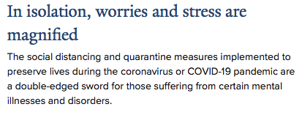



COVID-19 situation is likely increasing stress for many and for this and other reasons may increase engagement in addictive behaviors (https://medicine.yale.edu/news/yale-medicine-magazine/falling-through-the-cracks-in-quarantine/)
ISAM webinar, Potenza, 2020

Slide 36
Yale Program on Addiction Medicine and Division of Substance Abuse Guidance for SUDs in COVID-19
- Topics covered include triggers & relapse, medications and treatment, counseling and meetings, monitoring, smoking and vaping, travel, age and medical conditions, and resources for local and national information
Information at the Yale ADM twitter (@YaleADM) and website: https://medicine.yale.edu/intmed/genmed/addictionmedicine/
Clinician/OTP Guidance: bit.ly/38V98NG or https://drive.google.com/file/d/1ONbz6AFb5KSjrfhSudRb4-9nPZHBh1RT/view
Patient Guidance: bit.ly/2UdAxVY or https://drive.google.com/file/d/1W9mcVKIzaVOeIZfVLxGAsrfO2utaBVNj/view
ISAM webinar, Potenza, 2020

Slide 37
Roll Out of Connections Mobile App
by Addiction Policy Forum and CHESS
In the setting of COVID-19, social distancing measures may impact access to care including social support systems (e.g., through 12-step programs) that help people struggling with addictions
The Addiction Policy Forum has advanced its roll out of an empirically supported Connections Mobile App (A-CHESS – Addiction Comprehensive Health Enhancement Support System) that may assist people to combat addictions during the COVID-19 pandemic
ISAM webinar, Potenza, 2020

Slide 38
Connections Mobile App
The app “supports patients in recovery by offering anonymous, prosocial engagement with others in recovery, connections to their care team, and digital cognitive behavioral therapy (CBT),” among other features.
“Through the Connections App, the Addiction Policy Forum will supply trained counselors with a Telehealth strategy to help individuals with SUD maintain recovery. Training will occur daily from 9:00 AM to 10:00 PM. Both companies [APF and CHESS Health] will collaborate to moderate online discussion groups for individuals to support one another and share recovery strategies in a safe, anonymous setting.”
Over 900 people signed up in first 24 hours of operation
ISAM webinar, Potenza, 2020

Slide 39

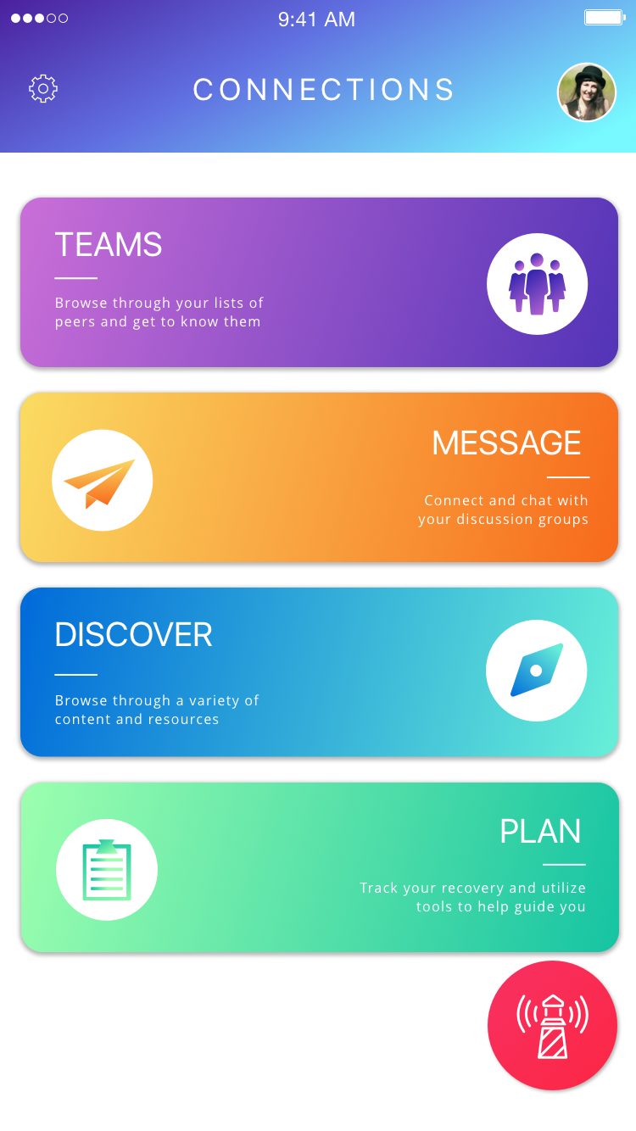
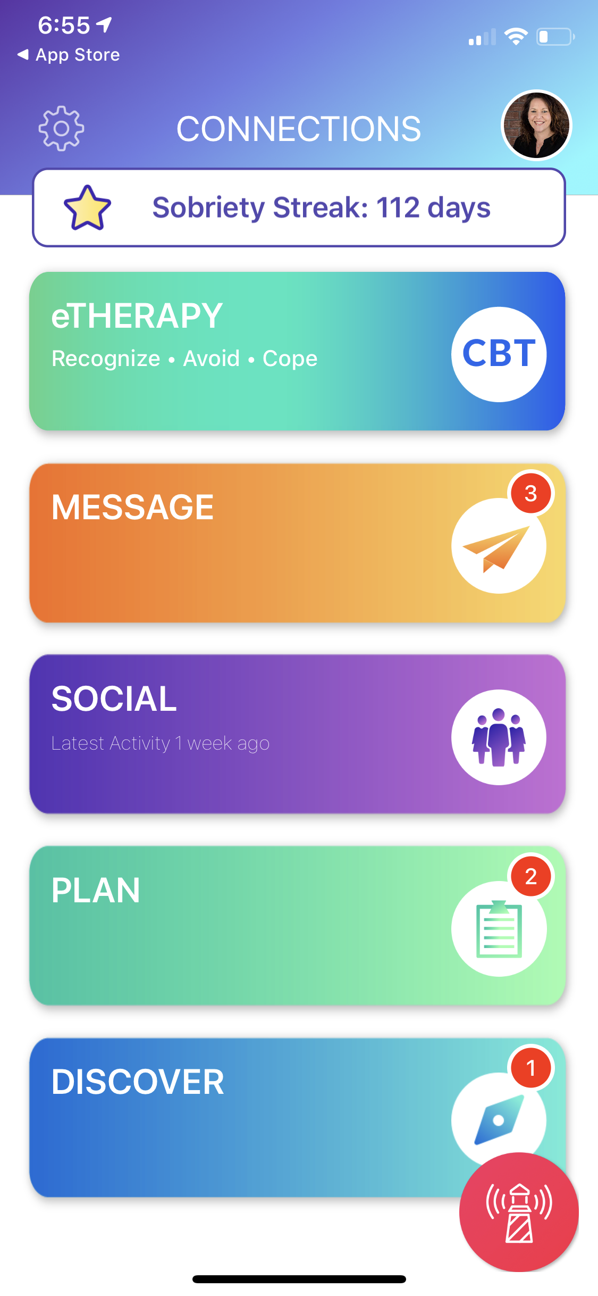
eRecovery: Functionality
Daily check-ins
Recovery support through discussion groups and messaging
Secure contact with counselors
Care plan reminders for medications and appointments
Goals, journals, and weekly surveys
Recovery help button
Audio, video and written content to support recovery
39
ISAM webinar, Potenza, 2020

Slide 40
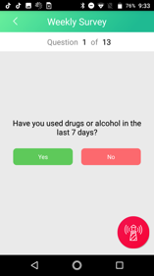
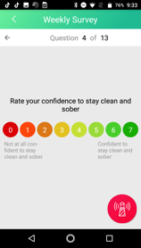
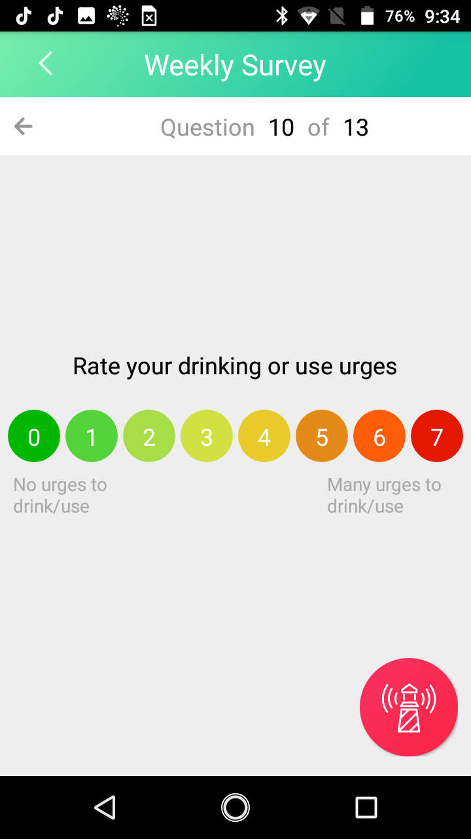
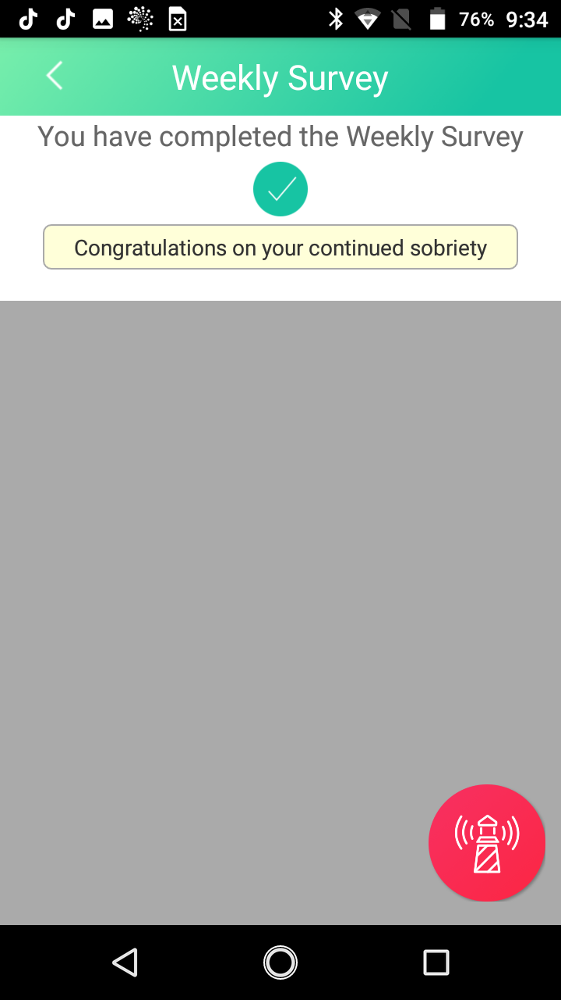
Connections: Functionality
Weekly Brief Addiction Monitor (BAM) Survey
Threshold Questions
Have you used drugs or alcohol in the last 7 days?
Protective Questions
Rate your involvement with work, school, volunteering
Rate amount of time with supportive family & friends
Risk Factor Questions
Rate your difficulty sleeping
Rate your drinking or use urges
Rate your relationship troubles with family or friends
Rate your level of depression or anxiety
Upon completion
Motivational messages displayed, content offered
APF counselor updated
Recovery score calculated
ISAM webinar, Potenza, 2020
Notes:
Additionally, ARC Connections mobile app users complete a validated weekly brief addiction monitoring (BAM) survey, which helps individuals track their own recovery progress and guides the support they receive from ARC counselors, as well as other providers/case managers involved in their care. This 24/7 remote mobile functionality makes the ARC Connections app uniquely suited to provide enhanced monitoring to individuals in need of additional support.

Slide 41
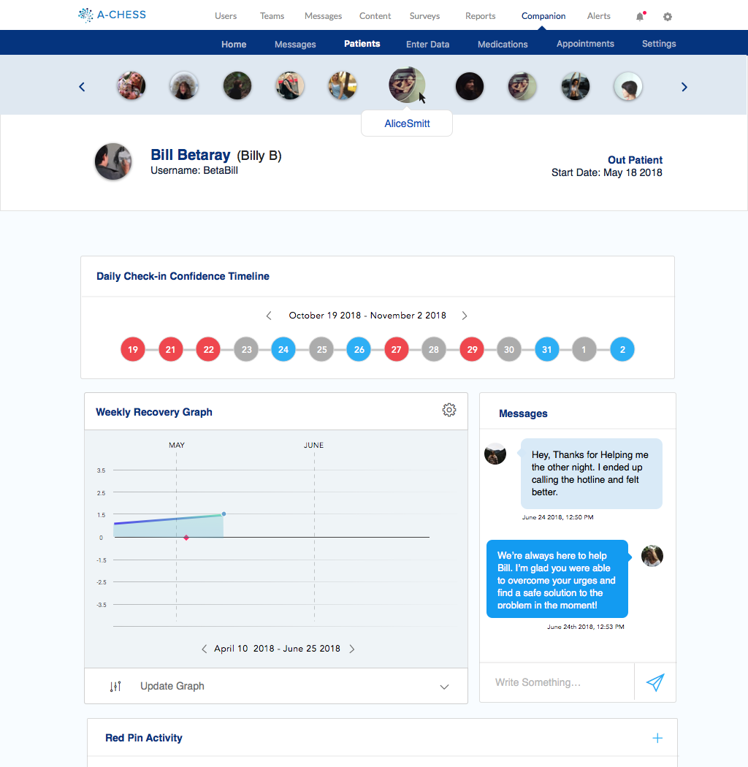
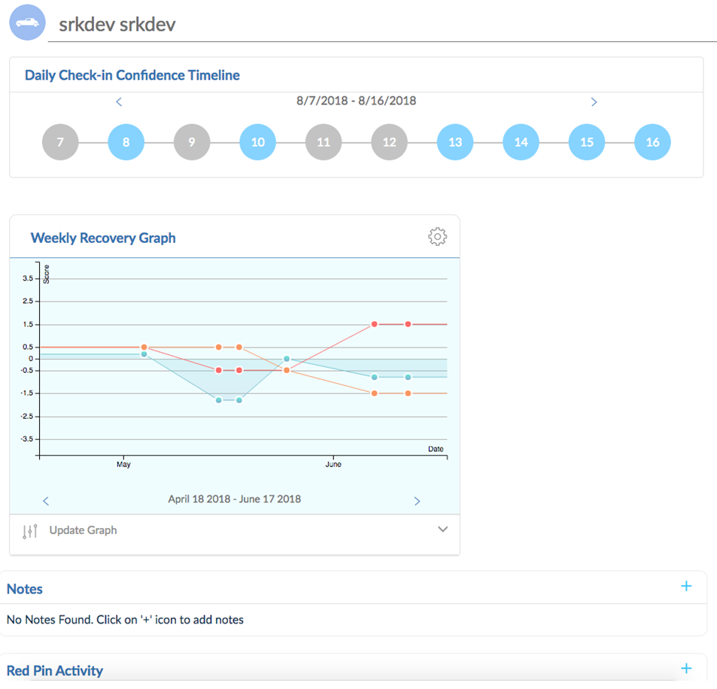
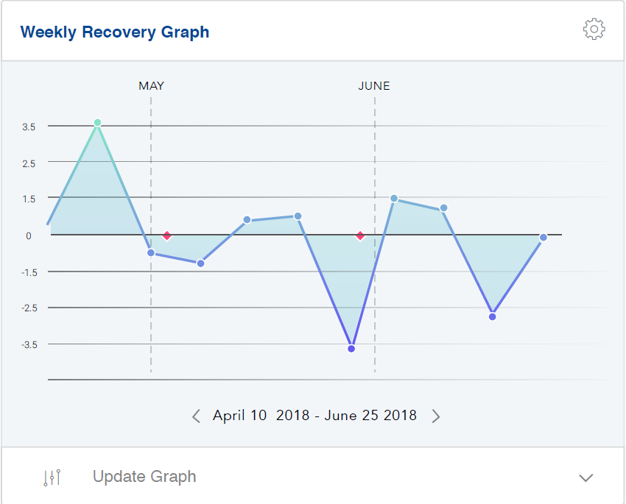
Connections App: Provider Dashboard
ISAM webinar, Potenza, 2020

Slide 42
Evidence-based Technology
Originally called A-CHESS the platform was created by:
University of Wisconsin
National Institute on Drug Abuse
National Institute on Alcohol Abuse and Alcoholism
NIATx (formerly the Network for the Improvement of Addiction Treatment)
CHESS Health provides the licenses for the technology to providers and manages functionality. The Connections mobile app utilizes scientifically proven methods to help individuals abstain from substance use & increase their engagement in recovery supports
ISAM webinar, Potenza, 2020

Slide 43
More Information
Addiction Policy Forum: https://www.addictionpolicy.org
Connection App Roll Out and COVID-19: https://www.addictionpolicy.org/post/free-smartphone-app-offering-telehealth-support-for-those-struggling-with-addiction-during-covid-19
Connection App Description: https://www.addictionpolicy.org/post/free-app-to-support-people-in-recovery-during-covid-19-outbreak
Connection App Download for Patients and Providers: https://www.addictionpolicy.org/connections-app
ISAM webinar, Potenza, 2020

Slide 44
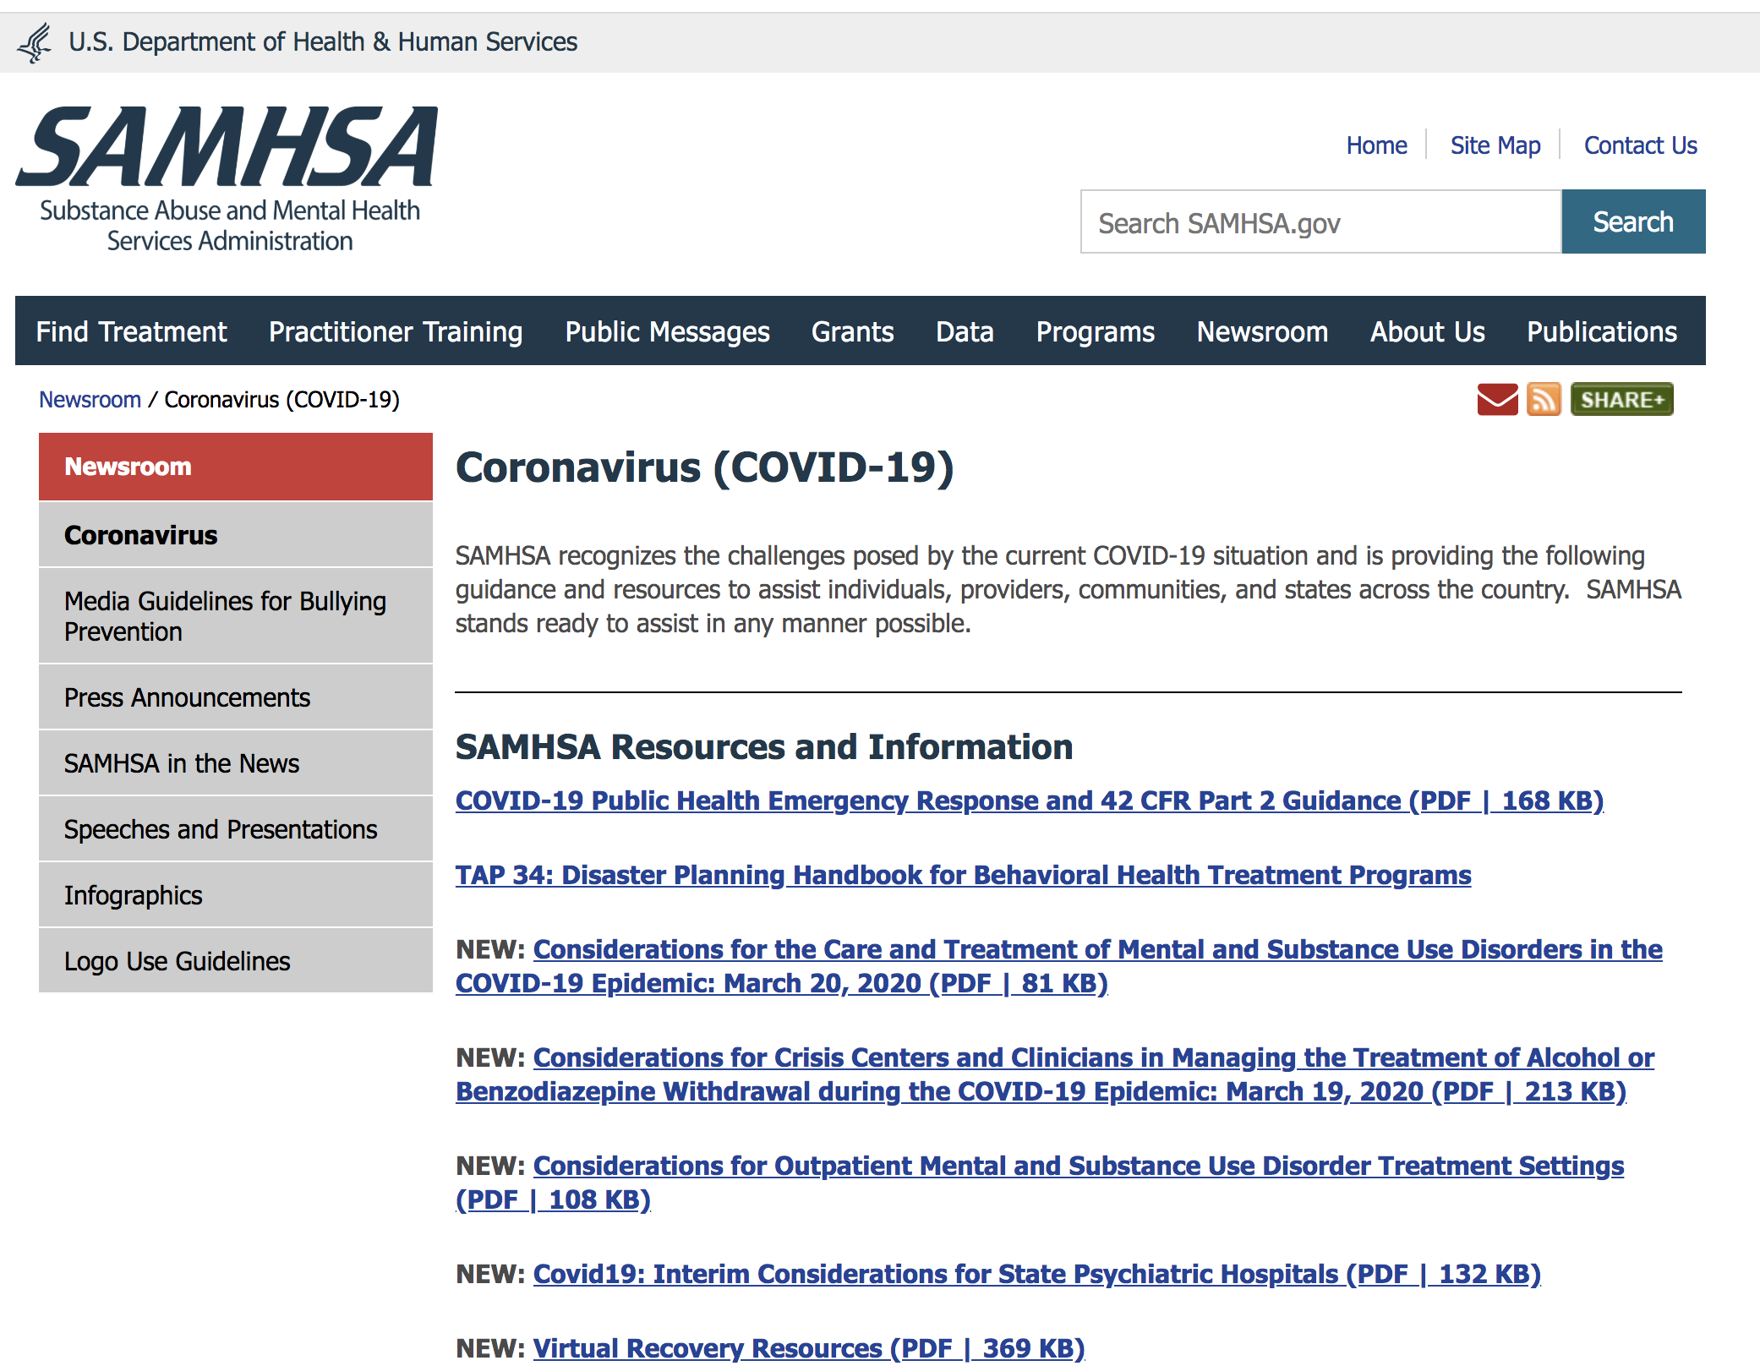

Slide 45
9:15-9:35, International Best Practices Panel: Oklahoma, USA, Jason Beaman New Zealand, Susanna Galea-Singer Norway, Fatemeh Chalabianloo Iran, Gelareh Mostashari Italy, Giuseppe Carra

Slide 46
COVID-19 in Oklahoma
Jason Beaman, OSU
Largest inpatient treatment center
Mostly indigent patients
Large homeless population
Stopped detox admissions
Week by week basis
Very aggressive infection control method
No PPE in the building
Starting conversation of closing facility
May happen if there is an active case
Facility may not reopen if that occurs

Slide 47
New Zealand
“Act early, decisively and go hard”
Level 3 ➣ Level 4 in the next 48 hours
Non face-to-face primary care consultations
Non essential / elective interventions deferred
Staff reprioritized
Only urgent Outpatient care
Virtual clinics & Telehealth
Video conferencing – compulsory assessment & treatment
Waiting rooms
What is essential care for substance misuse services?
Comorbid cognitive impairment;
? Inpatient detoxification necessary;
How essential is it to physically review;

Slide 48
Germany, Norbert Scherbaum, Ärztlicher Direktor des LVR-Klinikums Essen
In Germany we have a problematic development for the rehab clinics, which are even without Corona in a difficult economic state (they are now shut down with unclear recompensation).
Regarding MMT: the relatively strict rules are officially weakened (especially regarding take home prescription), in order to keep running maintenance treatment.
Inpatient detoxification is still available but limited; the therapeutic chain (detoxification > rehab treatment) does not function now (see above : shut down of rehab clinics).

Slide 49
Greece, Christos Koumstiditis
Major challenges for Greece, common I suspect to other countries are:
Continuation of provision of services and protection of opioid substitution treatment dispensing units. In Greece OST is provided from units based at local general hospitals across the country. As the need for space to provide treatment for COVID-19 increases, General Hospitals are instructed to find such spaces, hence OST units came under pressure to stop working. A compromised solution has been agreed, with a plan to reduce number of units where possible, which unfortunately will increase travelling and risk for clients.
Delay in treatment entries at all types of treatment facilities re-creating long waiting lists that the country worked very hard to absorb over the past 5 years.
The biggest challenge is the management and support to homeless people in the centre of Athens. A good percentage of those are IV drug users and migrants. Street work has now stopped, and needle distribution is only taking place at certain spots.
During such a crisis our vulnerable population could be further stigmatised and left without support.

Slide 50


Main goals Reduce the risk of infection among patients and staff Provide patients with sober information, how they can help themselves reduce the risk of being infected Ensure proper medical treatment Ensure continuous treatment with a substitute drug / reduce the risk of drop-out Ensure outpatient services / home delivery Reduce the risk of overdose and overdose deaths Higher risk groups: older age, comorbid chronic diseases and malnutrition, lower life standard Care and support to patients who may experience increased anxiety and social isolation (frequently phone consultations) Enhance the low threshold capacity for treatment intake
Pandemic plan Covid-19 SUD
Department of Addiction Medicine
Haukeland University Hospital Bergen, Norway
General advice to drug users
Be aware of lower access to drugs
Divide the dose and take less amounts than usual
Avoid injection and inhalation (smoking or vaping) more than sniffing or oral intake
Avoid taking drugs while alone, at the same time keep more than usual distance to others
Get a Naloxone nasal spray as an overdose prevention
Keep a lower threshold to contact the doctor / health service for those who are particularly vulnerable during this time
Contingency plan
Changes in structure and management
Resource allocation to ensure staffing
Area utilization, reduction of elective activity, reserve capacity and prioritization
Ensure up-to-date information and training needs
Changes in routines and procedures as the overall plan changes
Equipment needs and transport routines
General rules for outpatient care
General rules for inpatient care
Specialized Covid 19-SUD bed unit
Follow the national advices and governance
Norwegian Directory of Health
Norwegian Institute of Public Health
Norwegian Centre for Addiction Research

Slide 51
COVID-19 in Italy
Giuseppe Carra (Milano Bicocca University, Italy)
Nearly catastrophe medicine scenario
Almost any medical and surgical bed in wards reconverted to COVID-19 beds
High proportion of health staff positive to COVID-19 and/sick or quarantined
Shortage of specialist doctors and nurses> community nurses and doctors redeployed in A&E dpts. (including addiction and mental health staff)
Disruption of dispensing Methadone, Naloxone, and safe equipments in the community
Increasing clients with take-home methadone (weekly Provision)
Prison riots: 12 suicidal deaths by deliberate methadone/buprenorphine overdoses
Usual Drug dealers almost disappeared in the streets: significant risk from alternative, unknown sources
Addiction services delivering only urgent and not delayable treatments
Phone and web delivered interventions made legal with social workers and psychologists remotely working

Slide 52


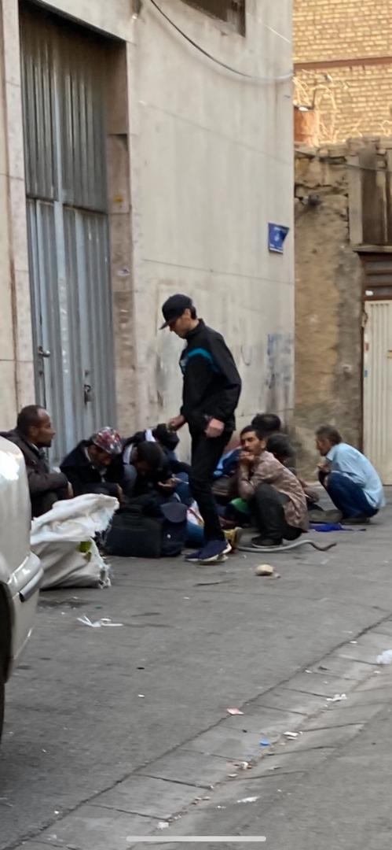
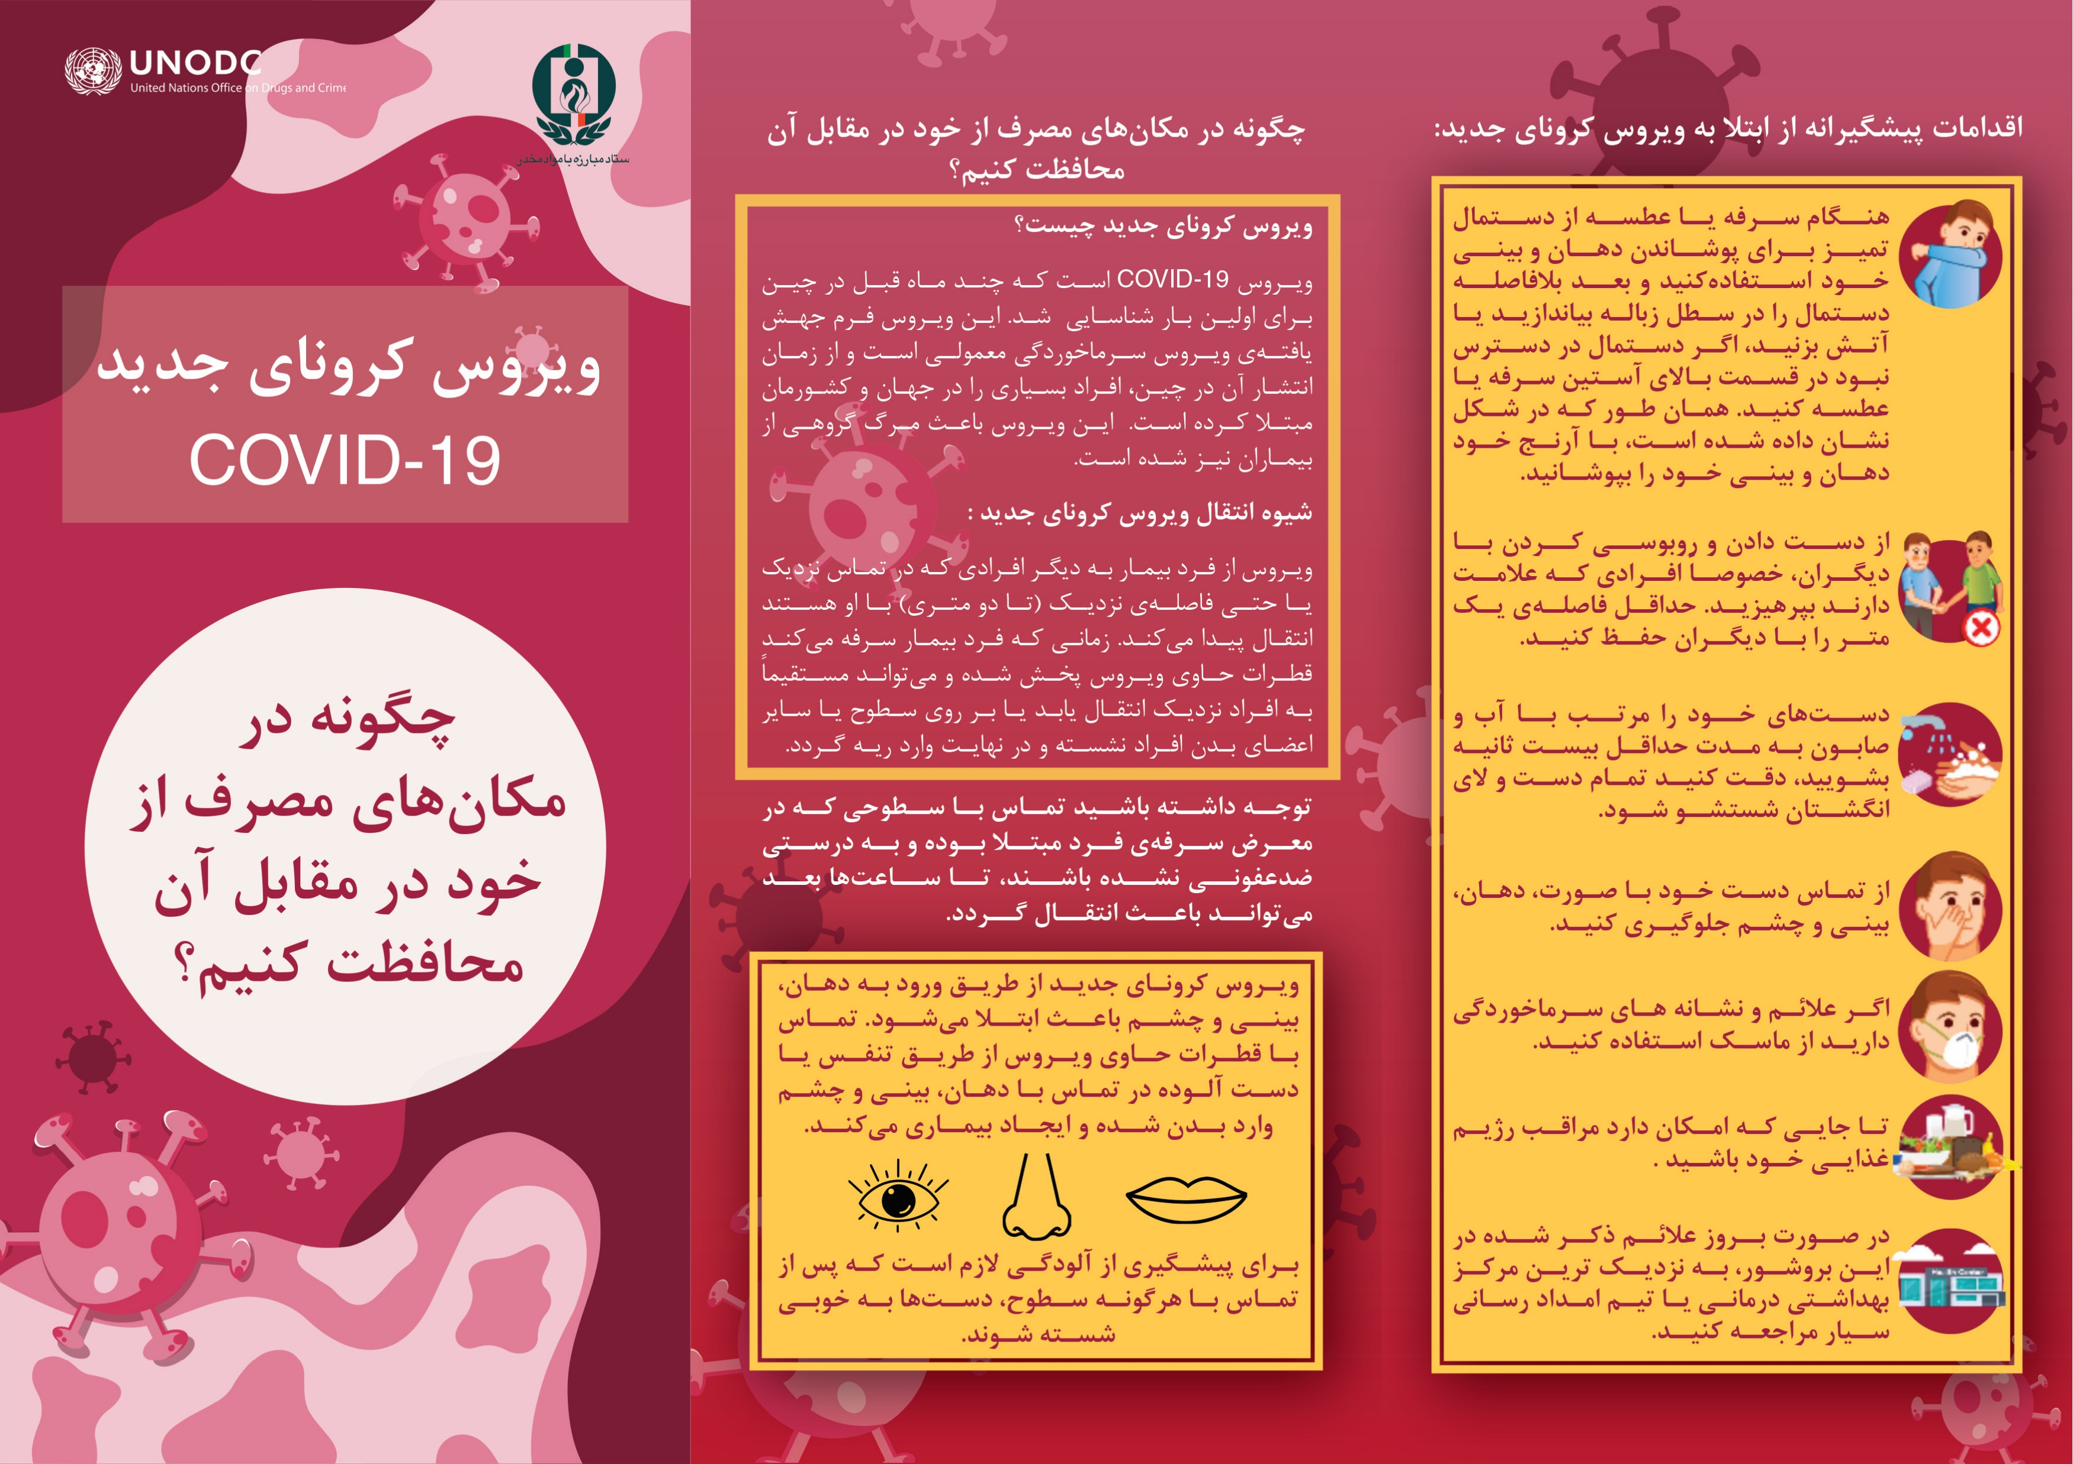
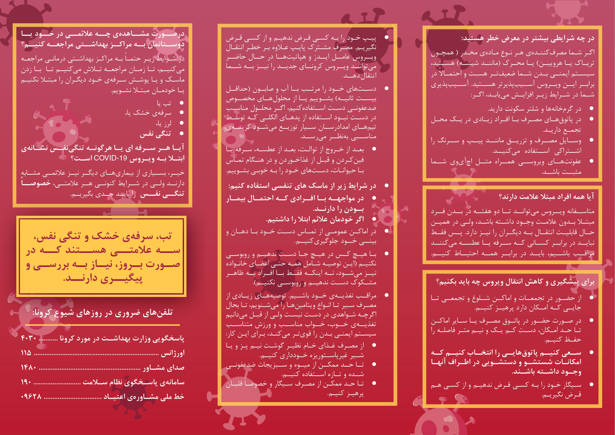
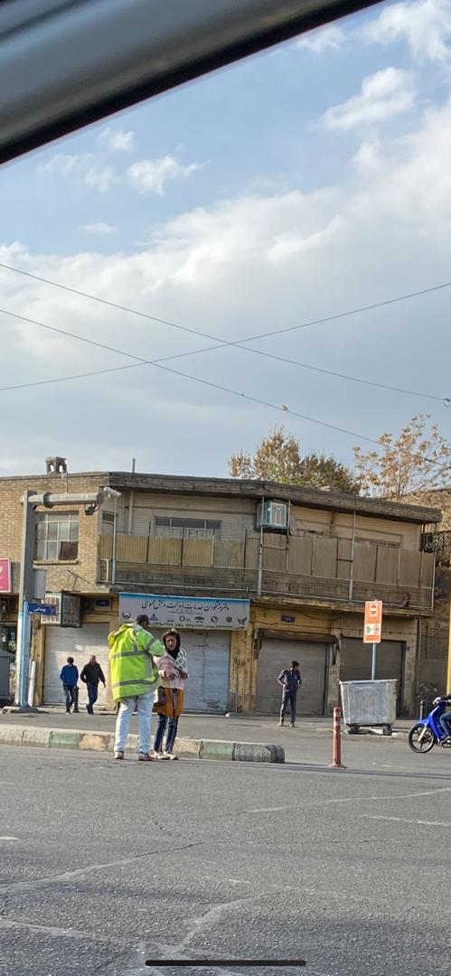
COVID-19 prevention in drug use hot spots
Situation:
Iran has one of the highest opiate consumption rates worldwide. Also there is a significant prevalence of ATS use disorders. Due various reasons open drug use in the public is prevalent with increasing number of the young and women landing on the streets.
Action
Developed a brochure
Developed three short podcasts
Created WhatsApp group with CSOs
Started Coordination for COVID-19 Outreach

Slide 53
9:35-9:50, Group Discussions on Major Questions and Potential Answers

Slide 54
9:50-9:55, Meeting Conclusion: Challenges and Hope, Alex Baldachino (ISAM President Elect, University of St Andrews), Kathleen Brady (ISAM President, Medical University of South Carolina)

Slide 55
Next Steps! Second Webinar: Wednesday, April 15, 2020, 8:00 AM - 10:00 AM (ET), 12:00 - 2:00 PM (GMT) Please register in the second meeting with sending an email to ISAM.NIG@gmail.com

