Slide 1
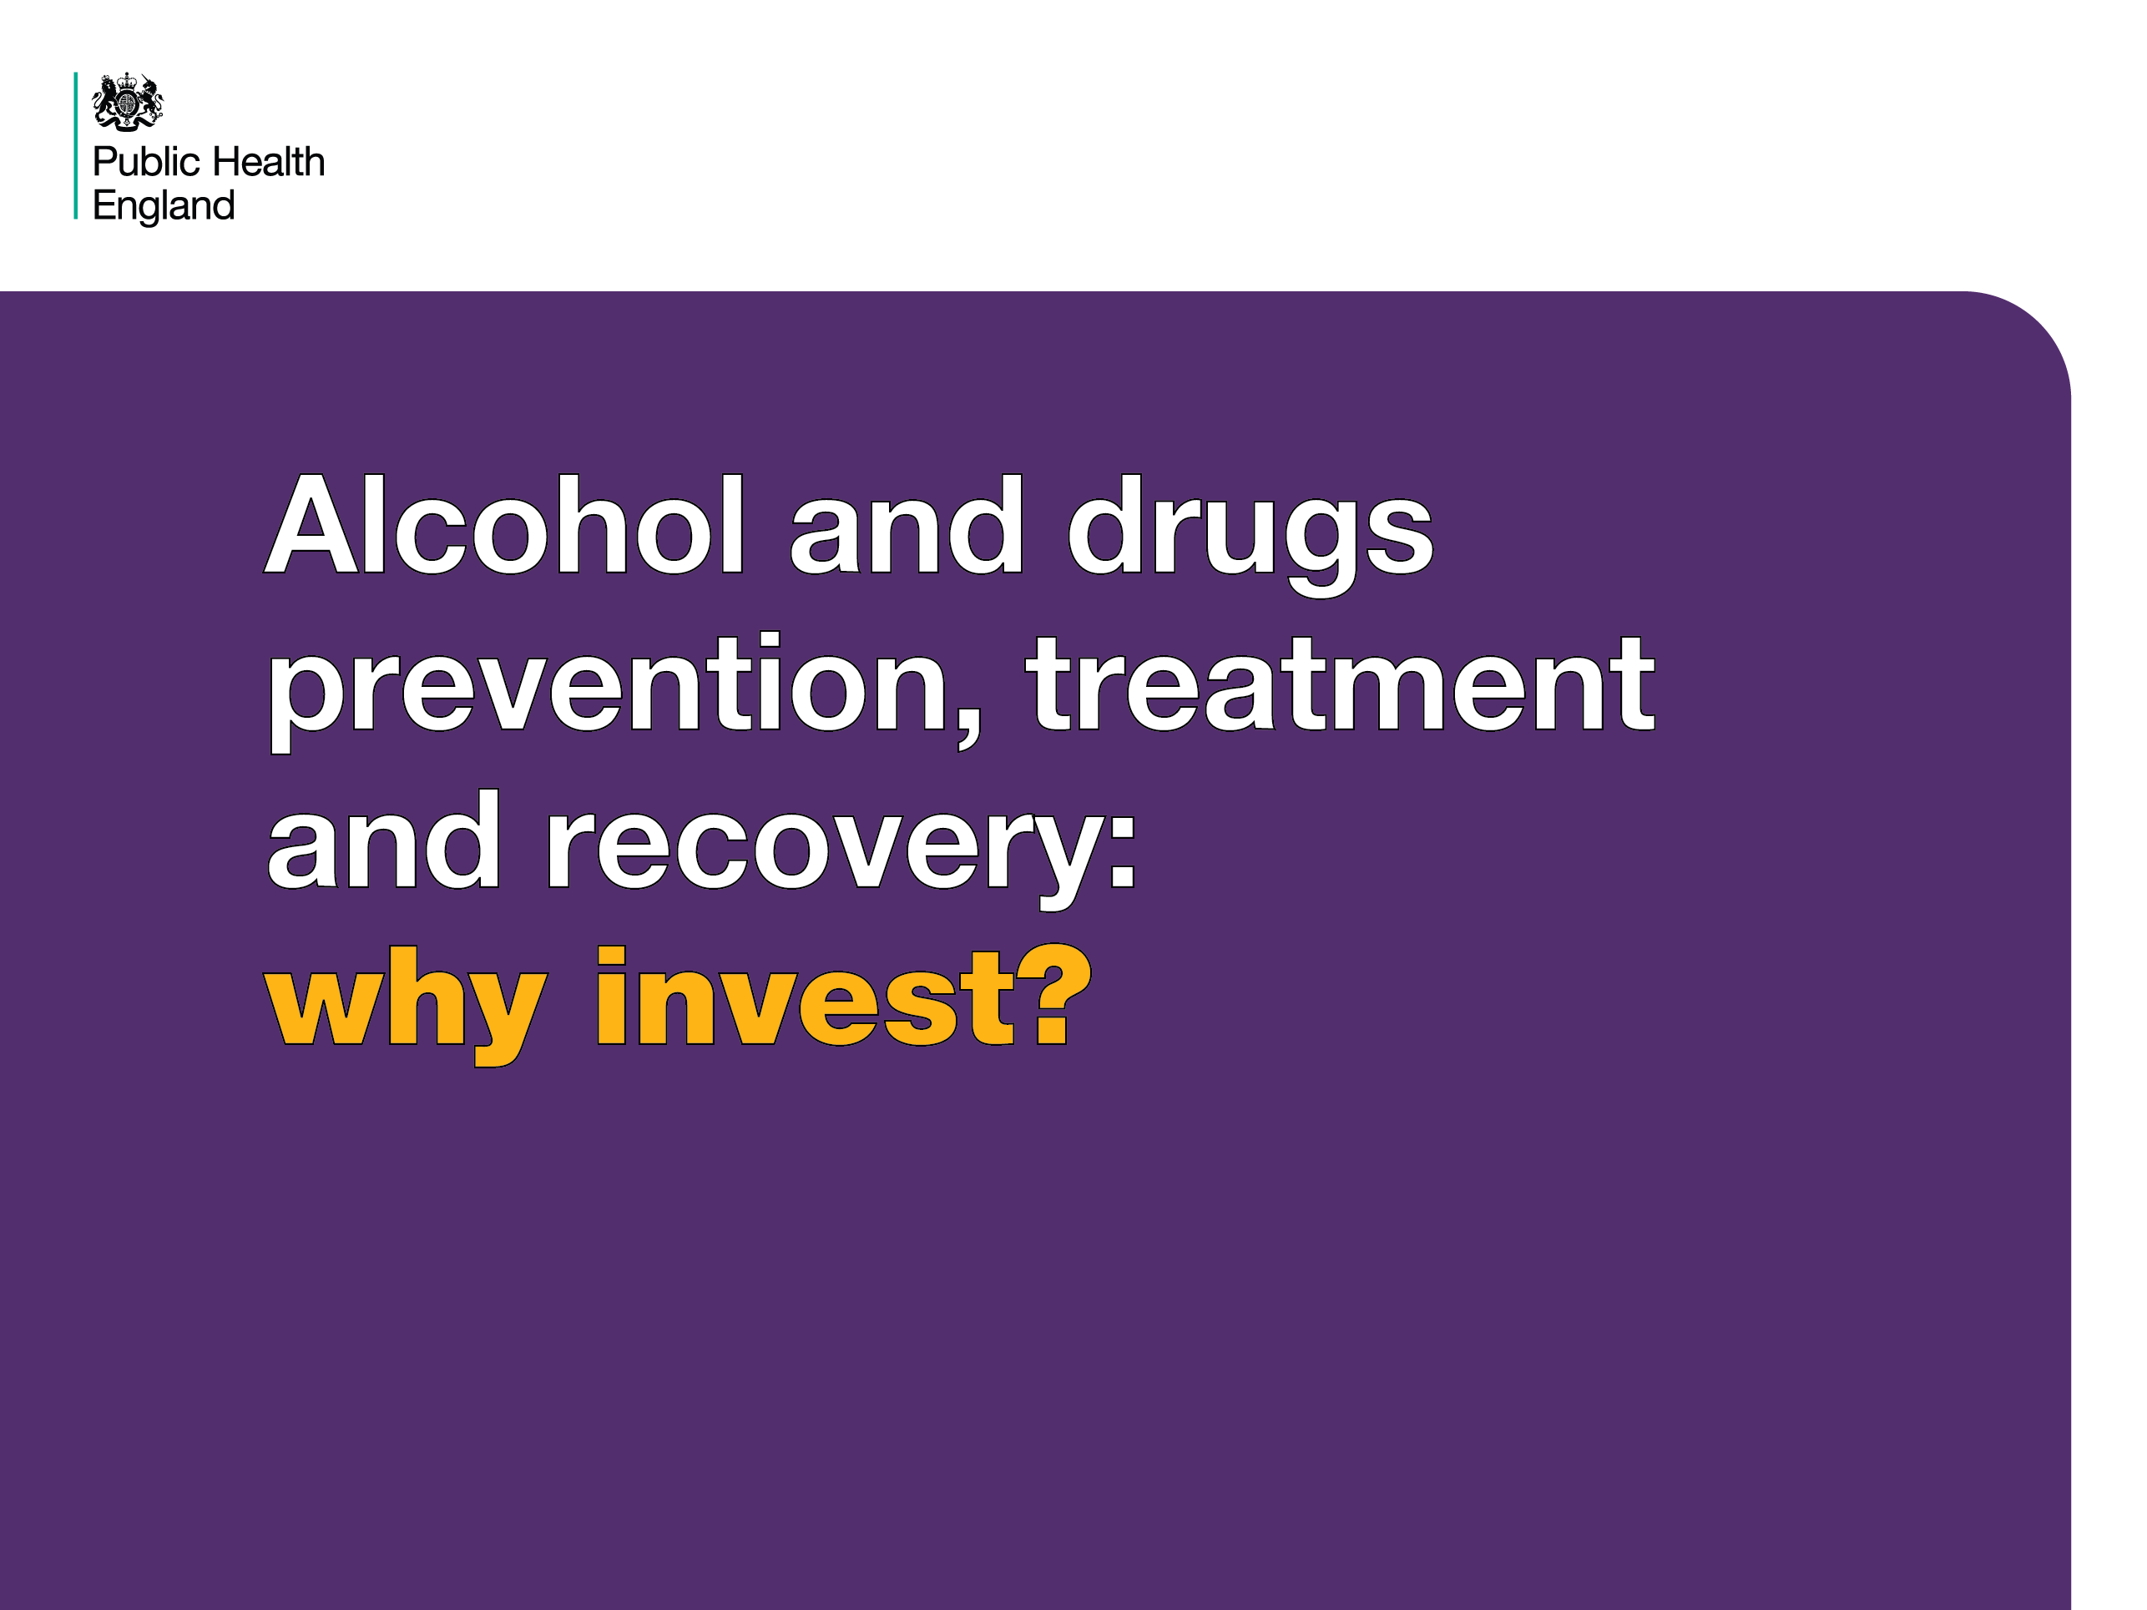
Notes:
Alcohol and drugs prevention, treatment and recovery: why invest?
This set of slides is intended to be used by commissioners and providers of drug and alcohol services to demonstrate the need and business case for investing in drug and alcohol misuse interventions and specialist treatment/recovery services. The slides can be used separately or as a set as required. The entire set of slides can be downloaded in powerpoint format.
The first 3 slides demonstrate how widespread drug and alcohol problems are and how many children are affected.

Slide 2
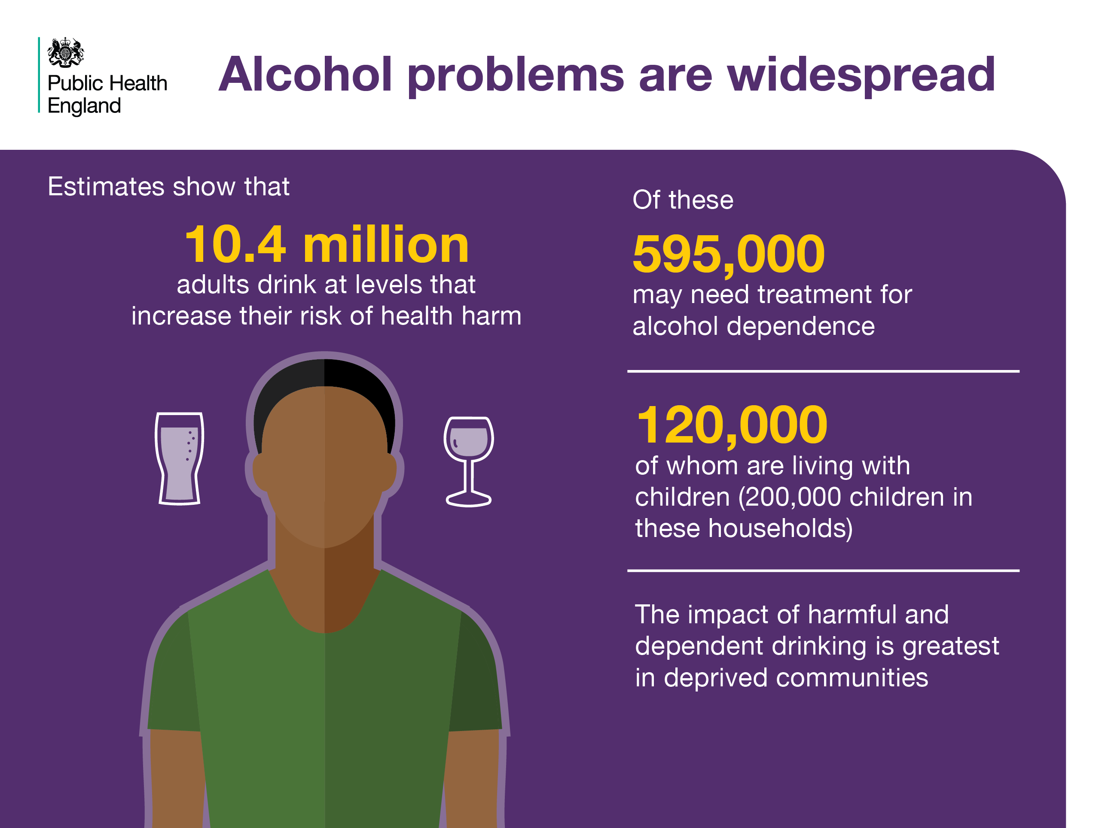
Notes:
The prevalence of alcohol problems
10.4 million people drink alcohol at a level that increases their risk of health harms. A smaller, but significant number of people are dependent on alcohol. Misuse and dependence is highest in deprived areas. Parental alcohol misuse can negatively affect children.
References
Cut and paste website addresses into your browser to access the links
NHS Digital Health Survey for England 2015 and ONS mid-year population 2015
2 & 3. Robert Pryce, Penny Buykx, Laura Gray, Tony Stone, Colin Drummond, and Alan Brennan. (2017). Estimates of Alcohol Dependence in England based on APMS 2014, including Estimates of Children Living in a Household with an Adult with Alcohol Dependence Prevalence, Trends, and Amenability to Treatment. University of Sheffield and King’s College. Prepared for PHE, London.
4. Alcohol Research UK (2015) Understanding the alcohol harm paradox in order to focus the development of interventions, Centre for Public Health, Faculty of Education, Health & Community, Liverpool John Moores University. Available at: Http://alcoholresearchuk.org/downloads/finalReports/FinalReport_0122.pdf

Slide 3
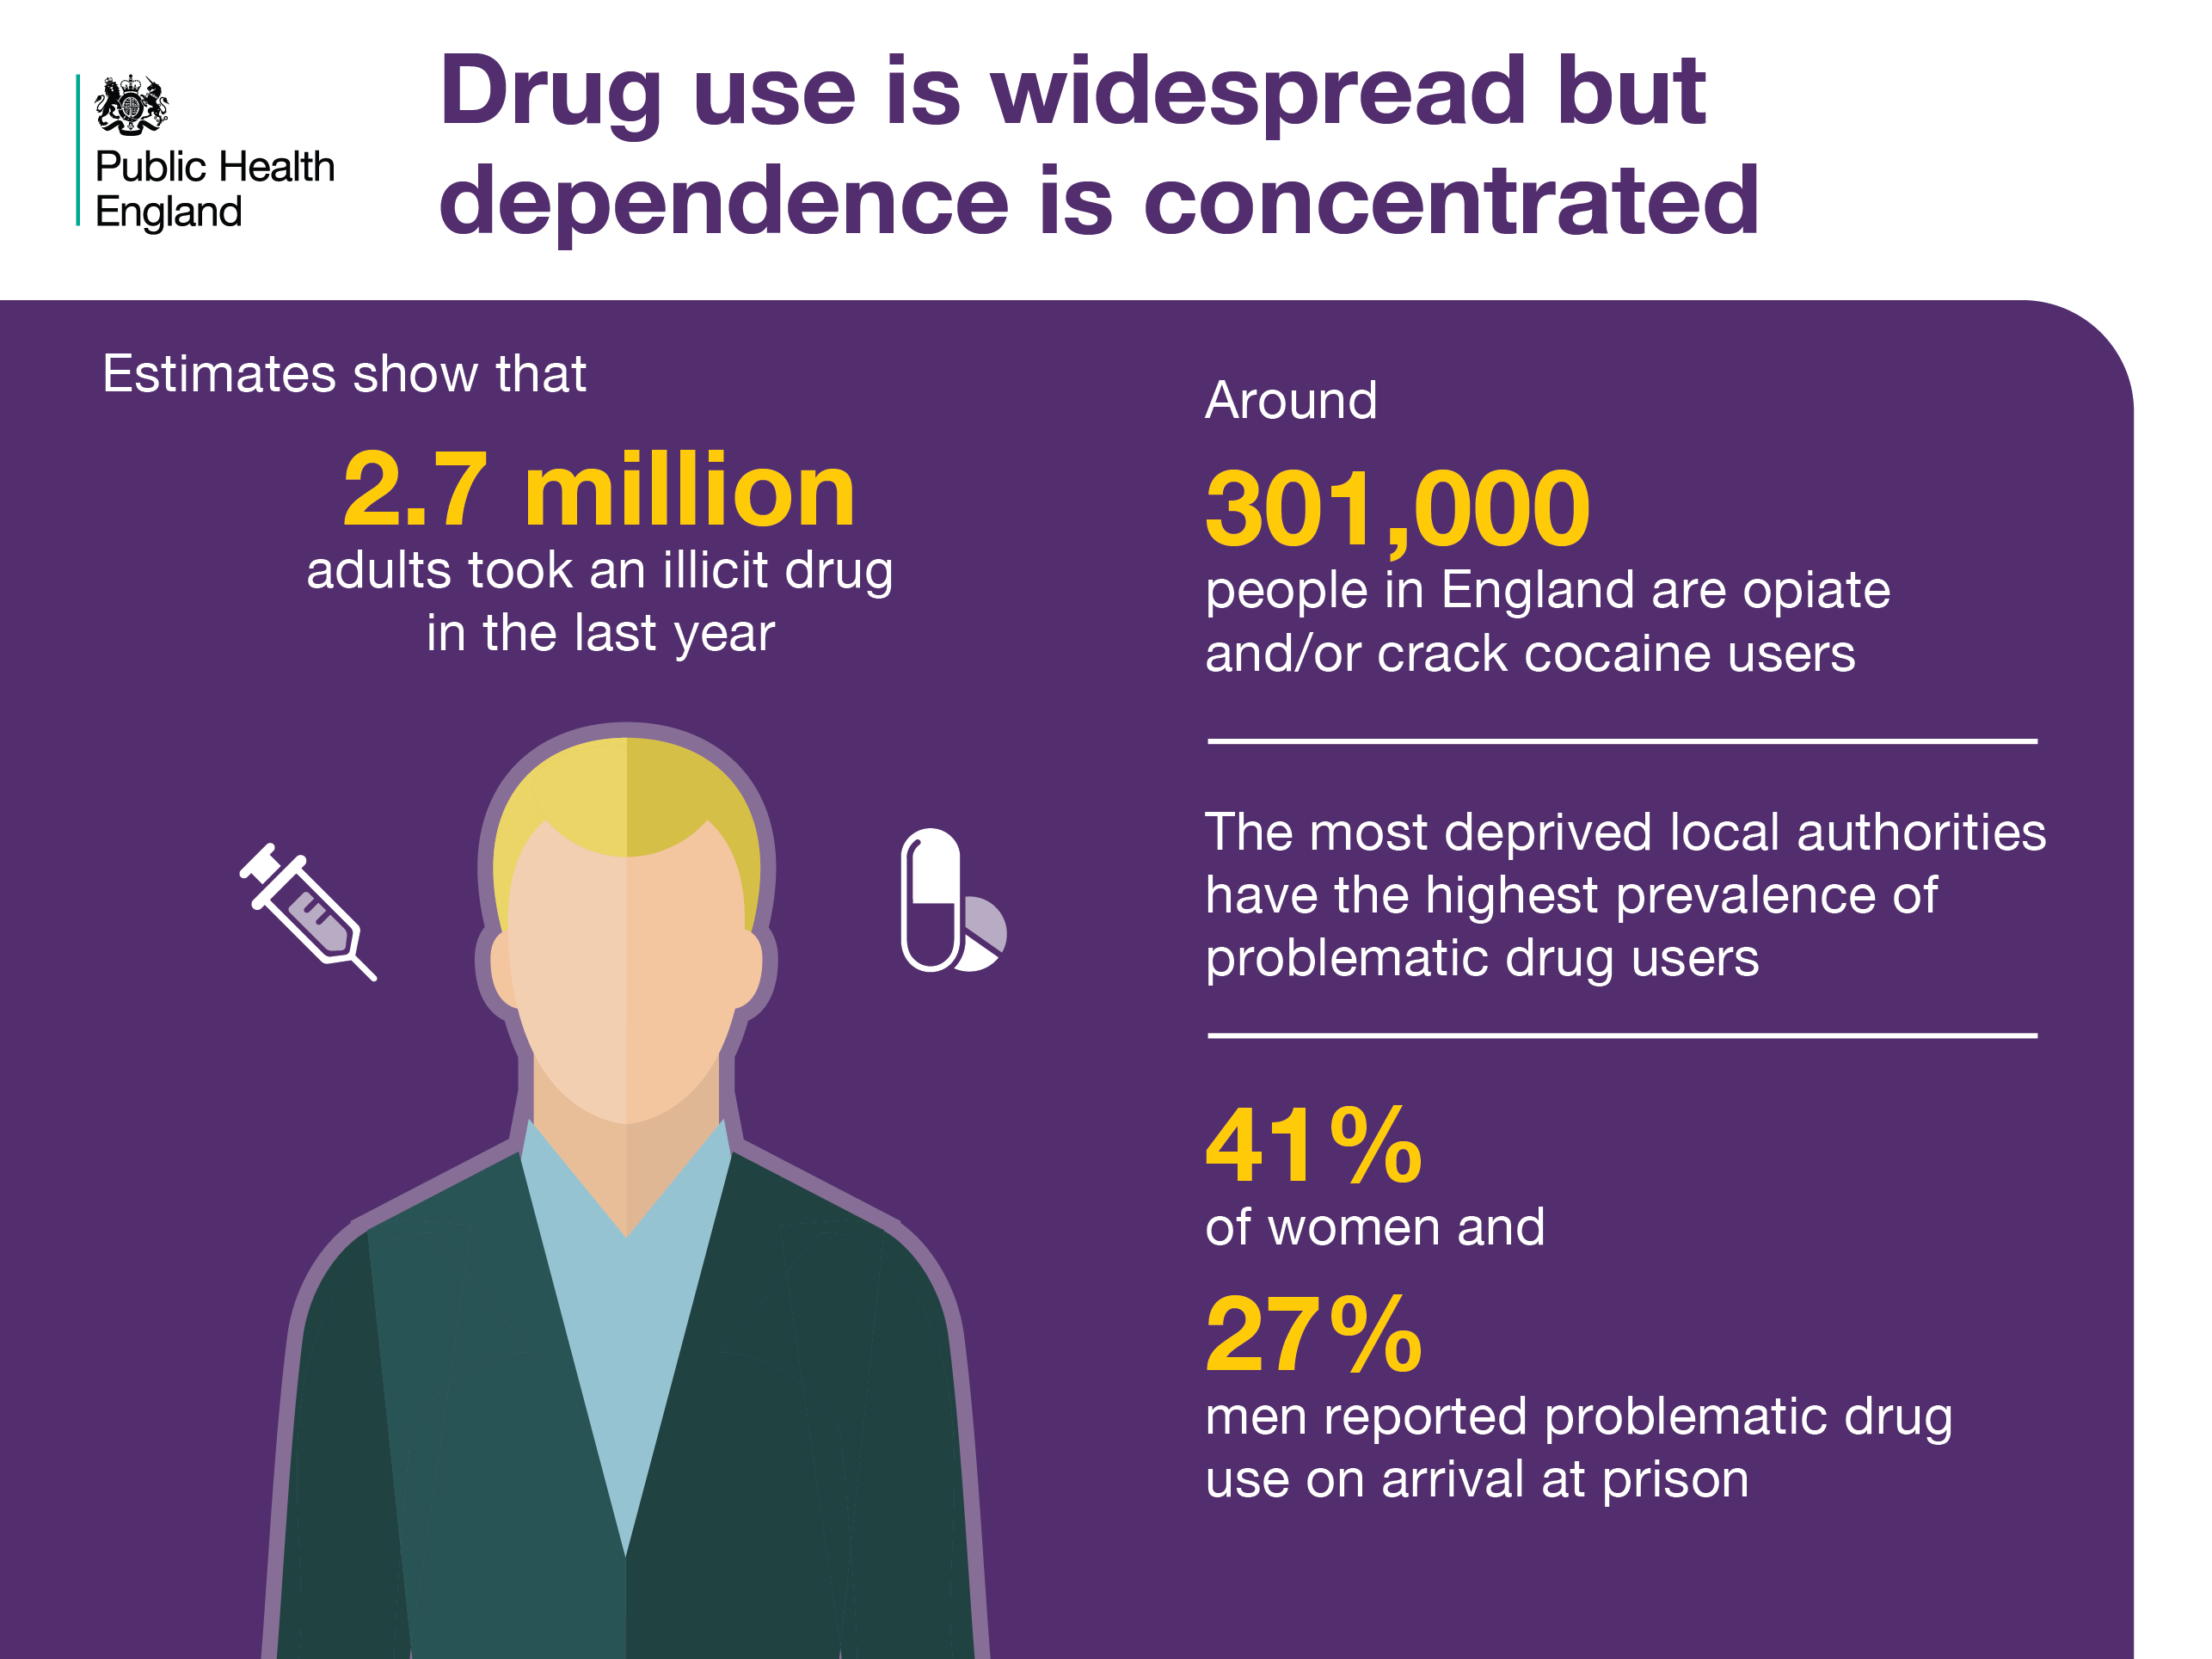
Notes:
The prevalence of drug use and dependence
Drug use is widespread but dependence is concentrated. Dependence is higher in deprived areas and in certain populations, for example prison populations.
References
Cut and paste website addresses into your browser to access the links
Statistics on Drugs Misuse: England, 2017. (2015/16 stats, age 16-59). Available at: http://www.content.digital.nhs.uk/catalogue/PUB23442
2. Hay, G. Rael dos Santos, A. & Swithenbank, Z. (2017) Estimates of the Prevalence of Opiate Use and/or Crack Cocaine Use, 2014/15: Sweep 11 report. Public Health Institute, Liverpool John Moores University. Available at: www.cph.org.uk/wp-content/uploads/2017/09/Estimates-of-the-Prevalence-of-Opiate-Use-and-crack-cocaine-use-2014-15.pdf
3. Marmot, M. (2010) Fair society, healthy lives: the Marmot Review: strategic review of health inequalities in England post-2010.
4. HM Inspectorate of Prisons (2015) Changing patterns of substance misuse in adult prisons and service responses. A thematic review by HM Inspectorate of Prisons. London: HMIP. (Stats cover England and Wales)

Slide 4
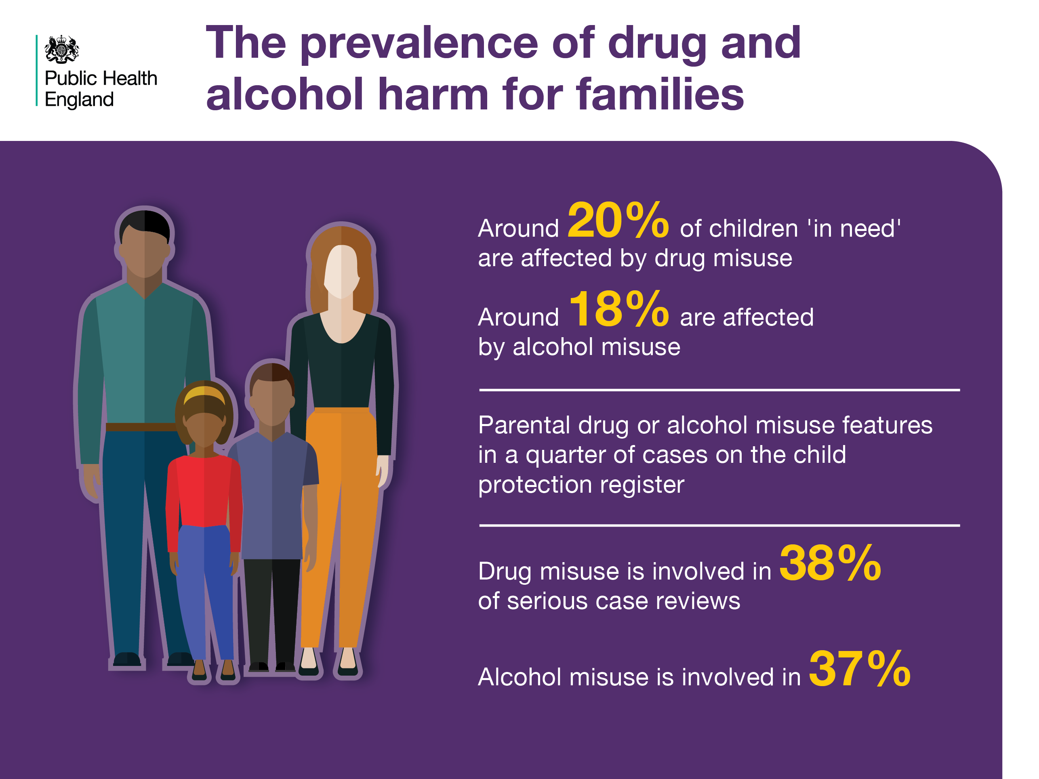
Notes:
The prevalence of drug and alcohol harm for families
Parental drug and alcohol misuse features as a component in the assessment of children in need, safeguarding cases and serious case reviews which are conducted when a child dies or is seriously harmed as a result of abuse or neglect.
References
Cut and paste website addresses into your browser to access the links
(Proportions as shown in assessment), DoE/ONS Nov 2017. Characteristics of children in need: 2016 to 2017.
2. Advisory Council on the Misuse of Drugs (2003) Hidden Harm: responding to the needs of children of problem drug users. Available at: https://www.gov.uk/government/publications/amcd-inquiry-hidden-harm-report-on-children-of-drug-users
3. Sidebotham P, Brandon M, Bailey S, Belderson P, Garstang J, Harrison E, Retzer A, Sorensen P. (2016) Pathways to harm, pathways to protection: a triennial analysis of serious case reviews 2011-2014. DfE. Available at: https://www.gov.uk/government/publications/analysis-of-serious-case-reviews-2011-to-2014

Slide 5
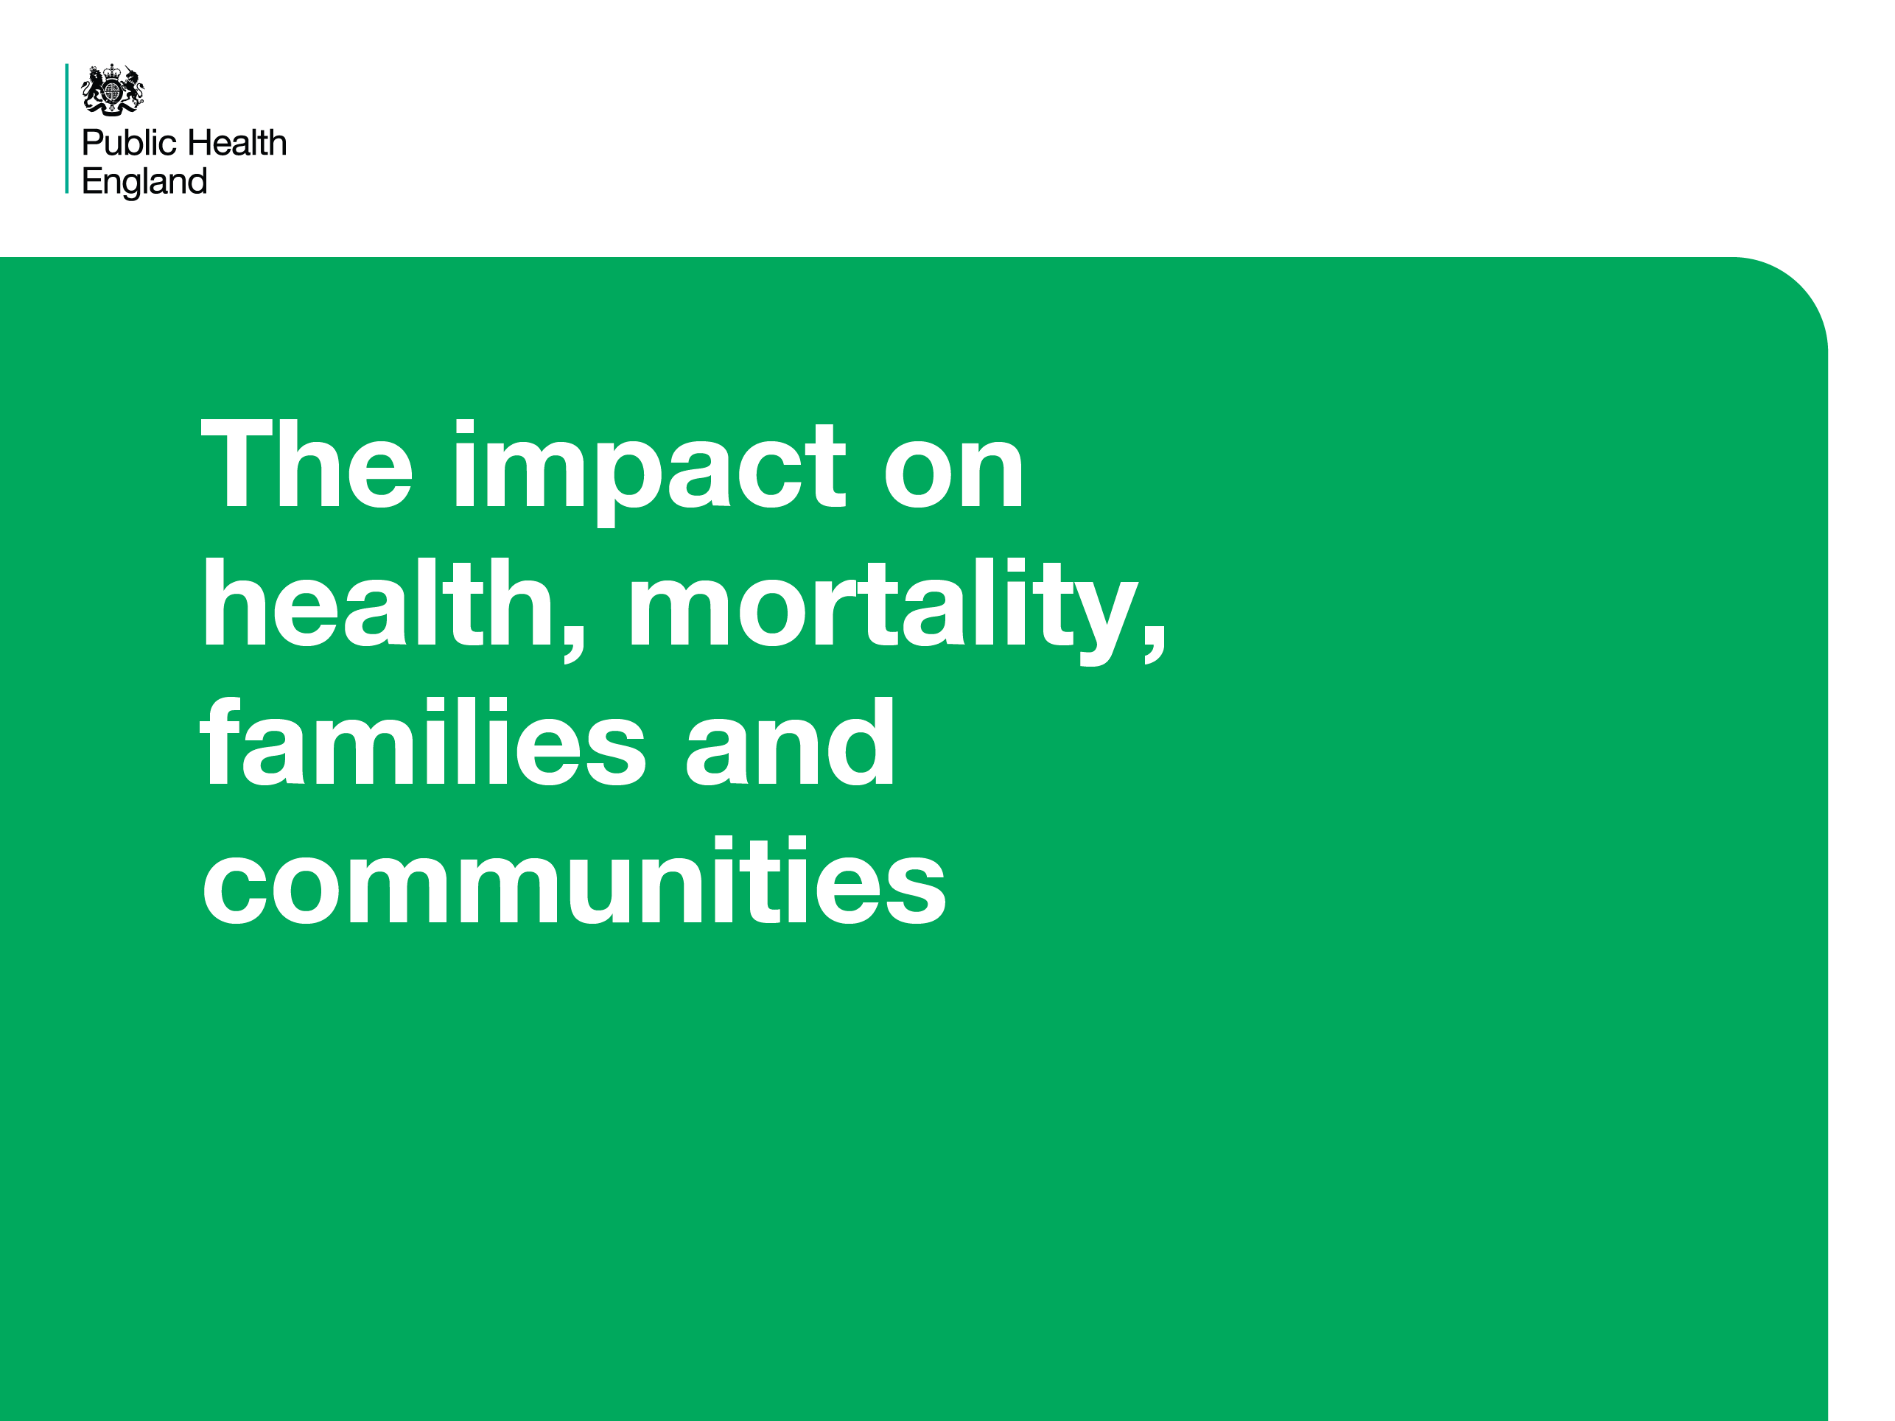
Notes:
Heading: The impact on health, mortality, families and communities
Slides in this section show how an individual’s health can be affected by drug or alcohol misuse and reflects on statistics about deaths associated with drug/alcohol misuse.

Slide 6
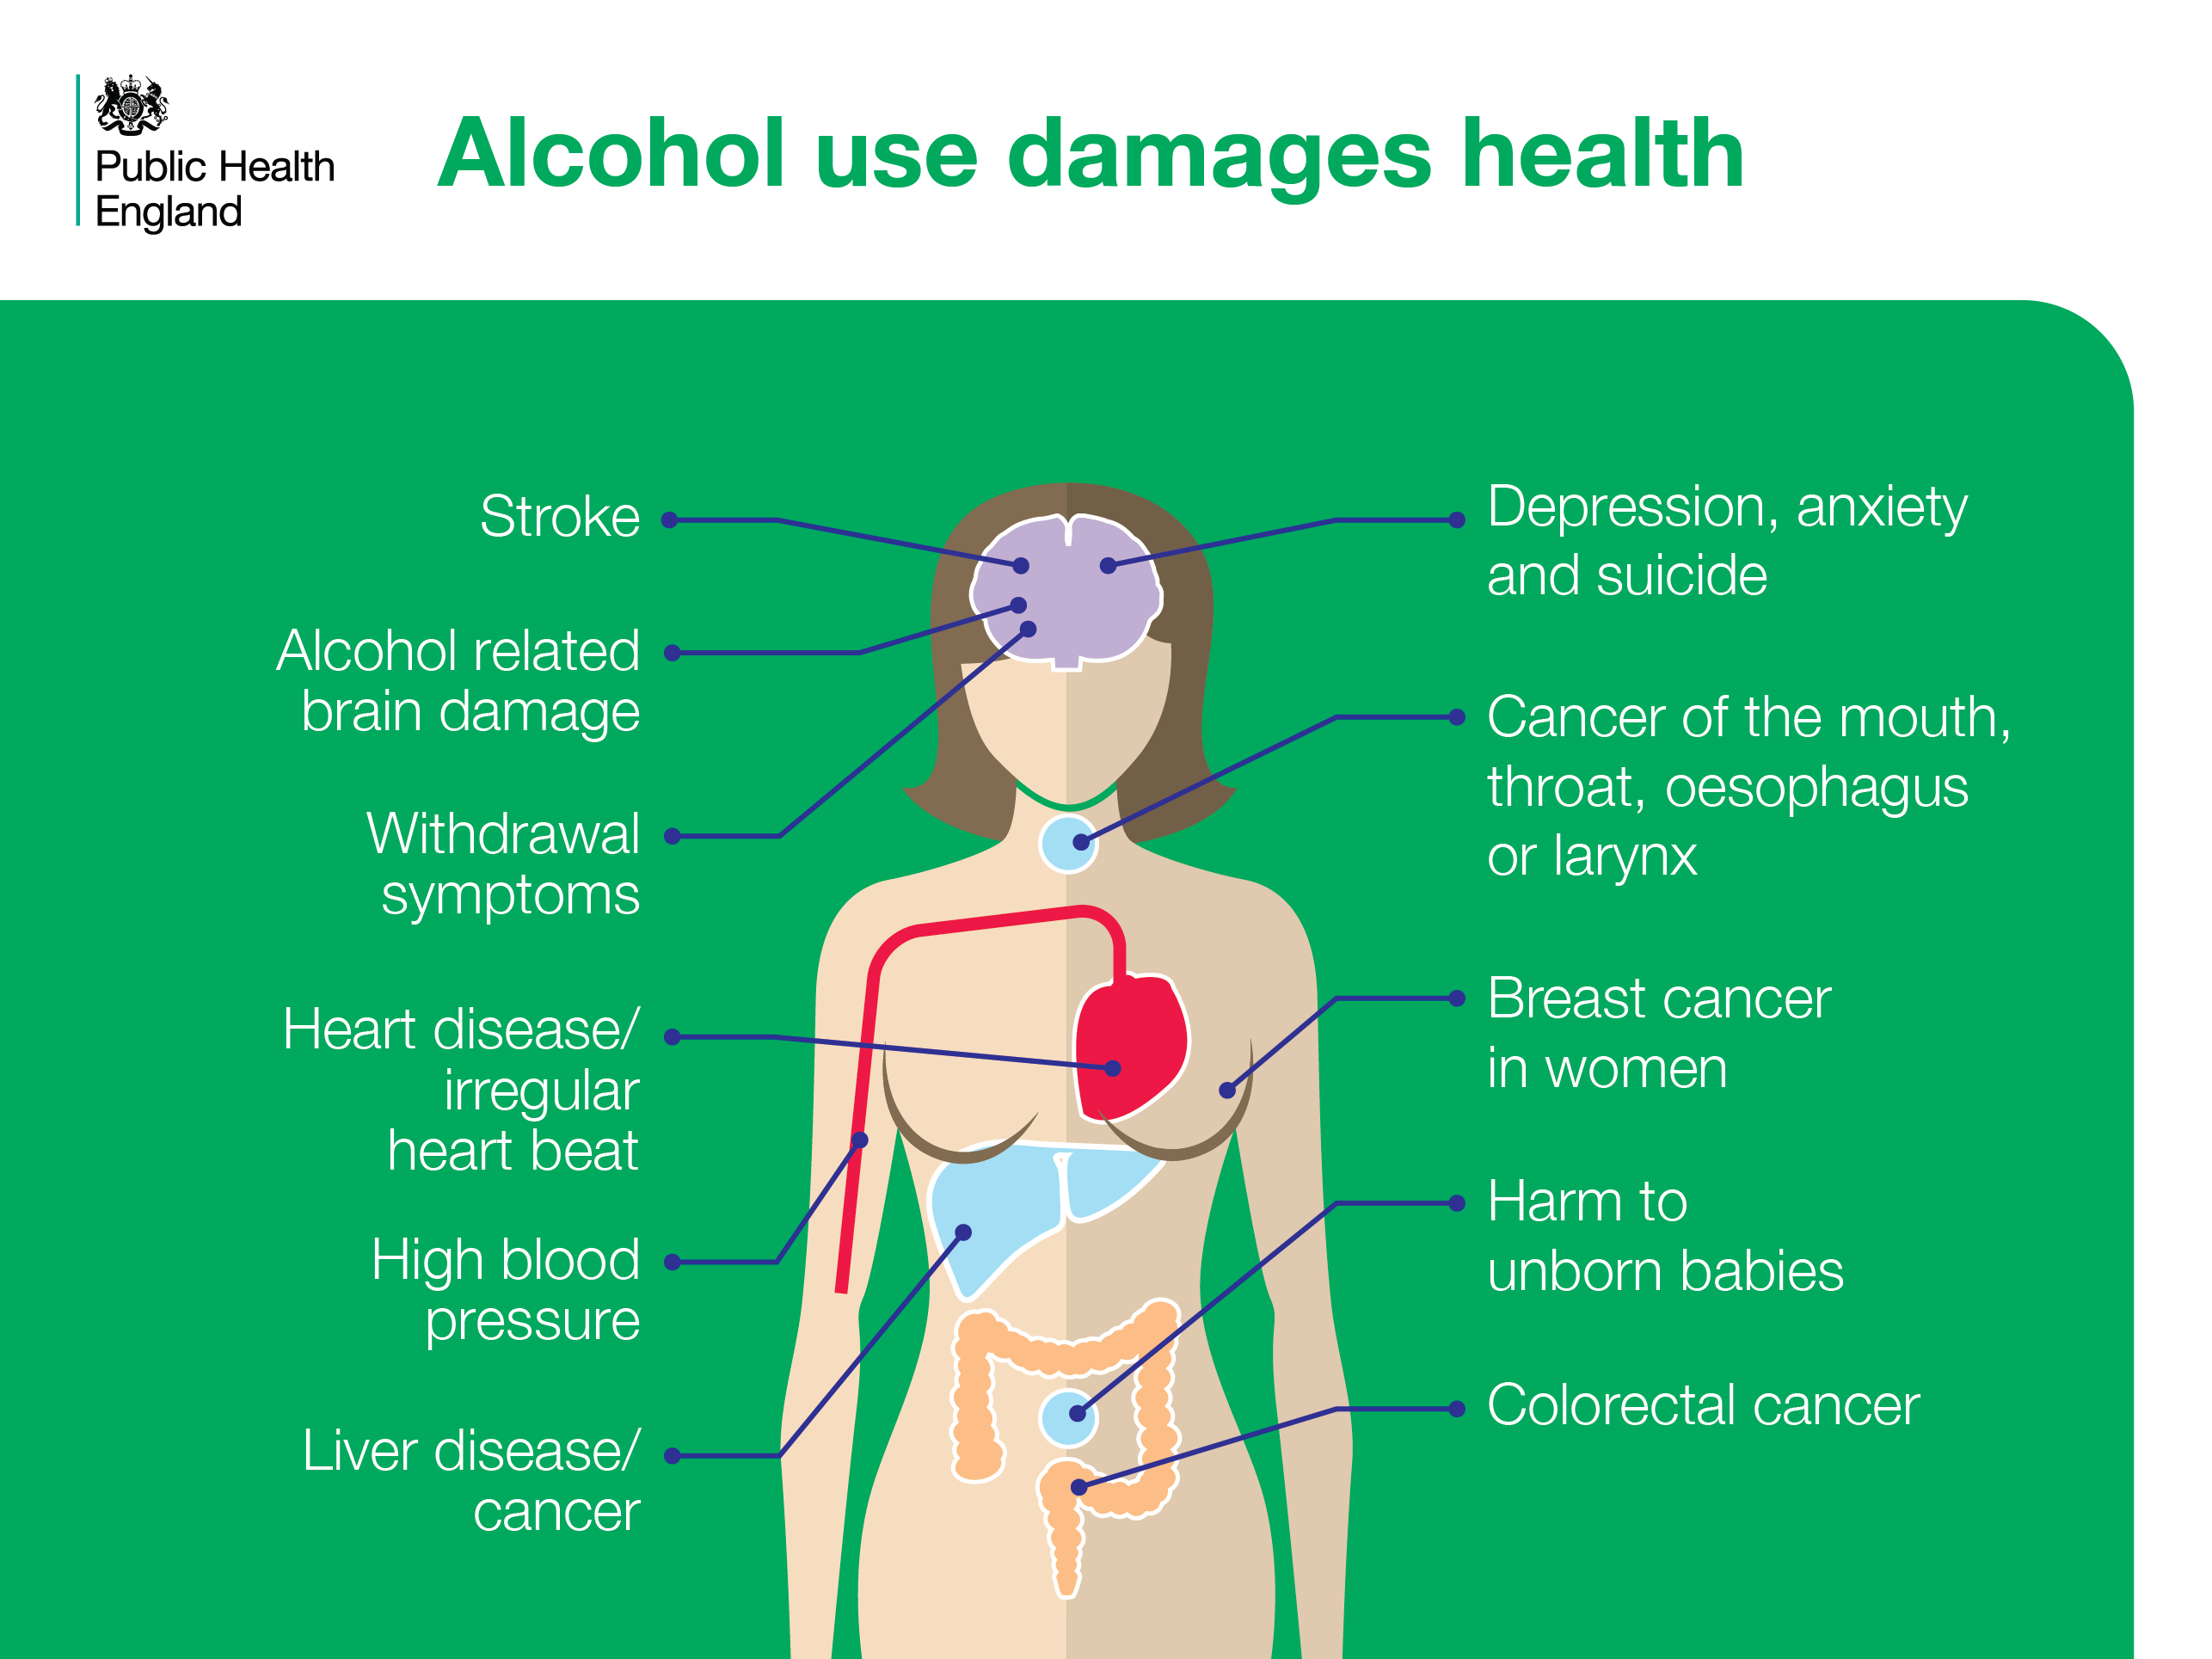
Notes:
Alcohol use damages health
Alcohol misuse increases the risk of a range of health harms. The harms range from alcohol specific conditions such as serious withdrawal effects and alcohol related brain damage to mental health issues such as depression and anxiety.
References
Cut and paste website addresses into your browser to access the links
All: Centre for Public Health (2013) Updating England-Specific Alcohol-Attributable Fractions. Centre for Public Health. Available at: www.cph.org.uk/wp-content/uploads/2014/03/24892-ALCOHOL-FRACTIONS-REPORT-A4-singles-24.3.14.pdf

Slide 7
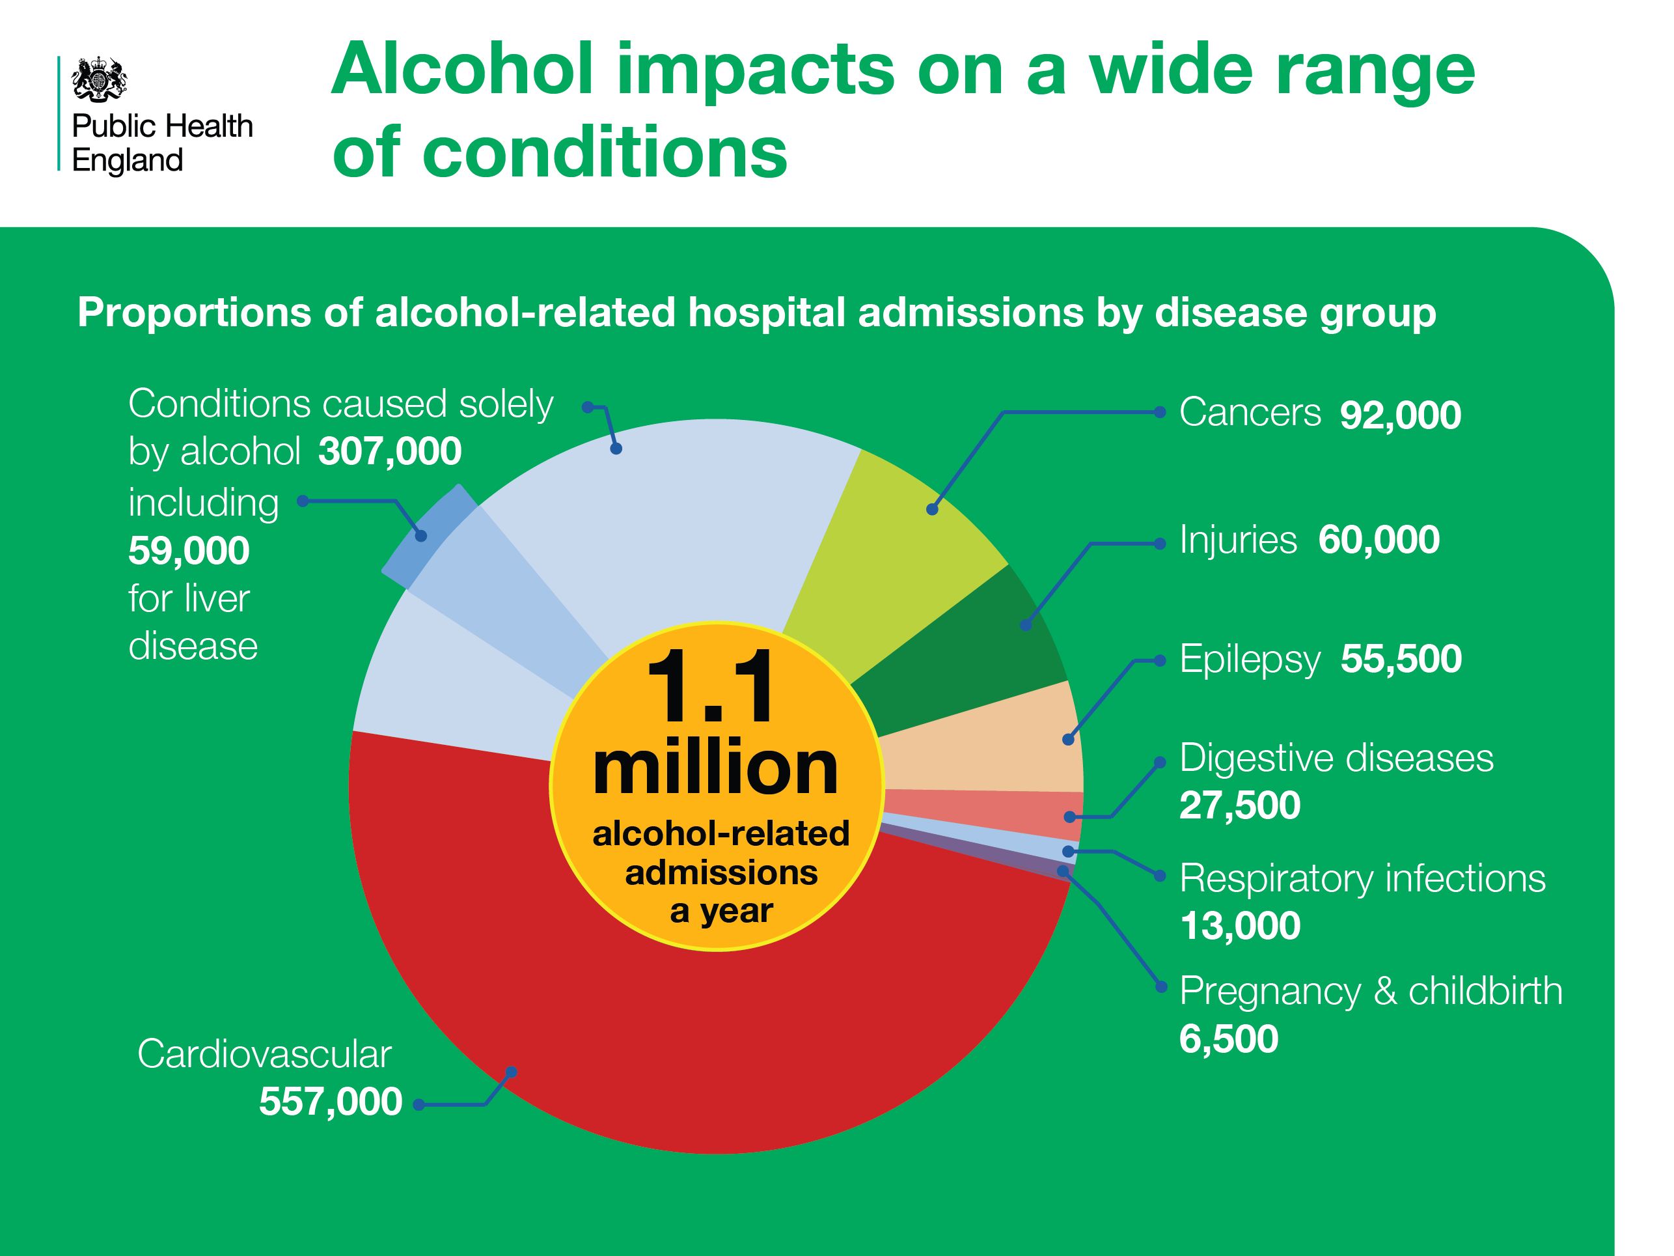
Notes:
Alcohol impacts on a wide range of conditions
There are around 1 million alcohol-related admissions to hospital each year. This pie chart shows the numbers of admissions in different disease groups that make up the 1 million admissions. Nearly half of the admissions are accounted for by cardiovascular conditions.
References
Cut and paste website addresses into your browser to access the links
Centre for Public Health (2014) Hospital Episode Statistics (HES) 2015-16– NHS Digital. Updating England-Specific Alcohol-Attributable Fractions.. Available at: http://www.cph.org.uk/wp-content/uploads/2014/03/24892-ALCOHOL-FRACTIONS-REPORT-A4-singles-24.3.14.pdf

Slide 8
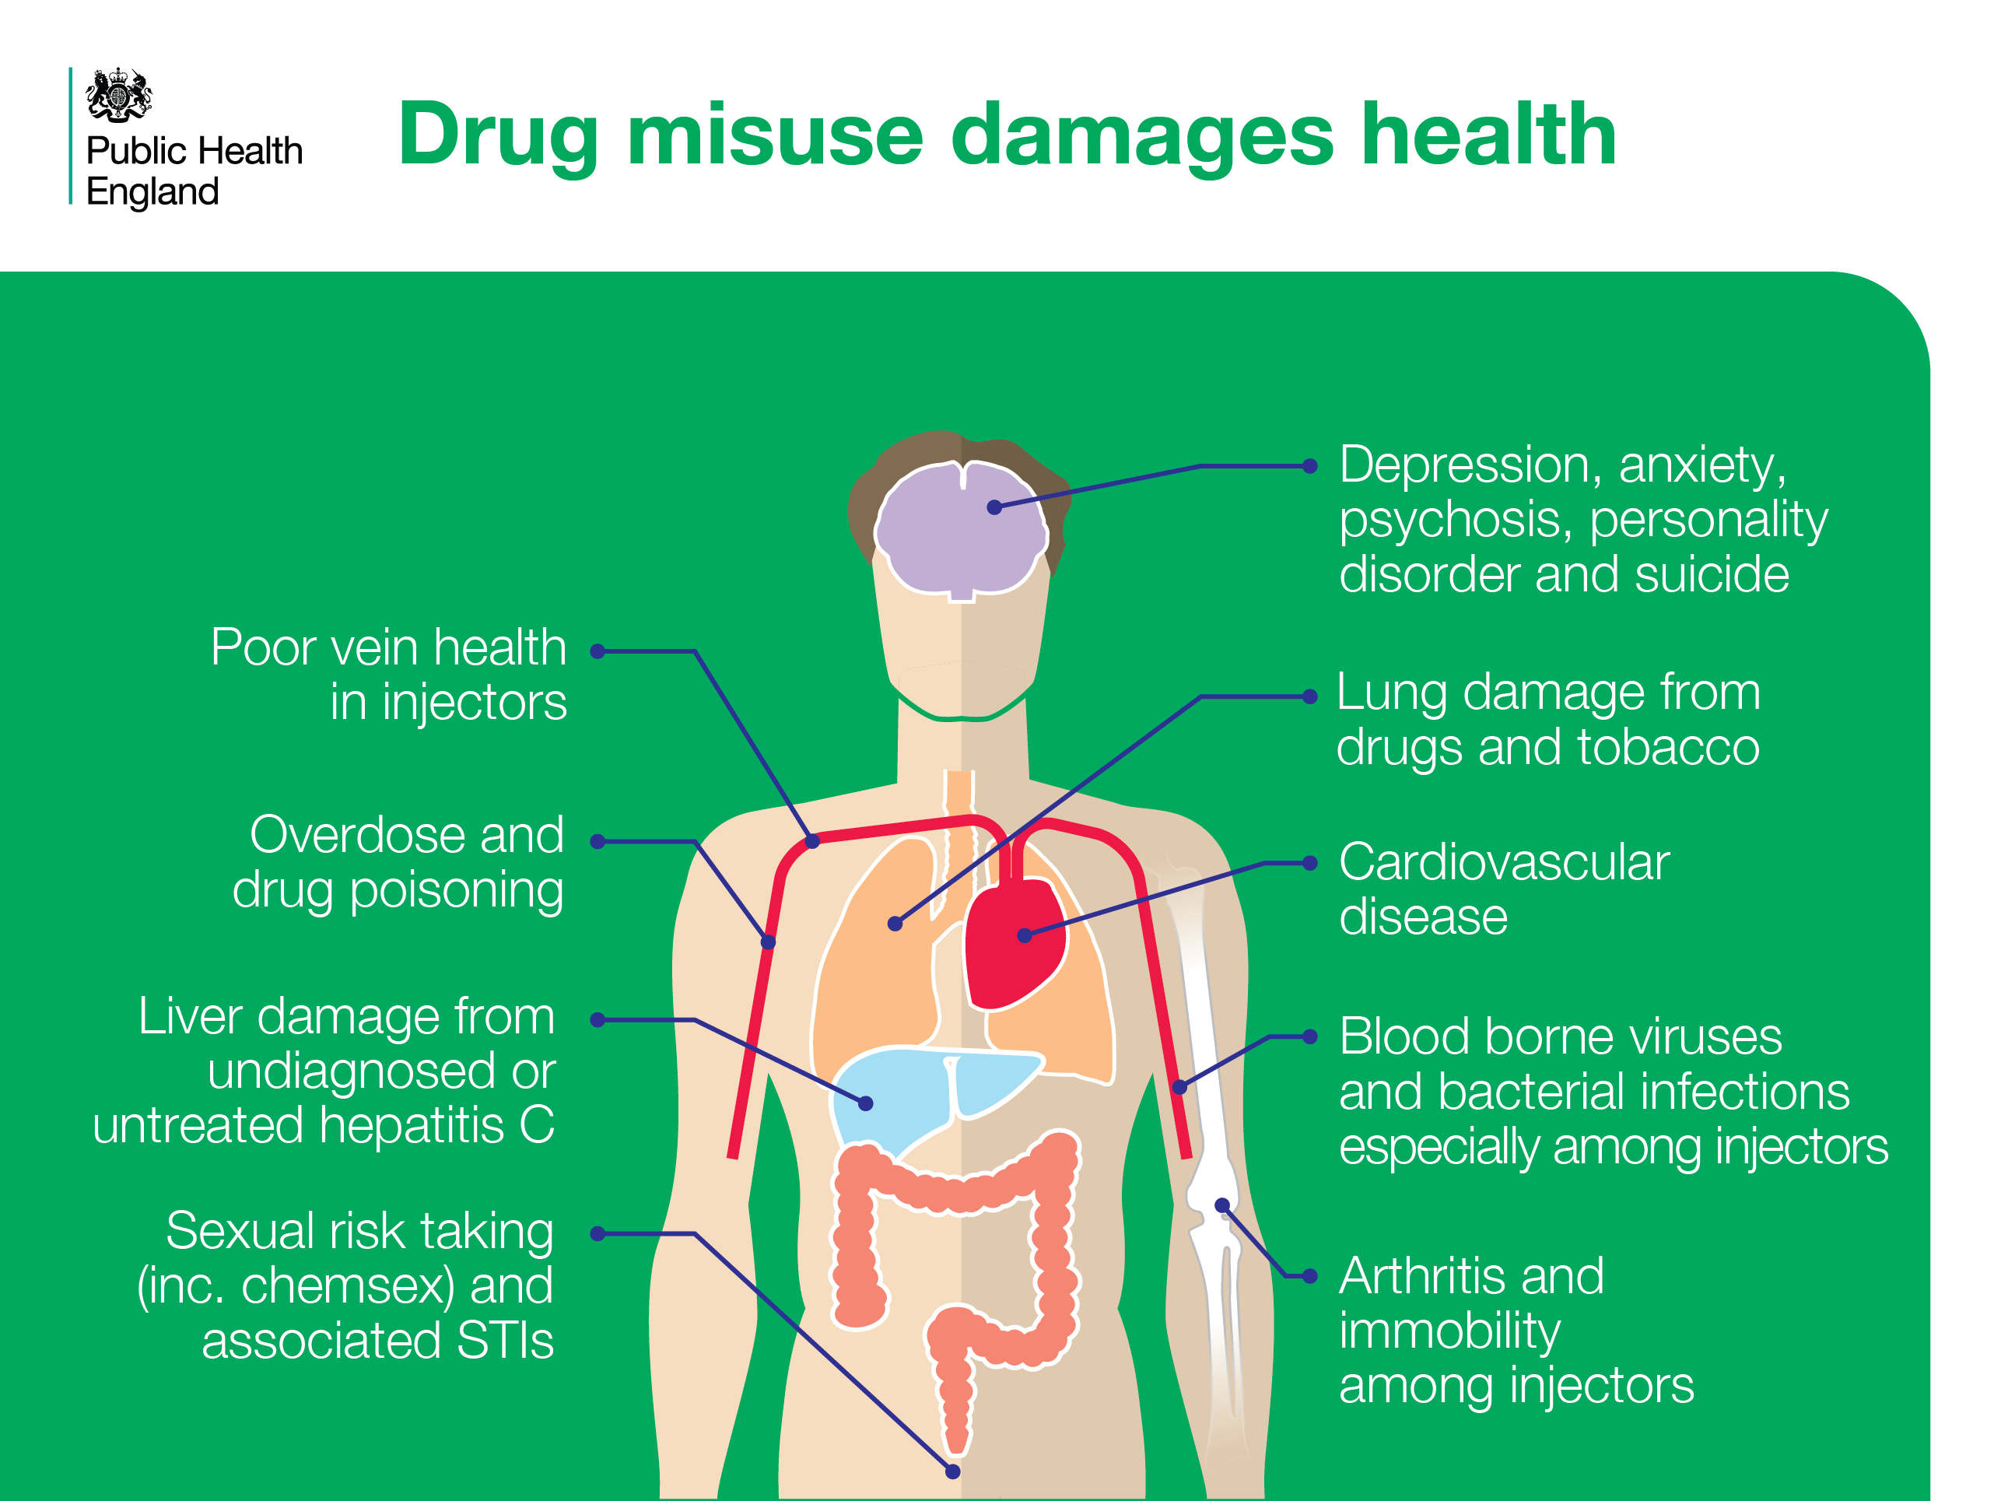
Notes:
Drug misuse damages health
Misuse of drugs can cause a range of harms depending on the drug of choice and the routes of administration such as smoking, injecting or snorting. This slide shows some of the health harms that can be associated with drug misuse.
References
Cut and paste website addresses into your browser to access the links
All: Department of Health, 2017. Drug misuse and dependence: UK guidelines on clinical management. London: Available at: https://www.gov.uk/government/publications/drug-misuse-and-dependence-uk-guidelines-on-clinical-management

Slide 9
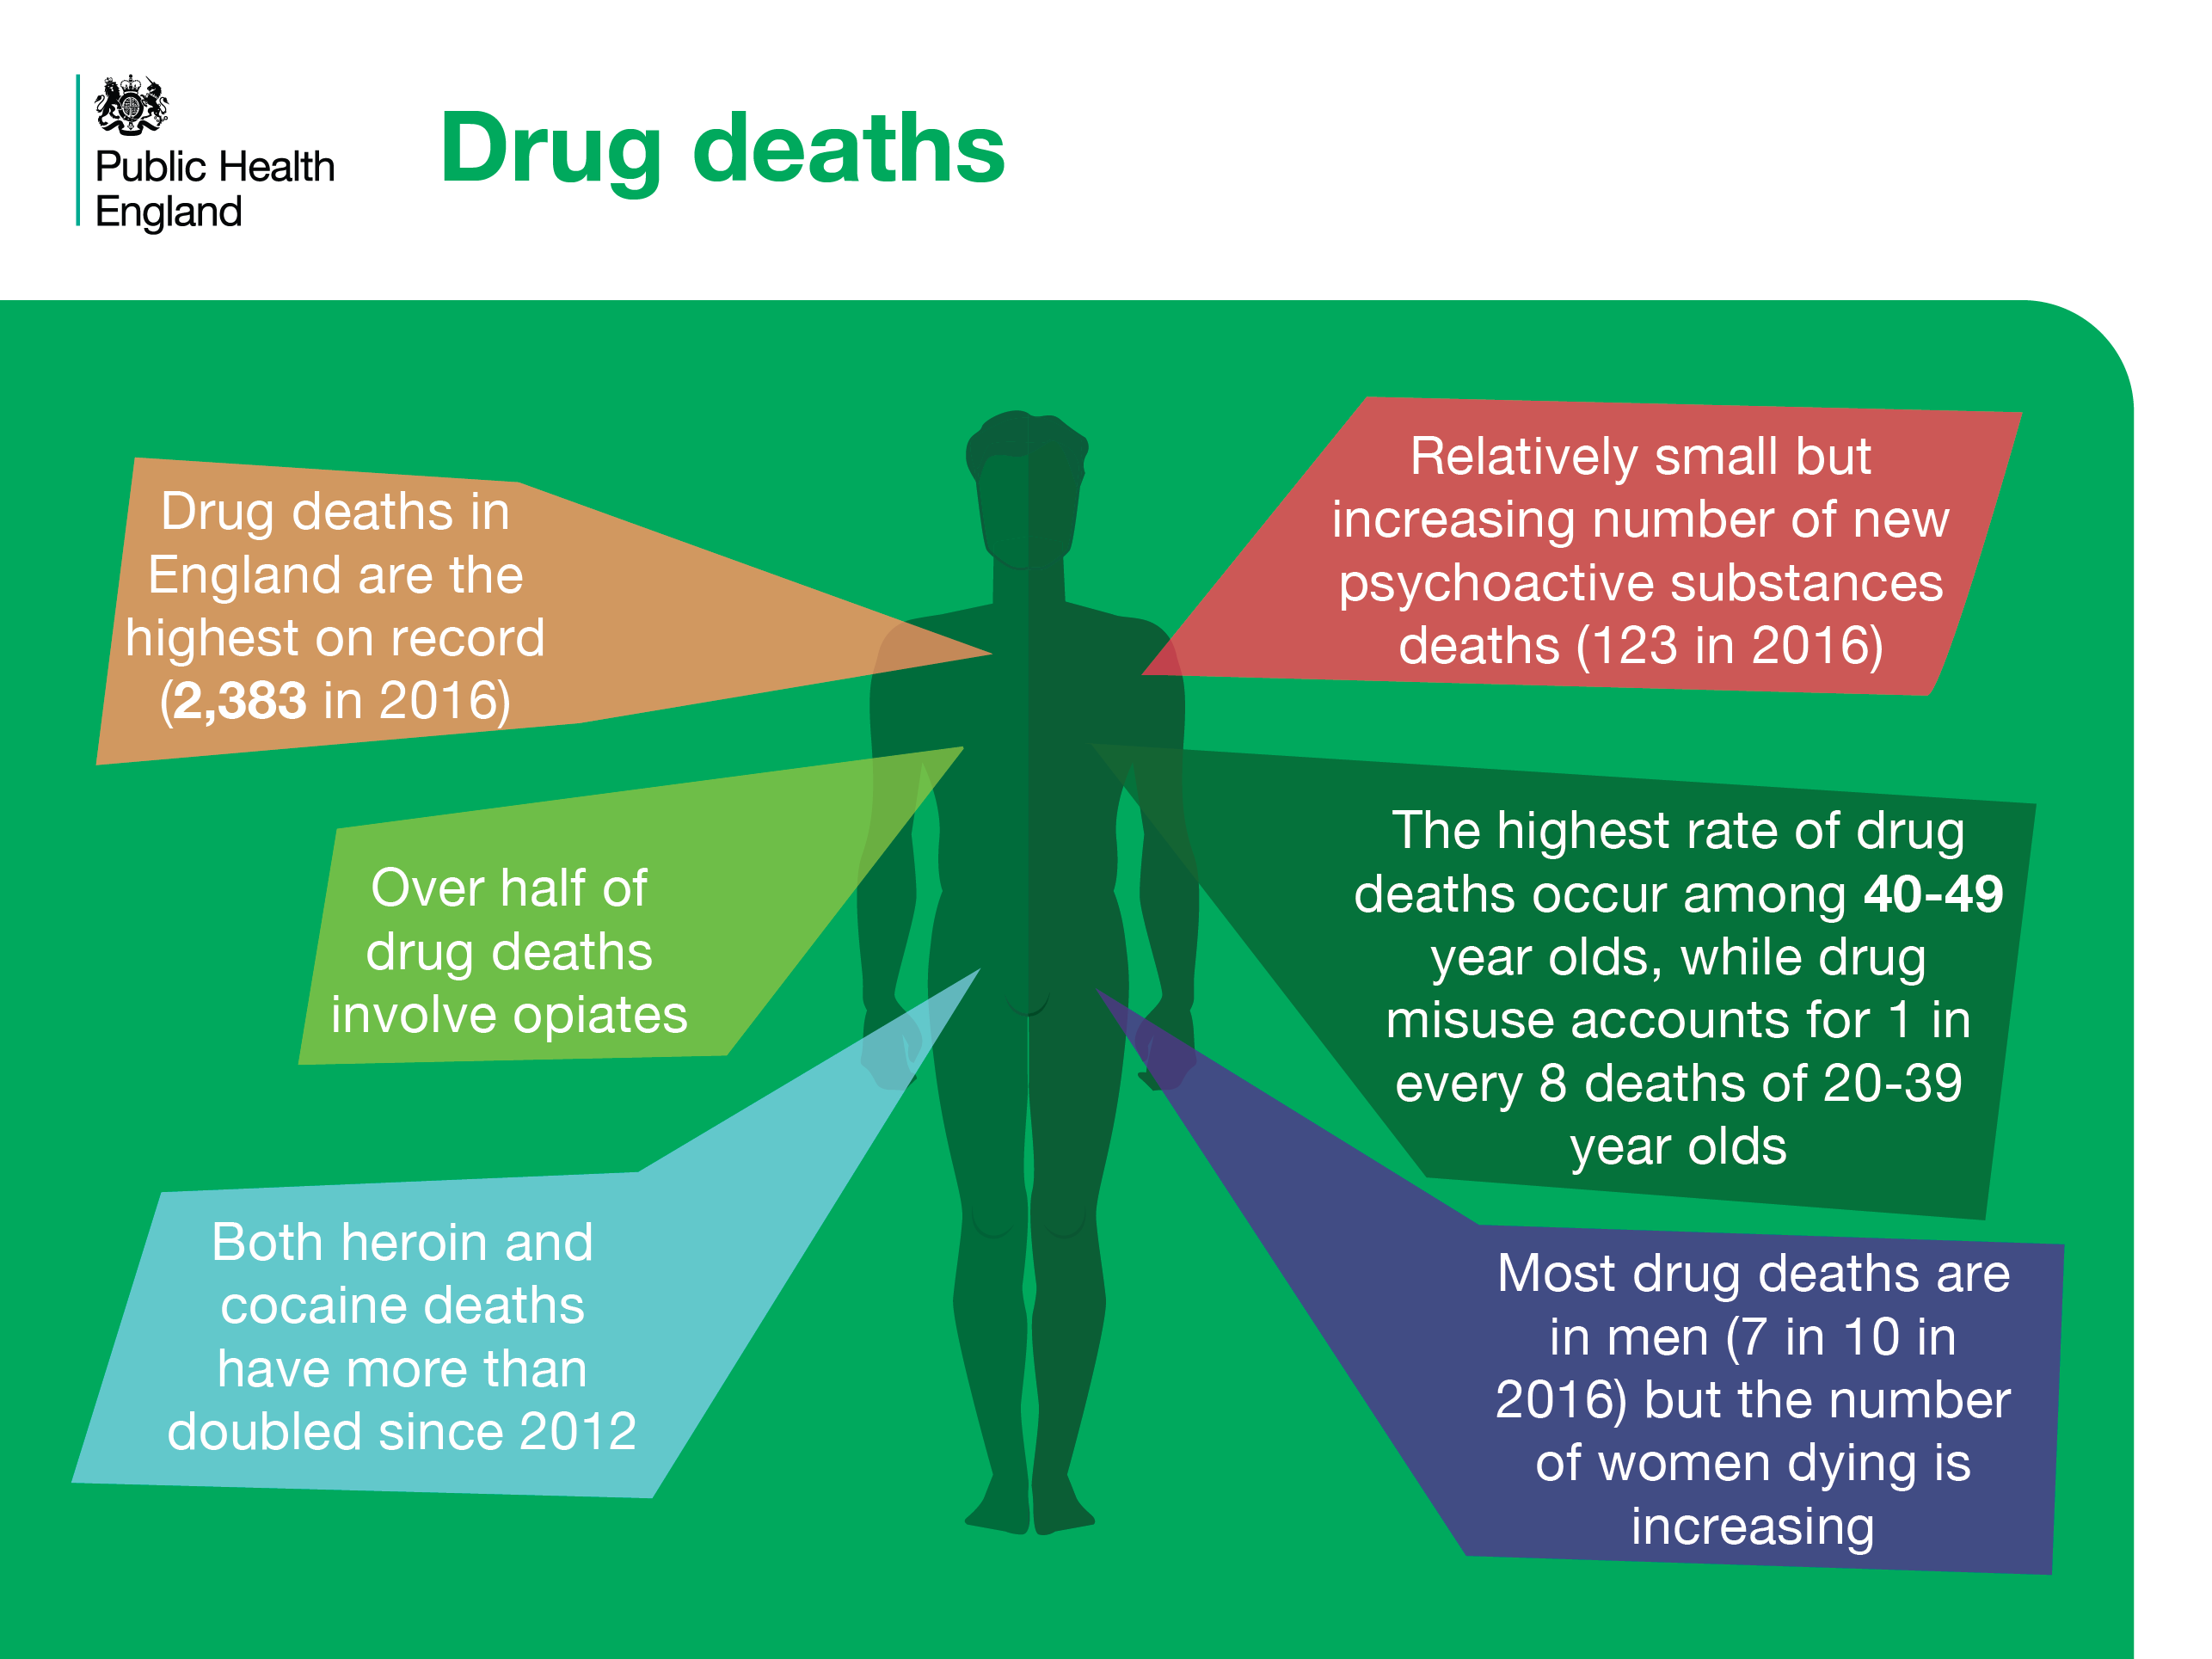
Notes:
Drug deaths
The number of drug deaths in 2016 is the highest on record (2,383). The highest numbers are in men and among those aged 40 to 49. Over half of all drug-related deaths in England involve opiates. New psychoactive substances account for a relatively small proportion of deaths.
References
Cut and paste website addresses into your browser to access the links
All: ONS (2017) Deaths related to drug poisoning in England and Wales: 2016 registrations. Available at: https://www.ons.gov.uk/peoplepopulationandcommunity/birthsdeathsandmarriages/deaths/bulletins/deathsrelatedtodrugpoisoninginenglandandwales/2016registrations
Please note: the statistics are for England only, with the exception of NPS deaths which is for England and Wales.

Slide 10
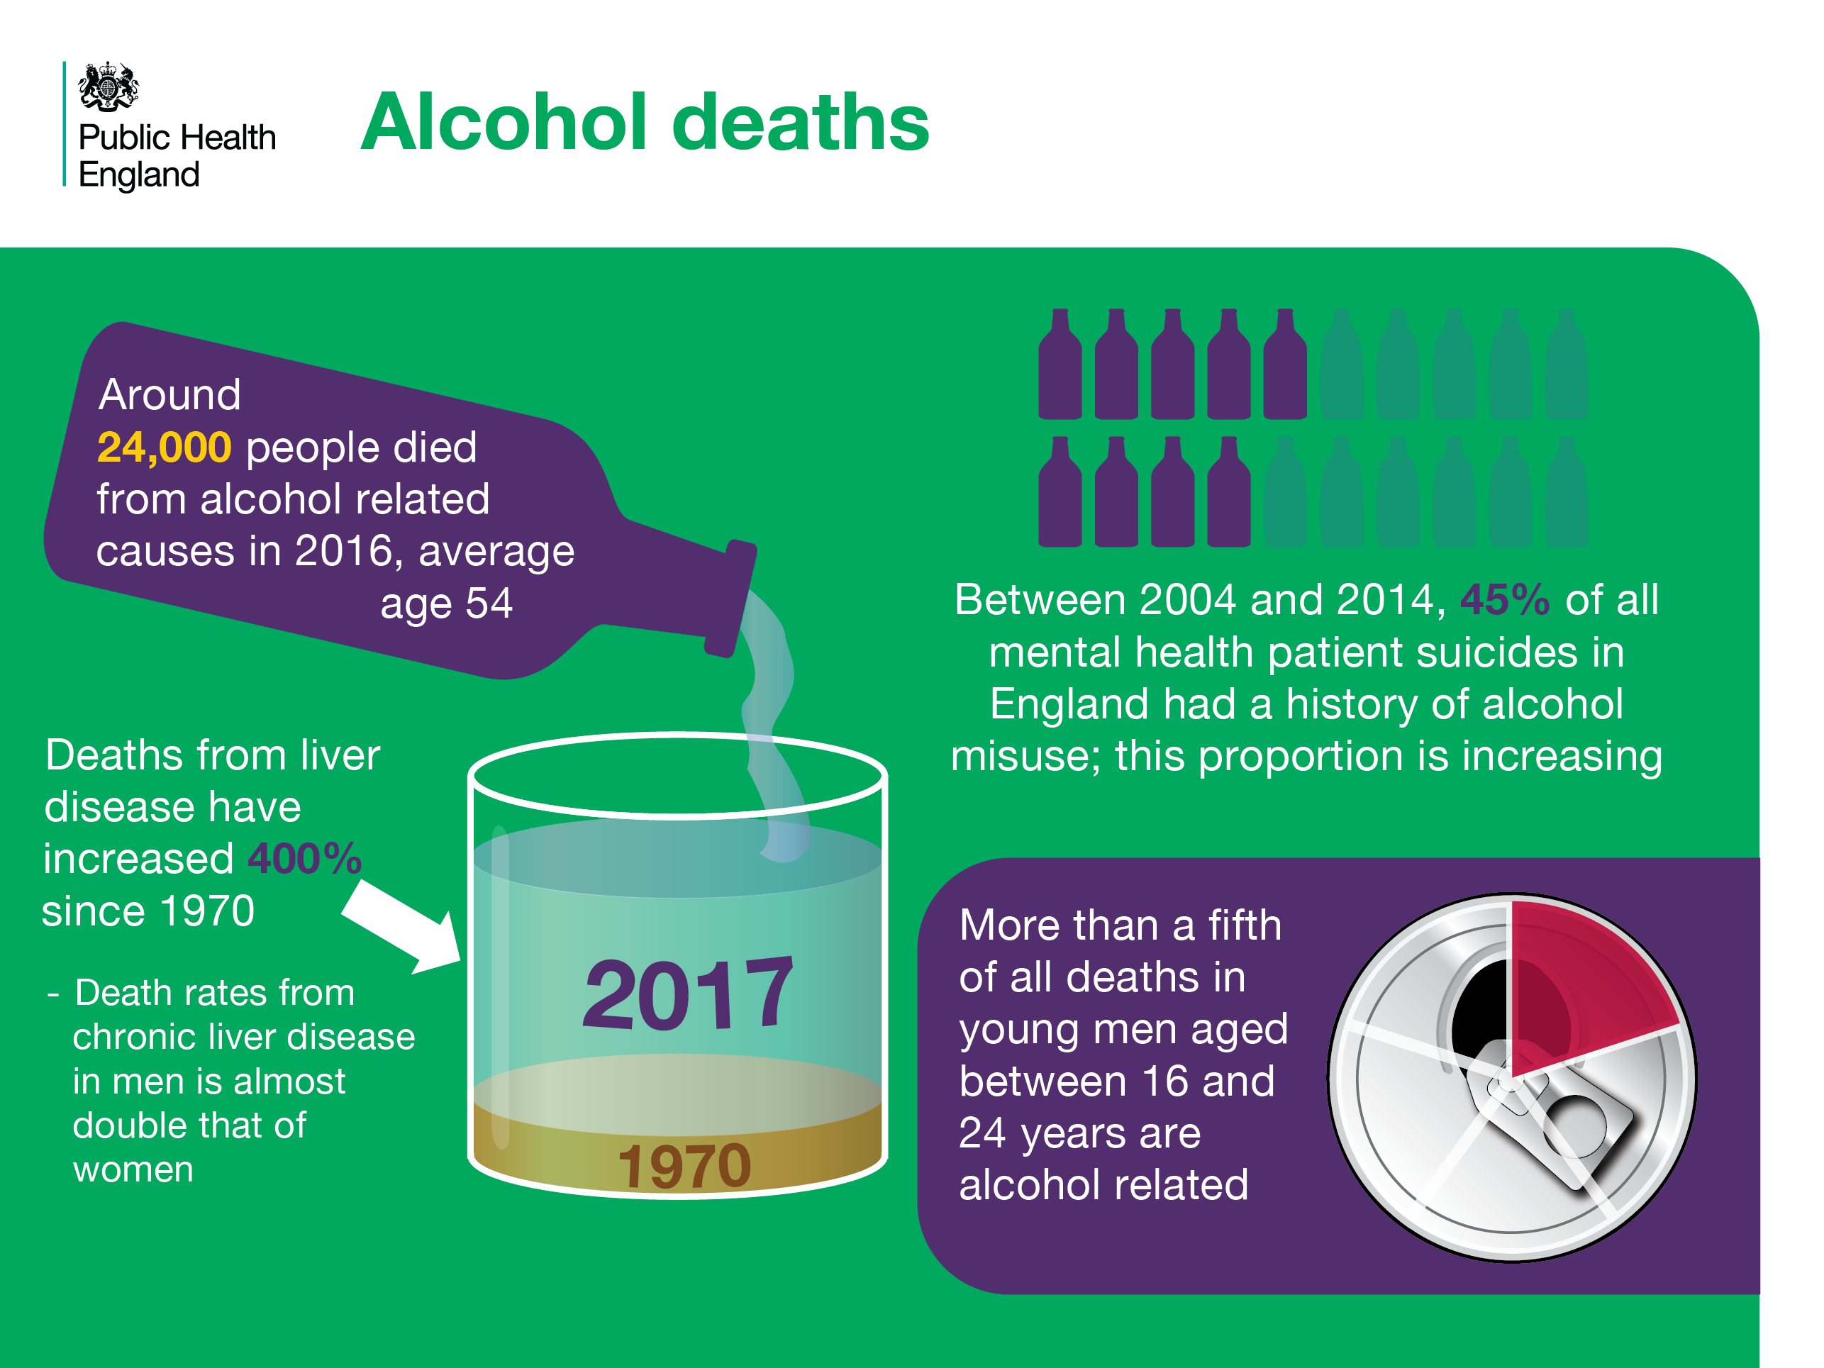
Notes:
Alcohol deaths
A significant number of deaths are from alcohol-related causes. Alcohol misuse is the single largest cause of liver mortality. It has gone up 400% since 1970 and men have been affected more than women, though the rate among women has also accelerated in recent years. There are strong associations between alcohol misuse and suicide in mental health patients. Significant proportions of deaths in young male adults are also attributable to alcohol.
References
Cut and paste website addresses into your browser to access the links
PHE. (2017).Local Alcohol Profiles for England. November 2017 statistical commentary. Available at: https://www.gov.uk/government/uploads/system/uploads/attachment_data/file/657094/LAPE_November_2017_statistical_commentary.pdf
2. PHE fingertips, Liver disease profiles, 2014-16, available at: https://fingertips.phe.org.uk/profile/liver-disease/data#page/0
3. The National Confidential Inquiry into Suicide and Homicide by People with Mental Illness. Annual Report: England, Northern Ireland, Scotland and Wales.
October 2017. University of Manchester
4. PHE. (2017).Local Alcohol Profiles for England. November 2017 statistical commentary. Available at: https://www.gov.uk/government/uploads/system/uploads/attachment_data/file/657094/LAPE_November_2017_statistical_commentary.pdf

Slide 11
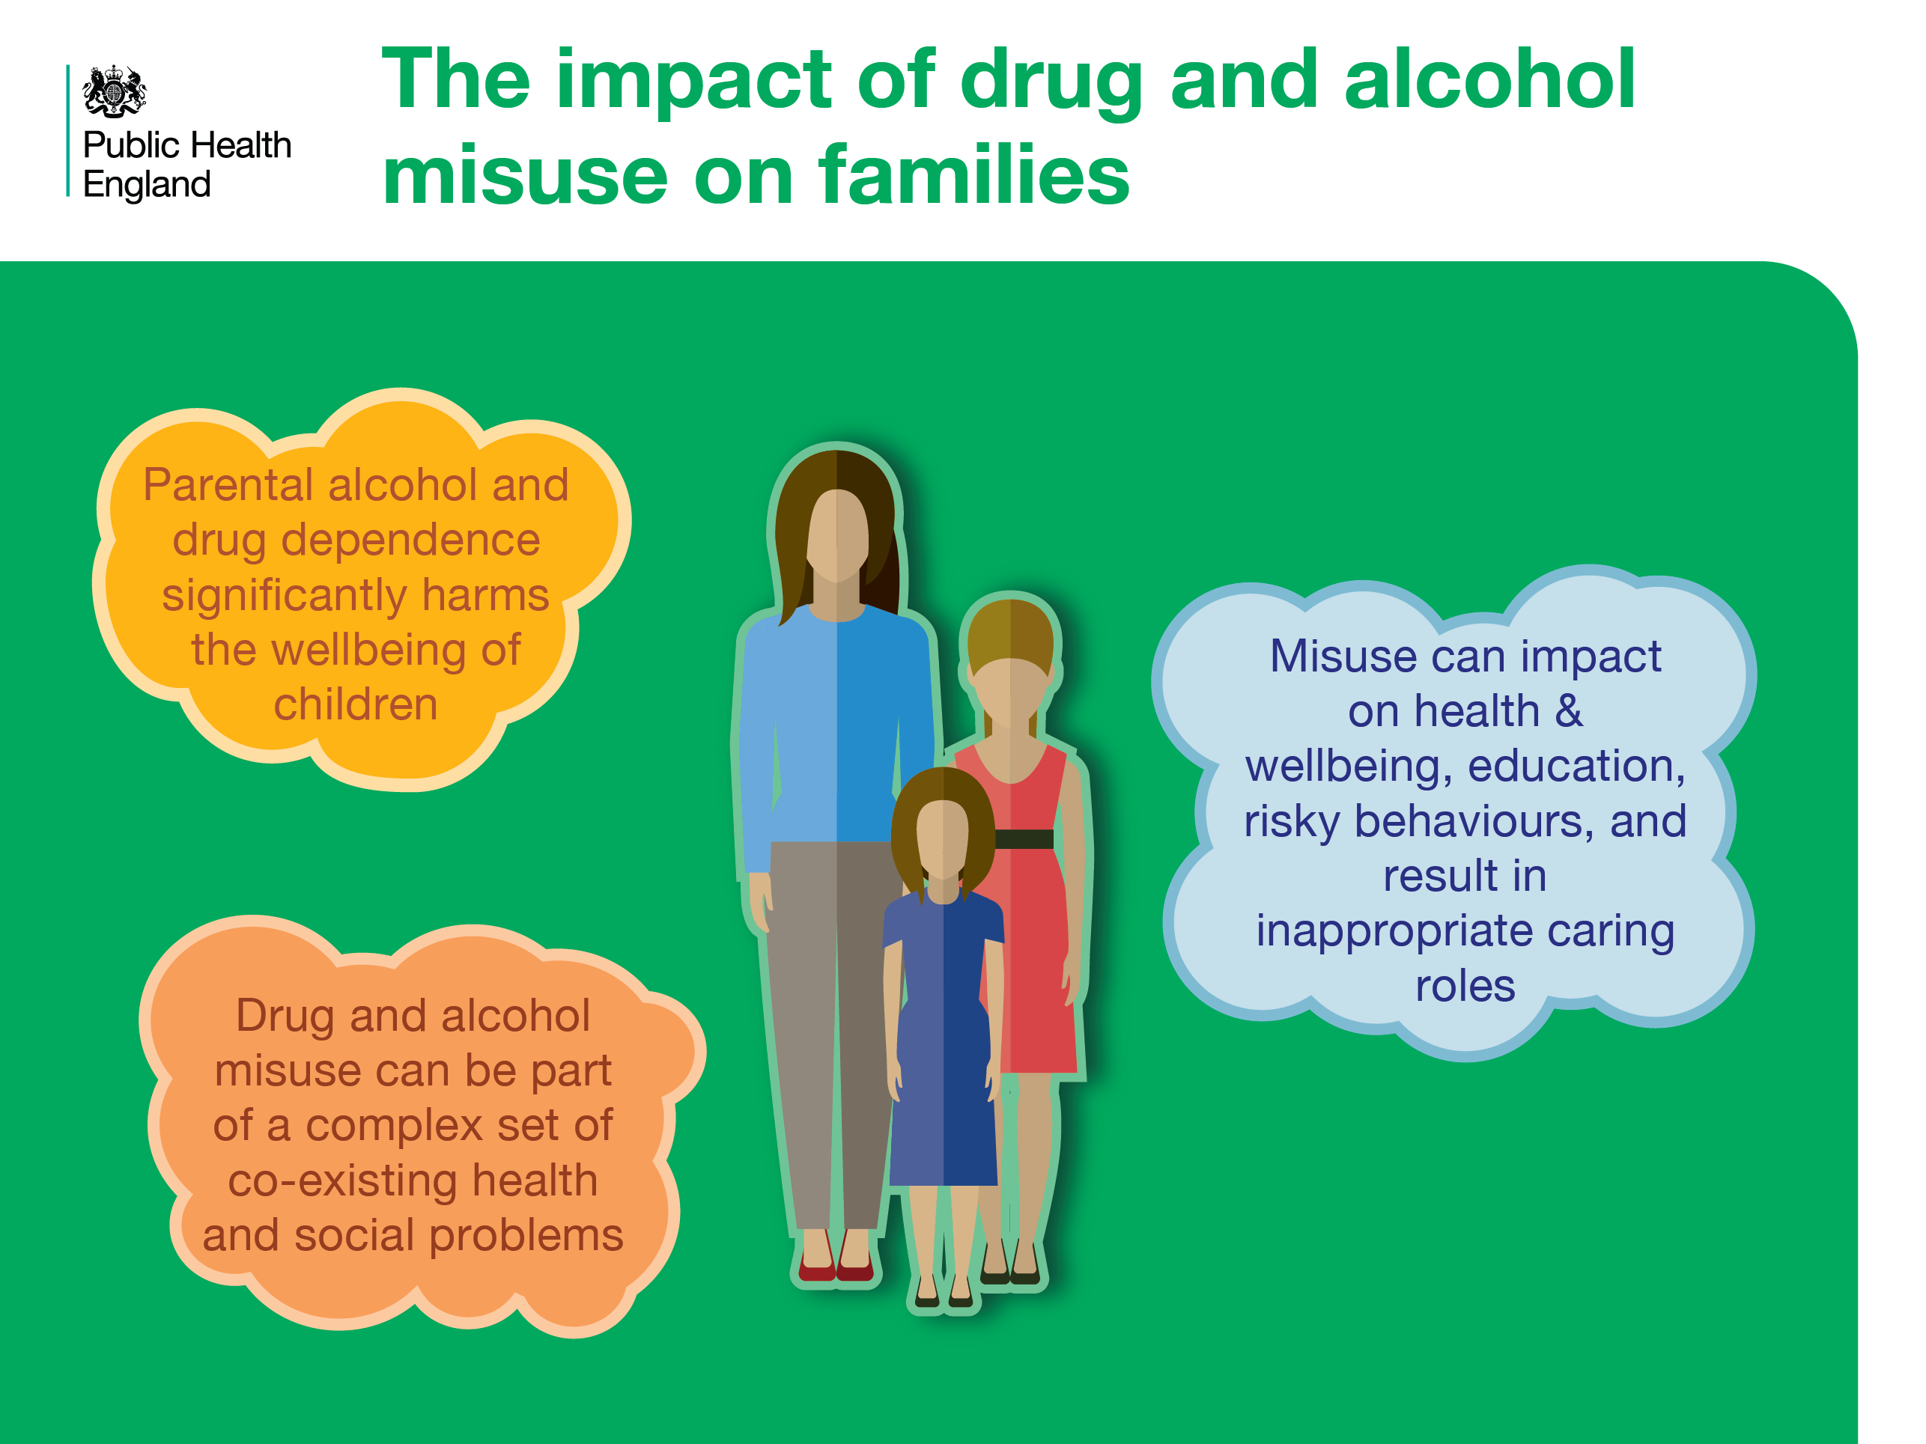
Notes:
The impact of drug and alcohol misuse on families
Parental drug and alcohol misuse can have a detrimental effect on the health and wellbeing of children. It can increase the risk of children partaking in risk-taking behaviours, reduce educational attainment and result in earlier uptake of drugs or alcohol.
References
Cut and paste website addresses into your browser to access the links
Adamson, J., Templeton, L. and Clifton, J. (2012) Silent Voices: Supporting Children and young people affected by parental alcohol misuse, London: The Office of the Children’s Commissioner.
2. Advisory Council on the Misuse of Drugs (2003) Hidden Harm: responding to the needs of children of problem drug users. Available at: https://www.gov.uk/government/publications/amcd-inquiry-hidden-harm-report-on-children-of-drug-users
3. National Treatment Agency for Substance Misuse (NTA) (2012) Parents with drugs problems: how treatment helps families. Available at: http://www.nta.nhs.uk/uploads/families2012vfinali.pdf

Slide 12
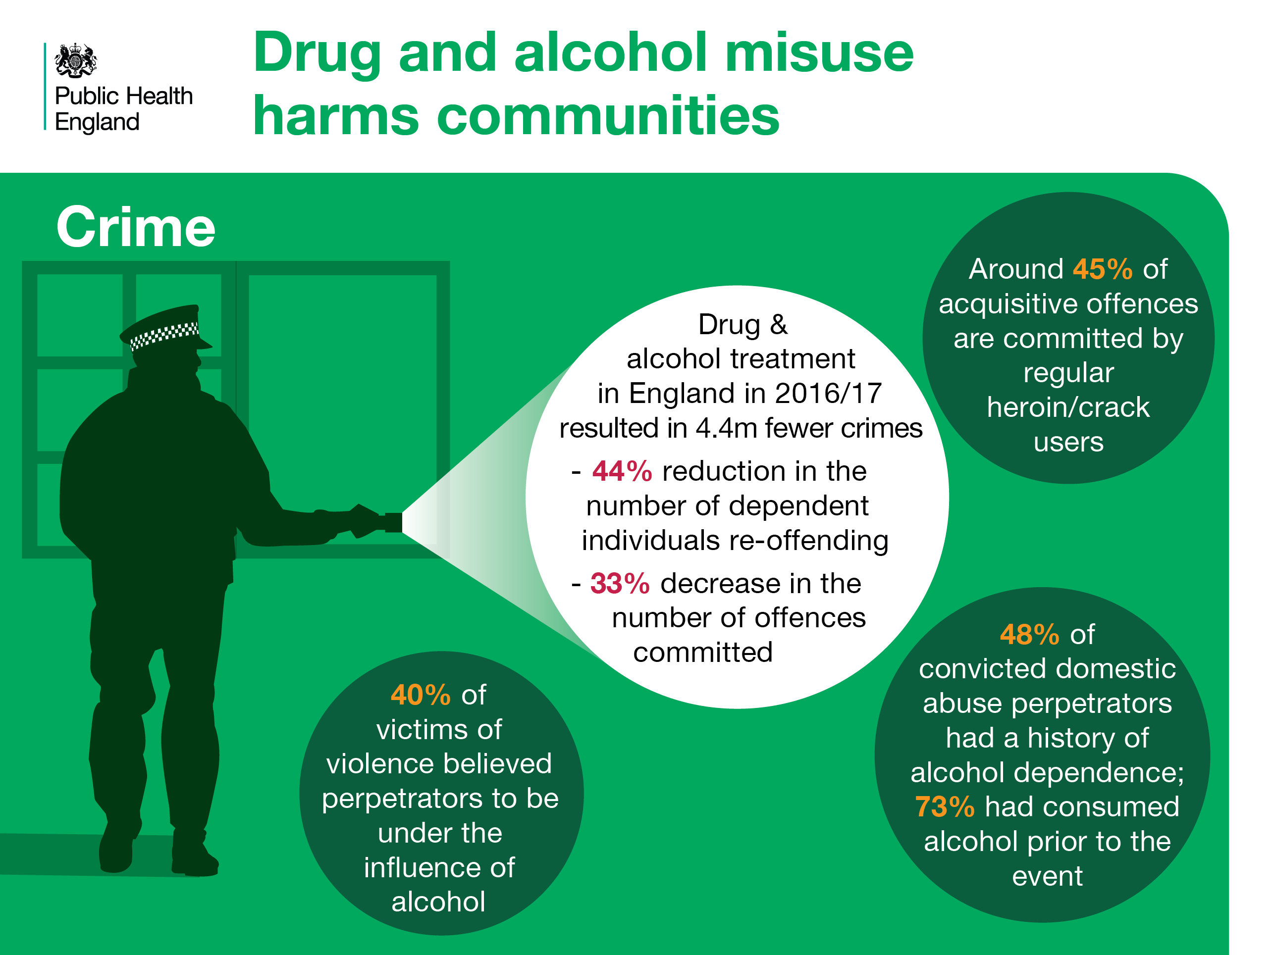
Notes:
Drug and alcohol misuse harms to communities: crime
Acquisitive crime, violent crime and domestic abuse are particularly associated with drug and alcohol misuse. Analysis of Ministry of Justice and drug & alcohol treatment data has shown that drug and alcohol specialist treatment results in significant reductions in offending behaviour in dependent drug and alcohol users. Drug/alcohol treatment results in a 44% reduction in the number of individuals re-offending in the 2 years after starting treatment for dependency, with a 33% decrease in the number of offences committed.
References
Cut and paste website addresses into your browser to access the links
1. The impact of community-based drug and alcohol treatment on re-offending. Joint experimental statistical report from the Ministry of Justice and Public Health England. (2017) Available at https://www.ndtms.net/ValueForMoney.aspx (registration required)
2. Mills, H., Skodbo, S. and Blyth, P. (2013). Understanding the organised crime: estimating the scale and the social and economic costs. Home Office Research Report 73. London: Home Office. Available at: https://www.gov.uk/government/publications/understanding-organised-crimeestimating-the-scale-and-the-social-andeconomic-costs
3. ONS (2017) Focus on violent crime and sexual offences, England and Wales: year ending March 2016. Analysis on violent crime and sexual offences from the year ending March 2016 Crime Survey for England and Wales and crimes recorded by police. Available at: https://www.ons.gov.uk/peoplepopulationandcommunity/crimeandjustice/compendium/focusonviolentcrimeandsexualoffences/yearendingmarch2016
4. Gilchrist,G. et al (2003) Domestic violence offenders: characteristics and offending related needs, Findings, 217, London, Home Office

Slide 13
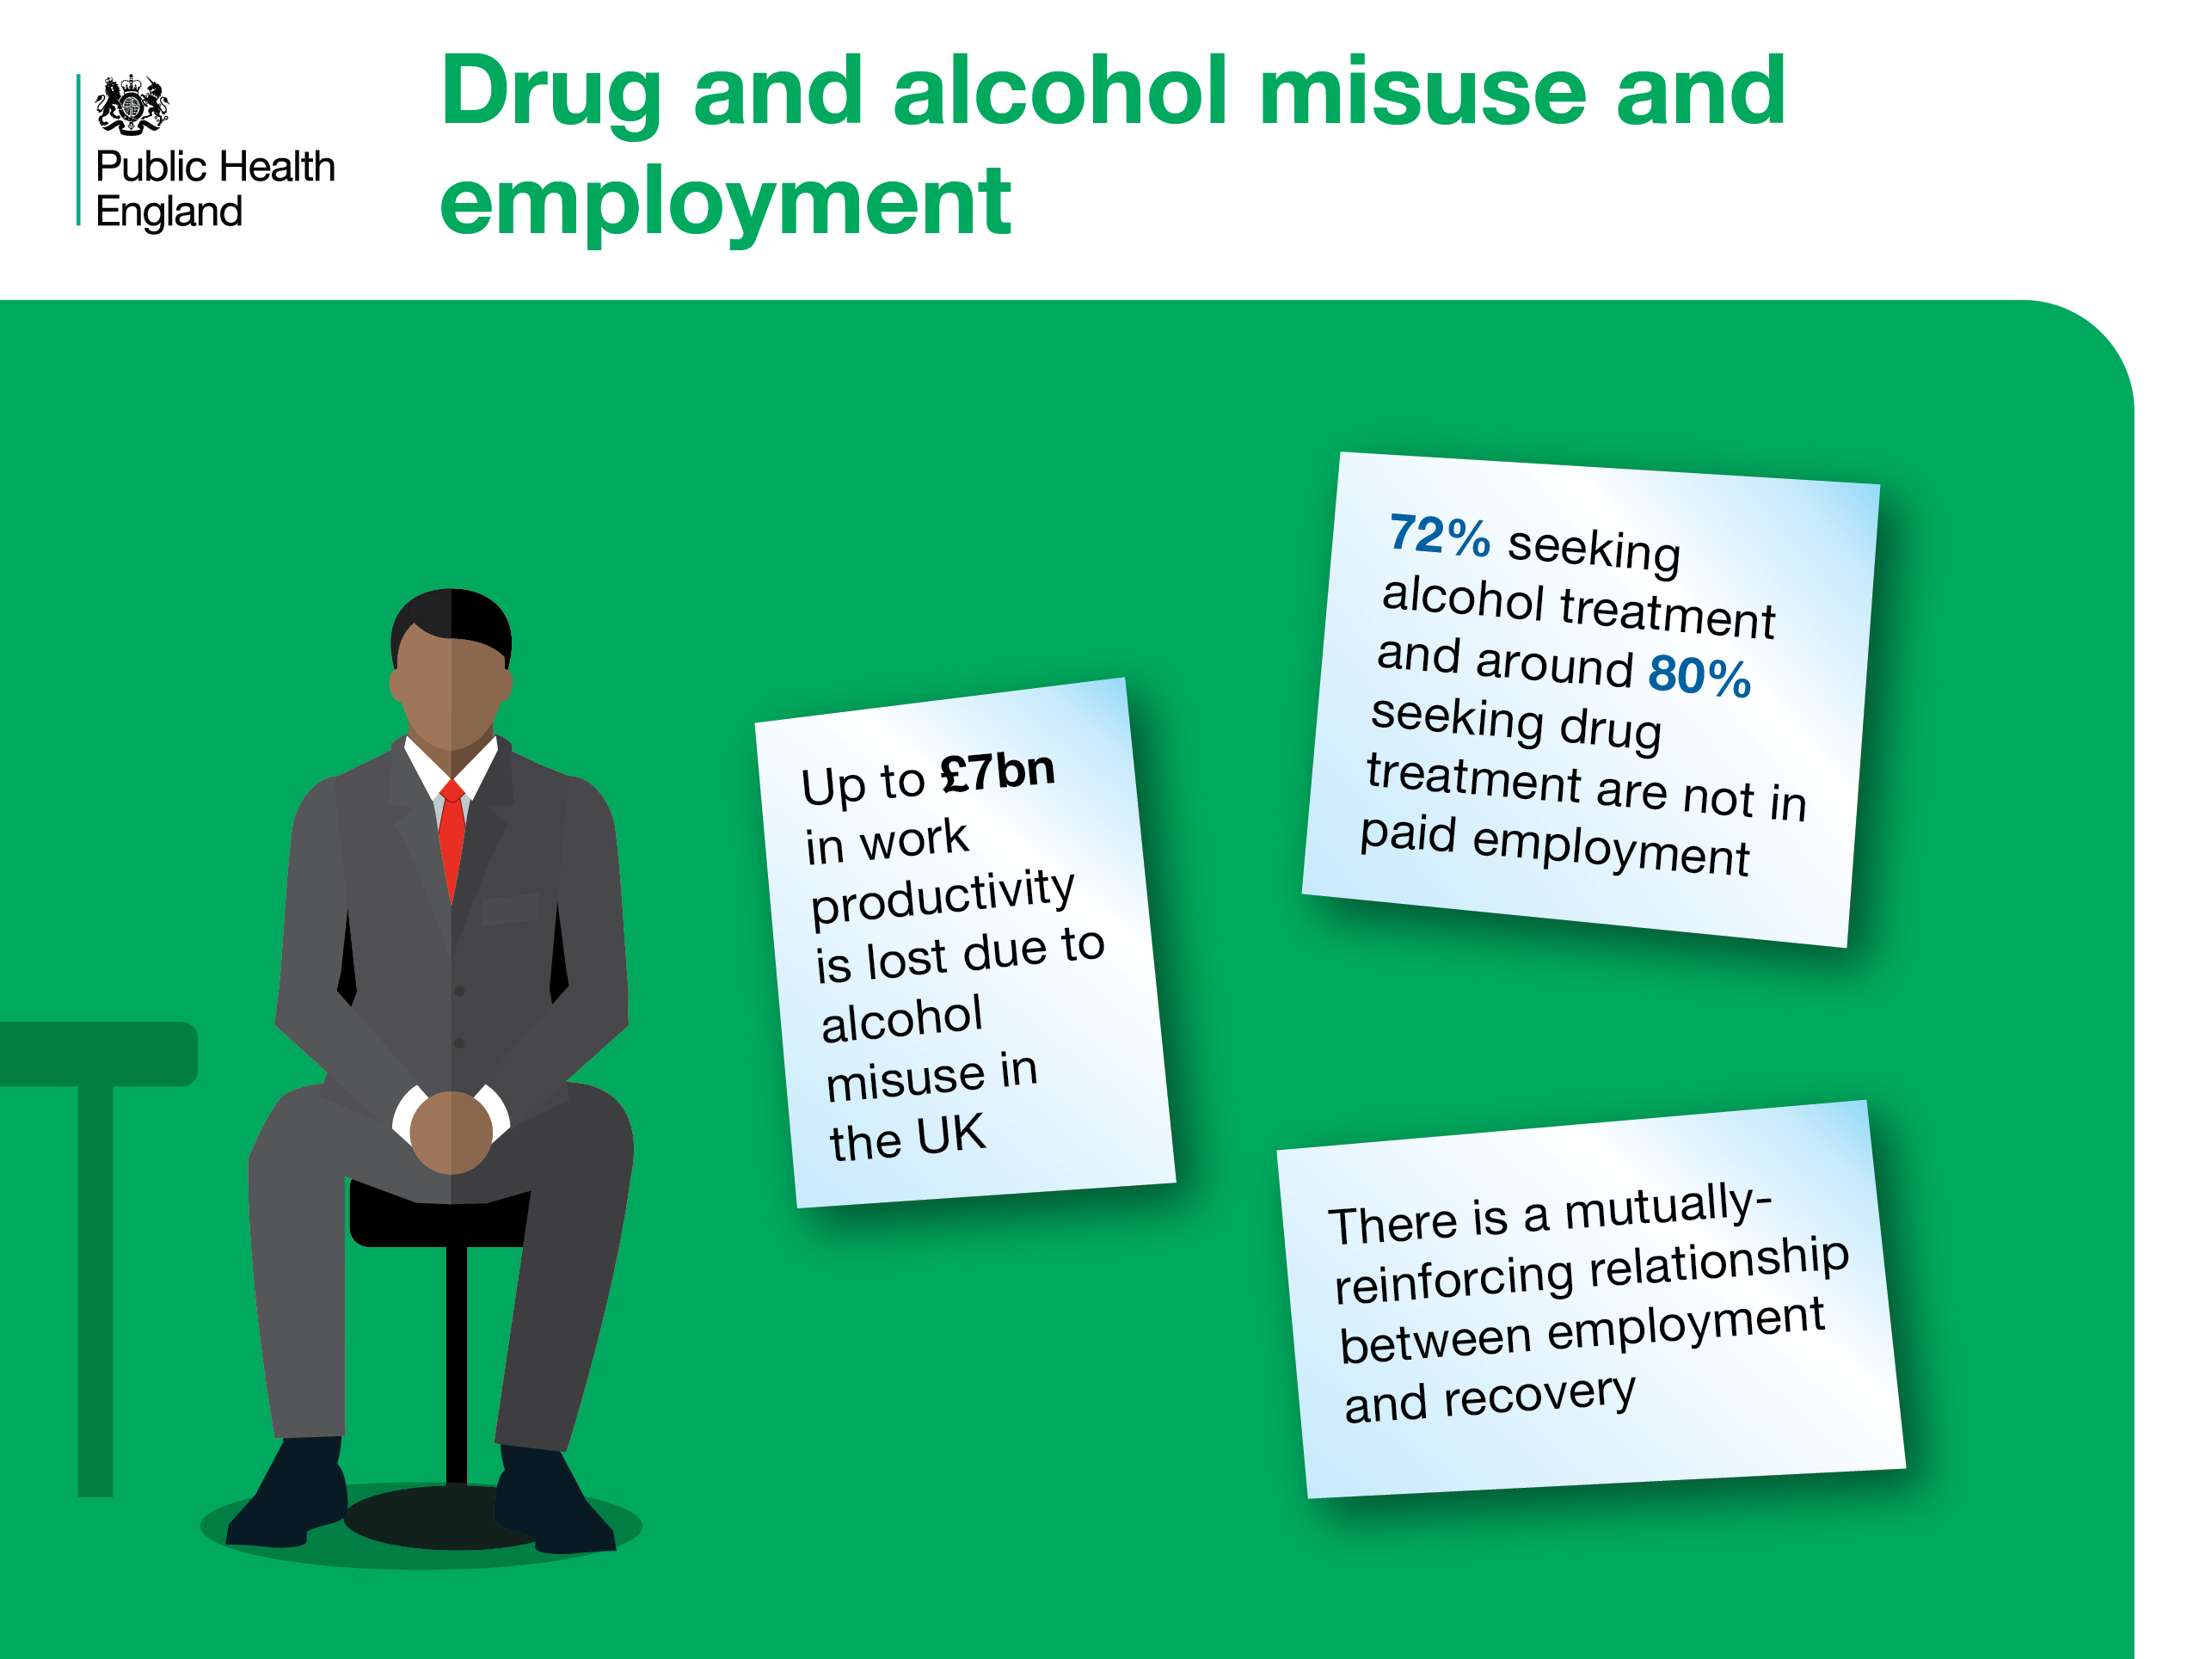
Notes:
Drug and alcohol misuse harms to communities: employment
Alcohol misuse has been estimated to cost £7bn in lost productivity nationally. Most individuals seeking drug or alcohol treatment are unemployed and treatment/recovery services actively seek to provide opportunities and support to individuals to find meaningful activities and employment. Employment and recovery are mutually reinforcing.
References
Cut and paste website addresses into your browser to access the links
PHE (2016) The public health burden of alcohol and the effectiveness and cost-effectiveness of alcohol control policies; an evidence review.
2. PHE (2017). Adult substance misuse statistics from the National Drug Treatment Monitoring System (NDTMS), 1 April 2016 to 31 March 2017. Available at https://www.gov.uk/government/uploads/system/uploads/attachment_data/file/658056/Adult-statistics-from-the-national-drug-treatment-monitoring-system-2016-2017.pdf)
Dame Carol Black 2016. An Independent Review into the impact on employment outcomes of drug or alcohol addiction, and obesity

Slide 14
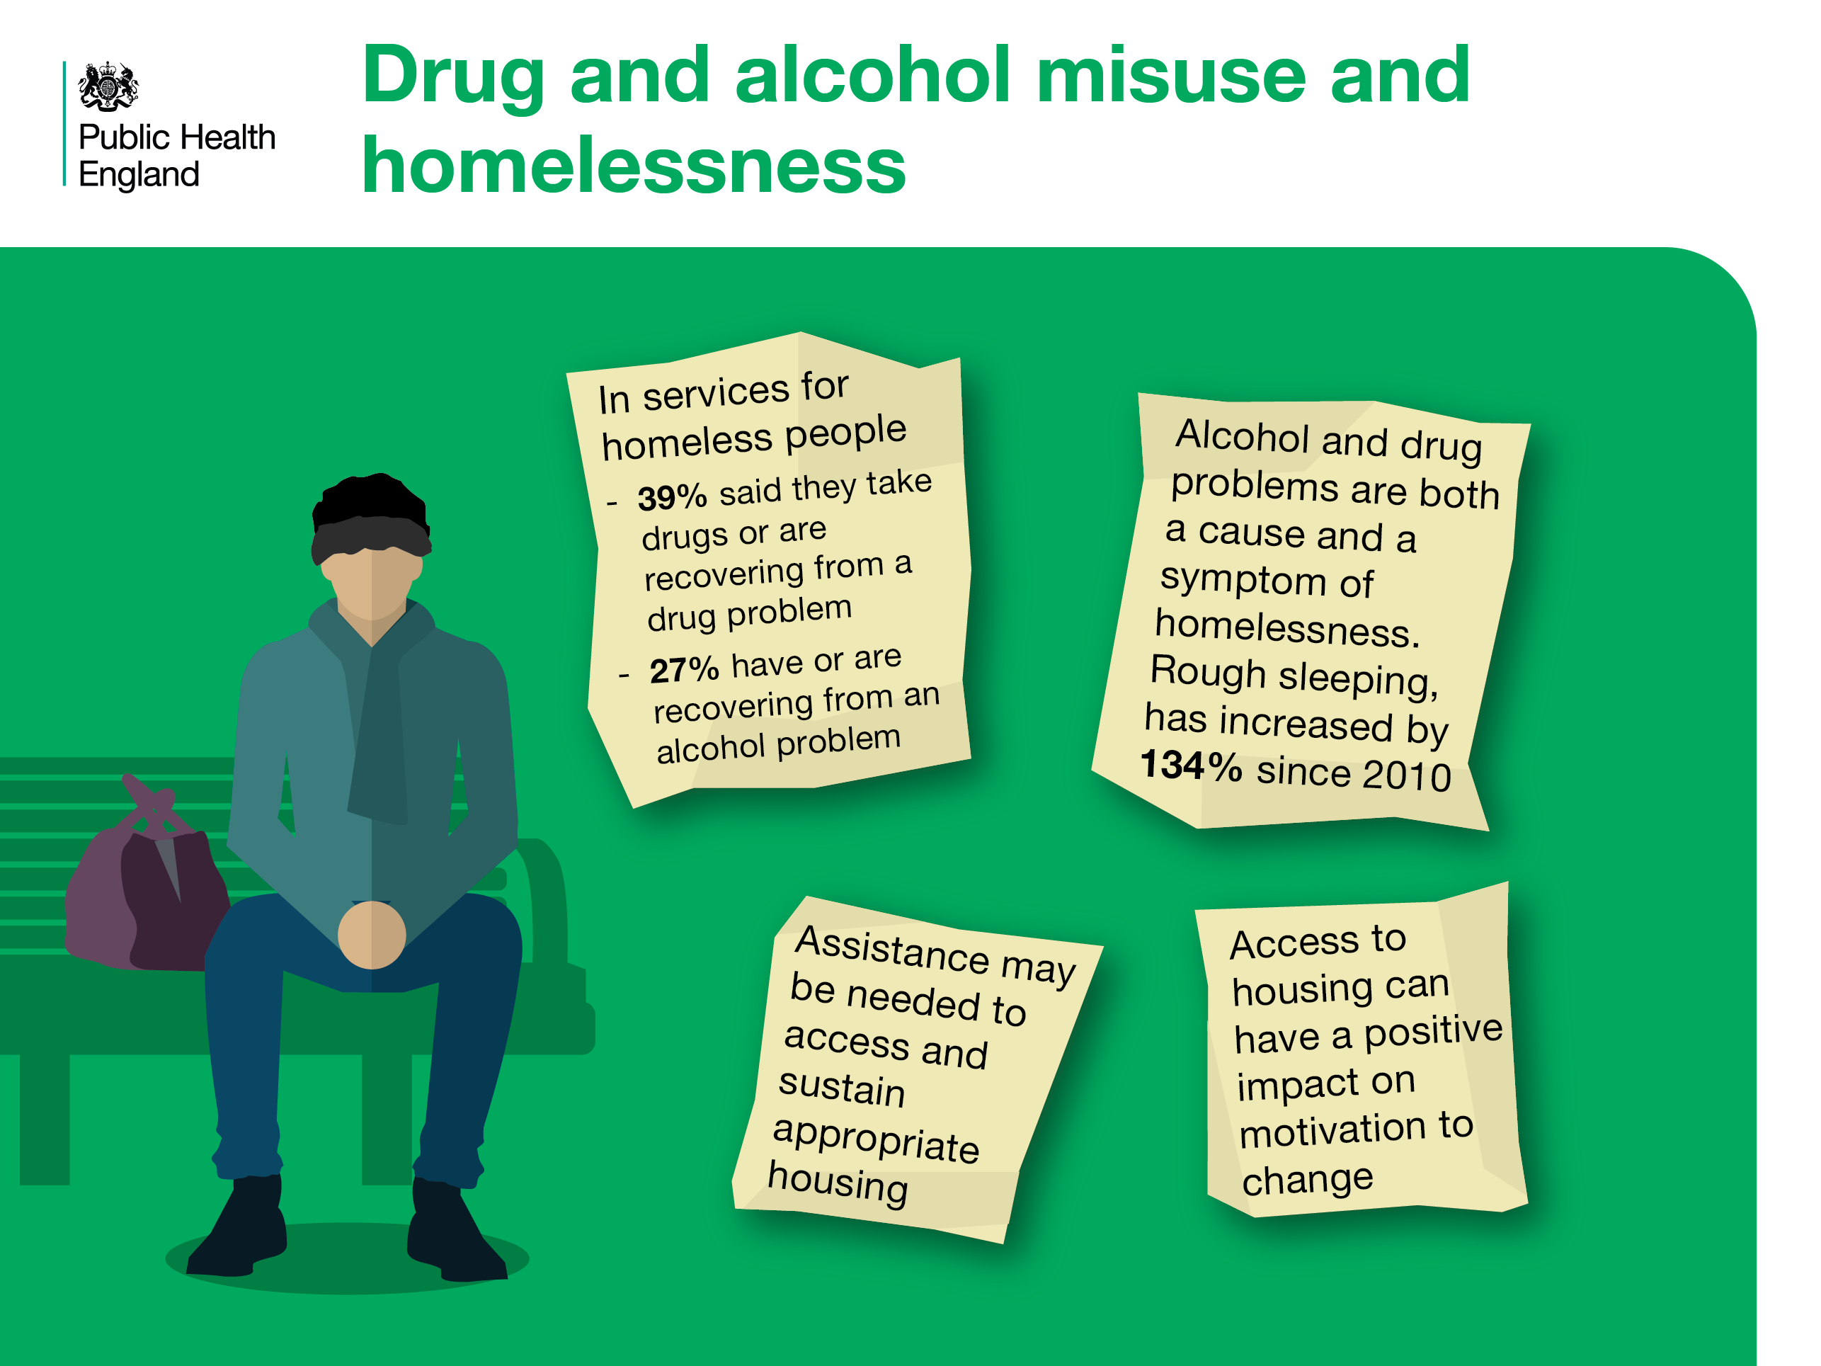
Notes:
Homelessness
Drug and alcohol problems can be both a cause and a symptom of homelessness. Significant proportions of homeless people have drug or alcohol problems. Providing support to address housing need is vital and can have a positive impact on motivation to change.
References
Cut and paste website addresses into your browser to access the links
Homeless link. (2014). The unhealthy state of homelessness: Health audit results 2014. http://www.homeless.org.uk/facts/our-research/homelessness-and-health-research
2. Homeless Link (2016). Rough sleeping count. Available athttps://www.homeless.org.uk/sites/default/files/site-attachments/Homeless%20Link%20-%20analysis%20of%20rough%20sleeping%20statistics%20for%20England%202016.pdf
3 & 4. PHE. (2017). An evidence review of the outcomes that can be expected of drug misuse treatment in England.

Slide 15
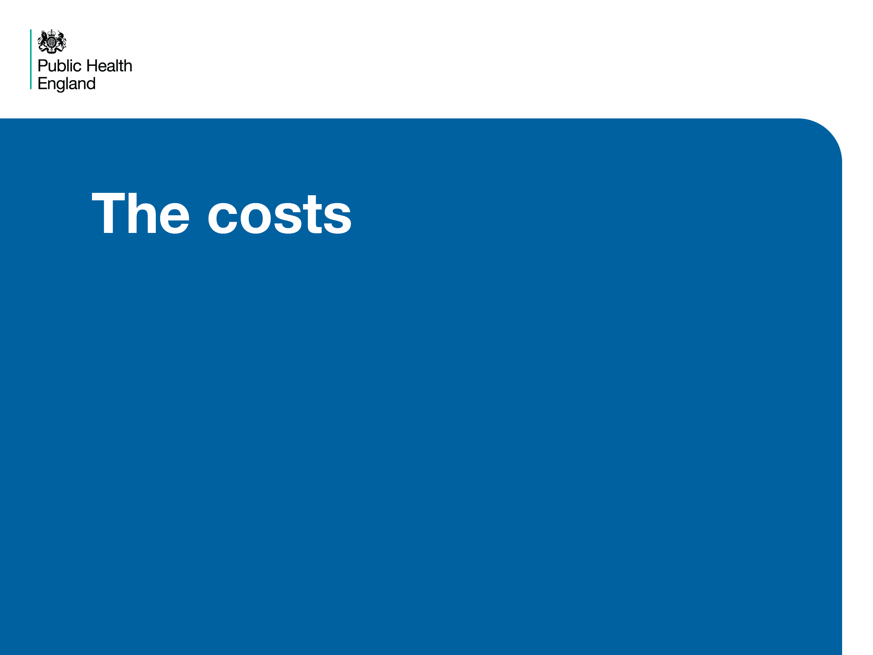
Notes:
The costs
The costs to society of alcohol related harms and drug misuse are considerable. The following slide describes estimated costs which include lost productivity, crime, policing, and NHS costs.

Slide 16
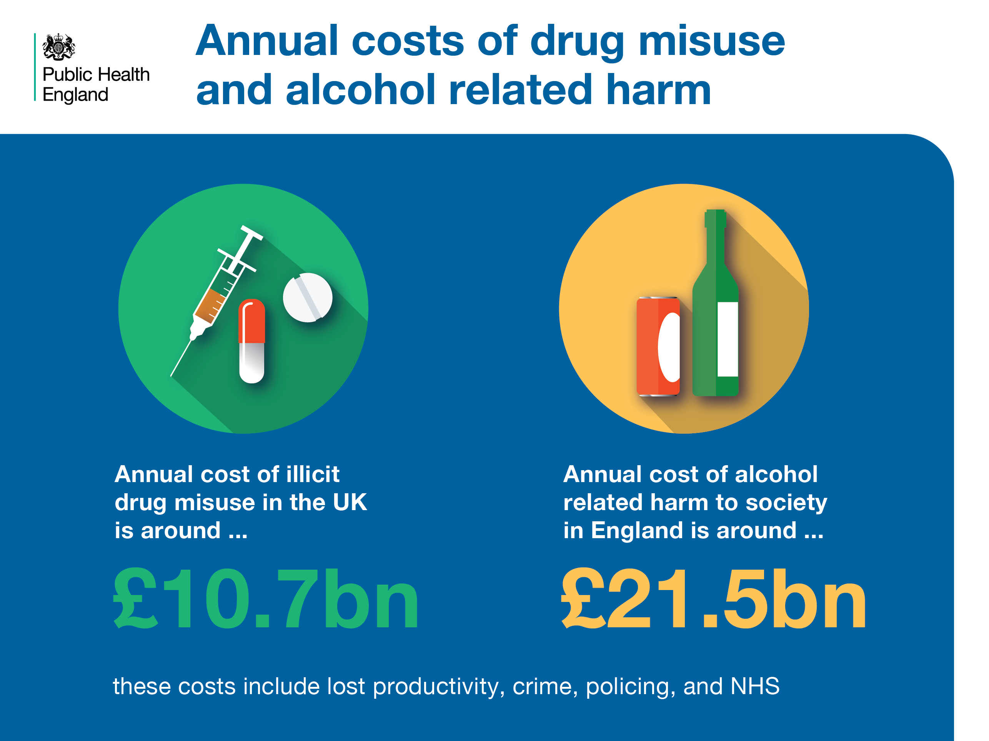
Notes:
The annual cost of drug and alcohol-related harm
The costs of alcohol and drug misuse to society are significant. Estimates show that the social and economic costs of alcohol related harm amount to £21.5bn, while that of illicit drug use costs £10.7bn. These include costs associated with deaths, NHS, crime and, in the case of alcohol, lost productivity.
References
Cut and paste website addresses into your browser to access the links
Drug misuse costs 10.7bn: PHE (2017) An evidence review of the outcomes that can be expected of drug misuse treatment in England. Available at: https://www.gov.uk/government/uploads/system/uploads/attachment_data/file/586111/PHE_Evidence_review_of_drug_treatment_outcomes.pdf
Alcohol misuse 21.5bn: PHE (2016) The Public Health Burden of Alcohol and the Effectiveness and Cost-Effectiveness of Alcohol Control Policies An evidence review. Available at: https://www.gov.uk/government/uploads/system/uploads/attachment_data/file/583047/alcohol_public_health_burden_evidence_review.pdf

Slide 17
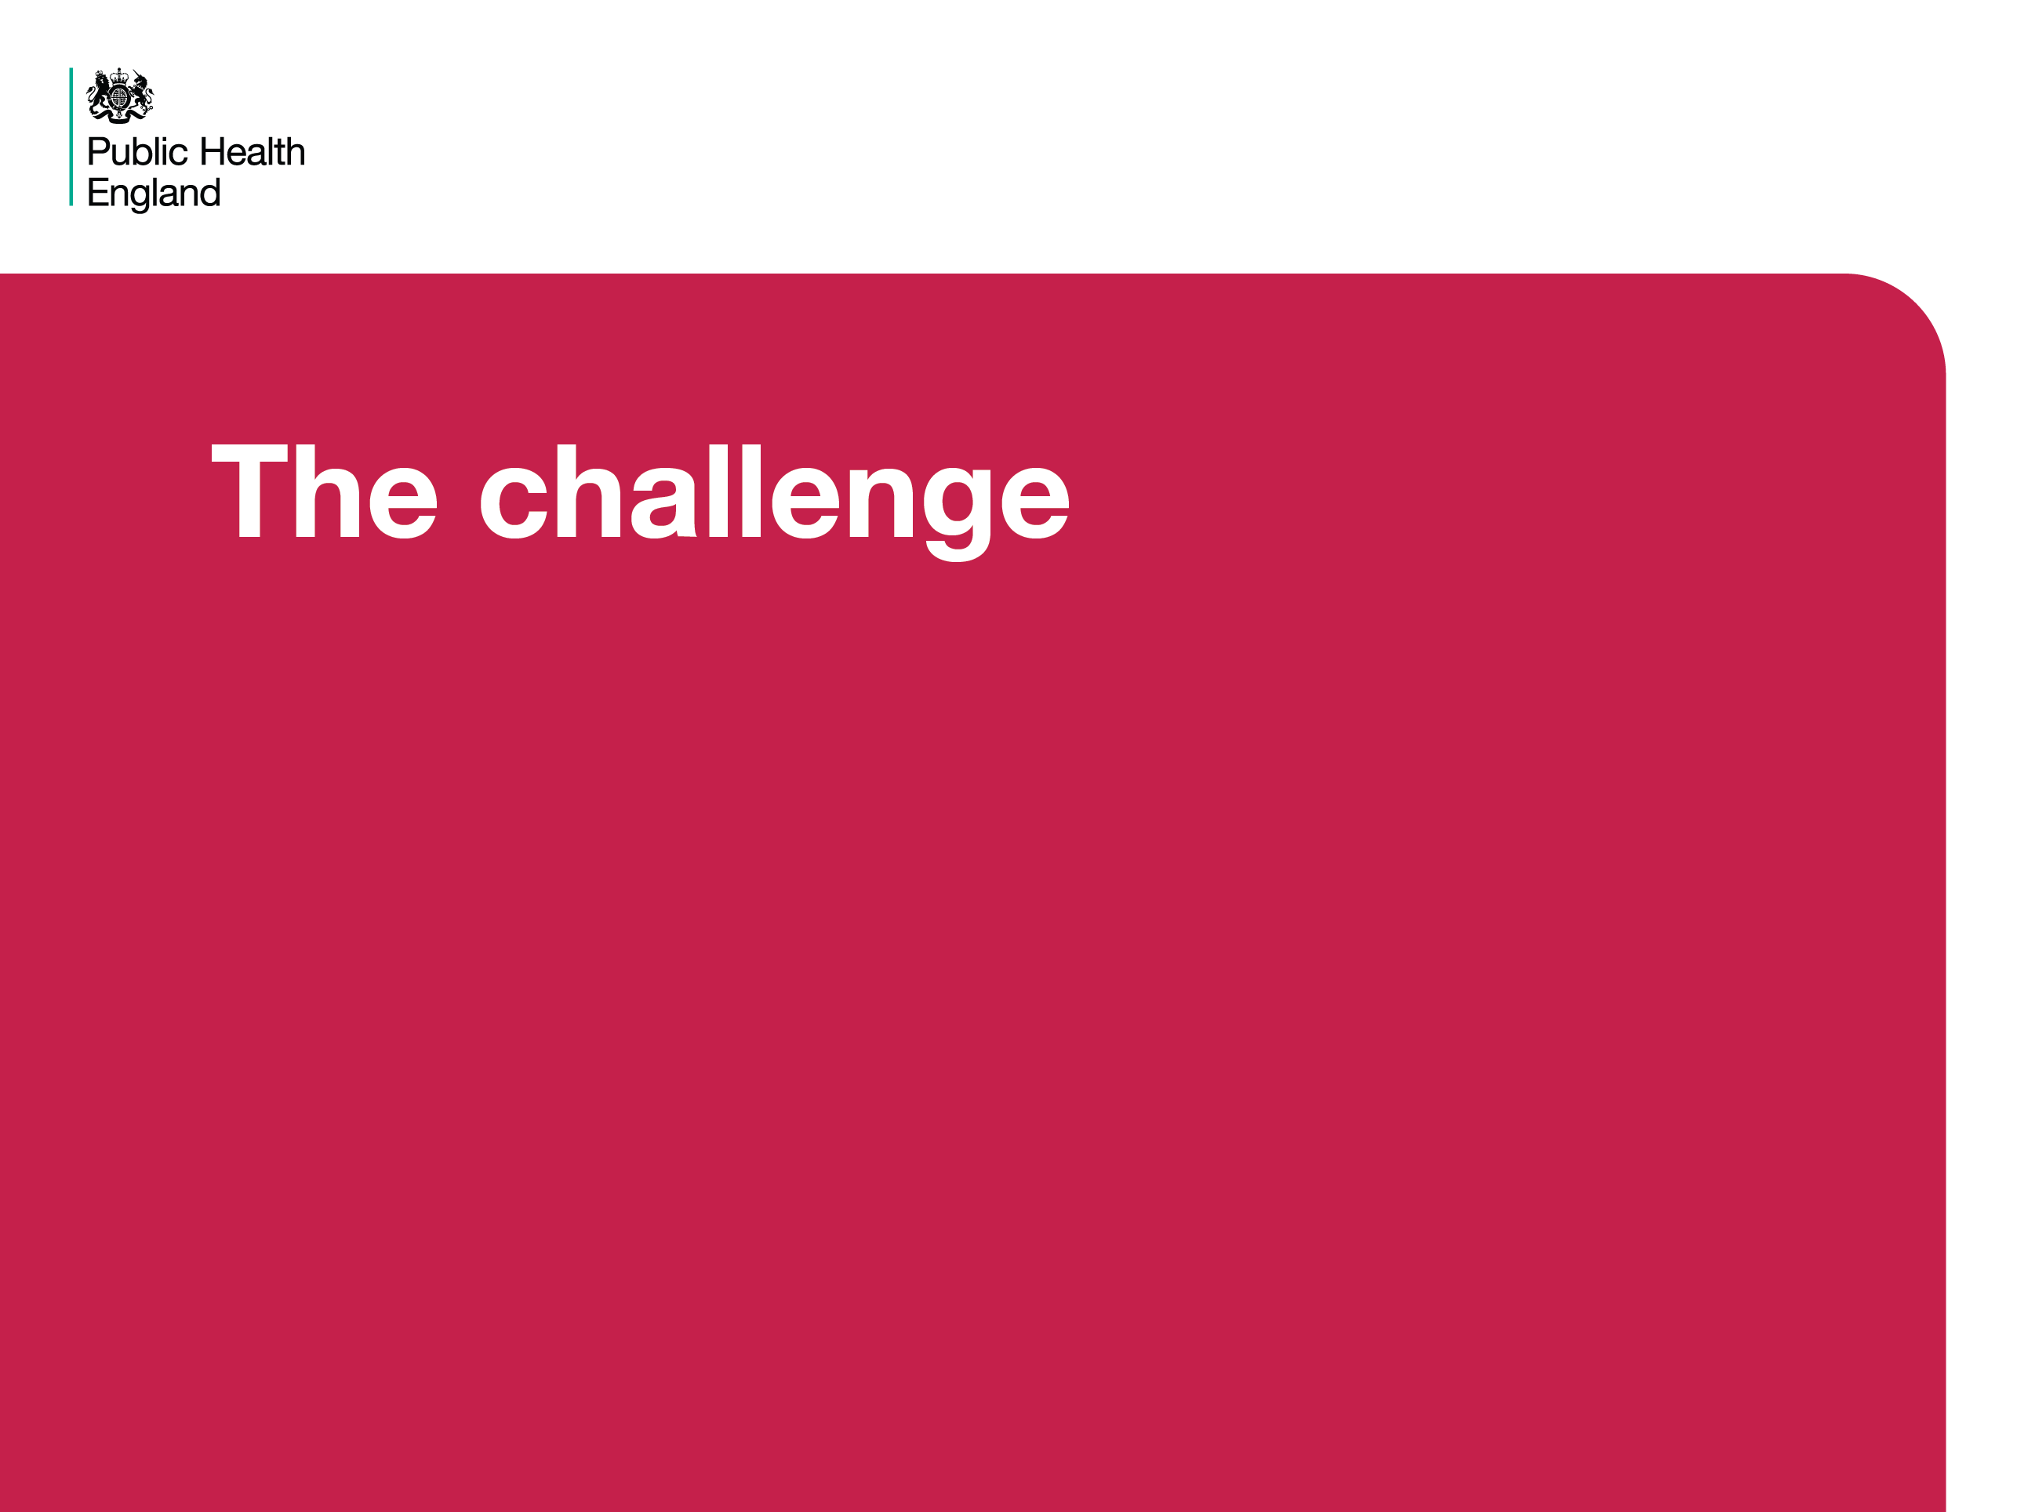
Notes:
The challenge
A multi-component approach is most effective, and multi-agency partnerships are necessary to ensure a strategic and effective local response to drug and alcohol problems.

Slide 18
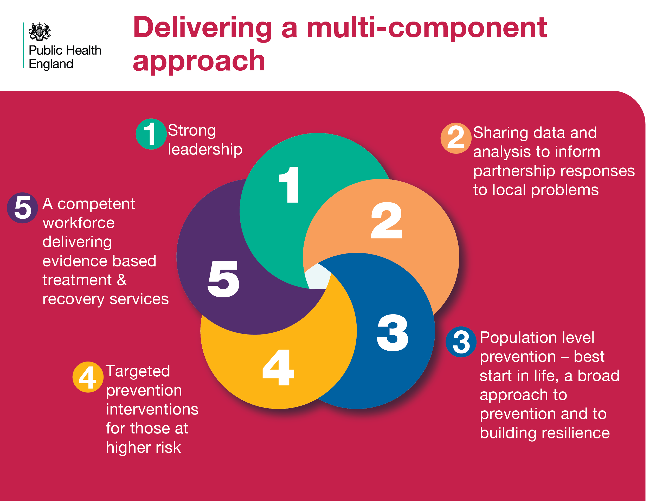
Notes:
Delivering a multi-component approach
Requires all 5 elements shown in the diagram.
Strong leadership and involvement of senior officers within local partner organisations.
Sharing data using locally agreed data sharing protocols to identify, plan, implement action and review effectiveness to address local drug and alcohol issues.
Ensure a broad approach to prevention which facilitates the best start in life: instilling resilience and confidence in young people to make healthy choices.
Target individuals or groups known to be at higher risk with tailored interventions (such as homeless people, people in the CJS).
Commission and deliver effective, evidence based treatment and recovery services.
References
Cut and paste website addresses into your browser to access the links
1,2,3. HM Government (2017) Drug strategy 2017 . Available at:
https://www.gov.uk/government/uploads/system/uploads/attachment_data/file/628148/Drug_strategy_2017.PDF
NICE PH24. Alcohol Use disorders: prevention. Available at: https://www.nice.org.uk/guidance/ph24
PHE (2016) Local Health and Care Planning: Menu of preventative interventions. Available at: https://www.gov.uk/government/uploads/system/uploads/attachment_data/file/565944/Local_health_and_care_planning_menu_of_preventative_interventions.pdf
Department of health (2017) Drug misuse and dependence. UK guidelines on clinical management. (Orange Book). https://www.gov.uk/government/uploads/system/uploads/attachment_data/file/628634/clinical_guidelines_2017.pdf

Slide 19
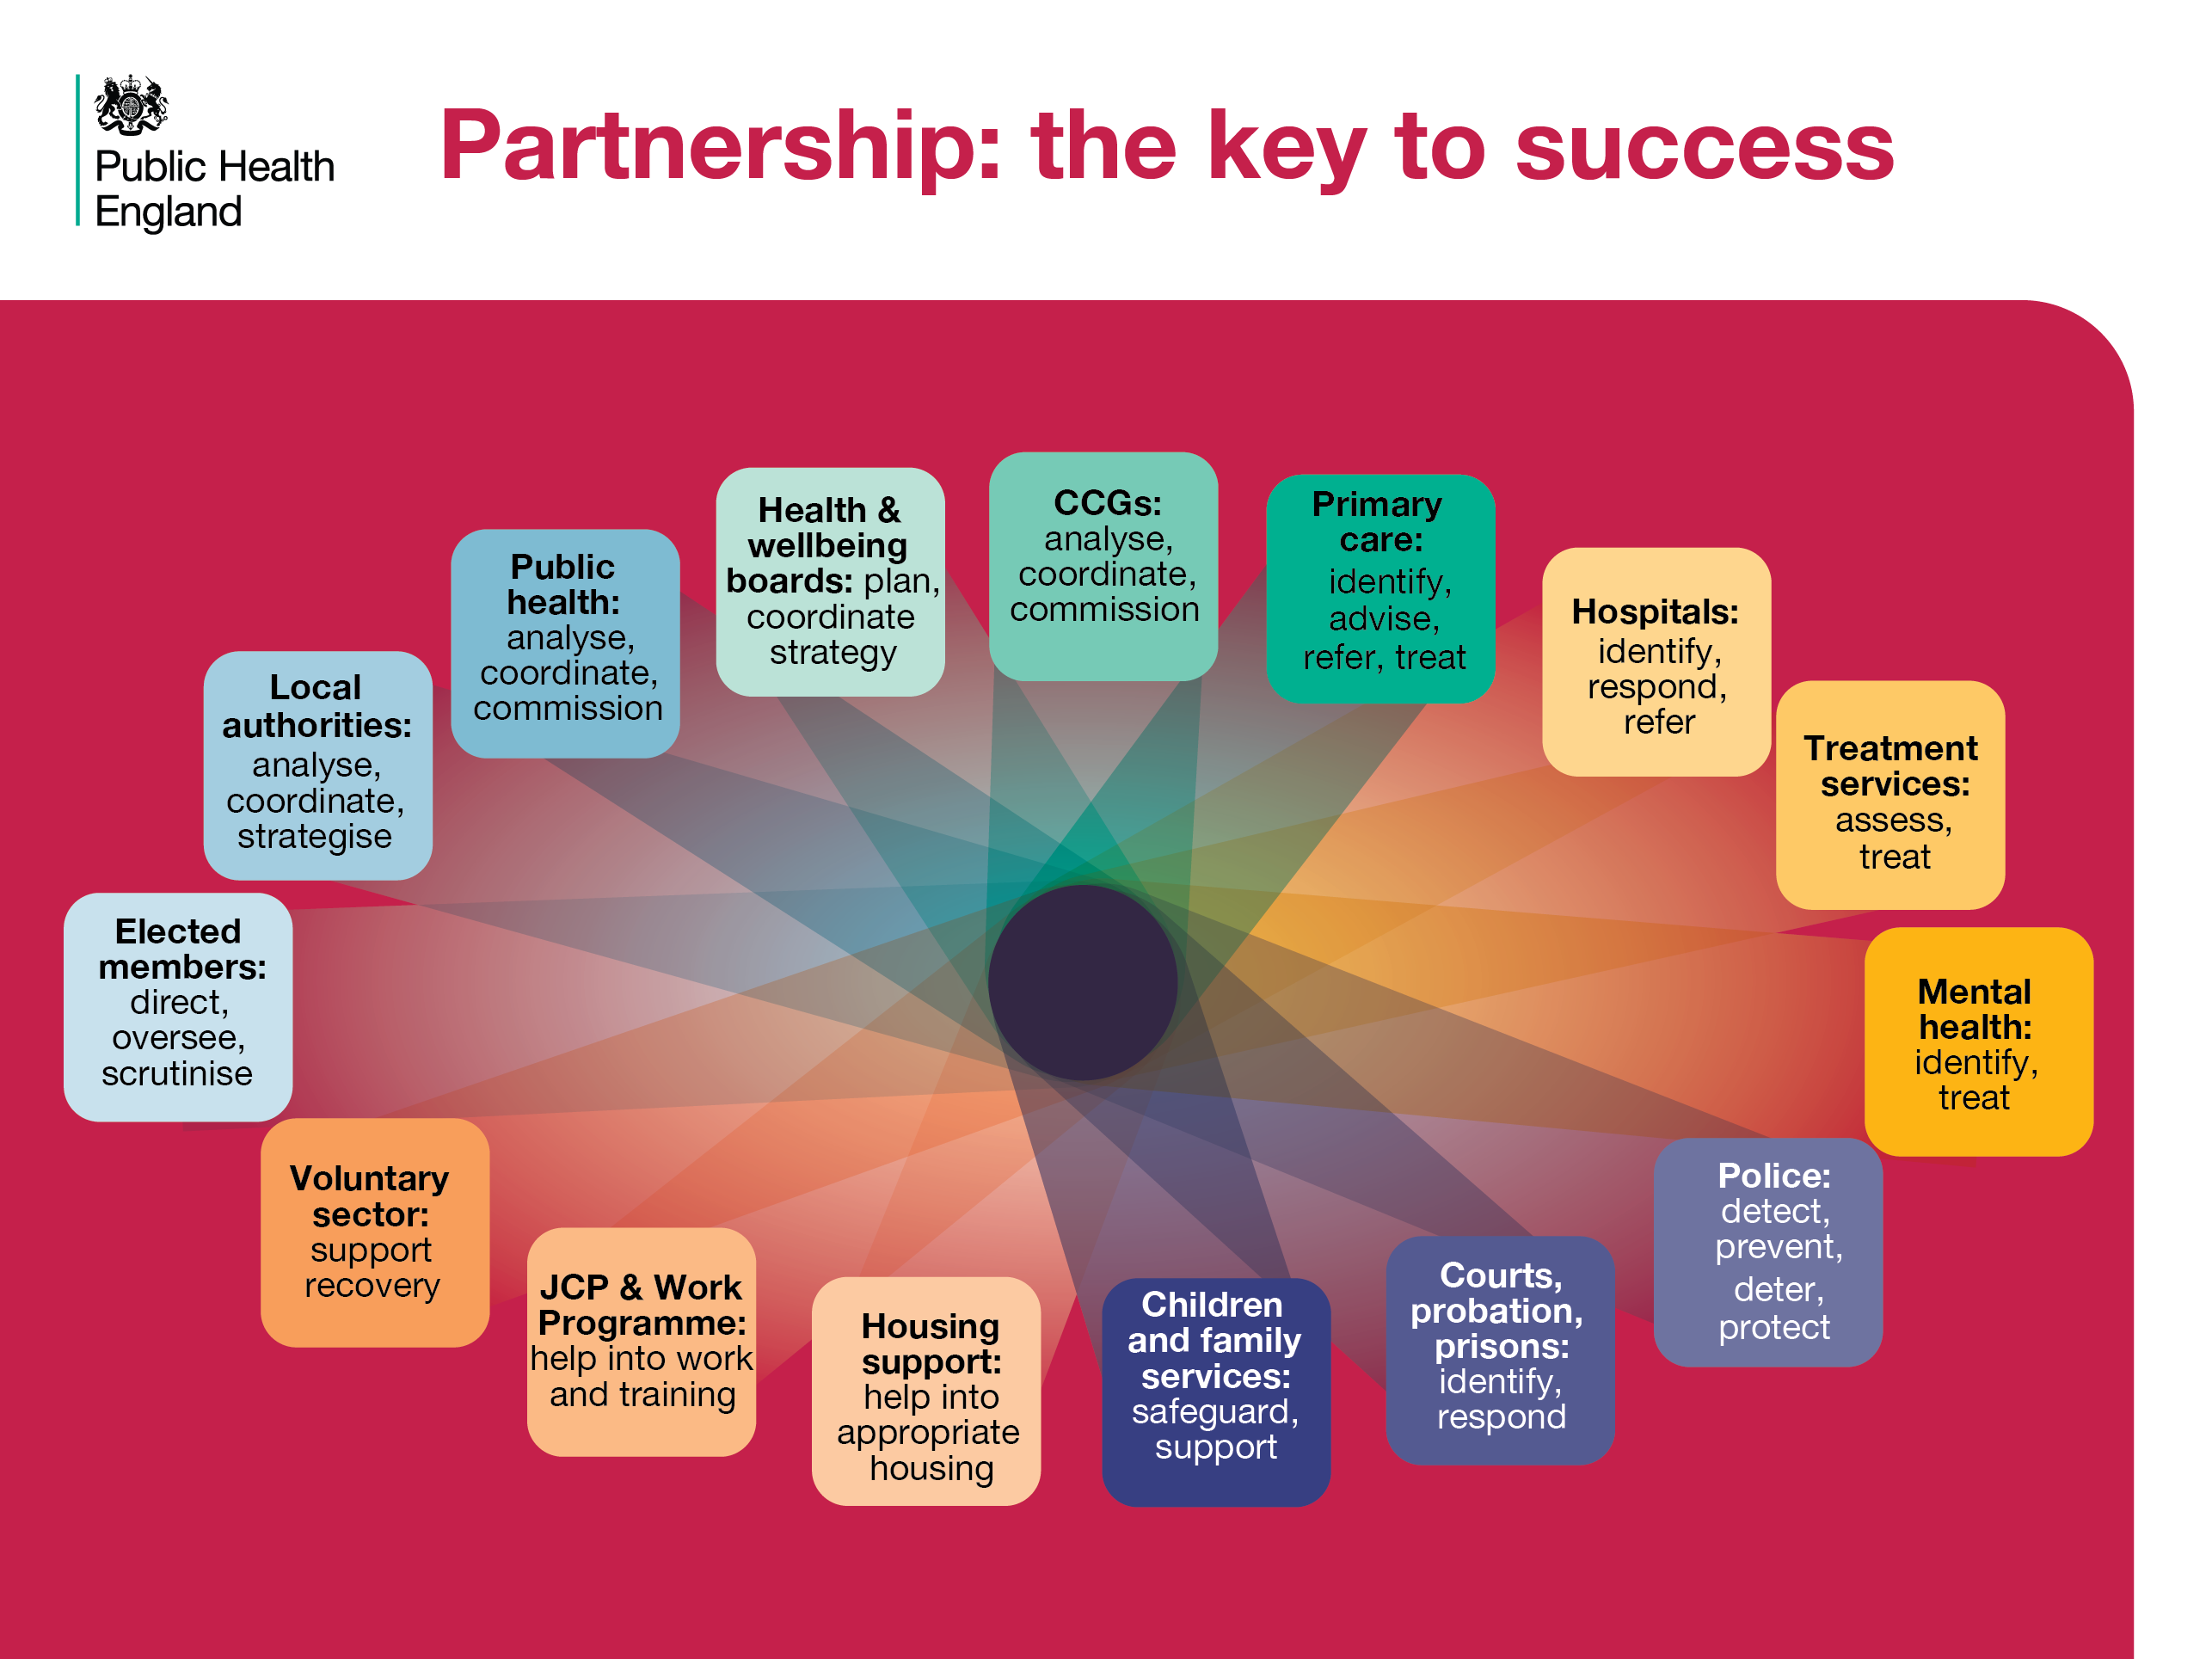
Notes:
Partnership: the key to success
A range of local partner organisations are needed to provide a strategic response to cross-cutting issues. Drug and alcohol misuse affects every agency, and each agency has a role to play in a coordinated response.
References
Cut and paste website addresses into your browser to access the links
HM Government (2017) Drug strategy. Available at https://www.gov.uk/government/publications/drug-strategy-2017

Slide 20
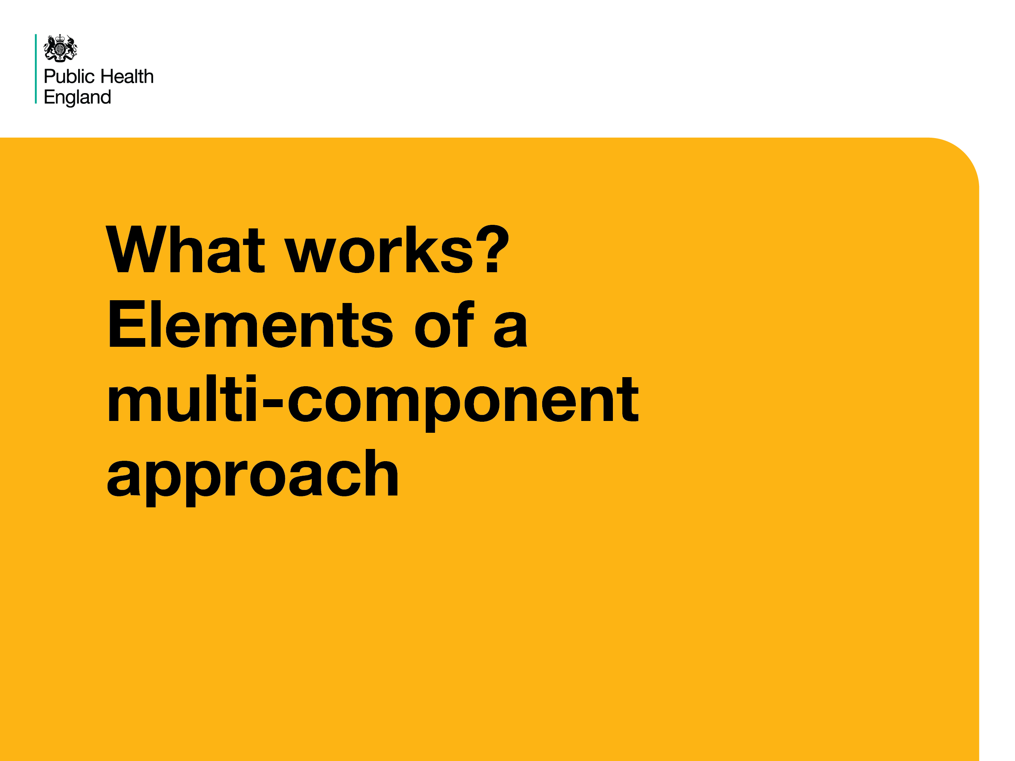
Notes:
What works? Elements of a multi-component approach
The following slides provide more detail about each important component of a multi-component approach.

Slide 21
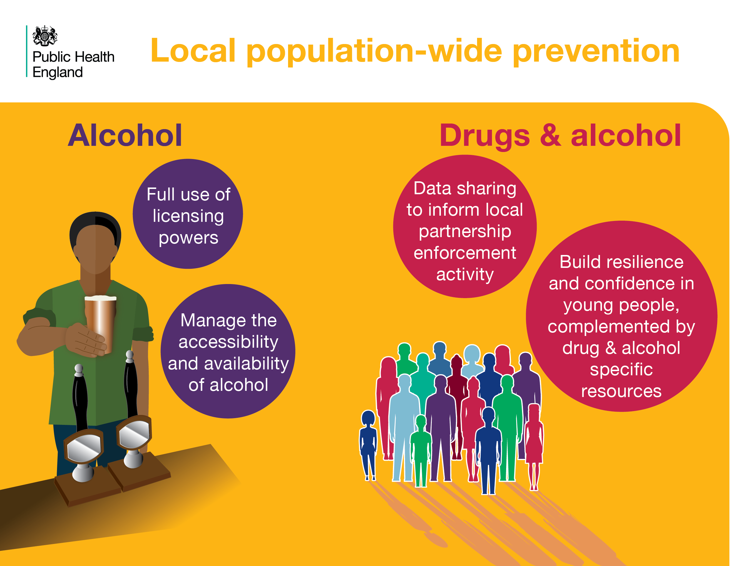
Notes:
Local population-wide prevention
Responsible authorities should exercise Licensing and Trading Standards powers fully to help manage and regulate the supply of alcohol in on and off licensed premises, to address local objectives to prevent crime and disorder, ensure public safety, prevent public nuisance and protect children from harm.
Partner agencies should share data and intelligence (within data sharing agreements) to inform plans and execute effective multi-agency responses to identified issues. Holistic responses, including drug and alcohol specific resources, help to build resilience and support healthy choices in young people.
References
Cut and paste website addresses into your browser to access the links
1. Alcohol: NICE Public Health Guideline PH24, Alcohol-use disorders: prevention (2010) .Available at: https://www.nice.org.uk/guidance/ph24/chapter/1-Recommendations#population-versus-individual-approach
Also: Hadfield, Phil and Newton, Andrew D. (2010) Factsheet: Alcohol, crime and disorder in the night-time economy. Alcohol Concern, London. available at: http://eprints.hud.ac.uk/9494/
Also: PHE (2016) Local Health and Care Planning: Menu of preventative interventions. Available at: https://www.gov.uk/government/uploads/system/uploads/attachment_data/file/565944/Local_health_and_care_planning_menu_of_preventative_interventions.pdf
2. Drugs & alcohol
HM Government (2017) Drug strategy. Available at: https://www.gov.uk/government/publications/drug-strategy-2017
NICE Public Health Guideline PH24, Alcohol-use disorders: prevention (2010) Available at: https://www.nice.org.uk/guidance/ph24/chapter/1-Recommendations#population-versus-individual-approach

Slide 22
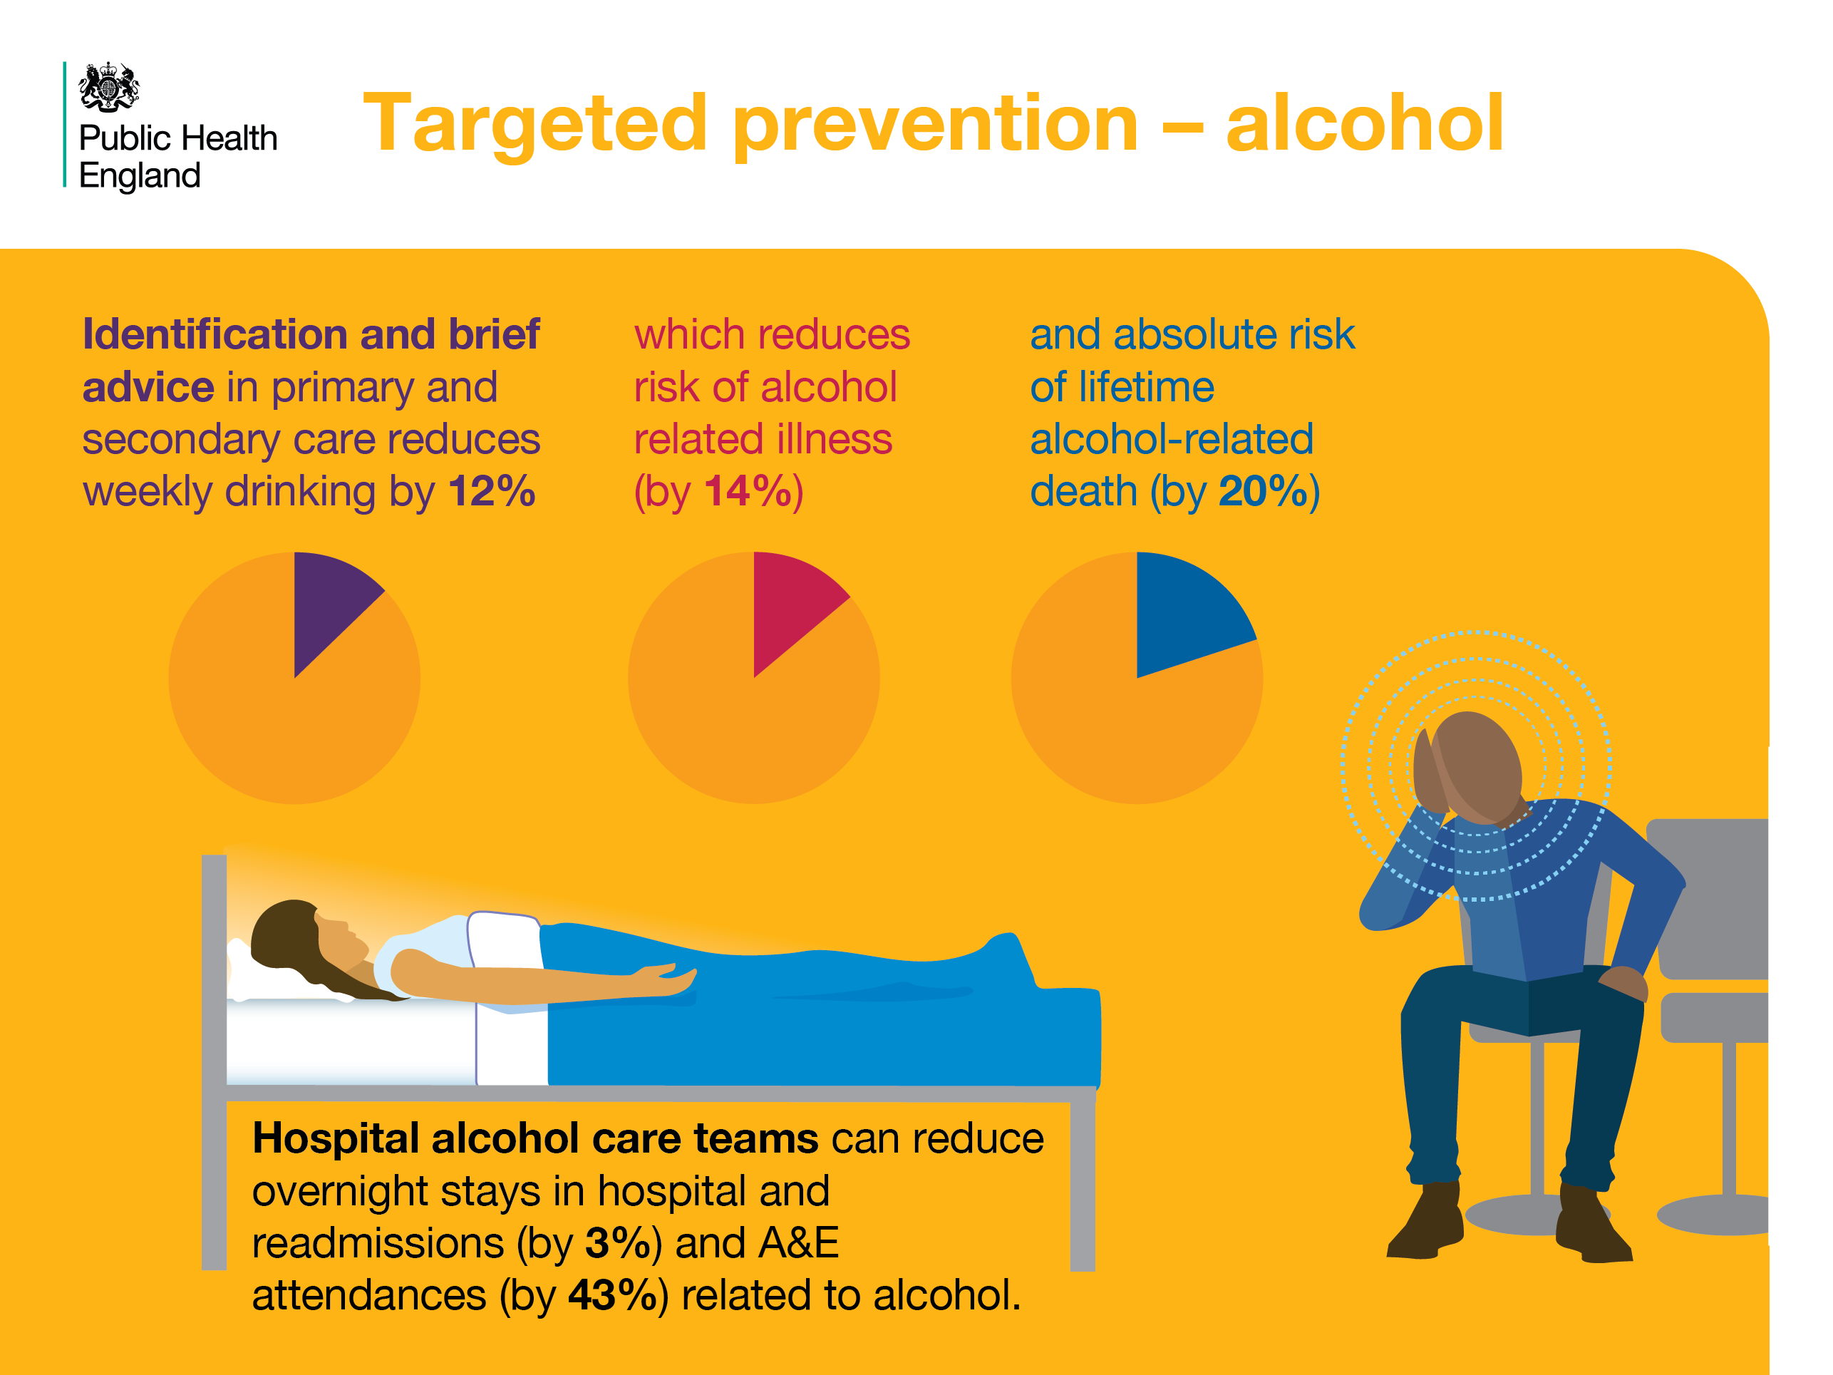
Notes:
Targeted prevention - alcohol
Evidence based interventions such as Identification and Brief Advice can help individuals reduce their alcohol consumption, which reduces risks of ill health and deaths.
Hospital based Alcohol Care Teams: identify inpatients and A&E attenders with alcohol problems and provide specialist care. These services save money by reducing length of stay, re-admissions, A&E attendances and ambulance call-outs.
References
Cut and paste website addresses into your browser to access the links
Angus C, Gillespie D, Ally A, Brennan A. (2015) Modelling the impact of Minimum Unit Price and Identification and Brief Advice policies using the Sheffield Alcohol Policy Model Version 3. University of Sheffield. Available at: https://www.sheffield.ac.uk/polopoly_fs/1.661445!/file/Final_mup_iba_report.pdf
2,3,4 & 5. PHE (2016) Local Health and Care Planning: Menu of preventative interventions. Available at: https://www.gov.uk/government/uploads/system/uploads/attachment_data/file/565944/Local_health_and_care_planning_menu_of_preventative_interventions.pdf

Slide 23
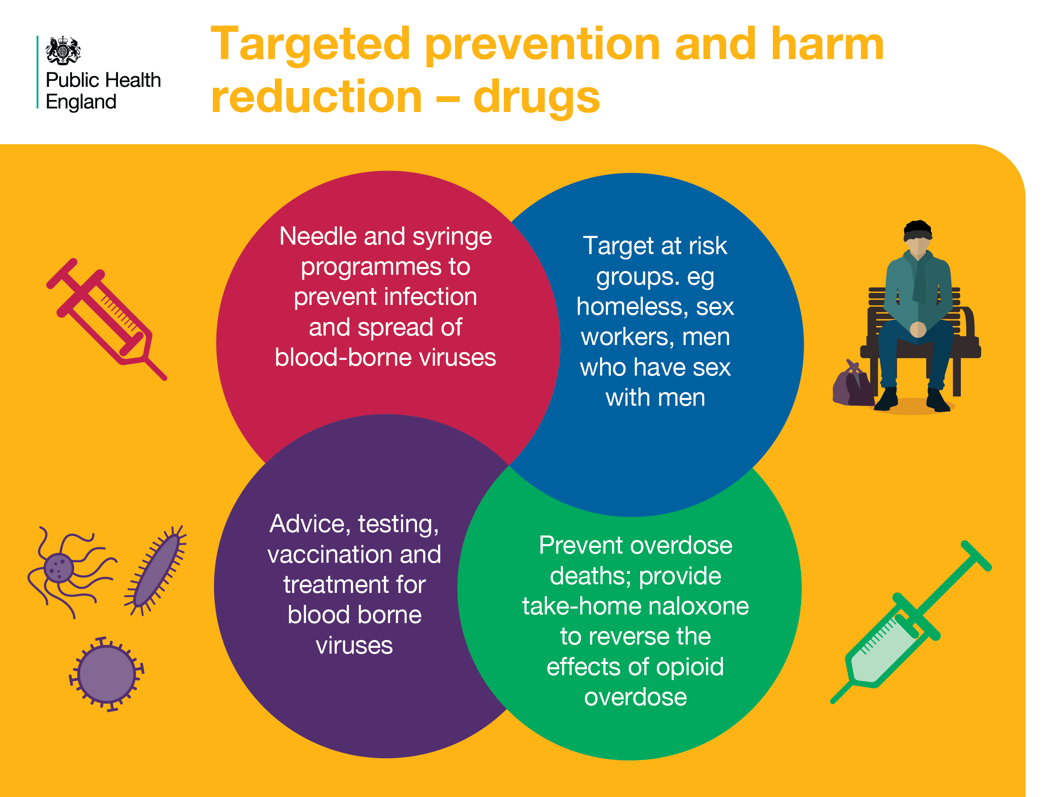
Notes:
Targeted prevention and harm reduction - drugs
Harm reduction services are essential components of the drug treatment system. Needle and syringe programmes and services to test for and treat blood borne viruses are evidence-based and reduce the risk of transmission. They can also act as a point of engagement with drug users where they can access pathways to other treatment and health services.
Provision of naloxone can reduce the risk of death from opiate overdose.
References
Cut and paste website addresses into your browser to access the links
Interventions covered in both:
Department of health (2017) Drug misuse and dependence. UK guidelines on clinical management. (Orange Book). Available at: https://www.gov.uk/government/uploads/system/uploads/attachment_data/file/628634/clinical_guidelines_2017.pdf
PHE (2016) Local Health and Care Planning: Menu of preventative interventions. Available at: https://www.gov.uk/government/uploads/system/uploads/attachment_data/file/565944/Local_health_and_care_planning_menu_of_preventative_interventions.pdf

Slide 24
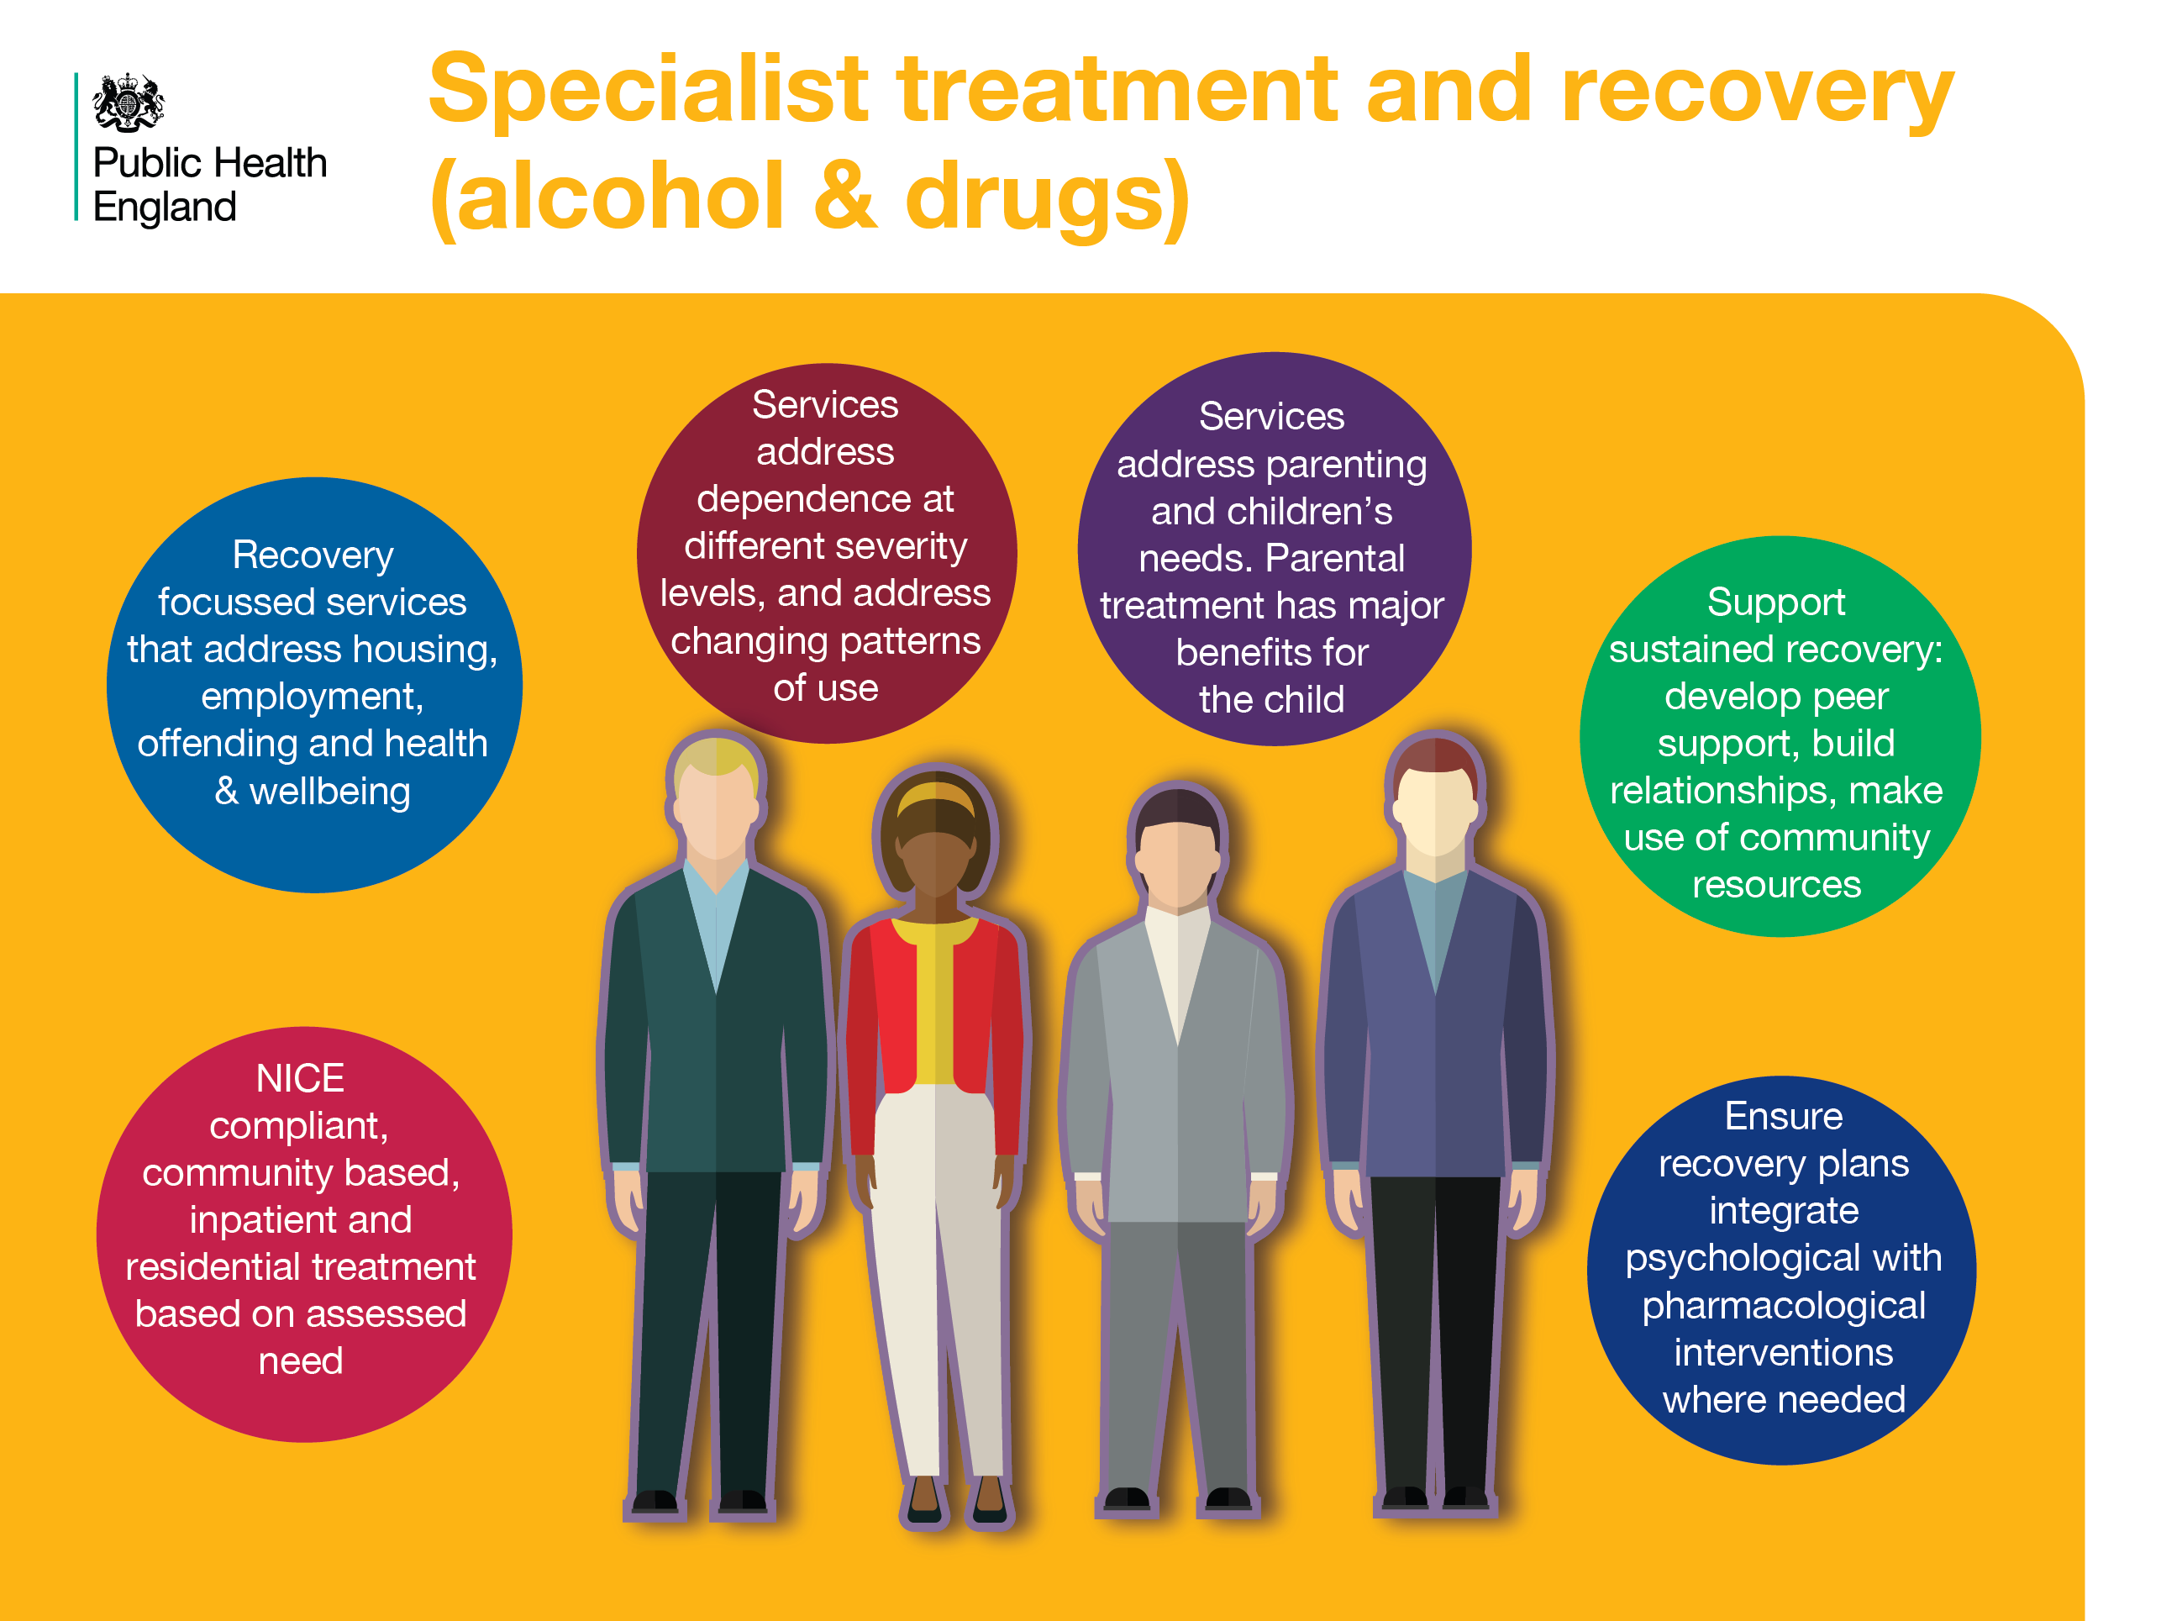
Notes:
Specialist treatment and recovery (alcohol & drugs)
Evidence based treatment and recovery services are essential to motivate and support people with drug and alcohol problems. They should provide a range of interventions, according to the level and type of dependency and an individual’s assessed need. Engagement in treatment reduces the risk of drug related deaths.
Components of the treatment system include: community, inpatient and residential services; integrated pharmacological and psychosocial interventions (where appropriate); holistic, recovery focussed support; addressing family/parenting issues; and building support networks.
References
Cut and paste website addresses into your browser to access the links
Drugs:
Department of health (2017) Drug misuse and dependence. UK guidelines on clinical management. (Orange Book). Available at: https://www.gov.uk/government/uploads/system/uploads/attachment_data/file/628634/clinical_guidelines_2017.pdf
NICE guidance for alcohol:
Alcohol-use disorders: diagnosis, assessment and management of harmful drinking and alcohol dependence (2011) NICE guideline CG115
Alcohol-use disorders: diagnosis and management of physical complications (updated 2017) NICE guideline (CG100)
Nalmefene for reducing alcohol consumption in people with alcohol dependence (2014) NICE technology appraisal guidance 325

Slide 25
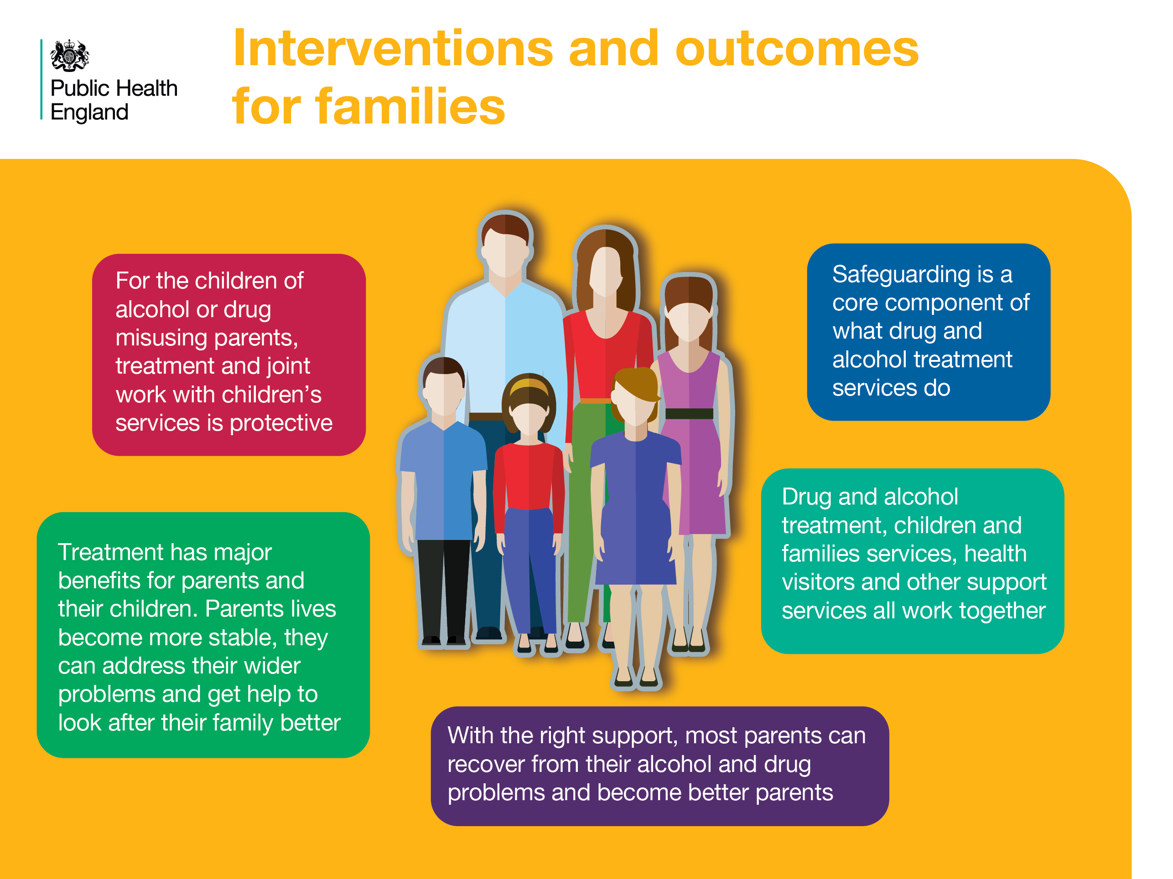
Notes:
Interventions and outcomes for families
Partnership work between treatment services and local children’s health and social care agencies is crucial. Parental drug and alcohol treatment can be a protective factor for children and can enable parents to engage with support agencies.
References
Cut and paste website addresses into your browser to access the links
All: National Treatment Agency for Substance Misuse (NTA) (2012) Parents with drugs problems: how treatment helps families. Available at: http://www.nta.nhs.uk/uploads/families2012vfinali.pdf
Ofsted (2013) What about the children? Available at: https://www.gov.uk/government/uploads/system/uploads/attachment_data/file/419128/What_about_the_children.pdf

Slide 26
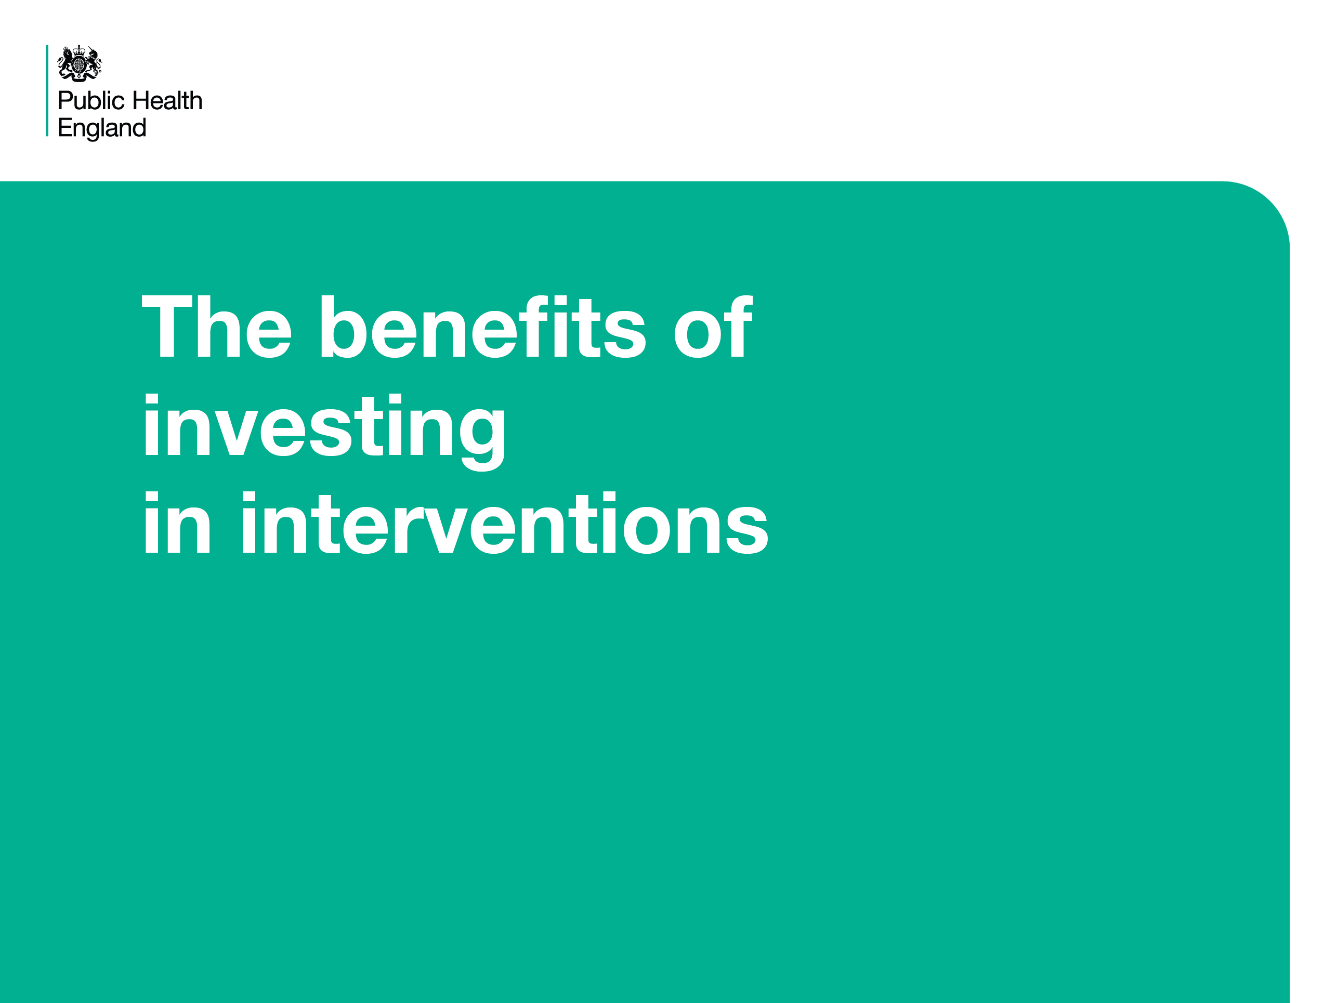
Notes:
The benefits of investing in interventions
These slides provide economic information about return on investment for different types of drug and alcohol interventions and services as well as potential outcomes for partner organisations.

Slide 27
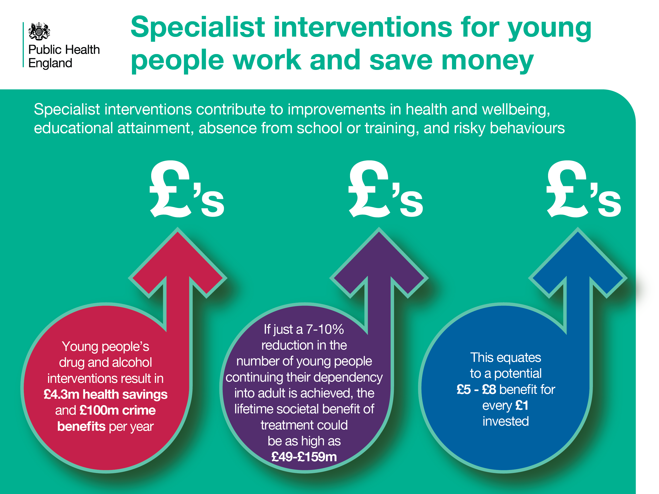
Notes:
Specialist interventions for young people work and save money
Research has shown that specialist interventions for young people are effective and contribute to improvements in health and wellbeing as well as a range of other benefits. As such these interventions represent value for money.
References
Cut and paste website addresses into your browser to access the links
Frontier Economics (2011) Specialist drug and alcohol services for young people: a Cost Benefit Analysis. Department for Education. Retrieved from: https://www.gov.uk/government/uploads/system/uploads/attachment_data/file/182312/DFE-RR087.pdf

Slide 28
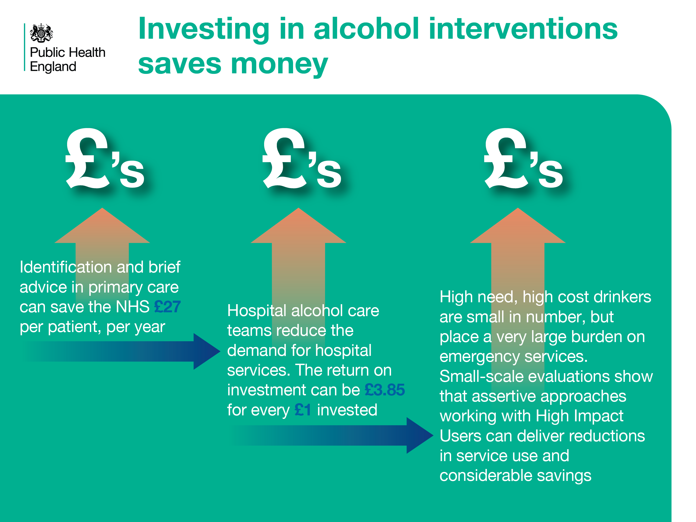
Notes:
Investing in alcohol interventions saves money
Considerable return on investment (ROI) can be achieved by providing alcohol interventions. For example, identification and brief advice has been estimated to save £27 per patient per year; alcohol care teams in hospital can deliver returns on investment of £3.85 for every £1 invested; and assertive outreach teams that work with ‘high impact users’ of emergency services have achieved up to 62% cost savings.
References
Cut and paste website addresses into your browser to access the links
1 & 2 PHE (2016) Local Health and Care Planning: Menu of preventative interventions. Available at: https://www.gov.uk/government/uploads/system/uploads/attachment_data/file/565944/Local_health_and_care_planning_menu_of_preventative_interventions.pdf
3. Evidence is limited but growing, with positive examples seen in: Sandwell, Alcohol Research UK (2017). The Sandwell multi-agency management group for high impact problem drinkers. Interim evaluation Available at: http://alcoholresearchuk.org/alcohol-insights/the-sandwell-multi-agency-management-group-for-high-impact-problem-drinkers-interim-evaluation/ and Salford http://fg.bmj.com/content/flgastro/4/2/130.full.pdf

Slide 29
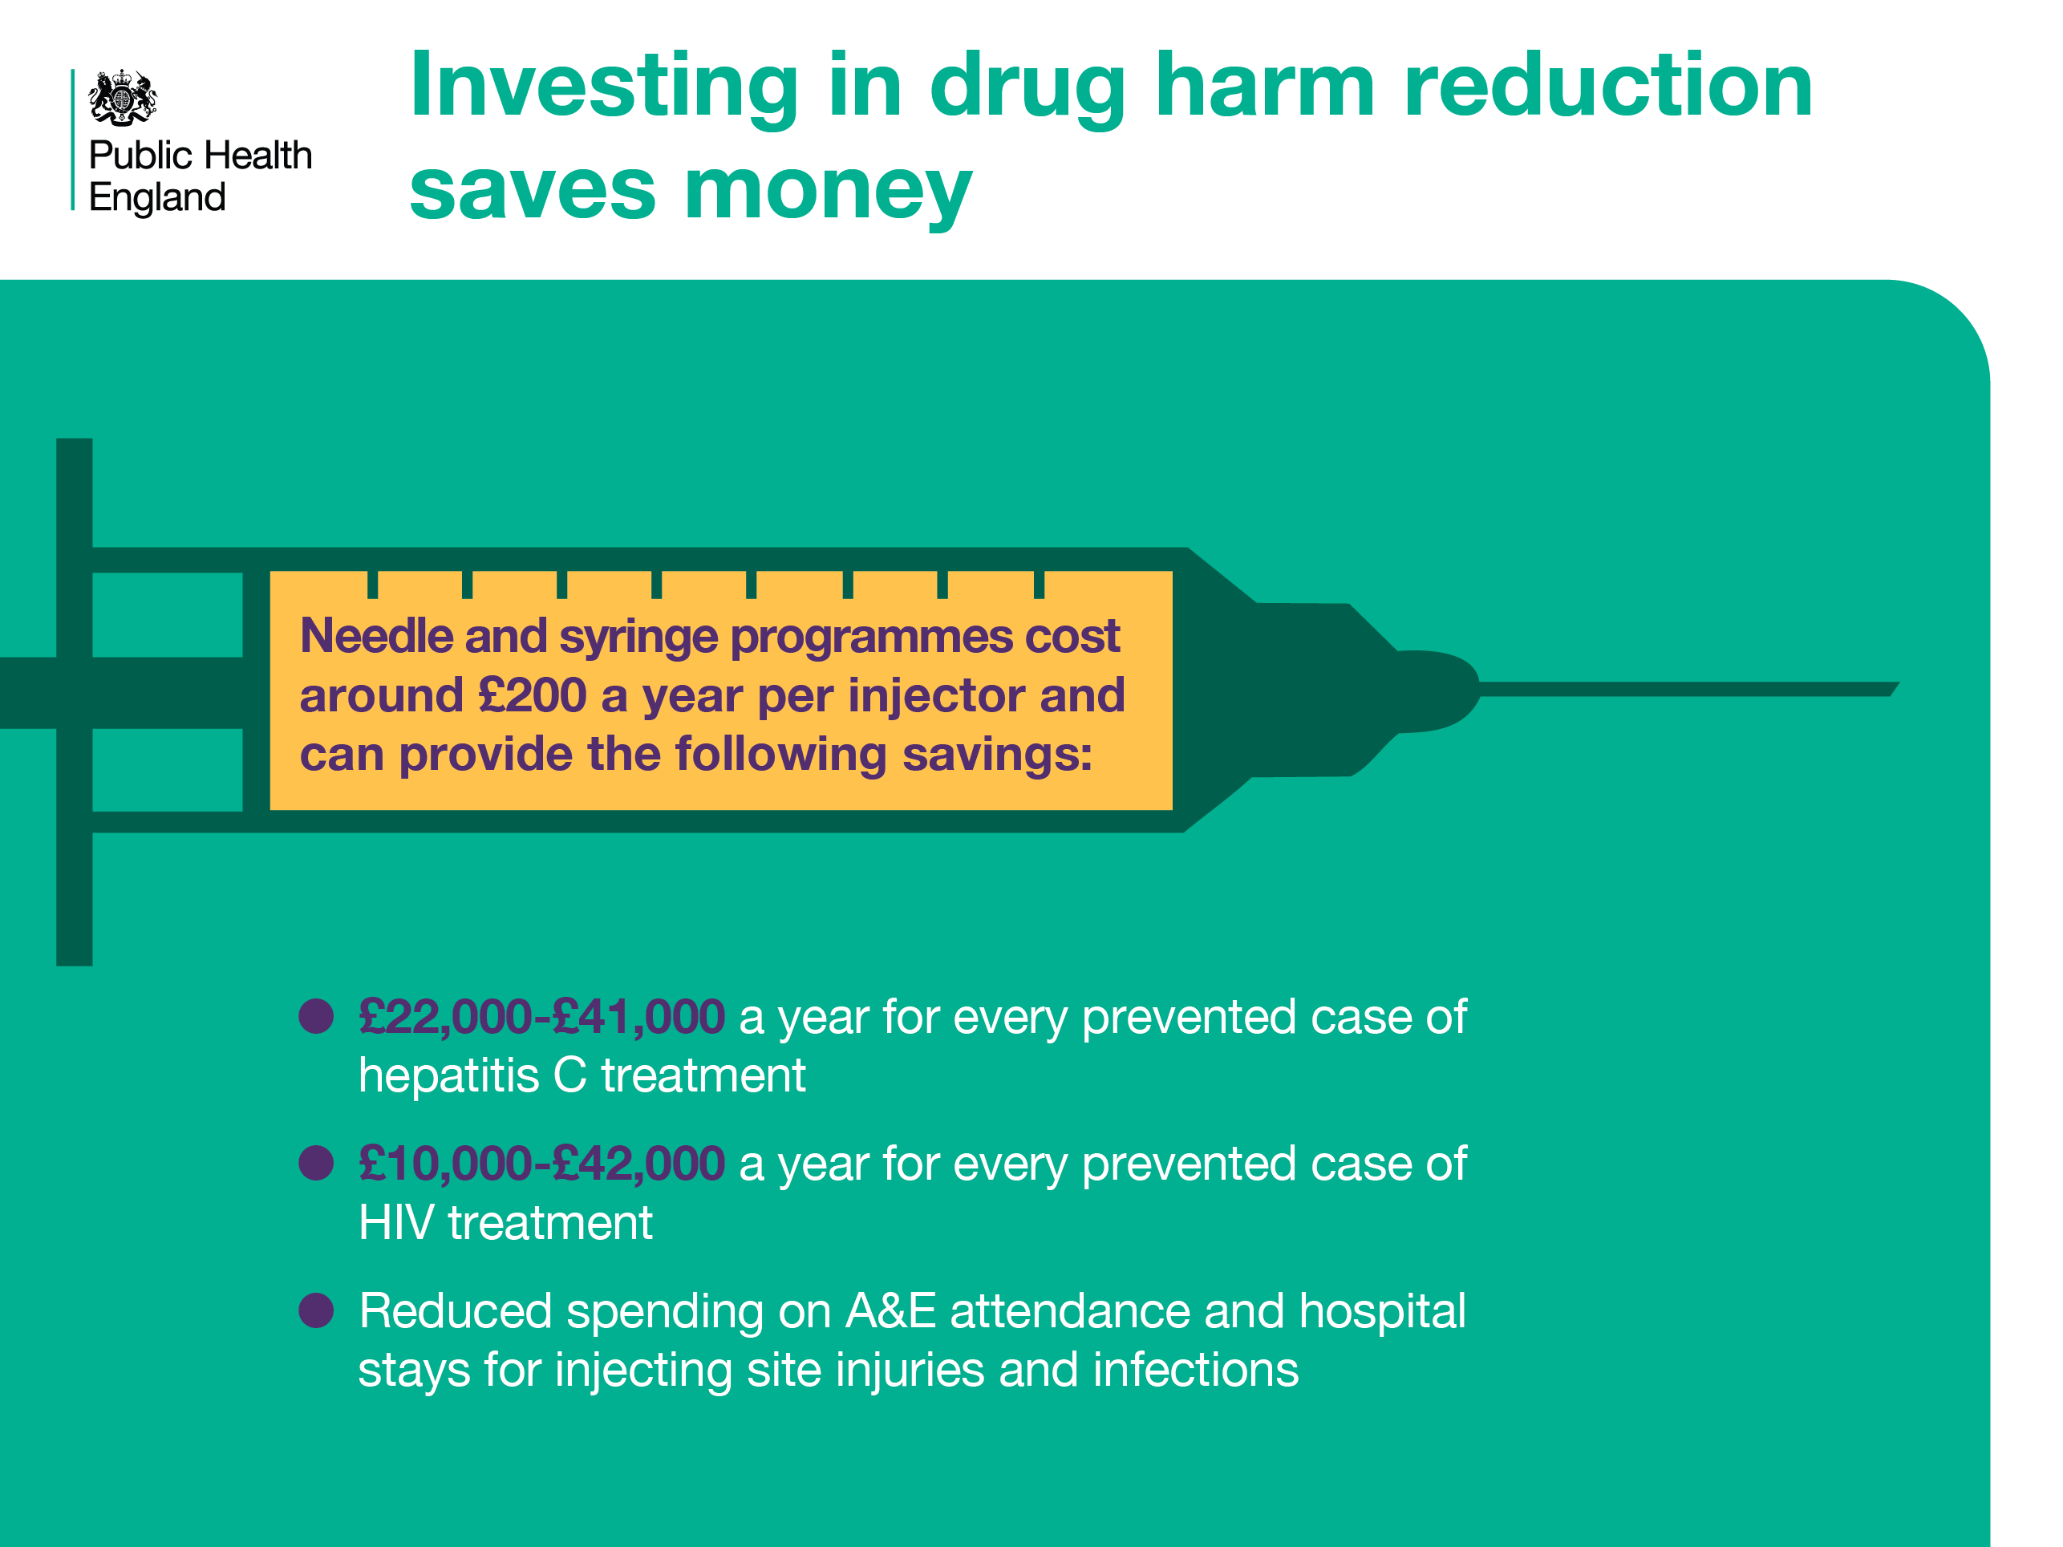
Notes:
Investing in drug harm reduction saves money
The substantial costs of treating injectors for blood borne viruses and other infections can be saved by provision of needle and syringe exchange programmes. Preventing patients from becoming addicted to prescription medicines and supporting them to withdraw safely can result in savings to the NHS.
References
Cut and paste website addresses into your browser to access the links
All: PHE (2016) Local Health and Care Planning: Menu of preventative interventions. Available at: https://www.gov.uk/government/uploads/system/uploads/attachment_data/file/565944/Local_health_and_care_planning_menu_of_preventative_interventions.pdf
NICE (2014) Costing statement: Needle and syringe programmes Implementing the NICE guidance on Needle and syringe programmes (PH52). Available at: https://www.nice.org.uk/guidance/ph52/resources/costing-statement-pdf-69237469

Slide 30
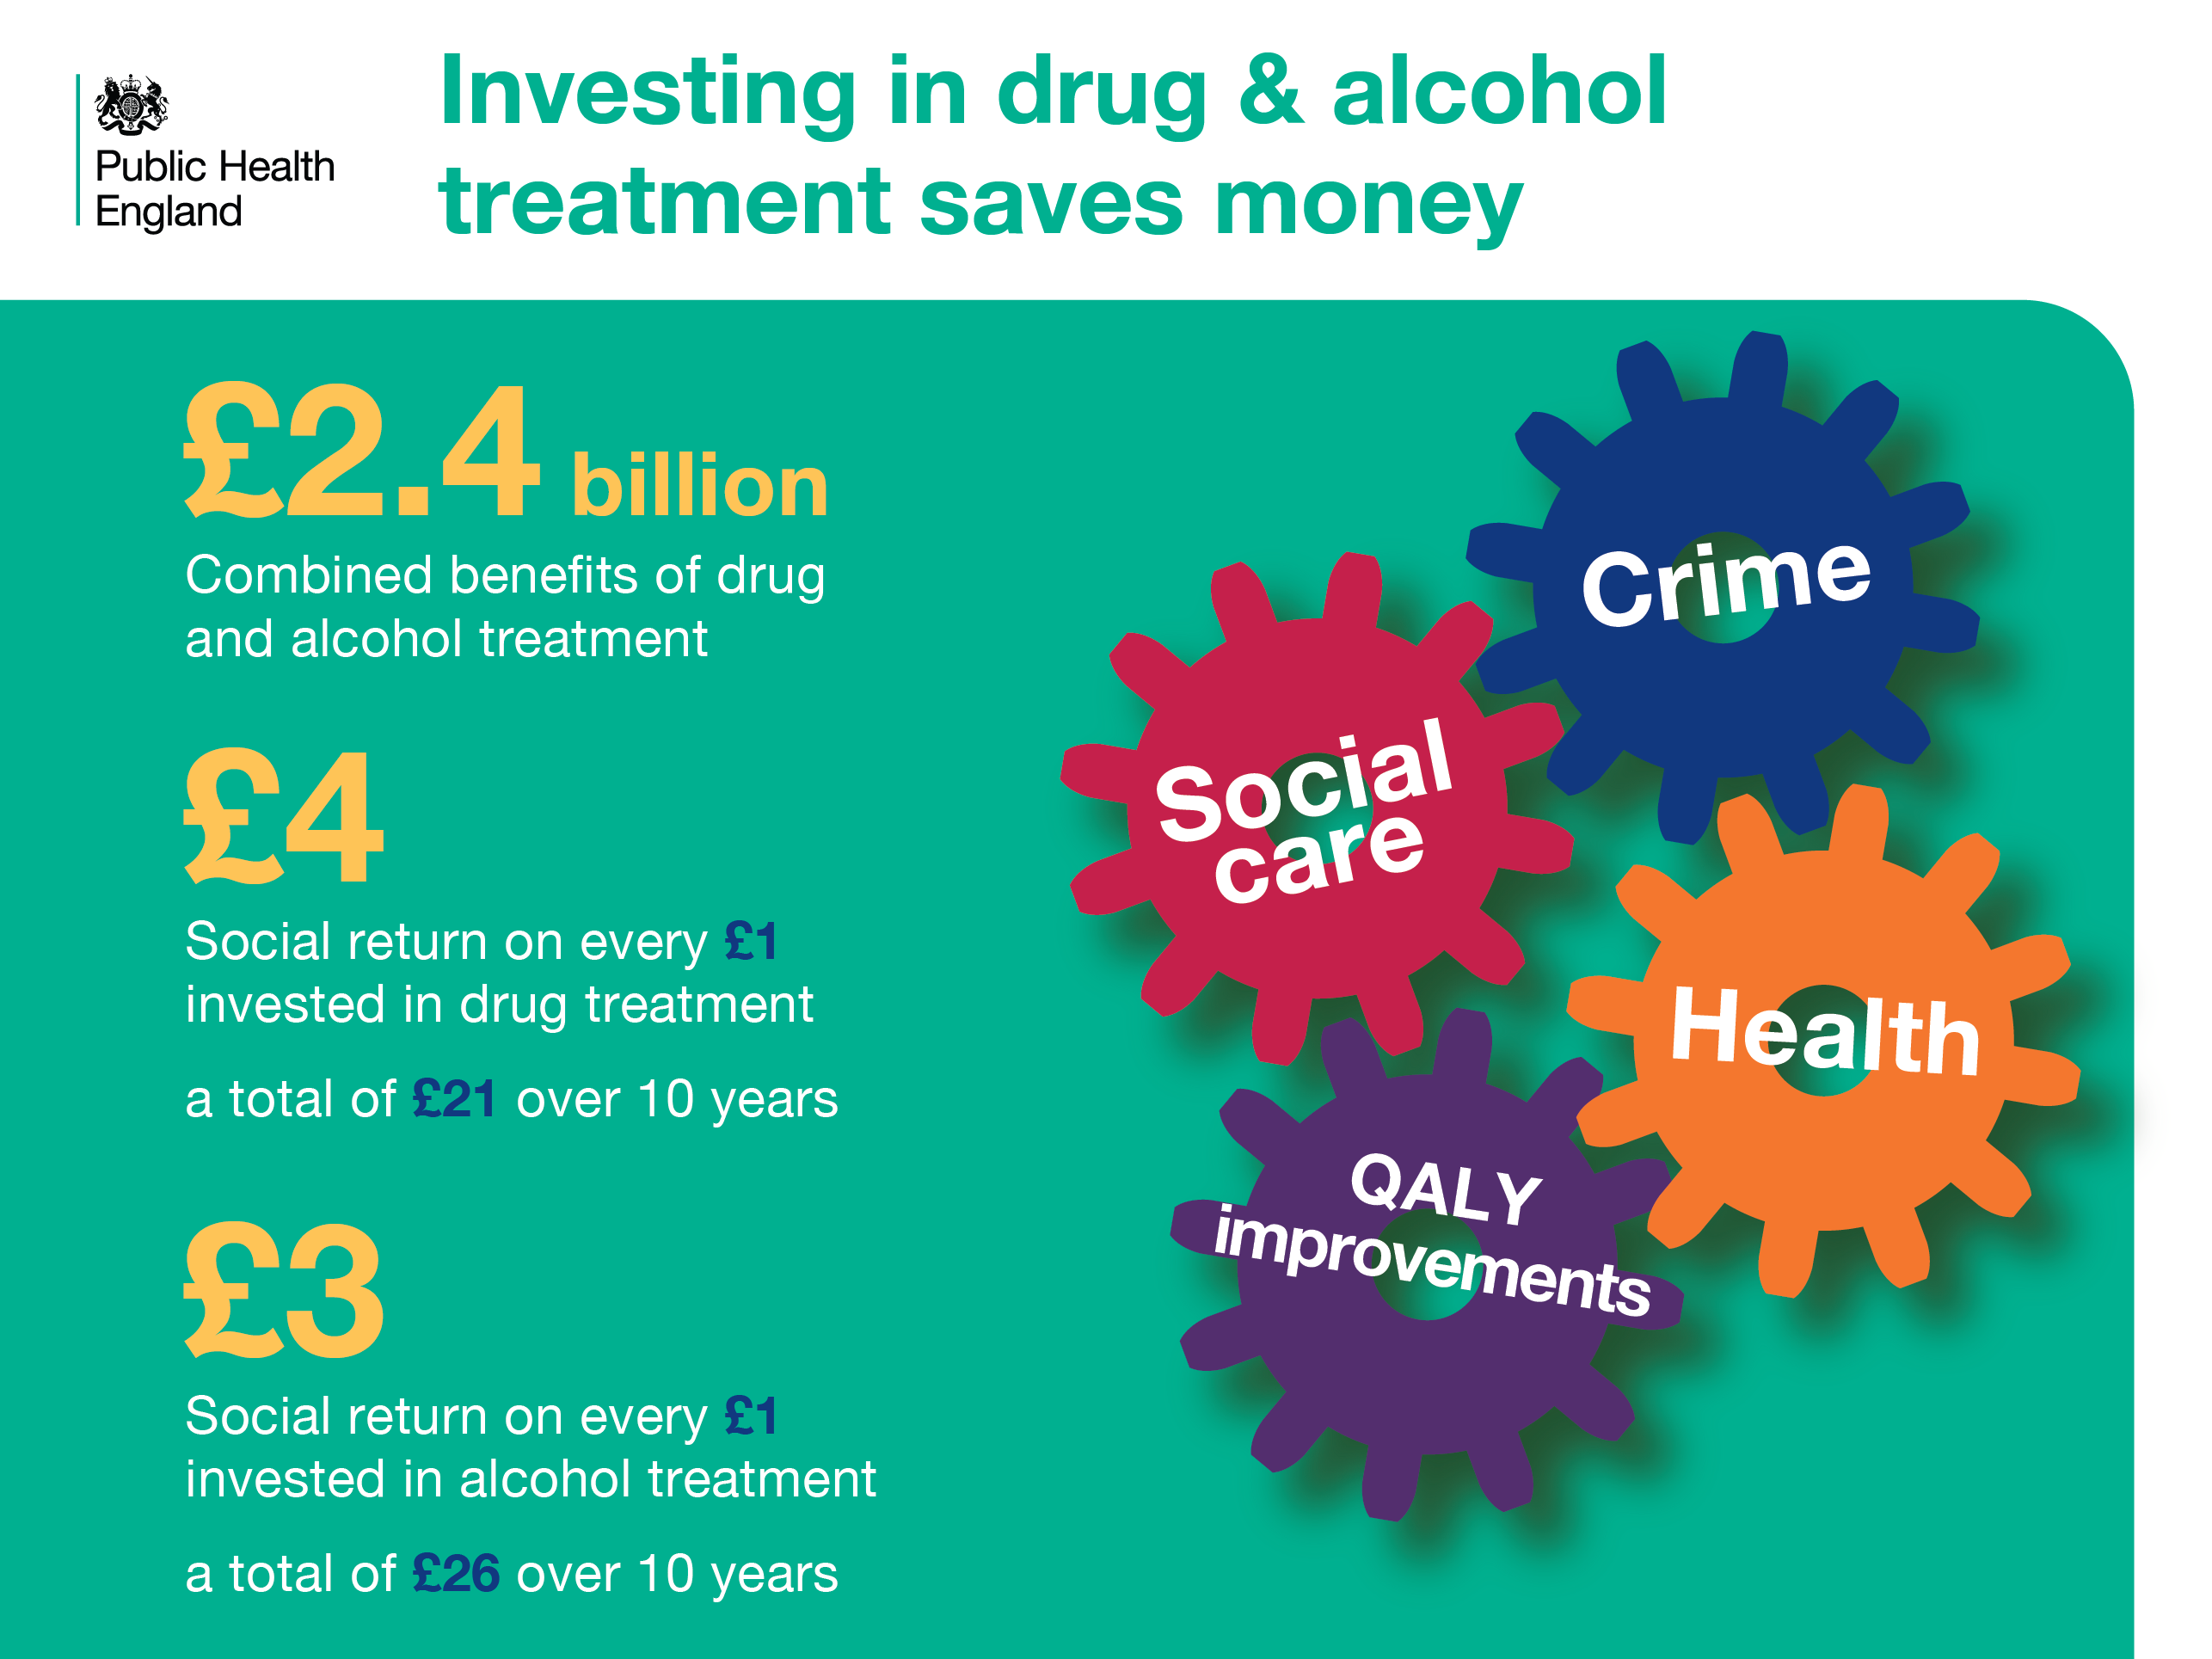
Notes:
Investing in drug and alcohol treatment saves money
Drug and alcohol treatment results in savings in a number of areas, such as Crime, QALY improvements and health & social care.
Quality-adjusted life years (QALYs) are measures of life expectancy and quality of life, fundamental in health economic evaluations and resource allocations.
Alcohol treatment reflects a return on investment of £3 for every pound invested.
Drug treatment reflects a return on investment of £4 for every pound invested
References
Cut and paste website addresses into your browser to access the links
A social return on investment tool is available for local areas to calculate their own SROI. It is available at: https://www.ndtms.net/ValueForMoney.aspx

Slide 31
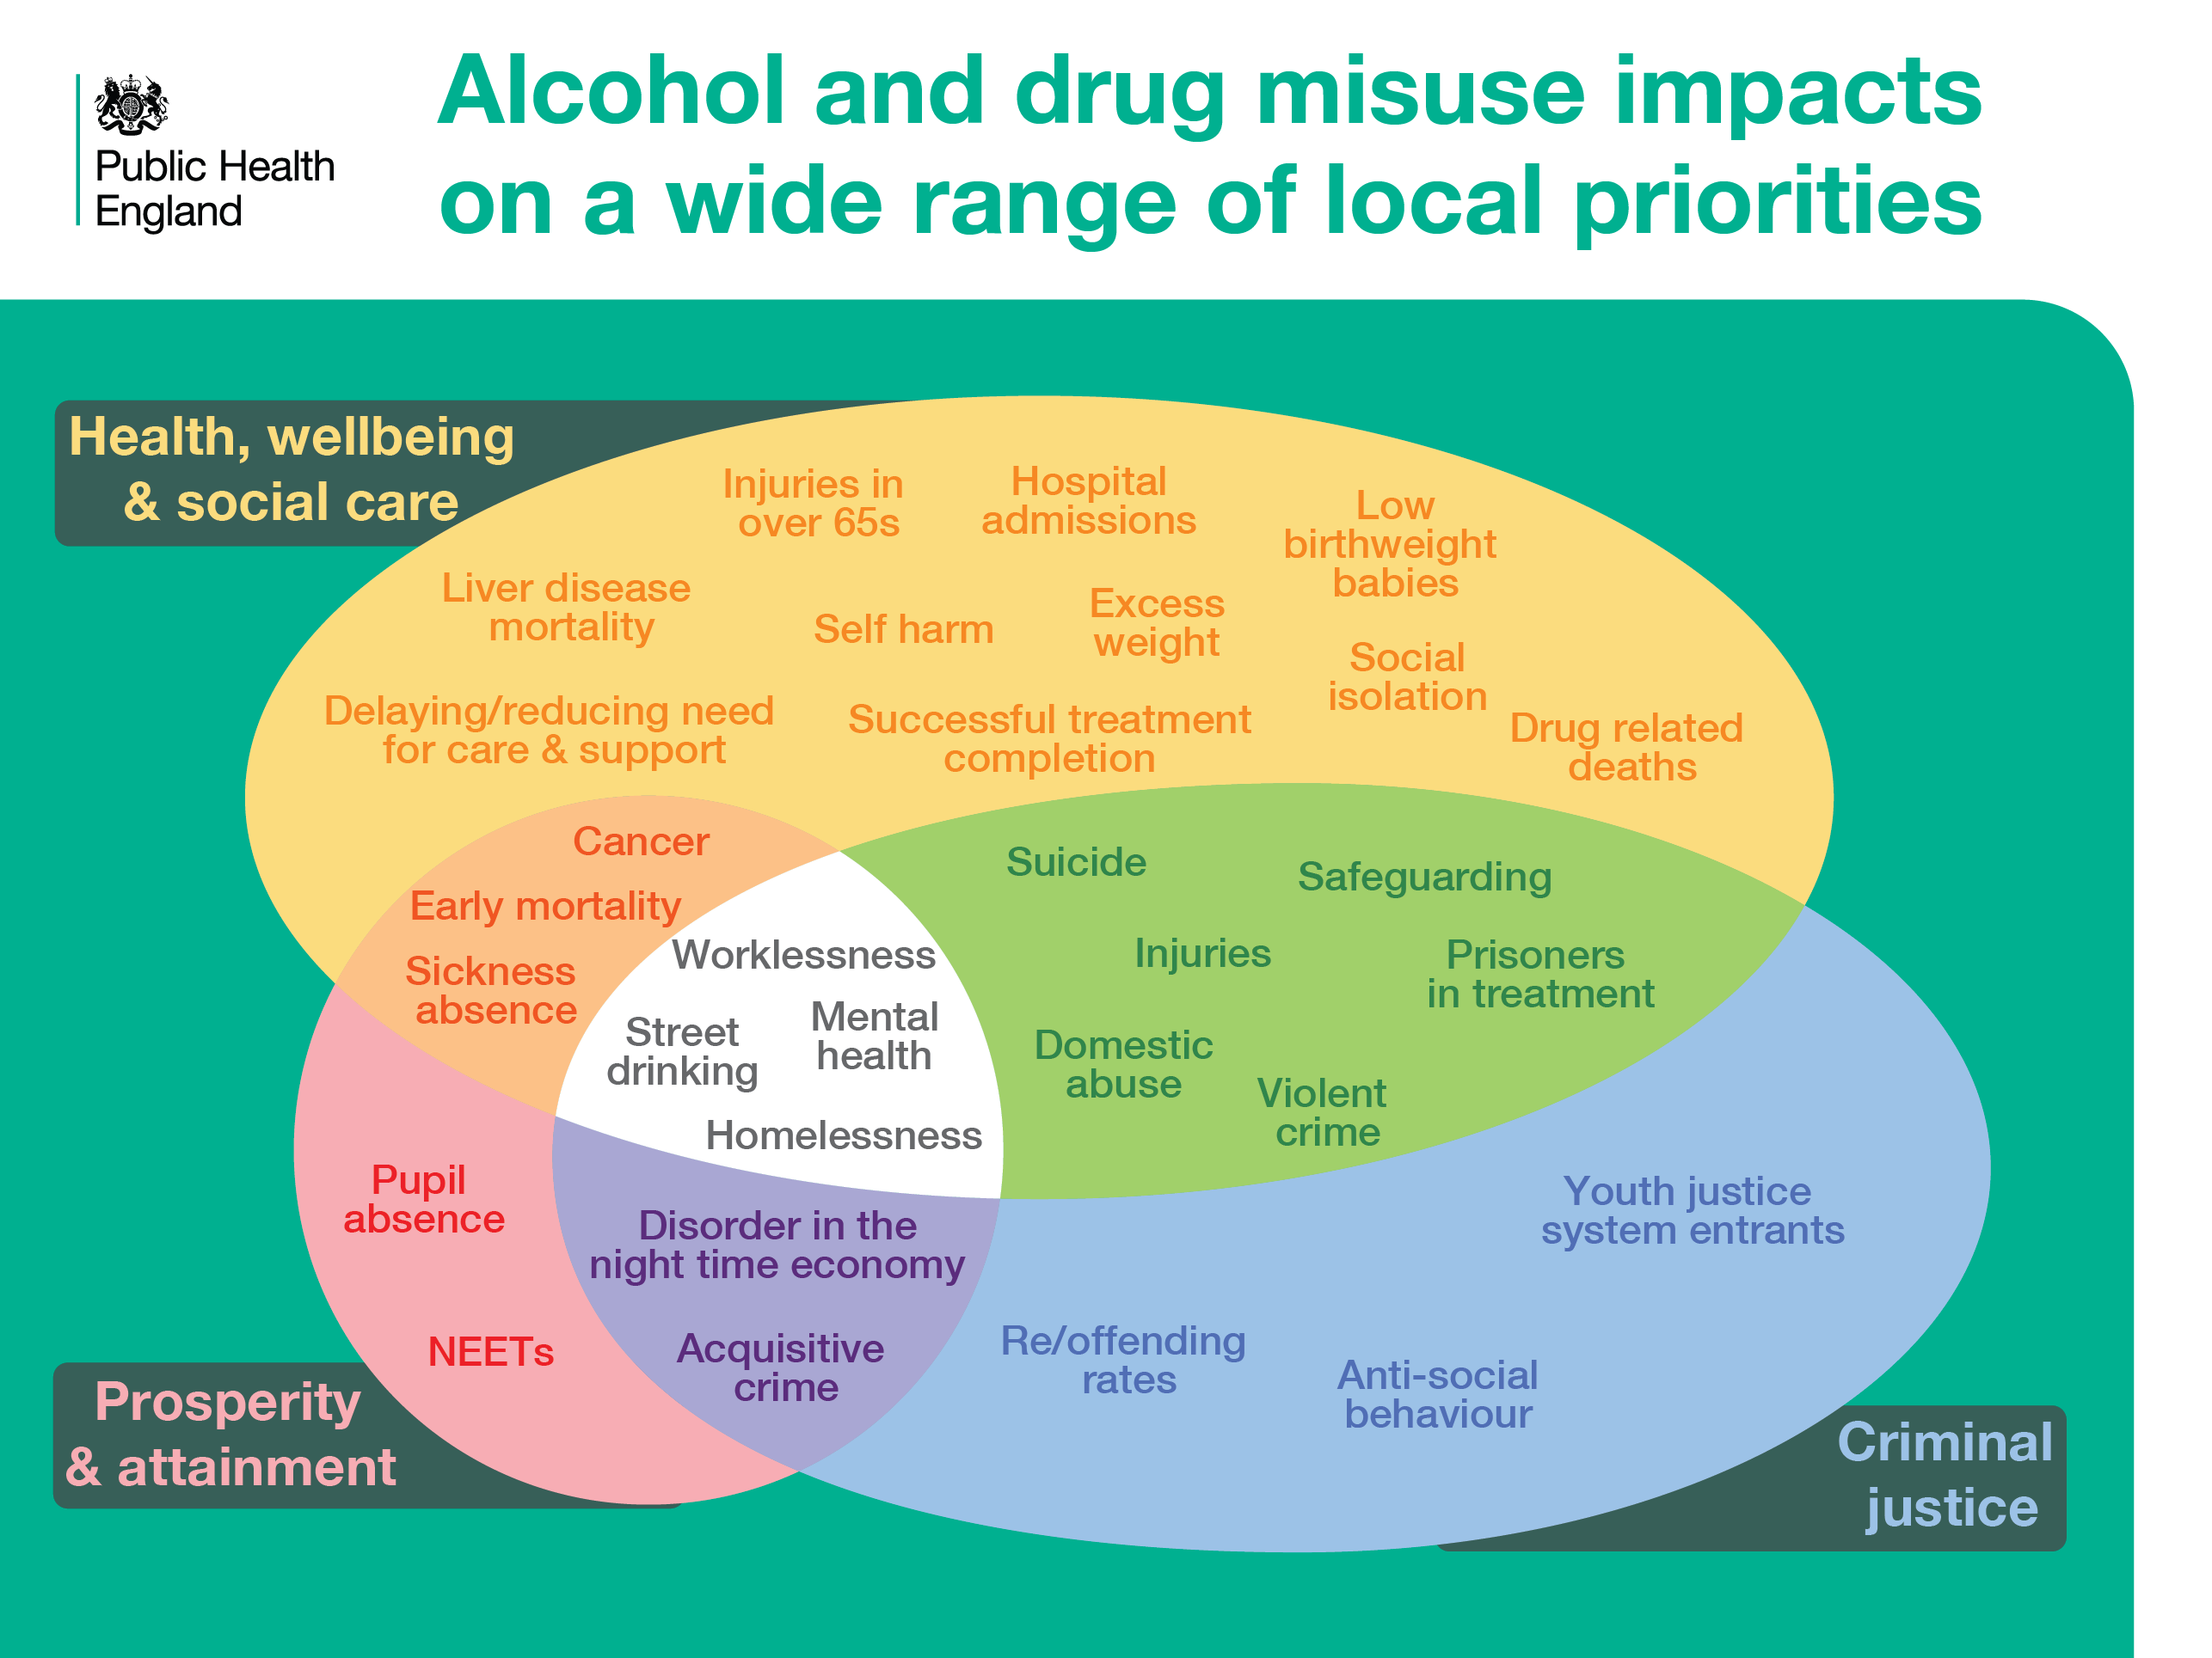
Notes:
Shared Outcomes
Investing in drug and alcohol interventions and treatment contributes to the achievement of priority outcomes for all local stakeholders and partners. For example, local authorities (PHOF & ASCOF), Education, Police, PCCs, CCGs and Health Trusts.

Slide 32
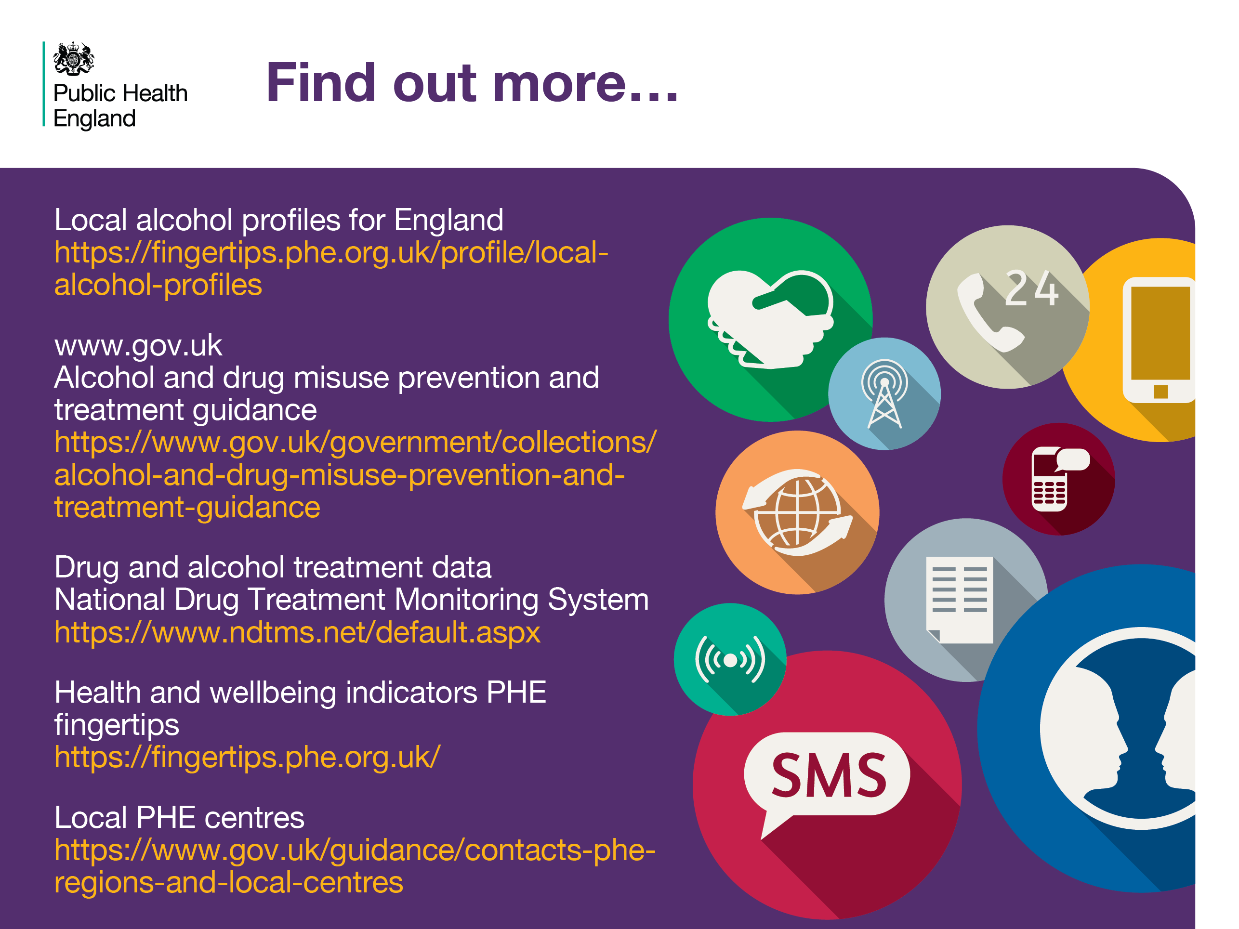
Notes:
Find out more
Cut and paste website addresses into your browser to access the links
Local alcohol profiles for England
https://fingertips.phe.org.uk/profile/local-alcohol-profiles
www.gov.uk
Alcohol and drug misuse prevention and treatment guidance
https://www.gov.uk/government/collections/alcohol-and-drug-misuse-prevention-and-treatment-guidance
Drug and alcohol treatment data
National Drug Treatment Monitoring System
https://www.ndtms.net/default.aspx
Health and wellbeing indicators PHE fingertips
https://fingertips.phe.org.uk/
Local PHE centres
https://www.gov.uk/guidance/contacts-phe-regions-and-local-centres

